Slide 1
Altera’s SoC FPGAs
Your User-Customizable System on Chip
SoCKIT to Me!
Don’t Just Elevate, Integrate.

Slide 2

Reminder – System Requirements
TOOLS INSTALLED
Quartus II Web Edition: v13.0
LAPTOP OS and Memory
PC with Windows 7
Intel i3 processor or better
10 GB Hard disk space
4 GB RAM
NOTE: If you don’t have the above tools installed, you may install them during the presentation – please ask for disks
Notes:
Customers really do need to have a recent machine with good performance. If not, they can partner up with another engineer.

Slide 3
Introductions
Arrow Electronics
2012 Sales:
$20.4 billion
Customers:
More than 140,000
Suppliers:
More than 700
Altera Corporation
2012 Sales:
$1.8 billion
Customers:
More than 15,000
Linear Technology
2012 Sales:
$1.3 billion
Customers:
More than 60,000
Notes:
Don’t bother verbally mentioning sales numbers. Simply emphasize that the 3 companies are stable corporations that can be relied upon.

Slide 4
Agenda – Hardware Session (morning)
Introduction and Workshop Objectives
System Architecture Overview
System Design Overview
System Tool Flow [LAB]
Cyclone V SoCKit Overview
Hardware Debug [LAB]
Next Steps

Slide 5
Workshop Objectives – Hardware Session
Provide a high-level overview of the hardware architecture of the SoC devices.
Walk through the design flow needed to implement a design for the SoC devices.
Provide hands-on familiarity with the tools for implementing an SoC design.
Hands-on exposure to the hardware debug tools available.
Guidance towards next steps for further learning and development.
Notes:
This workshop provides a high-level overview of the SoC devices and the tool flow.
What this lab is NOT: This is not an in-depth training. Simply not enough time. Please steer customers towards the Altera trainings.

Slide 6
Altera Cyclone V SoC and Arria V SoC High-Level Overview
Your User Customizable System on Chip
Notes:
This section will walk through the hardware architecture overview of the SoC devices.

Slide 7
First Things First: What Is An FPGA?
FPGA stands for Field Programmable Gate Array
Field programmable
  Program (and re-program) product features and functions.
  Reconfigure hardware for specific applications even after the device is deployed in the field.
Gate Array – a configurable array of basic building blocks within a specific device
  Logic Elements
  DSP Blocks
  Memory
  PLLs and clocking resources
Why use FPGAs?
Flexible
Customizable
Low development cost (no expensive ASIC development tools)
Fast time to market (quickly make modifications to an existing design)
Leading edge technology (e.g. 28nm)
Why do engineers love FPGAs?
Digital Etch-a-Sketch (no more mistakes, just re-program and start over).
Easy for anybody to get started with free tools and inexpensive dev kits.
Notes:
Since workshop attendees might be processor-centric engineers, start with an overview of FPGA.

Slide 8






Altera Device Series Overview
CPLDs
Low-cost,
low-power FPGAs
Mid-range FPGAs
High-density,
high-performance FPGAs
ASICs
Altera FPGAs:
Cyclone series FPGAs: industry’s lowest system cost and power.
Arria series FPGAs: right balance of cost/power and performance for mid-range applications
Stratix series FPGAs: built for bandwidth and high-performance.
Notes:
Altera has devices under a few different brand names. Highlight that Cyclone, Arria and Stratix brands are the FPGAs.

Slide 9







Altera SoC: The Best of Both Worlds
ARM Processor System
28-nm FPGA
Dual Core ARM Cortex-A9 MPCore Processor
Hard Memory Controller
Peripherals
SoC
ARM Cortex-A9 + Altera FPGA
Notes:
To address the trend of increasing processor use within FPGAs, Altera has combined the best of both worlds on our SoC FPGA, which integrates a hard ARM processor with the fabric of today’s most advanced FPGA, enabling embedded designers to develop customized ARM-based solutions.
The initial offering of SoC devices are based around Cyclone V and Arria V FPGAs. There will be a roadmap of other SoC products from Altera moving forward.
ARM has become the most widely used and preferred processor for embedded processing design. The popularity of ARM’s processor and it’s ecosystem is second to none in the embedded industry.

Slide 10
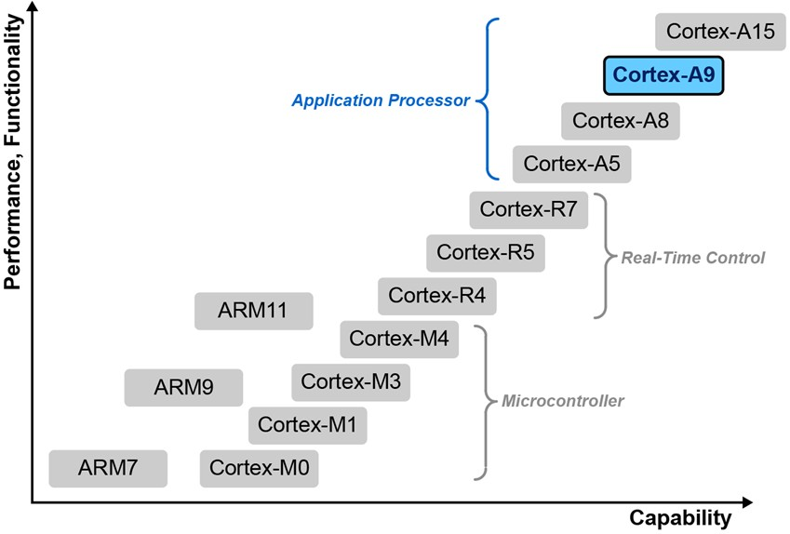
Cortex-A9: Comparison to Other ARM Cores
Notes:
This shows where the Cortex-A9 falls into the ARM processor portfolio. This is a high-end application class processor.
For customers familiar with Nios II, you can point out that Nios II is roughly in the same performance class as a Cortex-M3.

Slide 11
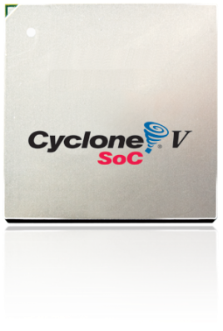

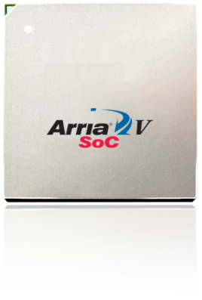
SoC FPGA Device Portfolio
Tailored to Address
Diverse Application Requirements
Notes:
This slide visually shows that the Hard Processor System has been paired up with 6 different device densities.
Broadest portfolio of SoC FPGA devices in the industry, including the lowest density part up to the highest density part in the industry.
Cyclone V SoC FPGA family features four devices ranging in density from 25KLE up to 110KLE. Arria V SoC FPGA family features two devices ranging in density from 350KLE to 460KLE.

Slide 12
SoC FPGA Device Family Package Plan
 |  | Non-XCVR Devices (FPGA User I/Os) |  |  | XCVR Devices (FPGA User I/Os,XCVRs)
Family | KLE | U484-WB 19x19 | U672-WB 23x23 | F896-WB 31x31 | U672-WB 23x23 (IO,3G) | F896-WB 31x31 (IO,3G/5G) | F896-FC 31x31 (IO, 6G, 10G) | F1152-FC 35x35 (IO, 6G, 10G) | F1517-FC 40x40 (IO, 6G, 10G)
Cyclone V SoC FPGA | 25 | 66 | 138 |  | 138,6
 | 40 | 66 | 138 |  | 138,6
 | 85 | 66 | 138 | 288 | 138,6 | 288,9
 | 110 | 66 | 138 | 288 | 138,6 | 288,9
Arria V SoC FPGA | 350 |  |  |  |  |  | 170,12,4 | 350,18,8 | 528,30,16
 | 460 |  |  |  |  |  | 170,12,4 | 350,18,8 | 528,30,16
HPS I/O |  | 161 | 188 | 188 | 188 | 188 | 216 | 216 | 216
Notes:
We have four device densities in the Cyclone V SoC FPGA ranging from 25KLE to 110 KLE.
There are two device densities in the Arria V V SoC FPGA ranging from 350 to 460KLE.
The total device I/O is the sum of the FPGA User I/O and the HPS I/O
All devices come with at least one multiport memory controller in the HPS
All but the smallest density are available with integrated serial transceivers, hard PCIe, and additional hard memory controllers in the FPGA.

Slide 13
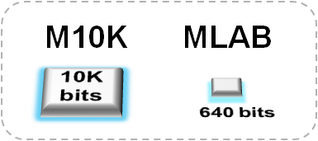
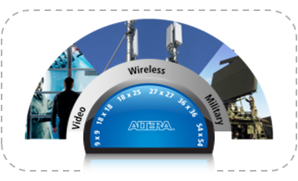
Altera 28nm FPGA Core Architecture
Enhanced ALM architecture
  Up to 30% increase in logic packing efficiency vs. 4-LUT
  2x registers in each ALM for easier timing closure
Variety of memory structures
  10K blocks optimized for highest port count
  640-bit MLABs for efficient data buffers
Variable precision DSP block
  One block equals either :
    One 27x27 multiplication
    Two 18x19 multiplications
    Three 9x9 multiplications
  Up to 1,600 GMACS, 300 GFLOPS in Arria V SoC
  Up to 150 GMACS, 100 GFLOPS in Cyclone V SoC
Cyclone V has inherited a high-end FPGA architecture
Notes:
This is the only slide in the presentation on the FPGA architecture. You can emphasize that Cyclone V has many high-end FPGA features.
The Cyclone V and Arria V SoC FPGAs use Altera’s 28nm technology and inherit much of the same core architecture found in the rest of the 5 series devices - such as the new ALM with 8-input LUT to increase logic packing efficiency, and 2 times the registers for easier timing closure.
They come with 10K bit block memories as well as distributed 640-bit memories that can be used for efficient data buffers
They also inherit variable precision DSP blocks that can be configured as one 27x27, two 18x19, or three 9x9 multipliers. And the number of multiplier blocks has been increased, particularly in the Arria V SoC to support high performance fixed and floating point applications.
All of these enhancements are designed to let you fit your design into a smaller device

Slide 14
System Architecture
Hard Processor System (HPS)
Processor
  Dual-core ARM® Cortex™-A9 MPCore™ processor
  4,000 MIPS (up to 800 MHz per core)
  NEON coprocessor with double-precision FPU
  32-KB/32-KB L1 caches per core
  512-KB shared L2 cache
Multiport SDRAM controller
  Up to 533-MHz DDR3 and LPDDR2
  Up to 400-MHz DDR2
  Integrated ECC support
High-bandwidth on-chip interfaces
  Dual HPS-to-FPGA bridge architecture
  FPGA-to-HPS interface
  FPGA-to-SDRAM interface
Cost- and power-optimized FPGA fabric
  Lowest power transceivers
  Up to 1,600 GMACS, 300 GFLOPS
  Up to 25Mb on-chip RAM
  More hard intellectual property (IP): PCIe® and memory controllers
ARM Cortex-A9
NEON / FPU
L1 Cache
ARM Cortex-A9
NEON / FPU
L1 Cache
USB OTG (x2) ⁽¹⁾
Ethernet
(x2) ⁽¹⁾
L2 Cache
GPIO
I²C
(x4)
QSPI Flash Control
64-KB
RAM
JTAG Debug / Trace ⁽¹⁾
HPS I/Os
SPI
(x4)
CAN
(x2)
NAND
Flash
⁽¹⁾ ⁽²⁾
SD / SDIO/ MMC ⁽¹⁾
Timers
DMA
(8 Channels)
UART
(x2)
Shared Multiport DDR SDRAM Controller ⁽²⁾
HPS to
FPGA
FPGA
to HPS
FPGA
Configuration
FPGA
28LP process
8-input ALMs
Variable-precision DSP
M10K memory and 640-bit MLABs
fPLLs
FPGA General Purpose I/Os
Hard Multiport DDR SDRAM Controller ⁽²⁾
Hard
PCIe
3-, 5-, 6-,
and 10-Gbps Transceivers
Multiport DDR SDRAM Controller
PCIe
Multiport DDR SDRAM Controller
Notes:
Integrated direct memory access (DMA)
Integrated ECC
Notes:
Here’s a more detailed block diagram of the SoC FPGA. The portion in blue is the HPS, and it contains the dual-core processor, each CPU with its own floating-point unit, NEON coprocessor, and L1 caches. The processors share a 512-KB L2 cache and a rich set of peripherals, including two triple-speed Ethernet ports, two USB on-the-go ports, interfaces to flash memory, general-purpose embedded peripherals such as UART, SPI, CAN, and I²C, and a shared multiport DRAM controller that supports DDR2, DDR3, and LPDDR2 – all with ECC.
Two high-bandwidth interfaces connect the HPS and FPGA fabric, with a third interface dedicated to low latency traffic from the processor to the FPGA. The processor has direct access to the FPGA configuration controller so it can configure the FPGA under program control.
The green portion represents the FPGA fabric and the grey blocks represent additional hard IP functions available to your custom logic, including additional multi-port DRM controllers, PCIExpress ports, and high-speed serial transceivers.
The HPS and FPGA have their own dedicated I/O and can are share some I/O functions when necessary. More on that later.

Slide 15
Hard Processor System Block Diagram
FPGA
HPS to
FPGA
Configuration
Control
FPGA
to HPS
FPGA-to-SDRAM
HPS
EMAC
(2)
L3
Interconnect
FPGA
Manager
ARM Cortex-A9MPCore
. . .
CPU0
ARM Cortex-A9
NEON/FPU
32 KB I$
32 KB D$
CPU1
ARM Cortex-A9
NEON/FPU
32 KB I$
32 KB D$
Multi-port
DDR SDRAM Controller
USB
OTG (2)
SCU
ACP
Flash
Control
L2 Cache
(512 KB)
DMA
Boot
ROM
TMC
(Trace)
On-chip
RAM
64 KB
Debug
Port
Clock
Manager
Reset
Manager
Scan Manager
System
Manager
Low Speed Peripherals
Timers, GPIO, UART, SPI, I2C, CAN
Notes:
Main points:
Dual core processors with shared 512KB L2 cache
High BW interfaces between SOC, FPGA, and memory controller
ACP is acceleration coherency port to enable memory coherency between processors and functions attached to the interconnect (including FPGA logic)
FPGA configuration block used to (re) configure the FPGA under program control
High speed peripherals (on left of interconnect)
Low speed peripherals (below interconnect)
Shared multiport SDRAM controller (6 ports)

Slide 16
MPU Subsystem Block Diagram
FPGA
HPS to
FPGA
Configuration
Control
FPGA
to HPS
FPGA-to-SDRAM
HPS
EMAC
(2)
L3
Interconnect
FPGA
Manager
ARM Cortex-A9MPCore
. . .
CPU0
ARM Cortex-A9
NEON/FPU
32 KB I$
32 KB D$
CPU1
ARM Cortex-A9
NEON/FPU
32 KB I$
32 KB D$
Multi-port
DDR SDRAM Controller
USB
OTG (2)
SCU
ACP
Flash
Control
L2 Cache
(512 KB)
DMA
Boot
ROM
TMC
(Trace)
On-chip
RAM
64 KB
Debug
Port
Clock
Manager
Reset
Manager
Scan Manager
System
Manager
Low Speed Peripherals
Timers, GPIO, UART, SPI, I2C, CAN
Notes:
We will begin by defining what is in the MPU subsystem and defining some terminology:
MPU subsystem vs. MPCore vs. processor core.

Slide 17
Components of the MPU Subsystem
ARM Cortex-A9MPCore
Cortex-A9 MPU subsystem contains:
  Cortex-A9 MPCore
  Level 2 cache
  Debugging module (not shown)
  Accelerator coherency port (ACP) ID mapper
  (not shown)
Cortex-A9 MPCore contains:
  Dual Cortex-A9 processor cores
  Snoop control unit (SCU) with Accelerator Coherency Port (ACP)
  Global interrupt controller (GIC)
  Global timer
  Private timers and watchdogs
Cortex-A9 processor core contains:
  ARM Cortex-A9 core
  NEON™ SIMD engine with scalar FPU
  Level 1 instruction and data caches (32KB per cache)
  Memory management unit (MMU)
CPU0
ARM Cortex-A9
NEON/FPU
32 KB I$
32 KB D$
CPU1
ARM Cortex-A9
NEON/FPU
32 KB I$
32 KB D$
ACP
SCU
L2 Cache
(512 KB)
Notes:
Defining some terminology: MPU subsystem vs. MPCore vs. Processor Core.
The MPU subsystem is comprised of many different cores. So, I will start in the top down fashion describing the major blocks and drilling down further.
The first part is the MPU subsystem itself. It contains a Cortex-A9 MP Core, a Level 2 cache, built in Debugging modules and an Accelerator Coherency Port (ACP) ID Mapper.
Then within the A9 Mpcore, it contains the following:
-Dual Cortex-A9 processor cores
-Snoop control unit (or SCU) with an accelerator coherency port
-a Global interrupt controller (or GIC)
-a Global timer
-Private timers and watchdogs for each CPU core
Each core within the MP core contains a Cortex A9 CPU,
as well as a NEON SIMD engine and a scalar FPU that comes with it,
Level 1 instruction and data caches,
and a Memory management unit (or MMU)

Slide 18
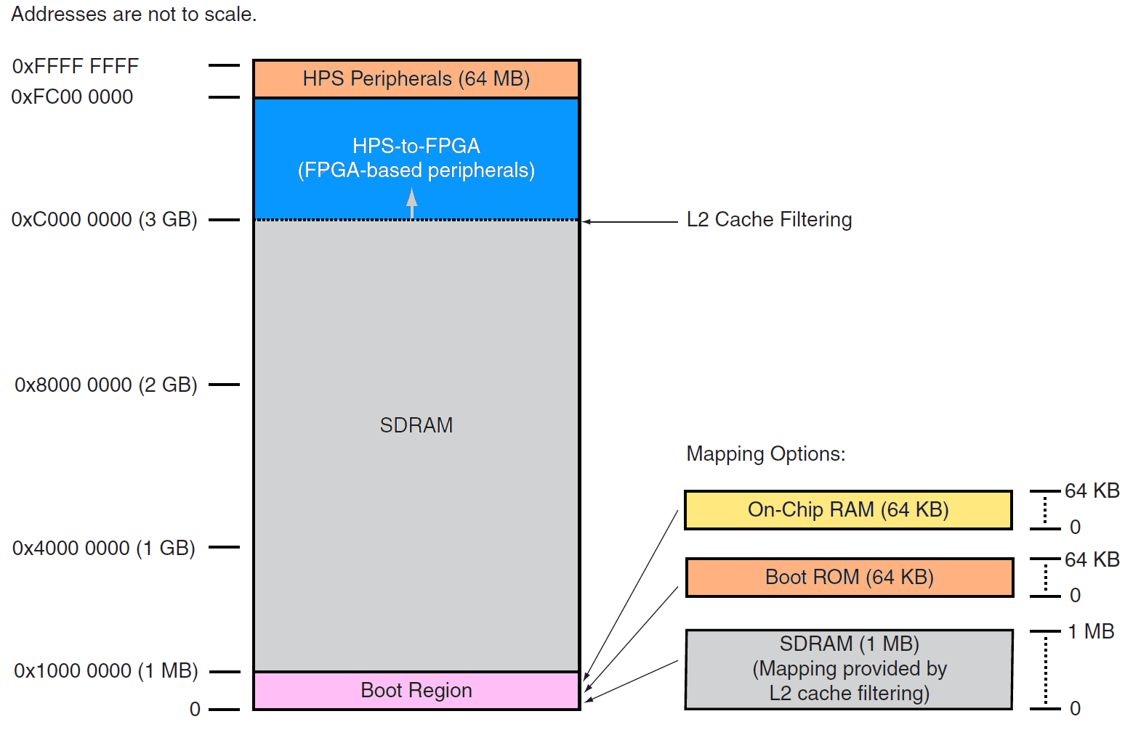
Cortex A9 MPU Memory Map
Notes:
This is the default memory map view. There are 32-bits of address space, so a 4GB memory map.
The boot region overlaps the bottom 1MB of SDRAM.
The HPS peripherals and FPGA window overlap the top 1GB of SDRAM.
These overlapping regions can be adjusted as we will see on the next slide.

Slide 19
Cortex-A9 MPU Memory Views
Notes:
The HPS supports different memory views from the Cortex A9 MPU Subsystem. There are various views that at a CPU can have on a system.
There is a default view where the Boot Rom is located at address zero. Since the boot ROM is not needed after boot, this address space can be remapped and used after boot.
You can remap address zero to contain the on chip RAM.
Or you can also remap SDRAM to be located at address zero, recovering the bottom 1MB of SDRAM.
And you can also expand the SDRAM address space to include more than 3 gigabytes worth of address space and shrink the FPGA window.

Slide 20
FPGA-HPS Interfaces
FPGA
HPS to
FPGA
Configuration
Control
FPGA
to HPS
FPGA-to-SDRAM
128-bit RD
128-bit WR
Arria V SOC
(250 MHz)
Cyclone V SOC
(200 MHz)
128-bit RD
128-bit WR
HPS
EMAC
(2)
FPGA
Manager
ARM Cortex-A9MPCore
128-bit RD
128-bit WR
Arria V SOC
(250 MHz)
Cyclone V SOC
(200 MHz)
L3
Interconnect
128-bit RD
128-bit WR
. . .
128-bit RD
128-bit WR
Arria V SOC
(250 MHz)
Cyclone V SOC
(200 MHz)
32-bit RD
32-bit WR
CPU0
ARM Cortex-A9
NEON/FPU
32 KB I$
32 KB D$
CPU1
ARM Cortex-A9
NEON/FPU
32 KB I$
32 KB D$
Multi-port
DDR SDRAM Controller
USB
OTG (2)
SCU
ACP
Flash
Control
L2 Cache
(512 KB)
DMA
Boot
ROM
TMC
(Trace)
On-chip
RAM
64 KB
Debug
Port
Clock
Manager
Reset
Manager
Scan Manager
System
Manager
Low Speed Peripherals
Timers, GPIO, UART, SPI, I2C, CAN
Notes:
Next we will discuss the interfaces between the HPS and the FPGA.
- There is a bridge from the FPGA that is 128-bit wide.
- There is a bridge to the FPGA that is 128-bit wide.
- There is also a 2nd bridge to the FPGA that is 32-bit wide.
We will discuss the reason for these three bridges.

Slide 21
Dual HPS-to-FPGA Bridge Approach
Two main types of HPS-to-FPGA traffic
  (Slow) Control/Status Register (CSR) accesses to peripherals
  (Fast) Accesses to memories and hardware accelerators
Dual bridges used to support two types of traffic
  LWH2F bridge used for short – latency sensitive accesses
    32-bit CSR data
    32-bit wide interface
  H2F bridge used for bursting – latency insensitive accesses
    MPU, DMA or peripheral data transactions
    Up to a 128-bit wide interface
Historically, architectures having only a single bridge could either cause latency issues with CSR accesses or throughput issues with high bandwidth transfers.
Providing dual bridges allows system to maintain low-latency accesses to CSRs in FPGA independent of large data transfers that might be occurring simultaneously on the H2F bridge.
When Architecture Matters
Notes:
So at this point you may be wondering why there are two different HPS-to-FPGA bridges. The reason for this there is two types of traffic in the HPS block itself. You have slow CSR accesses to peripherals to read their status and control them and you have faster accesses to things like memories and hardware accelerators. You kind of want to split this traffic into two different bridges so that one does not impact the performance of the other.
In terms of the CSR accesses that gets forwarded to the lightweight bridge, they are typically accessed as device memory…not always but typically. Devices memory accesses cannot be resized or merged by the bridges or the level 3 interconnect. These accesses are typically four bytes or less because they map into either reading from status registers or writing into control registers. Therefore, accesses to the lightweight bridge are typically used for short latency sensitive accesses…For example, clearing the interrupt in a peripheral that is implemented in the FPGA fabric.
While the regular HPS to FPGA bridge, or as I call it the heavyweight bridge, is used for more bursting type traffic. For example executing code that is within the FPGA fabric or triggering the DMA to move data back and forth to a hardware accelerator that’s implemented inside the FPGA fabric.

Slide 22
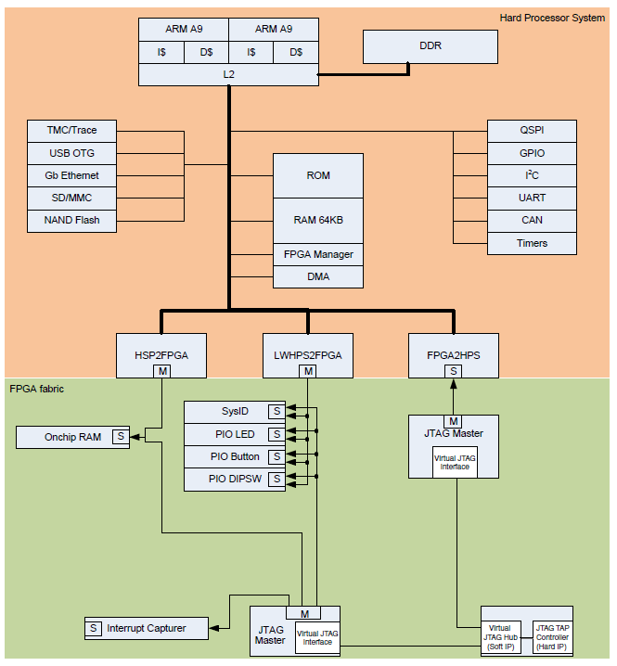
FPGA-HPS Interfaces Lab Example
In the lab, you will build the simple example system shown here.
H2F bridge connects to an On-Chip Memory
LWH2F bridge connects to a few Parallel IO and System ID peripherals
F2H bridge is connected to a JTAG Master peripheral

Slide 23
System Management
FPGA
HPS to
FPGA
Configuration
Control
FPGA
to HPS
FPGA-to-SDRAM
HPS
EMAC
(2)
L3
Interconnect
FPGA
Manager
ARM Cortex-A9MPCore
. . .
CPU0
ARM Cortex-A9
NEON/FPU
32 KB I$
32 KB D$
CPU1
ARM Cortex-A9
NEON/FPU
32 KB I$
32 KB D$
Multi-port
DDR SDRAM Controller
USB
OTG (2)
SCU
ACP
Flash
Control
L2 Cache
(512 KB)
DMA
Boot
ROM
TMC
(Trace)
On-chip
RAM
64 KB
Debug
Port
Clock
Manager
Reset
Manager
Scan Manager
System
Manager
Low Speed Peripherals
Timers, GPIO, UART, SPI, I2C, CAN
Notes:
The System Management Peripherals consists of the
1) Clock Manager
2) Reset Manager
3) System Manager
4) Scan Manager
5) FPGA Manager
These 5 blocks are Altera-developed IP.
We will discuss each of these topics in the upcoming slides, beginning with clocks and clock management.

Slide 24
HPS Input Clocks
HPS requires an external clock source
(OSC1, 10-50 MHz)
Optional second source (OSC2)
External Clocks connect to 3 PLLs that drive clock groups inside HPS
FPGA clocks are the same as in Cyclone V
Optional clocks to and from FPGA
  HPS-to-FPGA clocks 0/1/2, one from each PLL group
  FPGA-to-HPS peripheral pll reference clock
  FPGA-to-HPS SDRAM pll reference clock

Slide 25
Clock Manager
Generates/manages all system clocks in HPS
3 Clock Groups, each with it’s own PLL:
  Main PLL
  Peripheral PLL
  SDRAM PLL
FPGA-to-HPS clocks are enabled/disabled by the Clock Manager but are controlled from the FPGA not the Clock Manager
Hardware sets the base clock.
Software sets up the PLL dividers and VCO frequencies. This task is handled by the preloader.
Notes:
The Clock Manager generates and manages all system clocks in the HPS. It has three PLL’s:
the Main PLL,
the Peripheral PLL,
and the SDRAM PLL.
It also provides software programmable clock control, so it allows you to configure the PLL and it allows you to route the PLL outputs to different IP.
There’s also multiple clock inputs to drive the PLL. They’re External Oscillator 1 and External Oscillator 2. These are both clock input pins.
Then there’s also 2 FPGA sourced clock inputs, the FPGA to SoC SDRAM reference clock and the FPGA to SoC Peripheral reference clock.
The Clock Manager also provides two interrupts that go directly to the MPU. The first one is for Lock Status, so it provides an interrupt whenever the PLL loses lock or achieves lock, and it also provides an interrupt for waking up the MPU when it’s in standby.

Slide 26
3 HPS Clock Groups
FPGA
HPS to
FPGA
Configuration
Control
FPGA
to HPS
FPGA-to-SDRAM
HPS
EMAC
(2)
L3
Interconnect
FPGA
Manager
ARM Cortex-A9MPCore
. . .
CPU0
ARM Cortex-A9
NEON/FPU
32 KB I$
32 KB D$
CPU1
ARM Cortex-A9
NEON/FPU
32 KB I$
32 KB D$
Multi-port
DDR SDRAM Controller
USB
OTG (2)
SCU
ACP
Flash
Control
L2 Cache
(512 KB)
DMA
Boot
ROM
TMC
(Trace)
On-chip
RAM
64 KB
Debug
Port
Clock
Manager
Reset
Manager
Scan Manager
System
Manager
Low Speed Peripherals
Timers, GPIO, UART, SPI, I2C, CAN
Notes:
There is a PLL for each of the 3 HPS clock groups:
The MPU subsystem
The SDRAM controller
The peripherals

Slide 27
FPGA interface Clocks
FPGA Clocks Drive:
  FPGA AXI Bridges (clock crossing)
  Optional Clock inputs to Peripheral and SDRAM group PLLs
3 HPS Clocks routed to FPGA
  One from each PLL
Notes:
There are clock signals routed to and from the FPGA that can be connected.

Slide 28
Clock Manager - PLLs
Software programmable clock control
  Clock routing
  PLL configuration
    VCO speed
    Clock Divider setting (per output)
    Clock output phase (SDRAM group only)
  Clock gating
Each PLL can trigger the Clock Manager Interrupt
  PLL lock / PLL loss of lock
Clock Manager can trigger a MPU Wake Up Interrupt when clock hardware is stable
Notes:
The Clock Manager generates and manages all system clocks in the HPS. It has three PLL’s:
the Main PLL,
the Peripheral PLL,
and the SDRAM PLL.
It also provides software programmable clock control, so it allows you to configure the PLL and it allows you to route the PLL outputs to different IP.
There’s also multiple clock inputs to drive the PLL. They’re External Oscillator 1 and External Oscillator 2. These are both clock input pins.
Then there’s also 2 FPGA sourced clock inputs, the FPGA to SoC SDRAM reference clock and the FPGA to SoC Peripheral reference clock.
The Clock Manager also provides two interrupts that go directly to the MPU. The first one is for Lock Status, so it provides an interrupt whenever the PLL loses lock or achieves lock, and it also provides an interrupt for waking up the MPU when it’s in standby.

Slide 29
HPS Clock Manager Features
Enables dynamic scaling of MPU clock frequency
Delivers base clocks to Ethernet, USB, SDRAM, etc.
Enables ~all clocks to be gated off (power saving)
Entry/Exit of ‘Safe Mode’
  Put clocks into known safe state on cold reset or warm reset request from Reset Manager
    Bypasses Main PLL C0-C2 over to OSC1
    Clock manager registers settings, for reset PLL counter & dividers, bypassed to default values
    Enables all clocks (turns clock gating off)
    Flash controller clock multiplexer selects output from peripheral PLL
  Exit Safe Mode by resetting Safe Mode bit of CTRL register

Slide 30
Clocking Caveats
Clocks must be very carefully sequenced
It is possible to lock up system if mishandled
Altera provides library of functions to assist with clock management. These tasks are included as part of the preloader.
For more information refer to Volume 3, chapter 2 of the device handbook: Clock Manager
Notes:
Point out that customers should always use the Altera provided library functions rather than accessing the clock manager registers directly.

Slide 31
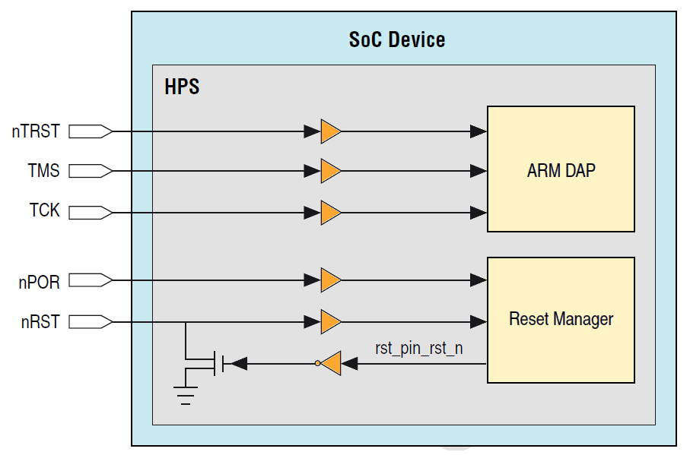
SoC Device Reset Pins

Slide 32
Reset Manager Overview
Generates module reset signals based on reset requests from various sources
Clocked by EOSC1 clock pin
Three separate reset domains
  HPS system
  JTAG port
  Debug system
Accepts reset requests from following
  Software writing module reset registers
  FPGA control block
  FPGA fabric
  External Reset pins
Implements Cold and Warm reset
Notes:
The Reset Manager accepts reset requests from the following peripherals and generates module reset signals.
It accepts requests from the FPGA Control Block,
FPGA fabric,
individual HPS modules,
reset pins,
and software.
The Reset Manager is only clocked by the External Oscillator 1 clock input pin .
It also provides handshaking signals to peripherals that it’s about to put in reset. For example, before it puts the SDRAM controller in reset, it makes the SDRAM controller put the SDRAM into a self-refresh mode.

Slide 33
Cold / Warm / Debug Reset
Cold Reset | Warm Reset | Debug Reset
Affects all reset domains (TAP, Debug, System) | Happens after HPS has already been cold reset | Only affects debug reset domain
Places hardware-managed clocks into safe mode | Used to recover system from a non-responsive condition
Places software managed clocks into their default states | Resets a subset of the HPS
Asynchronously resets all registers in the clock manager | Debug & TAP reset domain unaffected
Resets SDRAM so memory contents and setup lost | SDRAM unaffected so memory contents preserved
FPGA is not affected across any type of reset
Notes:
The reset architecture is a big differentiator for Altera. Point out that FPGA can stay configured and running across processor resets.

Slide 34
SoC Resets
HPS cold and warm resets can be
sent into FPGA logic
FPGA cold and warm resets can be
received by HPS
  FPGA traffic must terminate before HPS warm reset completes
Implemented and managed by Reset Manager
Notes:
The reset architecture is a big differentiator for Altera. FPGA is independent of processor resets
and has the ability to initiate processor reset (cold or warm).

Slide 35
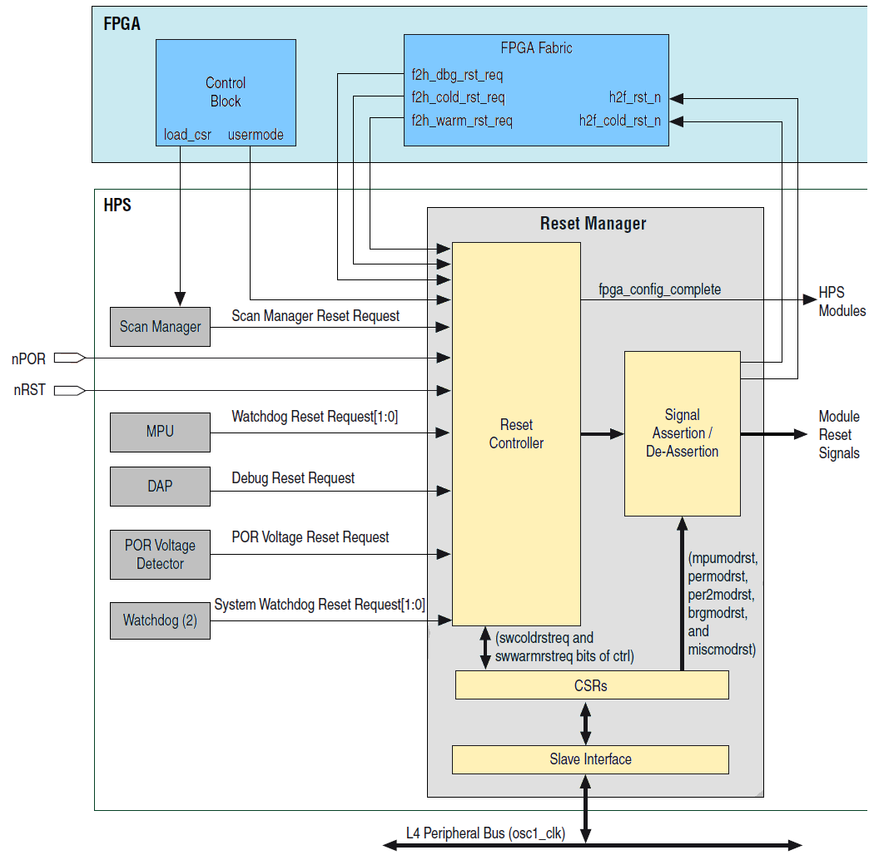
Reset Manager Integration
Reset Sources
  Power-On-Reset voltage monitor (cold reset)
  nPOR pin (cold reset)
  nRST pin (warm reset)
  Debug (Debug Reset)
  Watchdogs (SW control)
  FPGA
    f2h_cold_rst_req_n
    f2h_warm_rst_req_n
    f2h_dbg_rst_req_n
    h2f_cold_rst_n
    h2f_rst_n (cold or warm)
    load_csr (cold reset)
FPGA monitoring
  Reset from FPGA can occur only if FPGA is configured
_n
_n
_n
Notes:
*Reset from HPS to FPGA has to be synchronized to user clock domain
What we see here is that we have multiple reset sources.
We have pins like the power on reset which provide a Cold Reset, resetting the whole system.
Or you can do a Warm Reset with the reset pin in which you maintain the memory contents and the state. You’re simply resetting the particular hardware.
We also have a Debug Reset, which is used to reset the HPS from the debugger.
There are Watchdogs, both from the MPU and we also have Watchdog peripherals in the HPS Blocks.
And then, we also have reset signals coming from the FPGA core.
The one other thing that Reset Manager does is it monitors the control block. What this does is it makes sure that the FPGA is configured before they will accept a reset from the FPGA

Slide 36
FPGA Manager Overview
Manages and monitors the FPGA portion of the SoC FPGA device
  Configure the FPGA fabric
  Monitor FPGA configuration and power status
    INIT_DONE, CRC_ERR, PR_DONE, etc.
    Software configurable interrupts to MPU
  Can reset the FPGA
  Drive 32 general purpose outputs to the FPGA
  Receive 32 general purpose inputs from the FPGA
  Boot from FPGA handshake signals
    Used for booting the HPS from the FPGA fabric
Notes:
The FPGA Manager is used to:
manage the FPGA configuration from the HPS
and booting HPS from the FPGA.
So its main functionality is that the HPS can configure the FPGA.
It can monitor the status of the FPGA configuration. Their are software configurable interrupts sent to the MPU when certain conditions happen within the configuration of the FPGA fabric.
There’s also 32 general purpose outputs going to the FPGA as well as 32 general purpose inputs coming from the FPGA into the HPS.
The last feature is that when you’re doing boot from FPGA, there are some Handshake signals that the FPGA Manager takes care of.

Slide 37
FPGA Configuration / uP Boot : Flexibility
Processor boots first, then configures the FPGA
FPGA
HPS
Boot Sources
& FPGA Config
Sources
QSPI
/SPI
CPU
MMC
/SD
NAND
Flash
Config
Controller
Boot
ROM
Scratch RAM
FPGA
HPS
Independent FPGA config & processor boot
PCIe ⁽¹⁾
QSPI
/SPI
Boot
Sources
FPGA
Config Sources
CPU
MMC
/SD
QSPI
/SPI
Passive Serial
NAND
Flash
Config
Controller
Passive Parallel
Boot
ROM
Scratch RAM
FPGA
HPS
FPGA config first, CPU boots through FPGA logic (allows for secure boot)
PCIe ⁽¹⁾
FPGA Config
Sources
QSPI
/SPI
CPU
Passive Serial
Config
Controller
Boot
Source
Passive Parallel
Boot
ROM
Scratch RAM
AXI
User Interface
Notes:
BIG ADVANTAGE AND DIFFERENTIATION FOR ALTERA: Customers have multiple choices in configuring / booting the SOC device.
Top diagram shows the processor booting first, then configuring the FPGA.
Middle diagram illustrates independent FPGA configuration and SOC (processor) boot. Just as thought they were independent discreet devices.
Bottom diagram illustrates the FPGA configuring first. Logic in the FPGA provides a custom interface through which the processor fetches it’s boot code. Example: (custom backplane I/F, local flash device, etc.)
FPGA config times:
AS FPP
CV SoC 40 / 25 67ms 13ms
CV SoC 110 / 85 182ms 36ms
AV SoC 460 / 350 426ms 85ms

Slide 38
System Manager Overview
Contains memory-mapped control and status registers and logic to:
  Provide software access to boot configuration information
  Provide software access to status signals in other HPS modules
  Enable/disable other HPS modules and Peripherals
  Enable and controls ECC and parity in HPS modules
  Control/Manage HPS I/O features
  Provide eight registers that software can use to pass information between warm boots
  Pause watchdog timers during debug mode
Contains a System ID register – can be read from the FPGA side
Notes:
the System Manager controls system functions and modules that need external control signals.
Some of the examples of the System Manager control is that
it selects the boot configuration…it reads the boot select pins and decides where your boot source will be from.
It also looks at the FPGA interface, so it has some signals that will interface during the boot selection with the FPGA.
It controls HPS Pin Muxing, where it routes the signals coming from the peripherals to actual HPS pins.
It controls the Watchdog timers during debug, so it allows it to pause them so you don’t get the Watchdog timer while you’re debugging.
It controls a Freeze Controller, which allows you to freeze and unfreeze pins during configuration and booting. And it also monitors ECC in the RAM and allows you to inject errors for testing.

Slide 39
System Manager HPS I/O Features
Tri-states HPS-configurable I/O pins during configuration (Freeze controller)
Controls HPS peripheral I/O pin multiplexing
Enables/disables various HPS I/O peripherals interfaces
Enables/disables HPS-FPGA interfaces

Slide 40
System Manager – Managed Peripherals
EMACs
USB controllers
Flash controllers
  SD/MMC controller
  NAND controller
  Quad SPI controller
SPI masters
DMA controller
On-chip RAM
CAN controllers
Debug core
Reset manager

Slide 41
Scan Manager
Programs HPS I/O pin configuration
  Configures I/O bank settings (voltage, drive, pull up, etc.)
  Same IOCSR mechanism as FPGA IO
  (scan chains - JTAG Bit-stream)
  HPS I/O must be frozen by System Manager before configuration
Gives HPS access to FPGA JTAG
  Can perform any FPGA JTAG operation
  Disables external FPGA JTAG when it takes over

Slide 42
Scan Manager
Drives serial scan-chains connected to:
  HPS configuration IOCSR chains
    Configures HPS I/Os
    SDRAM DDR PHY (DLL/OCT)
  FPGA JTAG
    Allows HPS to monitor single event upsets (SEUs)
From cold reset will trigger freeze sequence
  All HPS I/O will be considered un-configured
    IO Buffers are in tri-state
    Weak pull-up enabled
  During Boot phase
    On-chip boot code uses Scan Manager to configure boot device’s IOCSR
    Initial software will use Scan Manager to configure I/Os
    When configuration complete, the freeze manager will receive an indicator from System Manager to unfreeze I/Os
Not involved in DFT or boundary-scan testing
Notes:
The main purpose of the Scan Manager is to drive the serial chains connected to the HPS configuration IO Control Status Register chains. This allows it to configure the HPS I/O and it also allows it to control the SDRAM DDR PHY for things like the DDL and the On Chip Termination.
The secondary function is that it provides access to the FPGA JTAG. The main purpose of this is to allow the HPS to monitor for Single Event Upsets.
So from a Cold Reset, this will trigger the freeze sequence….and if you remember from a couple of slides ago we were talking about the System Manager that controls this. So what happens during the Cold Reset is that all HPS I/O will be considered as un-configured:
The IO Buffers will be put in a tri-state with the weak pull-up enabled. And then during the boot phase, the Scan Manager will turn on the I/Os for the boot device, so whatever device we’re configuring from, the Scan Manager will turn those on so that we can use those and configure.
Then the initial software, after the initial boot sequence, will configure the rest of the I/Os. And then when the configuration of all the I/Os is complete, the Scan Manager will then tell the freeze manager to unfreeze all the I/Os, and then they’ll operate as normal I/Os.
One thing to note is that the Scan Manager is not involved with Design For Test or boundary-scan testing.

Slide 43
Summary – Altera Advantages
Higher performance
  2x CPU-to-FPGA & FPGA-to-CPU bandwidth
  2x FPGA-to-DDR bandwidth
  All masters (FPGA and HPS) can share memory coherently with the processor
  Application-class processing (SMP)
Greater memory security & protection
  Broader ECC support in HPS: DDR controller, L2, on-chip RAM, Flash I/F, HPS peripherals
  More robust DDR protection: address range protection per port & per master
  Exclusive memory sharing on all DDR controller ports
More design flexibility
  XCVRs/PCIe available in all devices
  Multiple DDR controllers in FPGA
  Finer control over DDR port priorities
  Greater FPGA density
  Can use multiple Flash devices (e.g. QSPI + NAND)
  FPGA / CPU boot options (FPGA first, CPU first, Independent)
  DMA request interfaces for FPGA and HPS peripherals
  Coherent memory access for FPGA and HPS peripherals
  More processor and system trace options
  No need to add power-down circuitry

Slide 44
SoC System Design

Slide 45
Quick Summary
FPGA:
  Looks like an FPGA
  Works like an FPGA
  Standard FPGA development flow
  QuartusII, Qsys, USB Blaster, SignalTap, System Console...
ARM Hard Processor System:
  Looks like an ARM processor system
  Works like an ARM processor system
  Standard ARM development flow
  ARM Cortex-A9 compiler/debugger, JTAG tools, program trace...

Slide 46

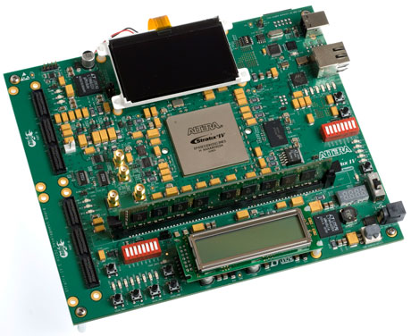
System Development Flow
Standard FPGA Flow
Standard Software Flow
Hardware
Development
Software
Development
Quartus II design software
Qsys system integration tool
Standard RTL flow
Altera and partner IP
Design
Design
ARM Development Studio 5
GNU toolchain
OS/BSP: Linux, VxWorks
Etc…
ModelSim, VCS, NCSim, etc.
AMBA-AXI and Avalon bus
functional models (BFMs)
Simulate
Simulate
Virtual Target
SignalTap™ II logic analyzer
System Console
Debug
Debug
GNU, Lauterbach, DS5
and ARM ecosystem
FPGA in the Loop
Quartus II Programmer
In-system Update
Release
Release
Flash Programmer
Notes:
We use standard design flows for both the processor and FPGA.
On the hardware side, developers use our Quartus II design software to create custom logic within the FPGA. The Qsys system integration tool lets you quickly build a custom system on a chip using a graphical design entry tool to add IP components, automatically generating an optimized network-on-chip interconnect, simulation testbench, and system header file for the software engineer. Our SignalTap II embedded logic analyzer and System Console debug tools help you debug the system once it is running in the FPGA.
Software developers can use their familiar ARM-based development tools available from ARM, industry-leading partners, and the open source community. To accelerate software development before the final hardware platform is ready, we offer the Virtual Target – a fast functional simulation of the HPS in the SoC FPGA.

Slide 47
Hardware Perspective
Silicon properties
Soft IP
Lowest level SW
Driver
Altera HWLib
Altera SoCAL (Lib)
App
OS
BSP
Registers
Silicon Device
Middle
Ware
IP Cores
Firmware
Engineer
Board
Designer
FPGA
Engineer
Notes:
This slide is designed to explain that the material covered in the HW (morning) are items that the Board designer, FPGA engineer and hardware “firmware” engineer would be interested in.

Slide 48
Software Perspective
Application
Software
Engineer
Application
Middleware
Hardware
abstraction
Driver
Altera HWLib
Altera SoCAL (Lib)
App
OS
BSP
Registers
Silicon Device
Middle
Ware
IP Cores
Firmware
Engineer
Notes:
This slide is designed to explain that the material covered in the SW (afternoon) are items that the software “firmware” engineer and application software engineer would be interested in.
Note that the software view of a firmware engineer is different than the hardware view of a “firmware” engineer.

Slide 49

Typical Hardware Design Flow
Create Quartus II Project
(Select SoC Device)
Perform Functional Simulation
Create Qsys Project (from Quartus II)
Add/Configure
HPS IP
Instantiate Qsys System in Quartus Project
Add IP to Qsys System
Run Analysis & Elaboration
Add Custom IP to Qsys System
Create I/O Assignments
(DDR,HPS Bank VCC)
Interconnect Components
Compile Quartus II Project
Generate Qsys System
HW Verification
SW Handoff
Notes:
You can point out that Functional Simulation is optional if using standard Altera FPGA IP, but highly recommended for custom FPGA IP.
Also, point out that both the QSys generation and the Quartus compilation produce files for software handoff.

Slide 50
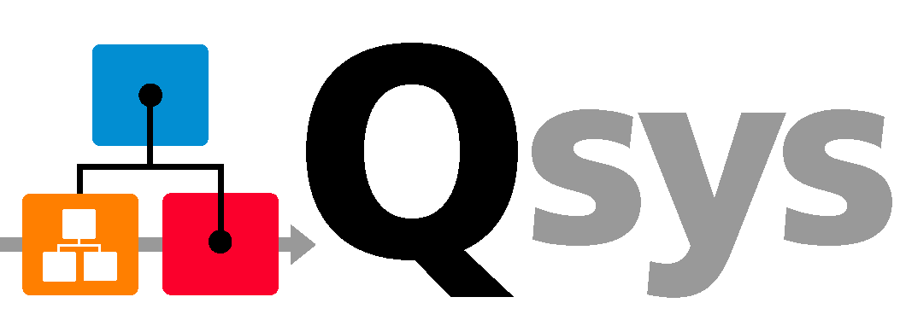
So… what exactly is Qsys?
GUI based system integration tool for system design using IP blocks.
Simplifies complex system development
Raises the level of design abstraction
Provides a standard platform:
  IP integration
  Custom IP authoring
  IP verification
Enables design re-use
Scales easily to meet the needs of end product
Reduces time to market
Notes:
The Qsys system integration tool saves significant time and effort in the FPGA design process by automatically generating interconnect logic to connect intellectual property (IP) functions and subsystems. Qsys is the next-generation SOPC Builder tool powered by a new FPGA-optimized network-on-a-chip (NoC) technology delivering higher performance, improved design reuse, and faster verification compared to SOPC Builder.

Slide 51

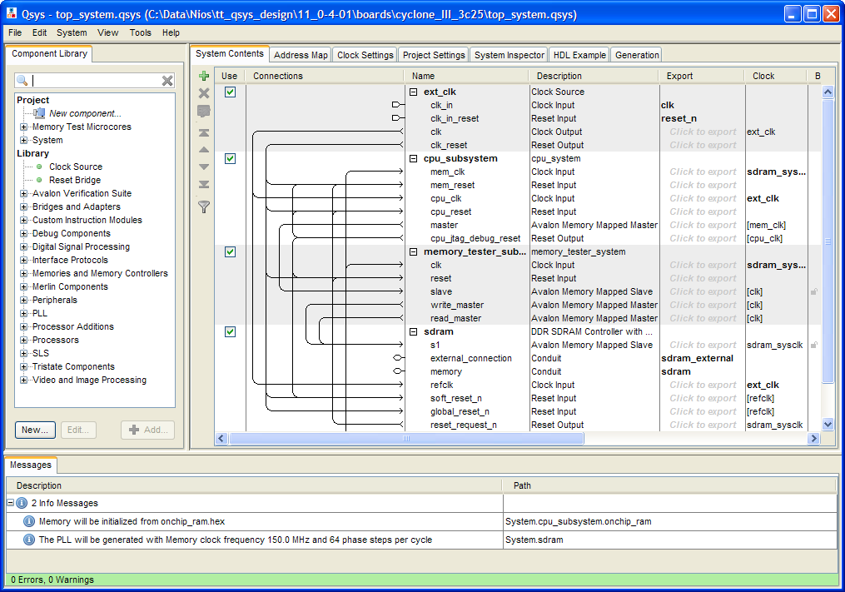





Qsys System Integration Platform
High-Performance Interconnect
Hierarchy
Design Reuse
Package as IP
Based on Network-on-a-Chip (NoC)
Architecture
Design
System
Add to
Library
Industry-Standard Interfaces
Real-Time System Debug
 | Avalon® Interfaces
 | AMBA® AXI3*, AXI4*
®
*AXI3 & AXI4 support in 2012+
Qsys is Altera’s design environment for
  Deployment of IP
  Deployment of reference designs and example designs
  Development platform for Altera custom solutions
  Design platform for customers to quickly create system designs
Notes:
Qsys is a system-level integration tool available in Altera’s Quartus II design software.
A GUI lets you add IP components to the system. IP cores based on ARM’s AMBA AXI interface standard as well as Altera’s Avalon Memory Mapped and Avalon Streaming protocols are supported. Qsys generates an FPGA-optimized network-on-a-chip interconnect that can be modified by the user to achieve the desired frequency and latency performance.
Qsys lets you create custom subsystems and save them as design templates for future reuse. Qsys also supports design hierarchy so the subsystems can be assembled quickly into a custom design.
The System Console debug tool lets you interact directly with IP components to facilitate board bring-up and to non-intrusively monitor the system operation while the device is running.

Slide 52
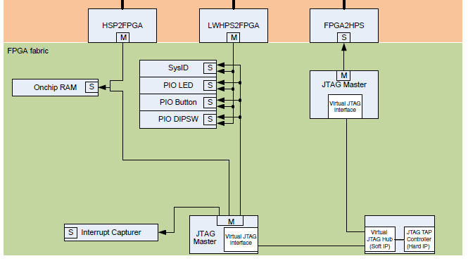
Traditional System Design
need to code up
interconnect manually
Components in system use different interfaces to communicate (some standard, some non-standard)
Typical system requires significant engineering work to design custom interface logic
Integrating design blocks and intellectual property (IP) is tedious and error-prone

Slide 53
Automatic Interconnect Generation
AXI Interface
AXI Interface
AXI Interface
Interrupt Controller
Arbiters
Qsys automatically
generates interconnect
Address
Decoder
Width Adapters
Avoids error-prone integration
Saves development time with automatic logic & HDL generation
Enables you to focus on value-add blocks
Qsys improves productivity by automatically
generating the system interconnect logic

Slide 54
System Tool Flow

Slide 55
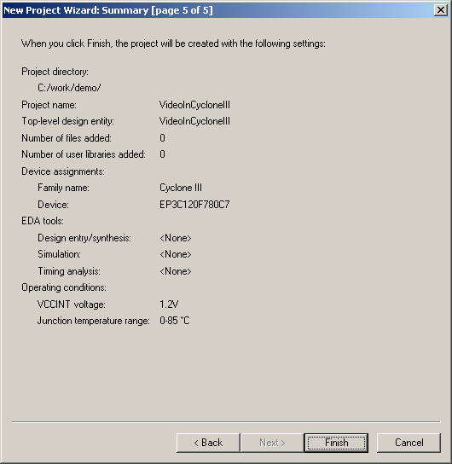
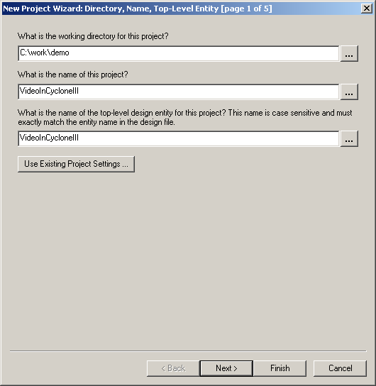
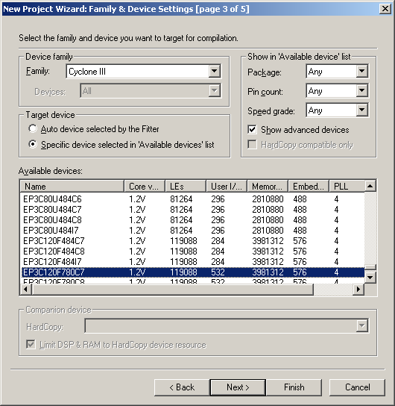
Create Quartus II Project for SoC Device
Start with a New Quartus II Project

Slide 56
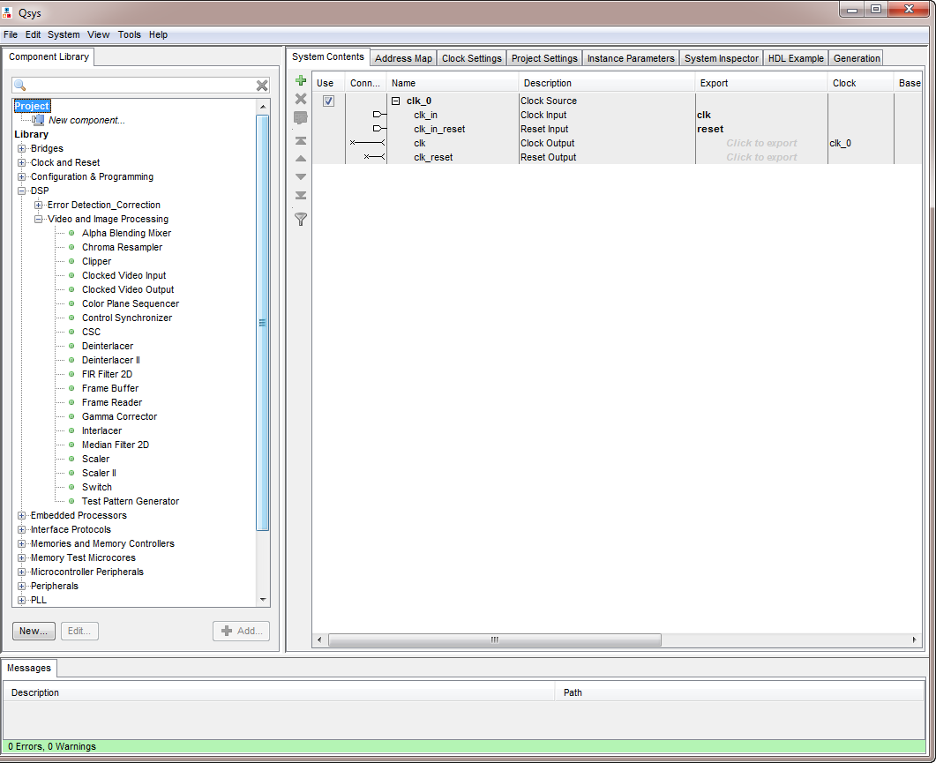
Start a New System in Qsys
Notes:
The entire video system can be built using a Qsys project

Slide 57
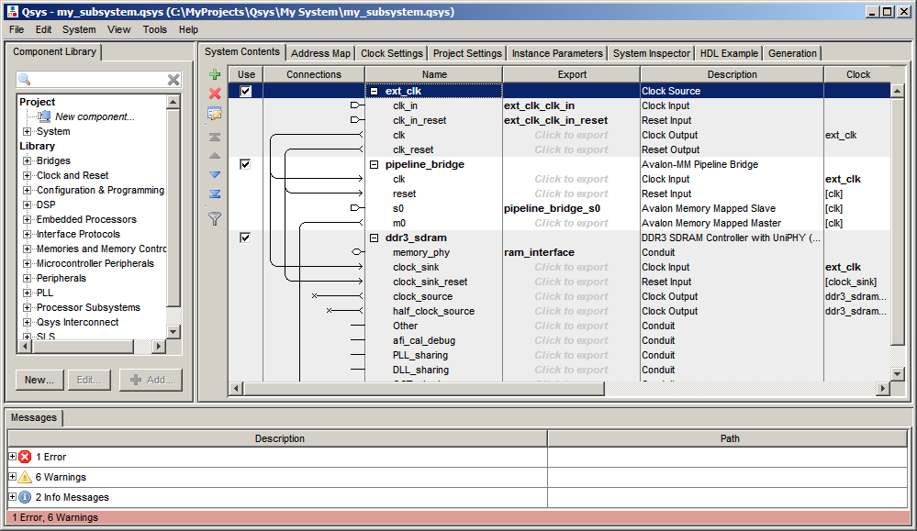
Qsys User Interface
IP Library
System Interconnect
Tabs
Interfaces Exported
for Hierarchy
Toolbar
Validation Display
Notes:
Summary of errors/warnings always visible and are grouped by severity.
The System Inspector view allows someone to see the internal model of the Qsys system, including:
System Properties
All interface properties and ports
Hierarchical subsystem
Connection Properties

Slide 58
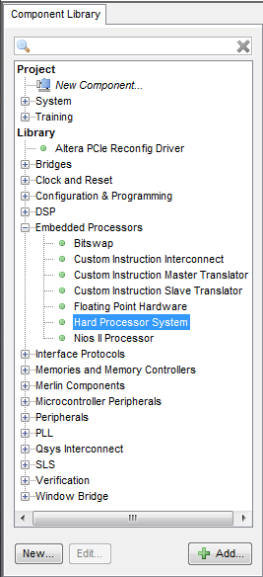
Add IP to Qsys System
Lists available IP and systems
Type search string to filter the list
Bring in your custom IP
Reuse systems or custom components
Expand categories to browse components
Double-click component or click Add button to add selected component to system
Notes:
The component library lists all of the available IP and subsystems that are available and can added to your current Qsys system. IP are listed under the Library section and subsystems are listed under the Project section. Any custom IP or components available will also be under the Project section. We will discuss custom components later in the class.
The component library is organized by categories to make it easier to find the IP you need. Just expand the category and possibly subcategories and highlight the component that you want to add to your system. To add a component to your system, double-click on the on the component name or click on the Add button with the component highlighted. You can also use the search field to filter the component library by name. Just start typing in characters and Qsys dynamically filters the list as you type.

Slide 59
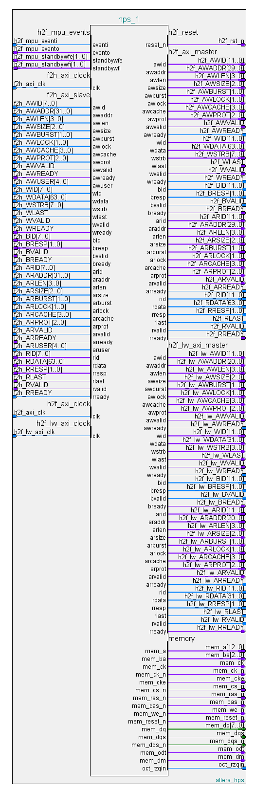
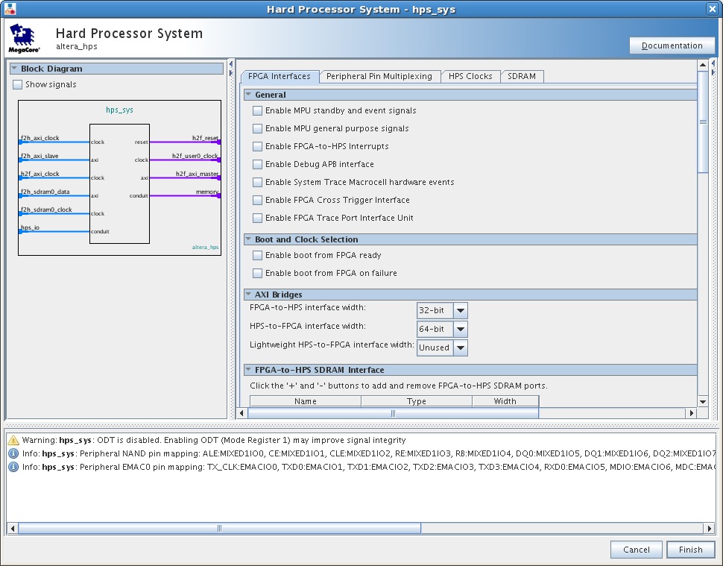
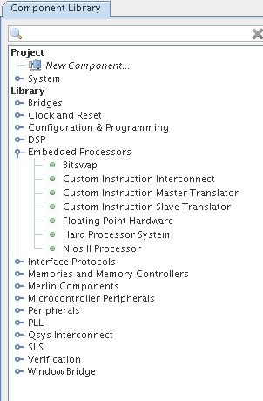
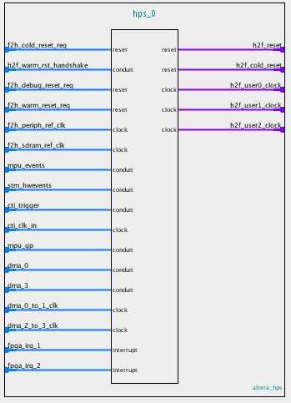
Hard Processor System Component

Slide 60
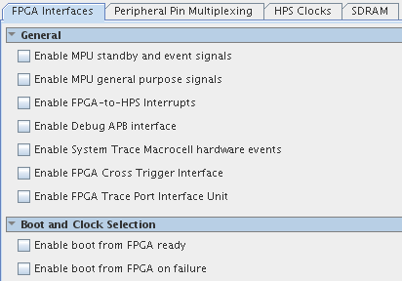
General Options & Boot Control
General
  Events
    Event in and out
    Wait for event condition
    Wait for interrupt condition
  GPIO
  Interrupts
  Debug interfaces
Boot from FPGA
Notes:
Event input and output
WFE & WFI condition info for each processor
GPIO 32 in and 32 out
Interrupts 32 for each processor

Slide 61
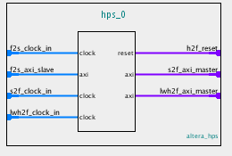
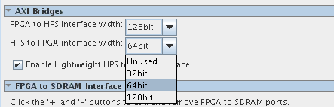
AXI Bridges
FPGA-to-HPS
  Access peripherals & memory
  4 GB space
  Widths 32, 64, 128
HPS-to-FPGA
  960 MB space
  Widths 32, 64, 128
Lightweight HPS-to-FPGA
  Lower performance (32 bits)
  Accessing CSRs
  2 MB space
All support soft Avalon connections
Notes:
HPS to FPGA – controlled by L2 registers

Slide 62
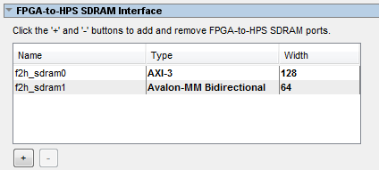
FPGA-to-HPS SDRAM Interface
AXI-3 or Avalon-MM
Select the number of interfaces
  Maximum of 3 AXI-3 or
  Maximum of 6 Avalon-MM
Data widths:
- 32, 64, 128, 256
Notes:
HPS to FPGA – controlled by L2 registers

Slide 63
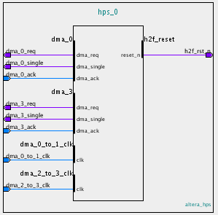
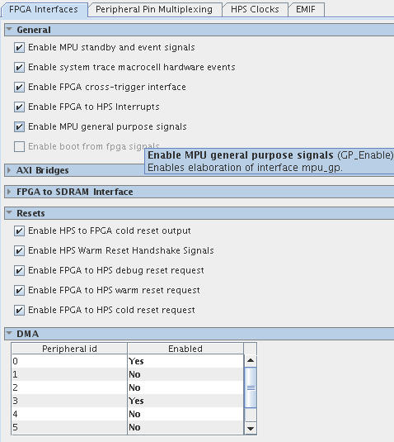
Resets & DMA Control
Resets
  Different reset domains
    Cold
    Warm
    Debug
  HPS can drive resets to FPGA
  FPGA can drive resets
DMA Control
  Up to 8 logical channels
  available to FPGA
  (4 shared with CAN)
Notes:
DMA controller has 8 peripheral request interfaces exposed to the FPGA and they along with all the request interfaces inside the HPS get mapped to the 8 logical channels inside the DMA. The key point to make in this slide is that up to 8 things in the FPGA can share the use of the HPS DMA along with the peripherals inside the HPS.
For the reset stuff when you talk to it the most important thing is that we have different reset domains so that you have the freedom to instrument complex reset subsystems in the FPGA fabric just like the HPS has internally.
Reset handshake hps to fpga request to fpga ack back from fpga.
Reset handshakes give you a request and acknowledge

Slide 64
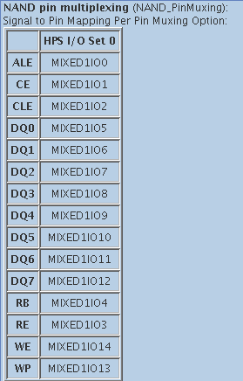
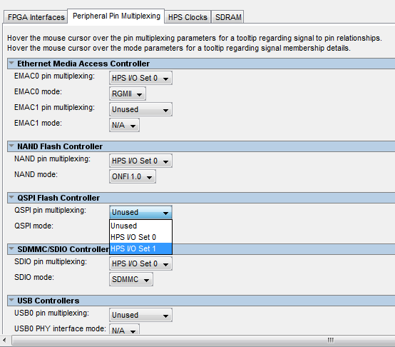
HPS Peripheral Pin Multiplexing
Enable peripheral interfaces
Choose peripheral
I/O modes
Select I/O set
Notes:
QSPI has 1, 2 or 4 selects
SPIM also has single or dual slave selects
UARTs flow control

Slide 65
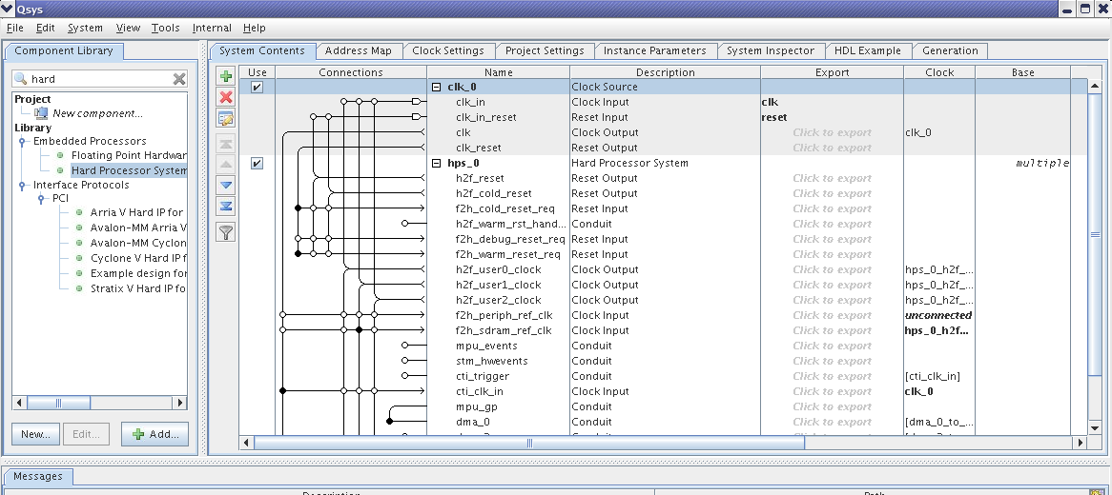
HPS in Qsys
Notes:
Summary of errors/warnings always visible and are grouped by severity.
The System Inspector view allows someone to see the internal model of the Qsys system, including:
System Properties
All interface properties and ports
Hierarchical subsystem
Connection Properties

Slide 66
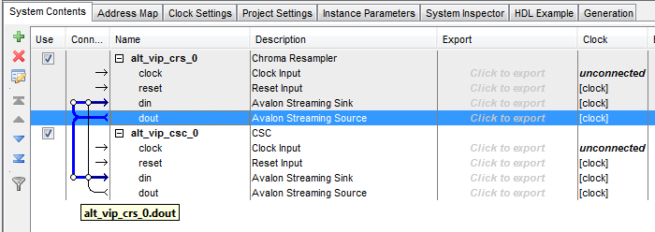
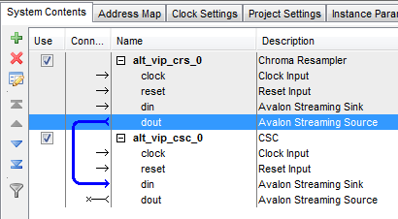
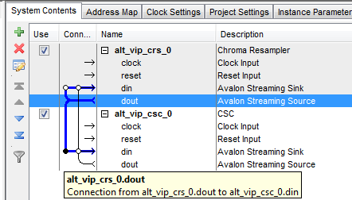
Connect the Components
Click the open dot to make connection
Notes:
Connect the dout of the CRS to the din of the CSC. All VIP blocks are designed for easy plug-and-play and so the entire system can be built up like this.

Slide 67
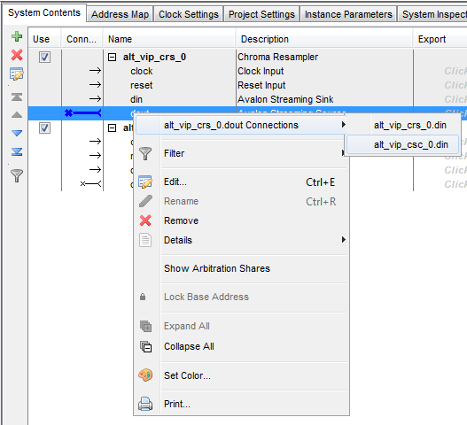
Connect the Components
Notes:
Can also right click on the signal and select the port to connect it to from a list of available connections

Slide 68
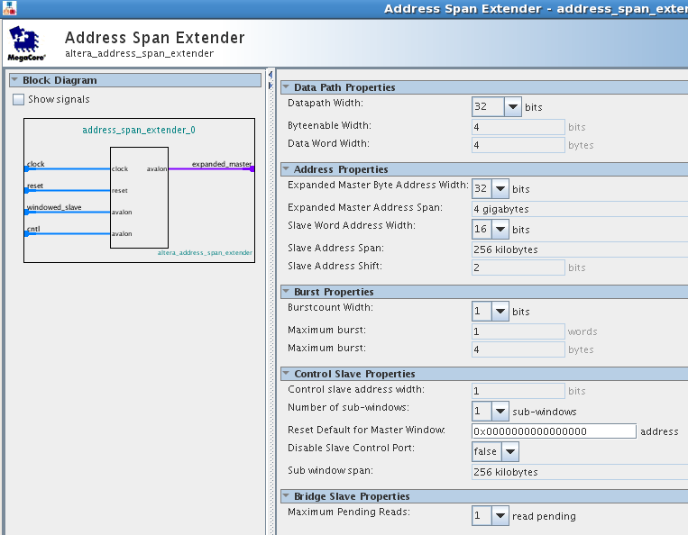
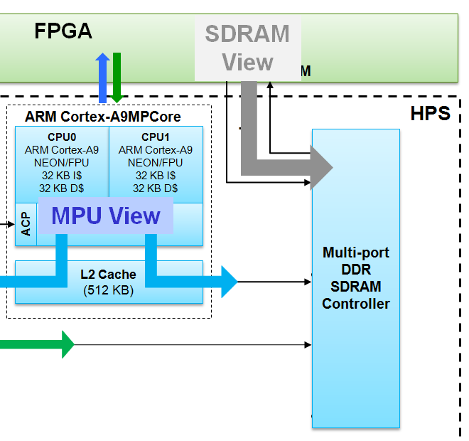
Accessing HPS Memory from FPGA
4 GB HPS memory map
Less capable FPGA masters
(e.g. Nios II has 31-bits of address / 2GB)
Address Span Extender (Windowed Bridge)
Notes:
Allows narrow masters access to a wider memory space

Slide 69
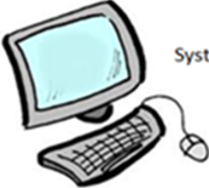
Example: Nios II master in FPGA → HPS
SoC
FPGA
HPS
System
Clocks
Resets
User I/O
System Control
h2f_lw_axi_master
Hardware
Accelerator
h2f_axi_master
HPS I/O
JTAG Bridge
DDR
Nios II
Subsystem
Address Span Extender
System
Console
f2h_axi_slave
Address Span Extender
f2h_sdram
Notes:
For a system with HPS and Nios II, address span extender can be used to allow the Nios II to access the full HPS memory map via a configurable window into memory.

Slide 70
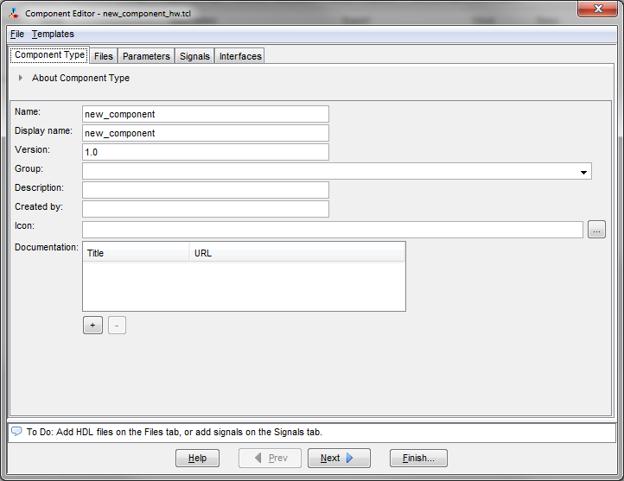
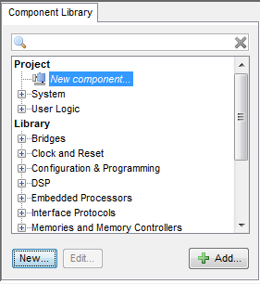
Qsys Component Editor
Import FPGA HDL custom logic as components into a Qsys system
  Launch from Qsys pick list or File menu
Notes:
We do not go over this in today’s lab, but this is a useful item to be aware of.
The tool that allows you to map the signals in your component into their appropriate NOC interface and signal types is called the “Component Editor”. You launch it from within Qsys – either directly from the picklist (as shown) or through the File menu.
There are a number of tabs – the first is the Introduction tab.

Slide 71
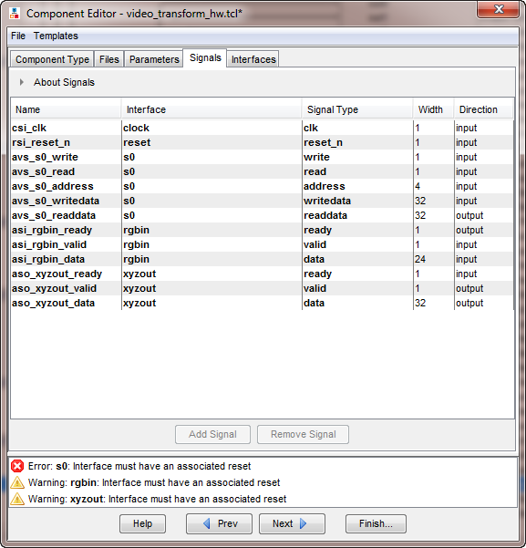
Create Custom Components
Design your own logic with Qsys supported standard interfaces
Map component signals to Qsys Interface types and Signal Names on the Signals tab
Notes:
The next tab is the Signals Tab, which should automatically be populated with your component’s signals. If you name the signals in your component in a clever way (as all the signals here are – and which we will describe in a minute), where the interface and signal types are embedded into their name, you can avoid having to manually map signals in this interface. Otherwise, you can map any signal to any interface/signal combination you like.

Slide 72
Qsys-Supported Standard Interfaces
Avalon-MM (memory mapped)
  Little Endian
  Control plane
  Master interface makes read and write requests to slave interface
Avalon-ST (streaming)
  Big Endian
  Data plane
  Source interface sends data to sink interface (point-to-point)
ARM AMBA™ AXI™ 3.0 & 4.0
  HPS interfaces are AXI 3.0
  AXI 4.0 is backwards compatible with AXI 3.0

Slide 73

Standard Interface Example
Avalon-MM Master
Qsys Interconnect (simplified)
Avalon-MM Slave
AXI Master
AXI Slave
Any master interface can
communicate with any slave interface
If Qsys system is all AXI components, then Qsys will generate interconnect that is natively AXI.
Otherwise, interconnect is based on Avalon.
Notes:
This slide demonstrates the concept of standard interfaces. Here are two master devices talking to two slave devices. The green devices use Avalon-MM interfaces and the blue use another interface like AXI. With the Qsys interconnect between them, any master can communicate with any slave, so the designer only has to add the components to the system and begin data transfers.

Slide 74
Advantages of Using Standard Interfaces
Ensure compatibility between IP blocks from different design teams or vendors
  Any component supporting interface can be connected
Simplify design entry and team-based design
  Signal behavior defined by interface
  Improved understanding, simplified documentation
  No manual wiring or mapping of control, data, and status signals
  Fast system-level integration
  Easy system changes
Simplify interface verification
  Use verification infrastructure to verify against standard
    Bus functional models, interface compliance assertions and monitors, functional coverage
Notes:
So what’s the big deal with using standard interfaces?
Well there are several advantages with using standard interfaces over custom ones.
With a standard interface, the signals required and the signal behavior is defined by the interfaces, so the individual designer does not have to worry about manually defining, assigning and wiring up control, status and data signals. This results in a reduction in the number of errors produced by doing this incorrectly.
With a standard interface, the communication between system components is pre-defined by the interface. This means that two components that support that interface can communicate with one another with minimal effort. It also means that two components that even support different interfaces can communicate by means of bridges and adapters. Bridges and adapters would serve to map the individual control, status and data signals between the interfaces. This allows a designer to design at a high-level because they only have to worry about connecting components and systems together and not about the individual signals that make of a component’s interface. This facilitates making design changes much more quickly and easily.
By using standard interfaces, verification can be performed on a component by comparing its behavior against the standard. This provides access to verification tools such as bus functional models and interface compliance assertions.

Slide 75
Summary: FPGA – HPS Connections
FPGA
HPS
(AXI, 32 / 64 / 128 bit)
(AXI, 32 / 64 / 128 bit)
(AXI 32-bit)
FPGA-to-HPS SDRAM
FPGA clocks and resets
(FPGA JTAG)
(HPS trace data to FPGA)
(FPGA trace events to HPS trace))
(FPGA triggers to/from HPS )
(4 channels)
(FPGA config, boot and GPIO signals)
(MPU interrupts from FPGA)
(MPU status to FPGA)
FPGA-to-HPS bridge (L3 Interconnect)
HPS-to-FPGA bridge
Lightweight HPS-to-FPGA bridge
(Up to six ports, 32 / 64 / 128 / 256 bit)
HPS clocks and resets
HPS-to-FPGA JTAG (Scan Manager)
TPIU trace
FPGA System Trace Macrocell (STM)
HPS Cross-trigger
DMA peripheral interface
FPGA manager interface
MPU Interrupts (64)
MPU standby, wake and events
Notes:
FPGA-to-HPS bridge—a high-performance AXI bus with a configurable data
width of 32-, 64-, and 128-bits, allowing the FPGA fabric to master transactions to
the slaves in the HPS. This interface allows the FPGA fabric to have full visibility
into the HPS address space. This interface also provides access to the coherent
memory interface.
f For information about the coherent memory interface, refer to the Cortex-A9
MPU System chapter in volume 3 of the Arria V Device Handbook.
■ HPS-to-FPGA bridge—a high-performance AXI bus with a configurable data
width of 32-, 64-, and 128-bits, allowing the HPS to master transactions to slaves in
the FPGA fabric.
■ Lightweight HPS-to-FPGA bridge—an AXI bus with a 32-bit fixed data width,
allowing the HPS to master transactions to slaves in the FPGA fabric.
■ FPGA-to-HPS SDRAM interface—a configurable interface to the MPFE of the
SDRAM controller. You can configure the following parameters:
■ AXI-3 or Avalon® Memory-Mapped (Avalon-MM) protocol
■ Up to six ports
■ 32-, 64-, 128-, or 256-bit data width of each port
■ FPGA clocks and resets—provide flexible clocks to and from the HPS.
■ HPS-to-FPGA JTAG—allows the HPS to master the FPGA JTAG chain.
■ TPIU trace—sends trace data created in the HPS to the FPGA fabric.
■ FPGA System Trace Macrocell (STM) events—an interface that allows the FPGA
fabric to send hardware events stored in the HPS trace using STM.
■ FPGA cross-trigger—an interface that allows triggers to and from the CoreSight
trigger system.
■ DMA peripheral interface—multiple peripheral-request channels.
■ FPGA manager interface—signals that communicate with FPGA fabric for boot
and configuration.
■ Interrupts—allow soft IP to supply interrupts directly to the MPU interrupt
controller.
■ MPU standby and events—signals that notify the FPGA fabric that the MPU is in
standby mode and signals that wake up Cortex-A9 processors from a wait for
event (WFE) state.

Slide 76
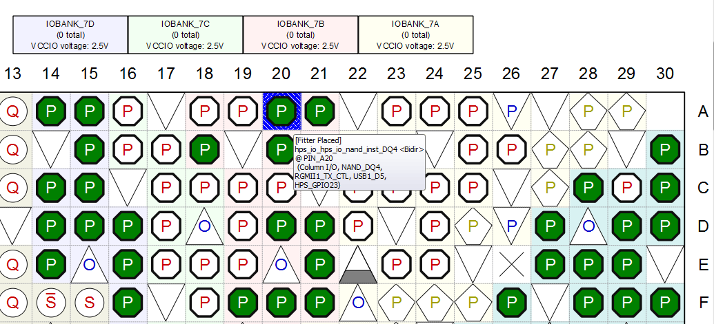
HPS Pin Assignments
Qsys Automatically assigns HPS pins
(pin mux settings transferred into Quartus II project)
Run hps_sdram_p0_pin_assignments.tcl
to set up SDRAM I/O assignments
Check Assignments in Quartus II pin planner:
  Drive strength
  VCCIO for banks

Slide 77


Hardware/Software Design Flow Overview
Altera
Complete
Design
Suite
Preloader Generator
Preloader
handoff
HW Design
.svd
DS-5 Debugger
.sopcinfo
DeviceTree
Generator
Device Tree
.sof
Hardware Flow
Software Flow
Notes:
ACDS = Altera Complete Design Suite (Quartus, QSys, etc)
Note: Device Tree not supported until 13.0 sp1
.svd file gives shows description of soft IP peripheral registers in FPGA . Located in <hps_qsys_project> directory.
.sopcinfo file output of Qsys

Slide 78
SoCKit – Details of the Kit

Slide 79

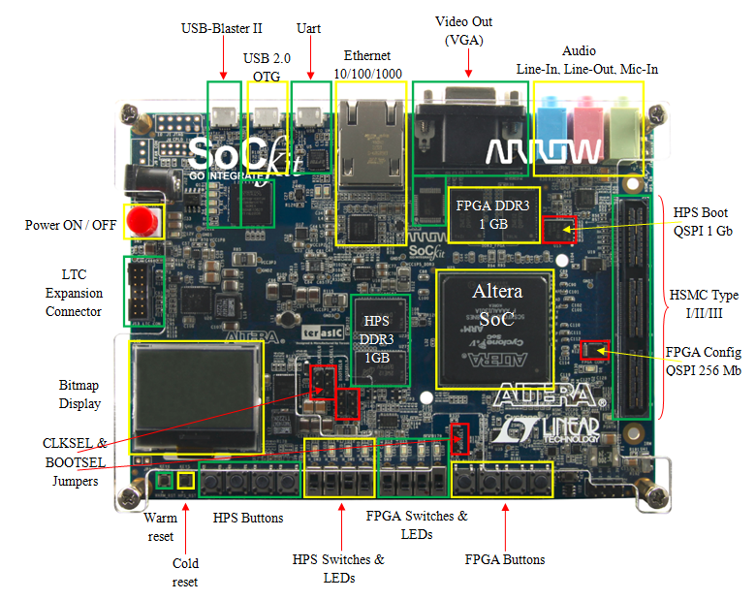
Arrow Cyclone V SoCKit

Slide 80
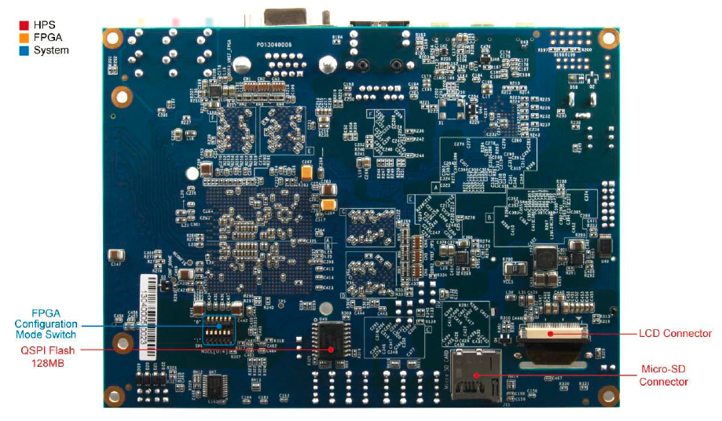
Arrow Cyclone V SoCKit

Slide 81
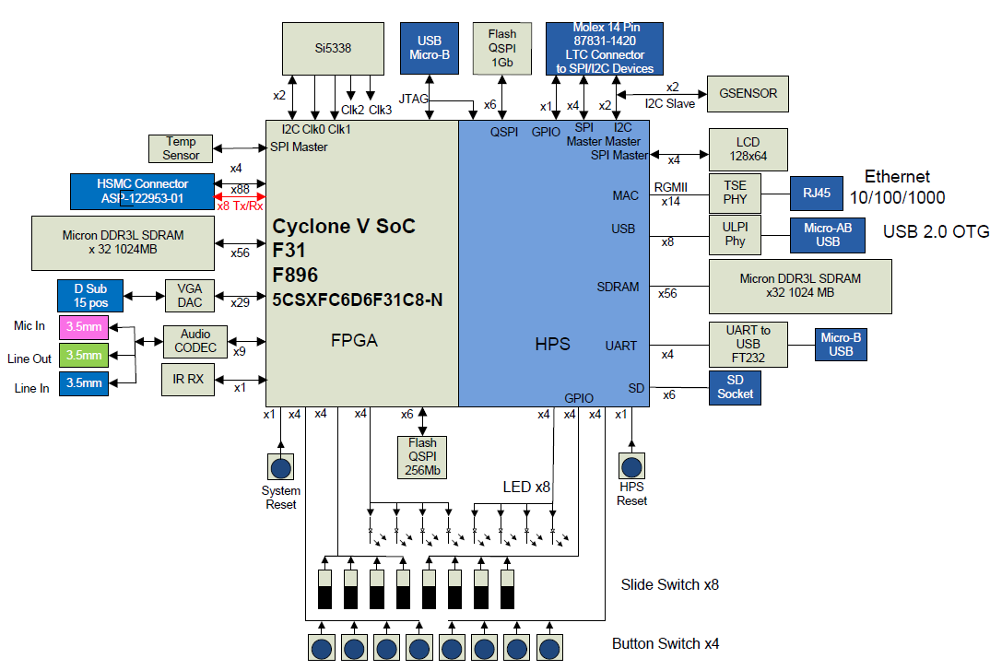

Arrow Cyclone V SoCKit

Slide 82
Golden Reference Design
HPS configuration
  DRAM, QSPI, SD/Card
  All peripheral functions exposed at least once
FPGA configuration
  Simple Qsys “sandbox” system
    First experience in ARM / FPGA integration
  Getting started guide to walk them through the process on integrating IP
    HW simulation
    Verification via system console
    Verification via CPU
    HW/SW hand-off

Slide 83
Lab
Part 1
Please go to
Modules 1-5
in the Lab Manual

Slide 84
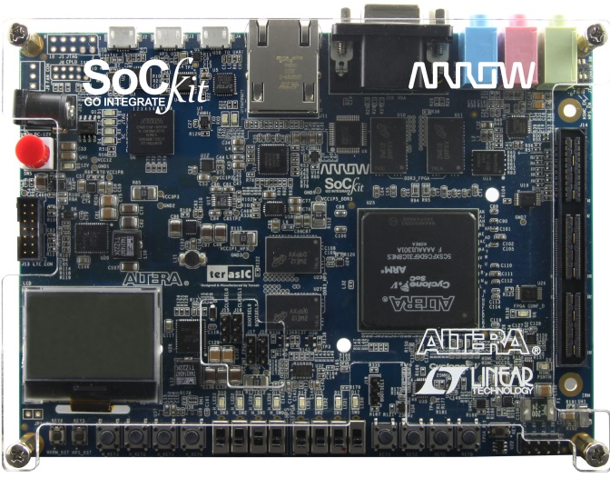
Cyclone V SoC Power Supply Solutions
Linear Technology

Slide 85
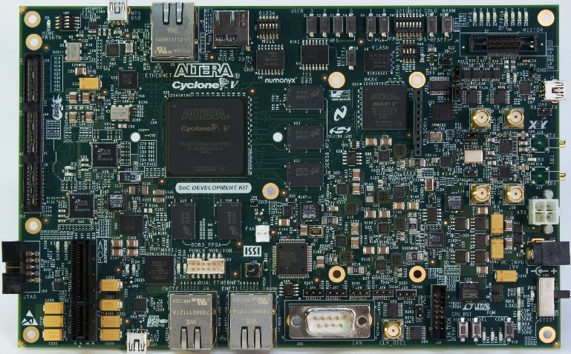
Altera Cyclone V SoC Block Diagram

Slide 86
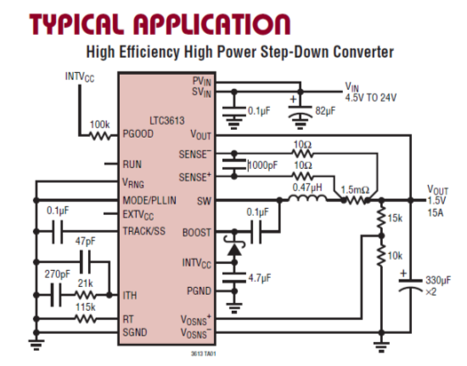
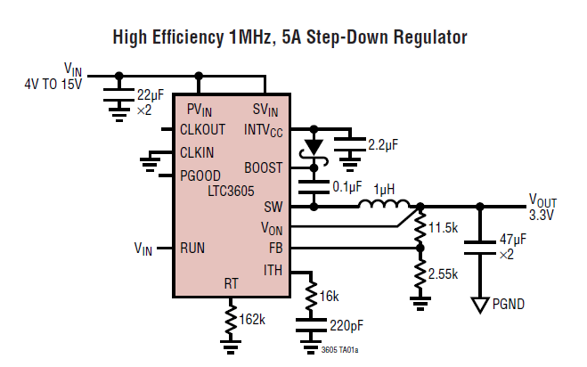
LTC Regulators Powering FPGA
LTC3613 (15A) Monolithic Regulator
2xLTCz3605 (5A) Monolithic Regulator
Low Iq
High efficiency
Fast transient response
Overvoltage protection
Current limit foldback
Power good status output
Small package with integrated FETs (7mmx9mm)
Low Iq
High efficiency
Excellent line and load transient response
0.6V+/- 1% reference accuracy
Small package with integrated FETs (4mmx4mm)

Slide 87

LTC Regulators Powering ARM
LTC3626 (2.5A) Monolithic Regulator
3x LTC3605 (5A) Monolithic Regulator
Low Iq
High efficiency
Programmable average input/output current limit with monitoring
Short circuit protection
Power Good status output
Small package with integrated FETs (7mmx9mm)
Low Iq
High efficiency
Excellent line and load transient response
0.6V+/- 1% reference accuracy
Small package with integrated FETs (4mmx4mm)

Slide 88


Arrow Cyclone V SoC Block Diagram
Simplified Arrow CV SoC Power Tree

Slide 89


CV SoC Power Supply Options
VIN | Output Current
 | 2A | 5A | 10A
<5V | LTC3615 Monolithic, LTC3618 Monolithic | LTC3616 Monolithic, LTC3415 Monolithic | LTC3613 Monolithic, LTC3610 Monolithic
<12V | LTC3626 Monolithic, LTC3633A Dual Monolithic | LTC3605 Monolithic, LTC3611 Monolithic | LTC3866 Controller, LTC3855 Dual Controller

Slide 90


Single IC Option for Applications that only require up to 8A - Eight Output LTC3375 VIN < 5.5V
Potential Example Application

Slide 91
Interfacing DACs & ADCs to SoC Kit
Linear Technology

Slide 92

On board LTC Quick Eval Connector
CV SoC Kits include DC934A – Demo Board for the LTC2607 DAC and LTC2422 ΔΣ ADC
Connect the Arrow & Altera SoC boards to any of Linear Technology ADCs and DAC demo boards that use the Linear Technology QuickEval Connector
Drivers, schematics and layout files available for easy integration with Arrow and Altera Cyclone V SoC FPGA kits

Slide 93
Cyclone V SoC Timing Solutions
Silicon Labs

Slide 94




Silicon Labs – Leading Timing Solutions
Si5338 Any-rate Programmable Clock Generators
  Flexible – Any frequency, format, voltage on each output clock
    Si5338: customizable clock with I2C programmability
    Si5335: customizable clock for cost-sensitive applications
  Easy to use – Free customization with two week lead times
  High performance – Low phase jitter at less than 1ps-rms
Si501 CMEMS Programmable Oscillator
  Flexible – supports any frequency 32 kHz – 156.25 MHz
    Si501/2/3/4 single, dual, quad and programmable oscillators
    Customizable on the web or in the field
  Simple – 4-pin DFN in 2025, 3225, 3240 industry-standard packages
  Reliable – excellent, guaranteed performance over 10 years
    Stability includes operating temperature range, initial frequency, power supply, solder shift, load pulling, shock and vibration
  www.silabs.com/timing

Slide 95
SoC Hardware Debug
Notes:
The last topic we will discuss in this presentation is on the Debug Logic

Slide 96
Debug Interfaces
JTAG
  Direct connection to hardware
  Halts processor, can master system via control of processor
  Debug any code at low level – driver, OS kernel, bare metal application
  Dual core processing requires 2 debugger interfaces
  OS aware debugger display optional
Ethernet
  Requires running software to drive it
  Processor/OS cannot be halted
  OS Application can be halted
  Good for high level programming (fast, easy)
  Debuggers usually have OS aware GUIs and features
  Cannot do low level debug (kernel, driver, bare metal) as OS cannot be stopped

Slide 97





SignalTap™ II Logic Debug
Built in logic analyzer/trace capability for FPGA logic
Captures the state of signals when running at full system speeds
Uses standard JTAG connection to PC
User defines target signals and trigger conditions to capture data
Data read back from memory and displayed on PC
Host
Display
Target
HW
USB
JTAG
S.Tap Logic
Notes:
Up to 200 MHz
Multi-Analyzer Support
1,024 Channels
128K Samples
10 Trigger Levels
No Probes!
Can be used simultaneously with the Nios II IDE debugger and the FS2 console!
The SignalTap® II logic analyzer is a second-generation system-level debugging tool that captures and displays real-time signal behavior in a system on a programmable chip (SOPC), giving engineers the ability to observe interactions between hardware and software in their system designs. Available exclusively in the Quartus® II software, the SignalTap II logic analyzer supports the highest number of channels, sample depth, and clock speeds of any embedded logic analyzer in the programmable logic market. The Quartus II software versions 4.0 and later also provides designers with a graphical interface to define custom-trigger-condition logic to provide greater accuracy and enhances the ability to isolate problems. Figure 1 shows the components of the SignalTap II embedded logic analyzer. The SignalTap II embedded logic analyzer does not require any external probes or changes to user design files to capture a design's state of internal nodes or I/O pins.
Running at speed under real-world system conditions is the ultimate testbench for engineers who want to see the active processes within their design as it operates. The SignalTap II embedded logic analyzer offers designers the ability to capture the state of internal nodes or I/O pins while the device is running in-system and at system speed. The SignalTap II embedded logic analyzer software can now be used in environments with multiple devices in a single JTAG chain, in combination with multiple logic analyzer megafunctions in each device in that JTAG chain. The following components are required to perform logic analysis with the SignalTap II embedded logic analyzer:
Quartus II design software
Soft embedded core megafunctions that are inserted into the device
SignalTap II logic analyzer megafunction
SignalTap II hub (automatically installed when an engineer chooses the SignalTap II logic analyzer in the Quartus II software)
Download cable
USB Blaster download cable
ByteBlasterMV™ download cable
ByteBlaster™ II download cable
MasterBlaster™ download cable
Device under test
Captured data is stored in the device's memory blocks and streamed out to the Quartus II software waveform display using a USB Blaster, ByteBlasterMV, ByteBlaster II, or MasterBlaster communications cable. Table 1 summarizes the features and benefits of the SignalTap II embedded logic analyzer. Detailed descriptions of these features and benefits can be found on the SignalTap II Feature Descriptions web page
FeatureBenefitMultiple logic analyzers in a single deviceSupports multiple clock domains in a single device
Multiple logic analyzers in multiple devices in a single JTAG chainAllows multiple devices with multiple clock domains to be analyzed
Up to 10 basic or advanced trigger levels for each analyzer Allows for more complex data capture commands to be given to the logic analyzer, providing greater accuracy and problem isolation. Version 4.1 adds support for event counter trigger conditions.
Flexible buffer acquisition modesEach trigger can be set up to sample at different ranges relative to the triggering event, in circular or segmented modes, which allows more accurate data collection
Up to 1,024 channels in each deviceEnables sampling many signals and wide bus structures, and allows for a great deal of data collection to locate problems
Up to 128K samples in each deviceProvides sufficient capacity for any practical application
Clock support up to 200 MHzAllows for sampling of design data at system frequency
Ability to incrementally add nodes, change signal selection and change trigger conditions without a full recompilationAllows user to change which nodes are monitored without a full design recompilation
Lock mode to prevent recompilationsPrevents SignalTap II configuration changes that will cause the need for a design recompilation
No-cost stand-alone viewer Allows easy deployment of in-system logic analysis capabilities to multiple lab locations or field service personnel
Mnemonic and radix tablesLabel signals with true signal names from software source to assist in identification of problem source
Multiple bus display formatsMakes viewing and analyzing buses easier (now includes bar chart and line chart display options for captured data)
Export data in multiple file formatsAllows other verification tools to be used to analyze captured data
Resource usage estimatorProvides estimate of logic and memory device resources used by SignalTap II embedded logic analyzer configurations
Auto detection of devices in JTAG chainConfirms connection to device before attempting to initiate data capture
Auto detection of programming hardwareConfirms connection to device before attempting to initiate data capture
Ability to print waveformsPrints captured waveforms for reporting
Vendor-independent application program interface (API) for Source-Level Debugging ToolsAllows third-party software to utilize SignalTap II resources
User-friendly interfaceEasier-to-use with status monitors to guide users through operation
SignalTap II Device Support
SignalTap II logic analyzers can now be used with the following device families:
Cyclone™ devices
Stratix® devices
Stratix GX devices
Excalibur™ devices
APEX™ II devices
APEX 20KE devices
APEX 20KC devices
APEX 20K devices
Mercury™ devices

Slide 98


FPGA Adaptive Debug
Allows for cross-triggering between HPS debug and FPGA debug.
Launch SignalTap II Logic Analyzer and DS-5 Debugger
HPS -> FPGA Cross Trigger
FPGA-> HPS Cross Trigger
Notes:
This is a huge competitive advantage for Altera. Be sure to emphasize that this is unique to Altera and there are items in silicon

Slide 99



System Console
Provides direct system access at
runtime from TCL command line
interface
  Access via Nios® II processor, JTAG bridge,
  JTAG UART or custom Agent
  Supports an Avalon-MM or Avalon-ST Master
  Use for board bring-up, debug, diagnostics,
  system profiling and configuration
FPGA
QSys Builder System
System
Console
IP
IP
Nios II
OCI
Nios II IDE
USB Blaster
Sys. Interconnect
SLD
Hub
JTAG
IP
Bridge
See http://nioswiki.jot.com/SystemConsole for sample applications

Slide 100

What is System Console?
Quick system-level debug of Qsys systems
  Interactive Tcl Console
    Opens as a separate window
    Opens in the Nios® II Command Shell
  Debug over various communication channels
    JTAG or TCP/IP
  Read from or write to memory mapped components
  No processor required
Notes:
In addition to the console itself, there is full scripting support, including stdin/stdout/stderr, argument handling and “sourcing” of Tcl files from within an interactive session.

Slide 101
Usage Examples
System-level debug
  Board bring-up and interface testing
  System clock, reset and JTAG chain validity testing
  Qsys component functionality testing
  Loopback testing of Avalon Streaming interfaces
  Provide test vectors, return responses

Slide 102
System Console Interfaces
System Console
Through JTAG and Virtual JTAG Hub
Nios II Processor
JTAG to Avalon Master Bridge
JTAG UART
Avalon-ST JTAG Interface
Qsys
Interconnect
Avalon-MM
Master
Avalon-MM
Master
Avalon-MM
Slave
Avalon-ST
Source and Sink
User Component
User Component
Avalon-MM
Slave
Avalon-ST
Source or Sink
Notes:
USB Blaster, Ethernet Blaster, Byteblaster to access the components through JTAG

Slide 103
Usage Flow – Summary
1. Add required component to Qsys
2. Connect board and program FPGA
3. Launch System Console
Complete master write and read example script
set m_path [lindex \
[get_service_paths master] 0]
open_service master $m_path
master_write_memory $m_path 0x2000 \
[list 0x01 0x02]
master_read_memory $m_path 0x2000 2
close_service master $m_path
4. Locate and open service path
5. Perform desired operation(s) with the service
6. Close the service
Notes:
This slide displays the basic flow when opening and using a service provided by the System Console.
The System Console uses a virtual file system to organize the available services, which is similar to the /dev location on Linux systems. Instances of services are referred to by their unique service path in the file system.
Most System Console service instances are automatically discovered when you start the System Console.
After ensuring that your board is properly configured and that System Console is launched and ready for interactive usage, you start by finding the service. This is done using the “get_service_paths” command. After locating your service, it’s convenient to set a variable equal to it. This is what is done in step 3. Step 4 opens the service using the variable defined in the previous step. Step 5 illustrates the sorts of commands that can be used on this sort of service.
Step 6 closes the device.

Slide 104
Lab
Part 2
Please go to
Module 6
in the Lab Manual

Slide 105
Next Steps

Slide 106
Documentation and Useful References
Altera Cyclone V Documentation page:
http://www.altera.com/literature/lit-cyclone-v.jsp
Useful items found on the documentation page:
  Cyclone V SoC HPS Address Map and Register Definitions
  Cyclone V Device Handbook, Volume 3: Hard Processor System Technical Reference Manual (HPS TRM)
Arrow SoCKit page on RocketBoards.org:
http://rocketboards.org/foswiki/Documentation/ArrowSoCKitEvaluationBoard
Support info & Links
  Altera’s MySupport – for submitting Service Requests – GO SIGN UP!
  Altera’s Design Resources Site
Altera Forum Community: www.alteraforum.com
Altera Wiki Community: www.alterawiki.com

Slide 107
Thank You

Slide 108

Valydate – We save re-spins
Hardware verification company focused on 5 services:
  Schematic Integrity Analysis (Detailed Schematic Review)
  Signal Integrity Analysis
  Power Integrity Analysis
  Static Timing Analysis
  Altera Schematic and Layout Reviews (active DSN Member)
On average, Valydate saves 1-2 re-spins off of the hardware development cycle
Simple/low burden engagement process for clients
Want to learn more? Have Questions? Want a free quotation for your Design?
Contact Valydate through your Arrow Rep. or direct at info@valydate.com

Slide 109

Module Solutions from Critical Link
MityARM-5CSX Product Information

Slide 110

MityARM-5CSX – ALTERA SoC FPGA
HPS – Hard Processor Subsystem
■ Dual ARM Cortex-A9 MPUs, 800MHz
■ Dual NEON SIMD Coprocessors
■ 32 KB L1 Program and Data Caches (per core)
■ 512 KB L2 Cache (shared)
■ 64 KB on-chip RAM
■ ECC Support
Actual Size
Cyclone-V FPGA
■ 110K Logic Elements (LE)
■ 460MHz Global Clock
■ M10K Memory: 41,509Kb (240MHz)
■ MLAB Memory: 5,140Kb (330MHz)
■ 112 DSP Blocks (200MHz)
■ 6 FPGA PLLs, each with fractional output
■ Differential I/Os up to 640Mbps
■ 256MB FPGA dedicated DDR3
Input / Output
■ Up to 145 FPGA I/O at card edge
■ 10/100/1000 Mbps RGMII (x2)
■ PCIe (Gen 1.1, x4)
■ 3.125Gbps Transceivers (x6)
■ USB 2.0 OTG
■ CAN Bus (x2), UART (x2)
■ MMC/SD/SDIO
■ I2C (x4), SPI Master (x2), SPI Slave (x2)
BENEFITS
■ Rapid development, minimize risk
■ Symmetric Multiprocessing
■ High speed interconnect between HPS and FPGA
■ Proven design, Long term availability
■ Advanced Operating System Support
  ■ Linux, Android, QNX,
  ■ Windows Embedded
■ Industrial Temp Version Available
Memory
■ 1GB DDR3 CPU RAM (x32 + ECC)
■ 256MB FPGA dedicated DDR3
■ 32MB QSPI NOR Flash
Mechanical
■ 3.5” x 1.5”
■ Card edge connector
■ MIL-STD-810F
PRELIMINARY
Notes:
Production ready system on module from Critical Link
Features OMAPL138 married to a Xilinx Spartan 6 FPGA
FPGA available in multiple sizes – LX9, LX16, and LX45
FPGA 100% available for customer use
FPGA loaded by the ARM9 in the OMAPL138, FPGA load command provided in Linux and QNX
96 FPGA I/O pins available at the edge connector
OMAPL138 connected to FPGA with uPP, EMIFA, EMAC RMII, VPIF, LCD, UHPI, MMCSD 1
Any of these signals can be routed through the FPGA to the base board.
Additional interfaces can be routed to the FPGA via the base board
FPGA cores available from Critical Link to speed designs, including ADC, DAC, Stepper Motor, UART, SPI, I2C, GPIO and signal processing cores.
Off the shelf base board available to prototype designs, base board design available to speed custom base board development
Module is pin for pin compatible with FPGA modules paired with AM1808 and C6748
Also pin compatible with non-FPGA modules featuring OMAPL138, AM1808 and C6748
Design guide provided by Critical Link to assist in custom base board development
Critical Link can custom design base boards for interested customers.
All products from Critical Link available through Avnet
Critical Link provides QNX BSP, as well as Real-time Linux ported to the module family. Critical Link provides Virtual Machine image of Linux development environment pre-loaded and pre-configured.

Slide 111

MityARM-5CSX – ALTERA SoC FPGA
PRELIMINARY
Notes:
Production ready system on module from Critical Link
Features OMAPL138 married to a Xilinx Spartan 6 FPGA
FPGA available in multiple sizes – LX9, LX16, and LX45
FPGA 100% available for customer use
FPGA loaded by the ARM9 in the OMAPL138, FPGA load command provided in Linux and QNX
96 FPGA I/O pins available at the edge connector
OMAPL138 connected to FPGA with uPP, EMIFA, EMAC RMII, VPIF, LCD, UHPI, MMCSD 1
Any of these signals can be routed through the FPGA to the base board.
Additional interfaces can be routed to the FPGA via the base board
FPGA cores available from Critical Link to speed designs, including ADC, DAC, Stepper Motor, UART, SPI, I2C, GPIO and signal processing cores.
Off the shelf base board available to prototype designs, base board design available to speed custom base board development
Module is pin for pin compatible with FPGA modules paired with AM1808 and C6748
Also pin compatible with non-FPGA modules featuring OMAPL138, AM1808 and C6748
Design guide provided by Critical Link to assist in custom base board development
Critical Link can custom design base boards for interested customers.
All products from Critical Link available through Avnet
Critical Link provides QNX BSP, as well as Real-time Linux ported to the module family. Critical Link provides Virtual Machine image of Linux development environment pre-loaded and pre-configured.

Slide 112
Contact Information
Website:
  http://www.mitydsp.com
  http://www.criticallink.com
E-Mail:
  tom.catalino@criticallink.com
Telephone:
  315-425-4045

Slide 113




Module Solutions from Novtech
NOVPEK™CV
(Platform Evaluation Kit)
NOVSOM™CV
(System On Module)
Unleash the power of the Altera Cyclone V SoC

Slide 114


NOVSOM™CV Features:
Cyclone V 896 BGA (F31) part and 672 BGA (U23)
Up to 2 GByte DDR3 with ECC
On board Solid state storage/boot options (HPS)
  MicroSD
  NAND FLASH
  QSPI serial FLASH
  FPGA
On Board FPGA configuration device (QSPI)
On-board clocks
All FPGA signals are routed B2B (excluding HPS DDR3)
Allows any voltage assignment to each bank (VCCIO, VREF)
Board to board height - 5mm or 8mm
SoM dimensions 2.89’’ (73.4mm) by 2.52’’ (64m)
Available in Commercial, Industrial and Automotive temperature ranges

Slide 115

NOVPEK™CV Features:
Connectivity:
PCIe slot (FPGA)
miniPCIe slot with SIM, USB & SMBus (FPGA)
1G Ethernet (HPS)
10/100 Dual Ethernet i.EEE1588 L2 Switch (FPGA)
USBOTG (HPS)
SD slot (HPS)
CAN (HPS)
UART (HPS Terminal)
USB 2.0 HOST (FPGA)
USB 3.0 Device (FPGA)
USB 3.0 HOST (FPGA PCIe Bridge)
Keypad (HPS & FPGA)
FPGA pins accessible via
  32x3 & 16x3 100mil pin headers
  HSMC (Type I, II and III
Multimedia:
Video Out:
  HDMI
  LVDS
  TTL
Video In:
  HDMI
  Composite
  TTL
Audio In/Out
Debug:
HPS:
  JTAG
  ETM
  TERMINAL
FPGA:
  JTAG
  System Console

Slide 116




Available Services:
Design and prototype of add-on boards with four to six week lead time
Customizing the base board to customer requirement
Design and prototype a single board solution
OS porting and device driver development
Customization of NovTech highly integrated Power Management solution
For NOVPED or module pricing and availability contact NovTech at (888) 701-7466, info@novtech.com
NovTech is a recognized third party and partner
with some of the leading IC manufacturers and CAD companies:

Slide 117
COM Express Single Board Computer solution from
Orion Technologies
SOC COM Express SBC

Slide 118


SOC COM Express SBC
Small Form Factor 55mm x 84mm
Re-Configurable SBC – All I/O that is routed to connector can be reconfigured
Customize base card for particular application
On-board temperature monitoring
COM Express Type 10 Connector
Extended Temperature (-40C - +85C)

Slide 119
Thank You

Slide 120
APPENDIX

Slide 121
System Validation
Simulation using ModelSim-Altera

Slide 122
RTL Simulation Support
Bus Functional Models of HPS-FPGA interface
Allows rapid verification of your FPGA IP
  Separate model for each interface
    Only instantiate interfaces required for your verification
  Simulates interface protocol
    Validate your IP will work when plugged into system
    Does not simulate entire HPS

Slide 123

RTL Verification IP
AXI3 Master/Slave BFMs & Assertion Monitor
  Developed by Mentor Graphics, based on existing VIP.
  Verilog in v 12.0 (VHDL in future releases)
  Have verilog task-based API.

Slide 124
Simulation Support
Simulation Model Features
  Support people developing FPGA logic & IP to interface to the SoC
  Provides an interface-level simulation model only.
  Does not provide a model of the functioning of the chip.
No VHDL Simulation Support
  The true barrier here is enabling Altera’s Avalon_* BFMs to be used in VHDL
    Designed to be used with cross-module referencing and functional calls in Verilog
Post-Fit simulation uses the same BFM models.

Slide 125

Simulation Support - Interfaces
Each interface will be supported by an interface BFM
Clock input interfaces will be connected to the appropriate BFM
Clock output interfaces will be driven by Clock Master BFMs
Pin-side interfaces will be unconnected within the HPS simulation model.

Slide 126





HPS Simulation – Obtaining Test System
Create HPS System in Qsys
Generate Simulation Model
Write Top Level Test

Slide 127


HPS Simulation – Writing the Test
How do I write a test?
  Instantiate Qsys Testbench System
  Control BFMs using verilog cross-module references.

Slide 128


HPS Simulation – Example Test Program
HPS parameterized with the following interfaces
Notes:
The following example shows
A read transaction between AXI Master to AXI Slave BFMs
Controlling and sampling signals of conduit BFMs

Slide 129
HPS Simulation – Example Test Program
Import AXI BFM Package
Instantiate Qsys Testbench System
Do Stuff

Slide 130
Power Supply Topologies

Slide 131







Power Management Solution Options
Linear Regulators
  Simple
  Low noise
  Few components
  Low power
Monolithic Switchmode Regulators
  More components
  than linear reg.
  Layout
  Consideration
  Mid-to-high power
  More efficient
Switchmode Controller Regulators
  More components
  than monolithic
  More Complex
  layout
  Mid-to-very high
  power, efficient
µModule Regulator Systems
  Complete circuit in
  a tiny package
  Simple layout
  Efficient
  Multi-output
  Low-to-high power
  New: Low noise…
Simple
Simple
Difficult
Difficult
Simple
Simple
Difficult
Difficult
Notes:
Each Altera FPGA is targeted towards a given set of requirements, high performance, high integration, high power, low cost, low component count , etc.
This slide briefly describes the basic power supply topologies that we offer, and we of course target the appropriate type based on the Altera FPGA and requirements provided by the Altera development board teams.

Slide 132



Power Supply Considerations for Altera FPGAs
High End: Stratix V Series
  High Performance
  Remote sense amplifiers for accurate voltage
  regulation at FPGA load point
  Ease of use
  Compact Solution
  Low ripple, low noise power supplies for analog transceiver rails
Mid Range: Arria V Series
  Lower system cost vs. Stratix
  High efficiency
    Synchronous monolithic
  Ease of use
Cost Sensitive: Cyclone V Series
  Lower cost
  Lower system power
  Ease of use for the design
  Low component count for the BOM

Slide 133
Power System Management

Slide 134

What is Power System Management (PSM) ?
Traditional Power Supply System
Analog Monitor and Control
POWER
SUPPLY
POL1
LOGIC
PSM
POL2
DDR
POL3
CPU
Core
POL4
I/O
PMBus
POL5
FPGA
CPU
Core
POL6
I/O
POL7
DSP
Core
Software Programmable
POL8
I/O

Slide 135




Traditional Power Supply
PSM with LTpowerPlay™
+5%
Vout (Drift)
+5%
Voltage Optimization
+/- 0.25%
TIME
Performance Optimized
0%
POL 1
POL 1
+/- 0.25%
0%
Vout (Corrected)
Power Optimized
+/- 0.25%
-5%
Trim DAC
-5%
Dynamic Voltage Control
Limited by tolerance % of components. Still subject to time/temp drift
DVFS
FPGA/DSP/ASIC
1.50V / 1Ghz
1.15V / .6Ghz
POL 2
POL 2
System Monitoring
POL 3
POL 3
Status and Fault Monitoring
OV/UV/OC Faults with no other system information
PMBus
Power In and Power Out
OV/UV/OC Faults
°C
Correlate Faults to System Status (Predict Failure) and “Black Box” Analysis

Slide 136





Traditional Power Supply
PSM with LTpowerPlay™
Discrete Components
Software Configurable
Sequence / Margin / Track
POL 1
POL 1
Changes may require board to be reworked
Unlimited changes by software
Debugging & Troubleshooting
POL 2
POL 2
Status of all POLs can be viewed in software
Probes and meters…GOOD LUCK!
Margin Supplies to Test System Stability
POL 3
PMBus
POL 3
Can’t be easily done
Test system performance with different combinations of voltages

Slide 137


PSM:LTC2978A used on Altera CV SoC Kit

Slide 138



PSM User Friendly Interactive GUI
DC1613A

