Slide 1
Operational Amplifier
FILS – Integrated Circuits

Slide 2
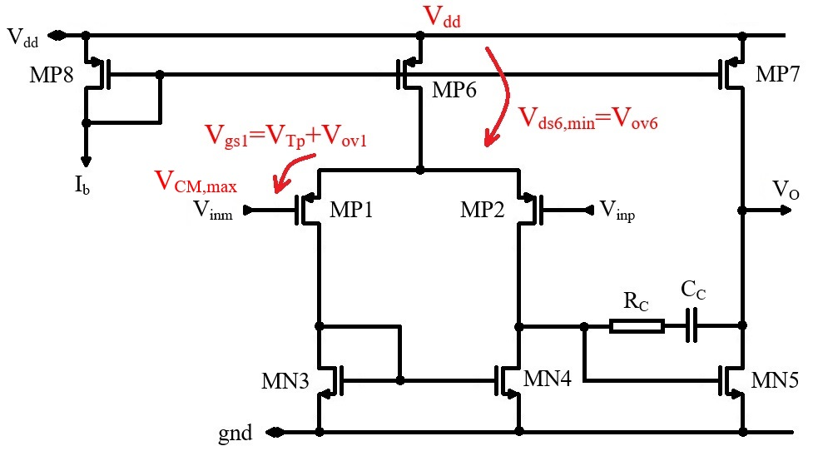
2 Stage Operational Amplifier – Common Mode Range
Input common Mode Range
Considered case:
PMOS input
Maximum V_{CM} voltage
Above V_{CM}, we need one V_{gs} for MP1. The rest of the voltage up to V_{dd} drops on MP6 as drain – source voltage.
This voltage must be large enough so that MN6 is in saturation.
The maximum common mode voltage results:
$$V_{CM,Pmax}=V_{dd}−V_{ov6}−V_{gs1}$$
$$V_{CM,Pmax}=V_{dd}−V_{Tp}−V_{ov1}−V_{ov6}$$
To see the order of magnitude, we consider all threshold voltages to be equal to V_{T} and all overdrive voltages to be equal to V_{ov}.
$$V_{CM,Pmax}=V_{dd}−V_{T}−2V_{ov}$$

Slide 3
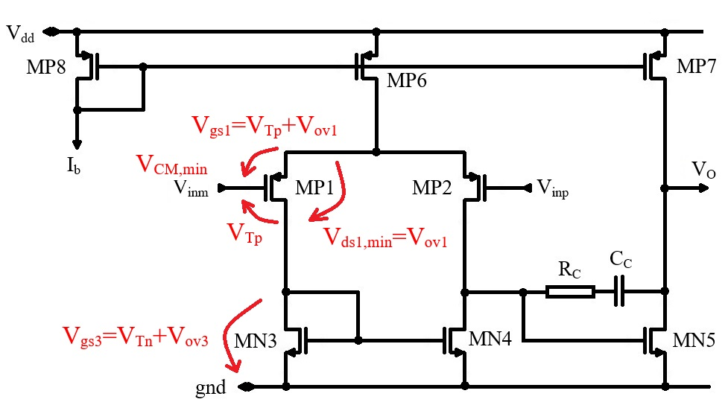
2 Stage Operational Amplifier – Common Mode Range
Input common Mode Range
Considered case:
PMOS input
Minimum V_{CM} voltage
MP1 drain must be above ground with MN3 gate – source voltage.
V_{CM} can actually be one threshold voltage below MP1 drain so that MP1 is still in saturation.
The minimum common mode voltage results:
$$V_{CM,Pmin}=V_{gs3}−V_{Tp}$$
$$V_{CM,Pmin}=V_{ov3}+V_{Tn}−V_{Tp}$$
To see the order of magnitude, we consider all threshold voltages to be equal to V_{T} and all overdrive voltages to be equal to V_{ov}.
$$V_{CM,Pmin}=V_{ov}$$

Slide 4
2 Stage Operational Amplifier – Common Mode Range
PMOS OpAmp common mode range
We have the following limits for the PMOS OpAmp common mode range:
$$V_{CM,Pmax}=V_{dd}−V_{T}−2V_{ov}$$
$$V_{CM,Pmin}=V_{ov}$$
As a numerical example, we shall consider V_{T}=0.8V and V_{ov}=0.2V.
We are not interested that much in the absolute V_{CM,Pmax} vale, but rather in how close the common mode voltage can get the supply rail, V_{dd}–V_{CM,Pmax}. We get:
$$V_{dd}−V_{CM,Pmax}=V_{T}+2V_{ov}=1.2 V$$
$$V_{CM,Pmin}=V_{ov}=0.2 V$$
The PMOS OpAmp can work pretty close to ground (one overdrive voltage) but needs a significantly larger voltage distance to the supply (one threshold voltage and two overdrive voltages).
In conclusion, the PMOS OpAmp is well suited for low common mode voltage operation.

Slide 5
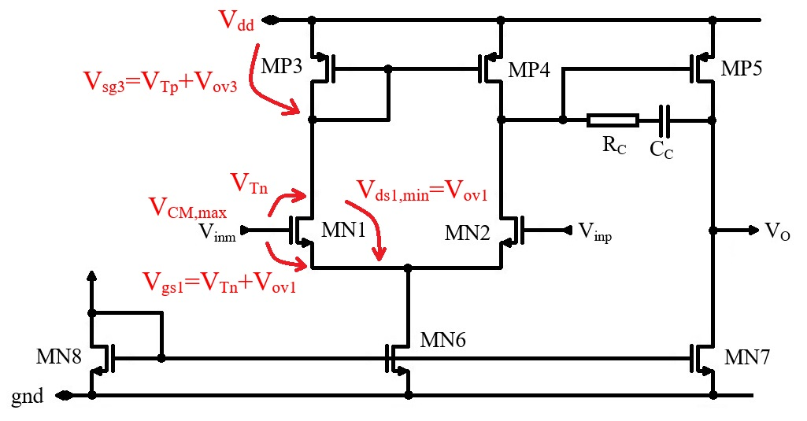
2 Stage Operational Amplifier – Common Mode Range
Input common Mode Range
Considered case:
NMOS input
Maximum V_{CM} voltage
The maximum common mode voltage for the NMOS configuration is very similar to the minimum V_{CM} calculation for the PMOS configuration.
The maximum common mode voltage results:
$$V_{CM,Nmax}=V_{dd}−V_{gs3}+V_{Tn}$$
$$V_{CM,Nmax}=V_{dd}−V_{ov3}+V_{Tn}−V_{Tp}$$
To see the order of magnitude, we consider all threshold voltages to be equal to V_{T} and all overdrive voltages to be equal to V_{ov}.
$$V_{CM,Nmax}={V_{dd}−V}_{ov}$$

Slide 6
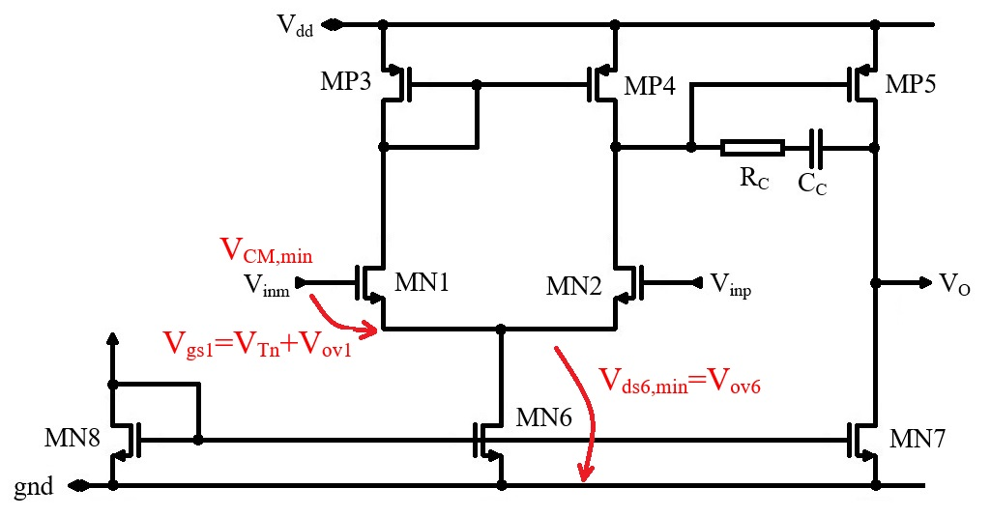
2 Stage Operational Amplifier – Common Mode Range
Input common Mode Range
Considered case:
NMOS input
Minimum V_{CM} voltage
The minimum common mode voltage for the NMOS configuration is very similar to the maximum V_{CM} calculation for the PMOS configuration.
The maximum common mode voltage results:
$$V_{CM,Nmin}=V_{ov6}+V_{gs1}$$
$$V_{CM,Nmin}=V_{Tn}+V_{ov1}+V_{ov6}$$
To see the order of magnitude, we consider all threshold voltages to be equal to V_{T} and all overdrive voltages to be equal to V_{ov}.
$$V_{CM,Nmin}=V_{T}+2V_{ov}$$

Slide 7
2 Stage Operational Amplifier – Common Mode Range
NMOS OpAmp common mode range
We have the following limits for the NMOS OpAmp common mode range:
$$V_{CM,Nmax}={V_{dd}−V}_{ov}$$
$$V_{CM,Nmin}=V_{T}+2V_{ov}$$
As an example, we shall consider V_{T}=0.8V and V_{ov}=0.2V.
We are not interested that much in the absolute V_{CM,Nmax} vale, but rather in how close the common mode voltage can get the supply rail, V_{dd}–V_{CM,Nmax}. We get:
$$V_{dd}−V_{CM,Nmax}=V_{ov}=0.2 V$$
$$V_{CM,Nmin}=V_{T}+2V_{ov}=1.2 V$$
The NMOS OpAmp can work pretty close to the supply (one overdrive voltage) but needs a significantly larger voltage distance to ground (one threshold voltage and two overdrive voltages).
In conclusion, the NMOS OpAmp is well suited for high common mode voltage operation.

Slide 8
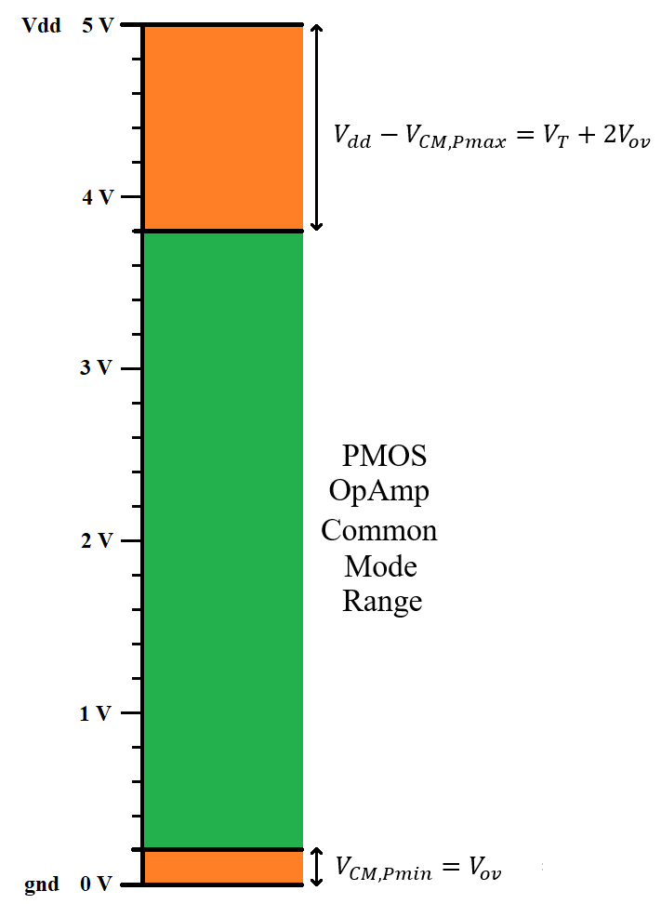
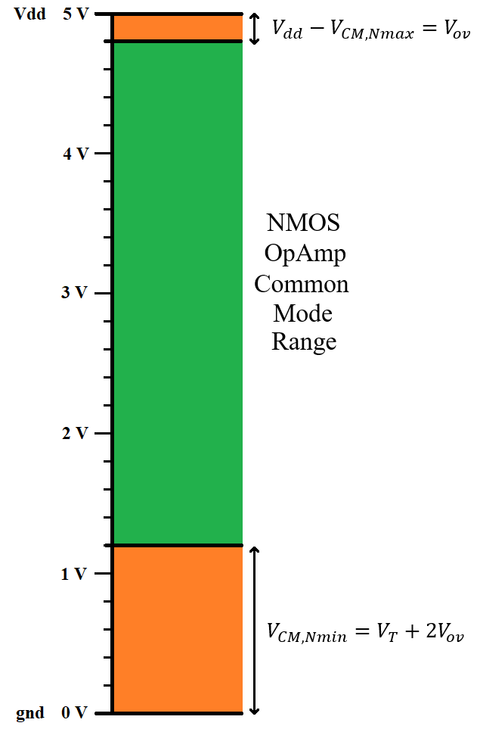
2 Stage Operational Amplifier – Common Mode Range

Slide 9
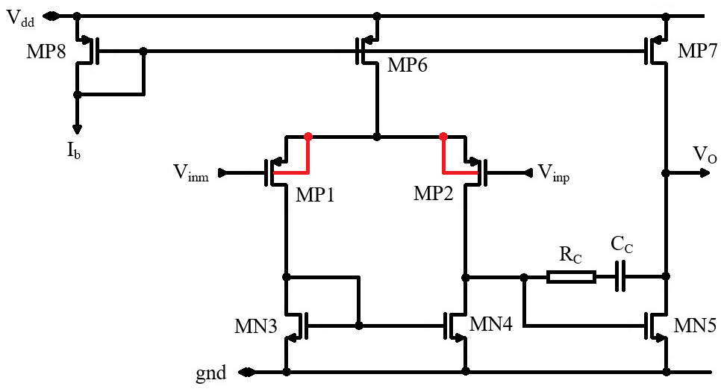
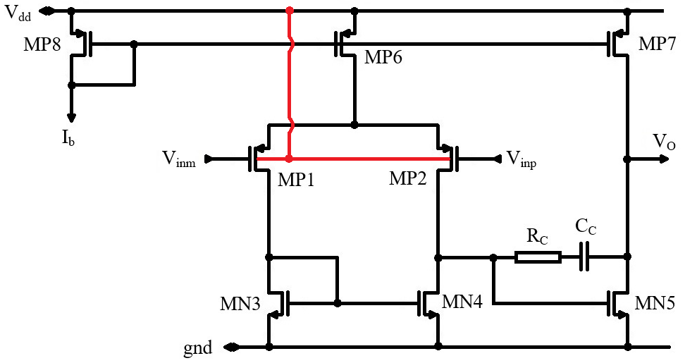
2 Stage Operational Amplifier – Common Mode Range
The common mode range can be shifted by using the substrate effect.
Let us use the PMOS differential pair OpAmp as example.
In this case, we can connect the differential pair transistors substrate to supply. This will introduce a substrate effect that will increase the differential pair threshold voltage.
$$V_{CM,Pmin}=V_{ov3}+V_{Tn}−V_{Tp}$$
Now V_{Tp} is definitely larger than V_{Tn} (due to the substrate effect) so the minimum common mode voltage is reduced.
This allows the PMOS differential pair common mode voltage range to even go below ground.
This technique can be used with the NMOS differential pair to increase the maximum common mode voltage to above supply.

Slide 10
Other Operational Amplifier Topologies
The 2 Stage OpAmp is one of the most popular OpAmp topologies and is typically the first topology presented in an OpAmp lecture. But it is not the only OpAmp topology!
In this lecture, beside the 2 Stage OpAmp, we shall briefly discuss 3 more topologies:
OTA – single stage transconductance amplifier
Telescopic Cascode OpAmp
Folded Cascode OpAmp

Slide 11
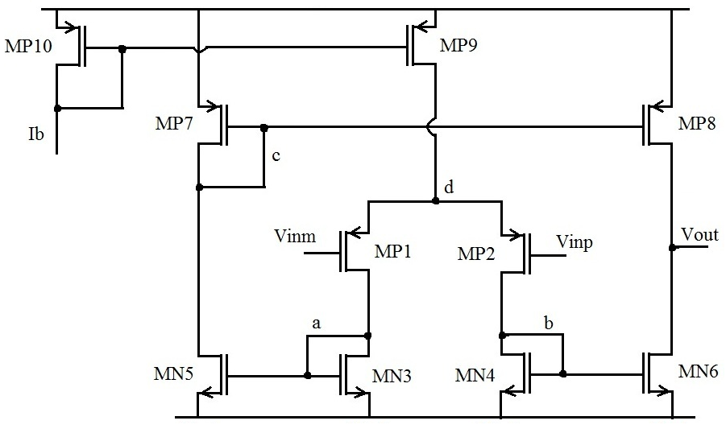
Other Operational Amplifier Topologies
OTA – Single Stage Operational Transconductance Amplifier

Slide 12
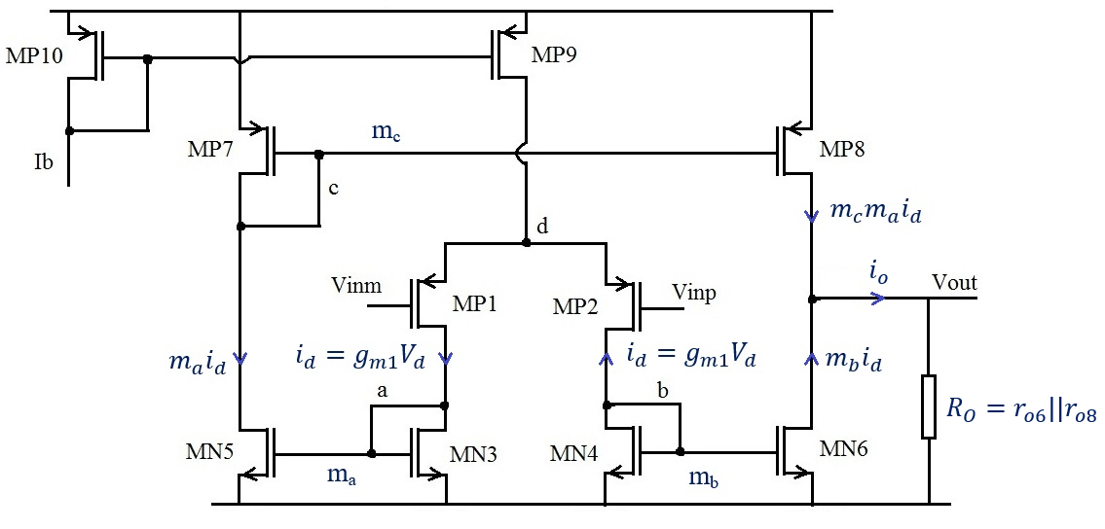
Other Operational Amplifier Topologies
OTA – Single Stage Operational Transconductance Amplifier
Gain estimation:
$$i_{o}={m_{c}m_{a}i_{d}+m}_{b}i_{d}$$
Both signal paths must have the same gain, so we need:
$${m_{c}m_{a}=m}_{b}=m$$
We get
$V_{o}=2mi_{d} R_{O}$= $m{ g}_{m1}R_{O} 2V_{d}$
$$A=m g_{m1}R_{O}$$
Stability:
The only high impedance node is in the output. This is where the dominant pole will be placed.

Slide 13
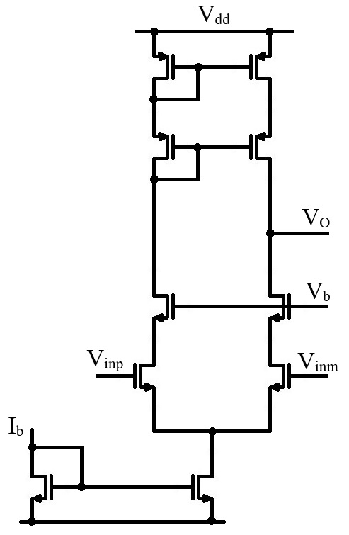
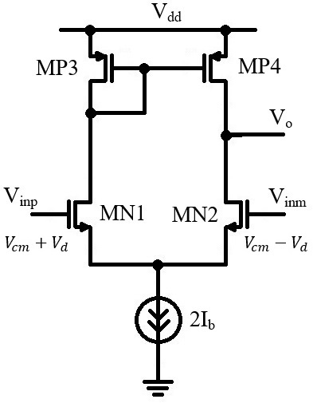
Other Operational Amplifier Topologies
Telescopic Cascode Operational Amplifier
This OpAmp topology is basically a differential pair stage with both the differential pair transistors and active load cascaded.

Slide 14
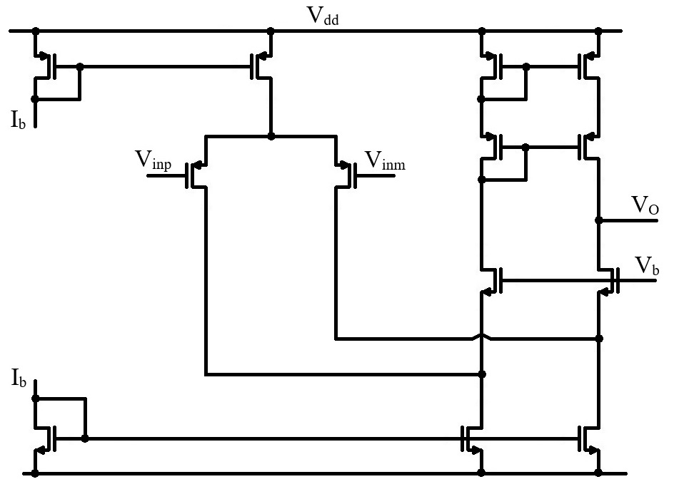
Other Operational Amplifier Topologies
Folded Cascode Operational Amplifier

Slide 15
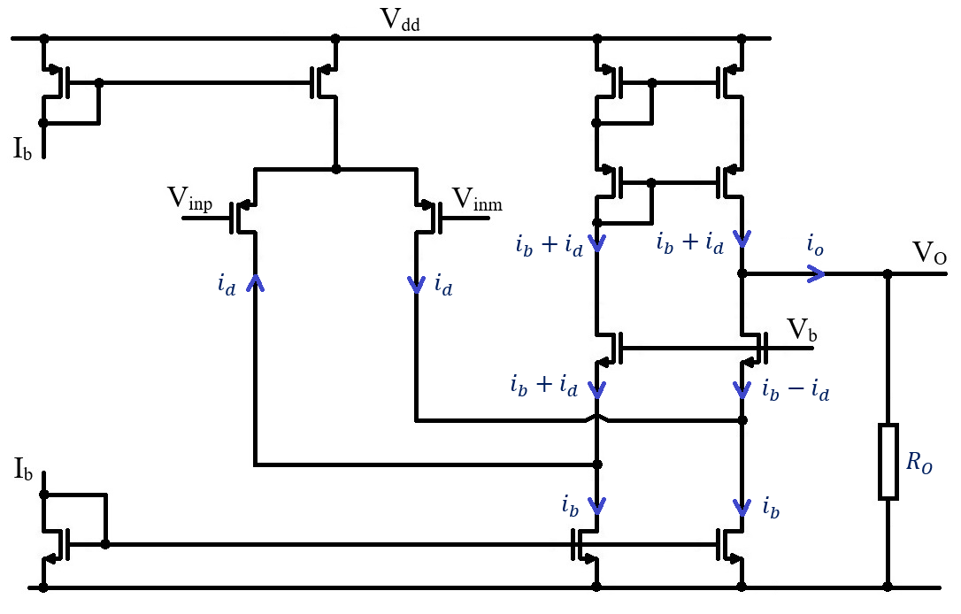
Other Operational Amplifier Topologies
Folded Cascode Operational Amplifier
Gain estimation:
$i_{o}=\left(i_{b}+i_{d}\right)−\left(i_{b}−i_{d}\right)=2$ $i_{d}$
$V_{o}=i_{o}R_{o}=2$ $i_{d}R_{o}$= $g_{m1}R_{o} 2V_{d}$
$$A=g_{m1}R_{o}$$
Stability:
The only high impedance node is in the output. This is where the dominant pole will be placed.

Slide 16
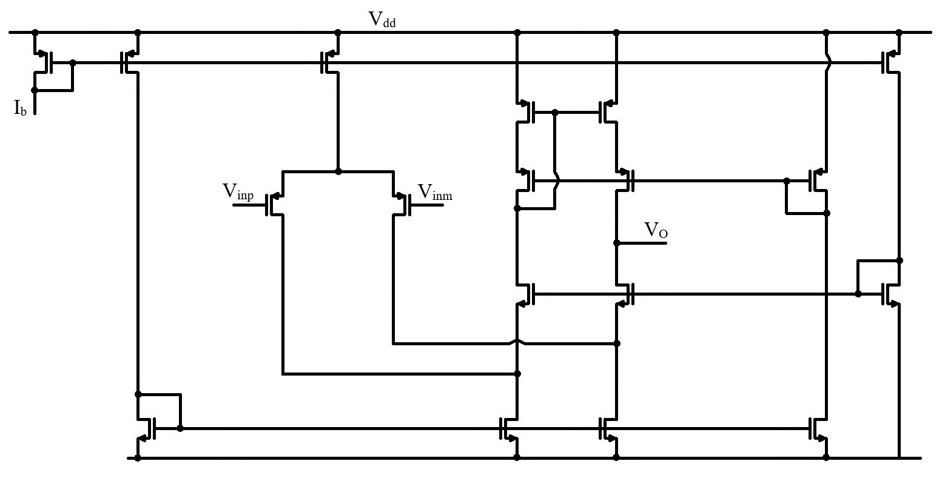
Other Operational Amplifier Topologies
Folded Cascode Operational Amplifier – with bias circuit

Slide 17
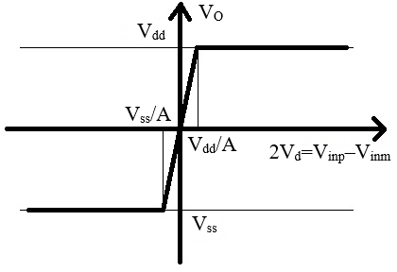
Operational Amplifier as a circuit component
The simplest OpAmp model is:
$$V_{O}=A_{0}\left(V_{inp}−V_{inm}\right)$$
Let us consider that our OpAmp is supplied between V_{dd} (positive supply) and V_{ss} (negative supply)
Most common cases are V_{ss}=–V_{dd} (differential supply) and V_{ss}=0 (asymmetric supply between V_{dd} and ground).
This model is ok around the equilibrium point (V_{inp}=V_{inm}) but the output voltage obviously cannot go above the positive supply voltage or below the negative supply voltage.
So o better model would be:
$$V_{O}=\left\{\begin{aligned}V_{ss} for V_{inp}−V_{inm}<\frac{V_{ss}}{A} \\ A_{0}\left(V_{inp}−V_{inm}\right) for \frac{V_{ss}}{A}<V_{inp}−V_{inm}<\frac{V_{dd}}{A} \\ V_{dd} for \frac{V_{dd}}{A}<V_{inp}−V_{inm} \end{aligned}\right.$$

Slide 18
Operational Amplifier as a circuit component
Most circuits are supplied between a positive supply, V_{dd}, and ground.
So it makes sense to see how the OpAmp model and characteristic look like for this case.
From the ideal OpAmp equation, V_{O}=A₀(V_{inp}–V_{inm}), we have
$$V_{inp}=V_{inm}$$
$$V_{O}=0$$
But this does not make much sense for an OpAmp supplied between V_{dd} and ground. V_{O}=0 corresponds to a totally unbalanced OpAmp (as zero is the negative supply in this case).
A much better choice is
$$V_{inp}=V_{inm}$$
$$V_{O}=\frac{V_{dd}}{2}$$
This is also what the OpAmp schematics discussed so far provide (in case they are perfectly balanced)
So the actual OpAmp equation, for the asymmetric supply case, is
$$V_{O}=A_{0}\left(V_{inp}−V_{inm}\right)+\frac{V_{dd}}{2}$$

Slide 19
Operational Amplifier as a circuit component
The output voltage cannot exceed V_{dd} or go below ground.
$$\left(V_{inp}−V_{inm}\right)=−\frac{V_{dd}}{2A_{0}}$$
$$V_{O}=0$$
$$\left(V_{inp}−V_{inm}\right)=\frac{V_{dd}}{2A_{0}}$$
$$V_{O}=V_{dd}$$
Sour our model results
$$V_{O}=\left\{\begin{aligned}0 for V_{inp}−V_{inm}<−\frac{V_{dd}}{2A} \\ A_{0}\left(V_{inp}−V_{inm}\right)+\frac{V_{dd}}{2} for −\frac{V_{dd}}{2A}<V_{inp}−V_{inm}<\frac{V_{dd}}{2A} \\ V_{dd} for \frac{V_{dd}}{2A}<V_{inp}−V_{inm} \end{aligned}\right.$$

Slide 20
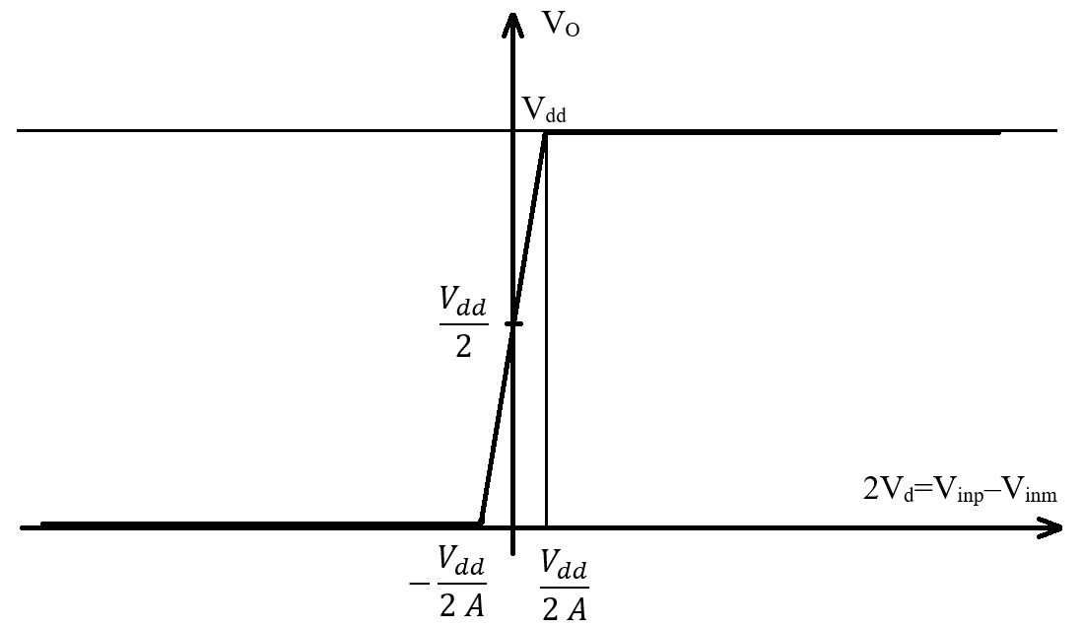
Operational Amplifier as a circuit component

Slide 21
Operational Amplifier as a circuit component
The next thing we do is to notice that
$$\lim_{A→∞}{\frac{V_{dd}}{2 A}}=\lim_{A→∞}{−\frac{V_{dd}}{2 A}=0}$$
In other words, if the OpAmp gain is high enough, the differential input voltage range for which the output is not saturated (to eider V_{dd} or ground) is very narrow.
We have two operation modes:
Open loop – if the opamp inputs are both controlled externally, independent one to the other, it is very unlikely they will be equal. So the opamp input will mostly be either stuck at Vdd (if V_{inp}>V_{inm}) or at ground (if V_{inp}<V_{inm})
Closed loop – if a negative feedback loop is used to control the output voltage, than the input voltages will be practically equal.
Numerical Example:
To make this more obvious, let us use some numbers.
As an example, we take V_{dd}=5V and A=10⁵.
$$\frac{V_{dd}}{2 A}=\frac{5 V}{2 {10}^{5}}=25 μV$$

Slide 22
Comparator
An OpAmp connected in an open loop configuration beaves as a comparator:
(1) If V_{inp}>V_{inm} (with at least V_{dd}/2A) then the output voltage will be at V_{dd} (logic “1”).
(0) If V_{inp}<V_{inm} (with at least V_{dd}/2A) then the output voltage will be at ground (logic “0”).
(X) There is a small undecided range (between –V_{dd}/2A and V_{dd}/2A) where the output voltage is in between supplied and ground (comparator output is not a digital signal).
(X)
(1)
$$V_{O}=\left\{\begin{aligned}0 for V_{inp}−V_{inm}<−\frac{V_{dd}}{2A} \\ A_{0}\left(V_{inp}−V_{inm}\right)+\frac{V_{dd}}{2} for −\frac{V_{dd}}{2A}<V_{inp}−V_{inm}<\frac{V_{dd}}{2A} \\ V_{dd} for \frac{V_{dd}}{2A}<V_{inp}−V_{inm} \end{aligned}\right.$$
(0)
(X)
(1)
(0)

Slide 23
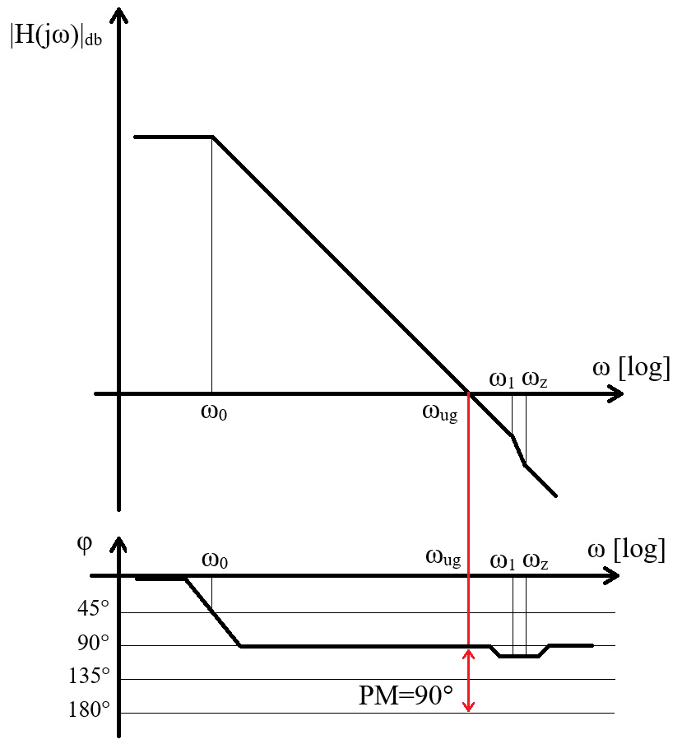
Comparator
As we have seen in the previous slide, an OpAmp connected in an open loop configuration beaves as a comparator.
But it is not a very good comparator!
An OpAmp is designed to be stable in a closed loop configuration. This means that (for a two stage OpAmp):
It has a Miller capacitor intended to crate a relatively low frequency dominant pole
It’s gain is kept low enough so that the unit frequency is below the second pole. This generally means that no more than 2 gain stages are used.
This two restrictions are very important for an OpAmp (meant to be stable in close loop conditions) but mean nothing to a comparator.
For a comparator:
The compensation capacitor only slows it down without any benefit (no stability problems in open loop).
Having a higher gain drastically reduces the “undecided range” with practically no drawback. (small delay introduced by additional gain stages).

Slide 24
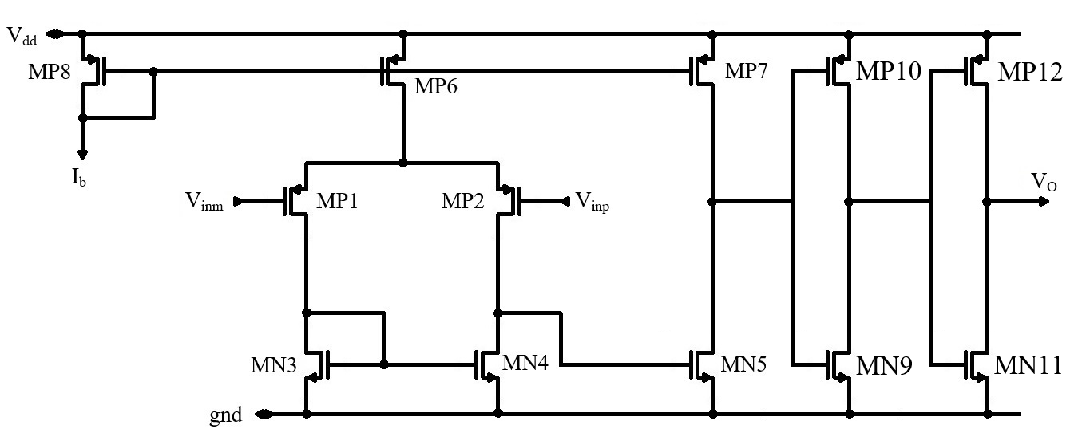
Comparator
A typical comparator based on the 2 Stage OpAmp removes the compensation network and adds 1 ore more inverters to the output to boost the gain. (In the example below, two inverters were used to keep the same positive and negative inputs as for the OpAmp. If an odd number of invertor is used, V_{inp} and V_{inm} must be swapped.)

