Slide 1
Operational Amplifier
FILS – Integrated Circuits

Slide 2
2 Stage Operational Amplifier
The 2 stage operation amplifier is one of the most common (largely used) operational amplifier topologies.
It is composed by a differential pair (as the first stage) and a common source stage (as the second stage).
There are two versions:
Pmos differential pair and nmos common source.
Nmos differential pair and pmos common source.
The two stages always use opposite transistor types (for voltage level compatibility).

Slide 3
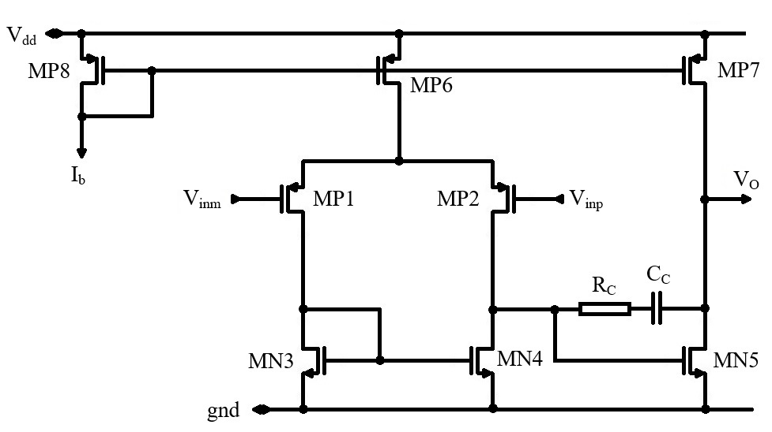
2 Stage Operational Amplifier
Differential pair stage
Common source stage

Slide 4
2 Stage Operational Amplifier
Bias current mirror diode
Differential pair tail current
Common source active load
Differential pair
Frequency Compensation
Differential pair active load
Common source

Slide 5
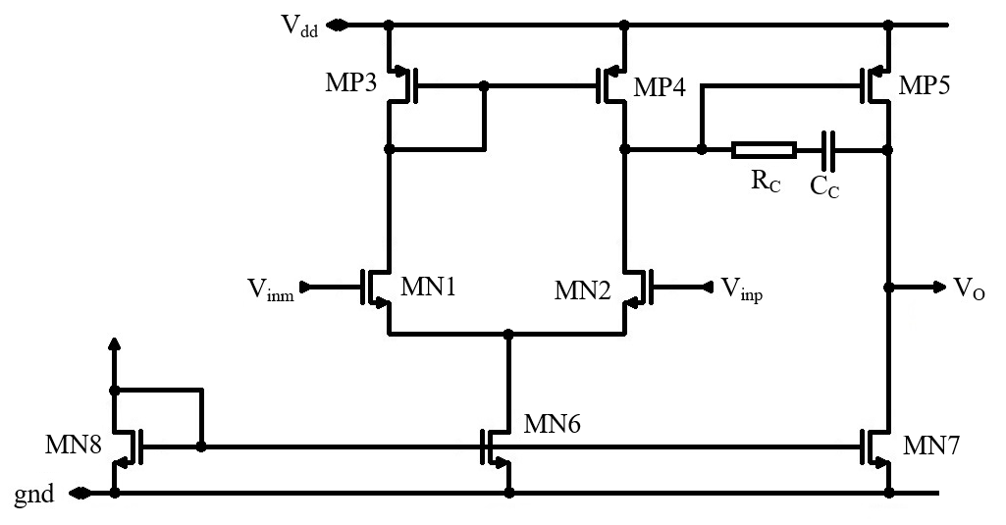
2 Stage Operational Amplifier
Differential pair stage
Common source stage

Slide 6
2 Stage Operational Amplifier – Positive and Negative Inputs
Positive and negative input.
I
V
V
V
I
I
I
V
I

Slide 7
2 Stage Operational Amplifier – Systematic Offset Cancelation
Systematic Offset Cancelation
At equilibrium, MN4 drain is at the same potential as MN3 drain/gate. In this conditions, MN5 works as if it is part of the MN3, MN4 current mirror.
To cancel the systematic offset, we need that, at equilibrium, the output is balanced (at V_{dd}/2) and both MN5 and MP7 are in saturation.
This is only possible if MN5 and MP7 “give the same current” (are biased such that their saturation currents match).
This is the systematic offset cancelation condition: MN5 and MP7 currents are the same at equilibrium.
MP7 current is given by I_{b} multiplied by MP8, MP7 current mirror ratio.
MP5 current is given by Ib multiplied by MP8, MP6 ratio, then divided by 2 (as only half of MP8 current goes to MN3), then multiplied by MN3, MN5 current mirror ratio.

Slide 8
2 Stage Operational Amplifier – Systematic Offset Cancelation
We remember that the current ratio given by a current mirror is equal to the W/L ratio between the mirror transistors. So, we have:
$$I_{D7}=\frac{{\left(W/L\right)}_{7}}{{\left(W/L\right)}_{8}}I_{b}$$
$$I_{D 6,7,8}=\frac{1}{2} μ_{p}C_{ox}{{\left(\frac{W}{L}\right)}_{6,7,8}\left(V_{gs}−V_{T}\right)}^{2}$$
$V_{gs6}=V_{gs7}$= $V_{gs8}$
$$I_{D6}=\frac{{\left(W/L\right)}_{6}}{{\left(W/L\right)}_{8}}I_{b}$$
At equilibrium, half of I_{D6} current goes to MN3
$$I_{D3}=\frac{1}{2}{ I}_{D6}$$
At equilibrium, MN5 acts as if it is part of the MN3, MN4 current mirror:
$$I_{D5}=\frac{{\left(W/L\right)}_{5}}{{\left(W/L\right)}_{3}}I_{D3}$$

Slide 9
2 Stage Operational Amplifier – Systematic Offset Cancelation
Now we put all this equations together:
$$I_{D7}=\frac{{\left(W/L\right)}_{7}}{{\left(W/L\right)}_{8}}I_{b}$$
$$I_{D5}=\frac{1}{2}\frac{{\left(W/L\right)}_{5}}{{\left(W/L\right)}_{3}}\frac{{\left(W/L\right)}_{6}}{{\left(W/L\right)}_{8}}I_{b}$$
The systematic offset cancelation condition requests that, at equilibrium, I_{D5}=I_{D7}. So we get:
$$\frac{{\left(W/L\right)}_{7}}{{\left(W/L\right)}_{8}}I_{b}=\frac{1}{2}\frac{{\left(W/L\right)}_{5}}{{\left(W/L\right)}_{3}}\frac{{\left(W/L\right)}_{6}}{{\left(W/L\right)}_{8}}I_{b}$$
Now we put all this equations together:
$$\frac{{\left(W/L\right)}_{7}}{{\left(W/L\right)}_{6}}=\frac{1}{2}\frac{{\left(W/L\right)}_{5}}{{\left(W/L\right)}_{3}}$$

Slide 10
2 Stage Operational Amplifier – Transfer Function
OpAmp Differential Gain
The operational amplifier is composed from a differential pair stage and a common source stage.
We know the differential pair (differential) gain: (note that V_{gs5} is the output of the first stage, we use A1 notation to denote the gain for the first stage)
$$A_{1}=\frac{V_{gs5}}{2V_{d}}{=−g}_{m1}\left({r_{o2}||r}_{o4}\right)$$
We know the common source stage gain
$$A_{2}=\frac{V_{O}}{V_{gs5}}{=−g}_{m5}\left({r_{o5}||r}_{o7}\right)$$
So the total OpAmp gain results:
$A_{0}=\frac{V_{O}}{2V_{d}}=\frac{V_{O}}{V_{gs5}}\frac{V_{gs5}}{2V_{d}}{=g}_{m1}\left({r_{o2}||r}_{o4}\right)$ $g_{m5}\left({r_{o5}||r}_{o7}\right)$
We introduce the R_{o1} and R_{o2} notations for the first and second stages output resistances
$$R_{o1}={r_{o2}||r}_{o4}$$
$$R_{o2}={r_{o5}||r}_{o7}$$
With this, we get:
$A_{0}=g_{m1}$ $R_{o1} g_{m5}R_{o2}$

Slide 11
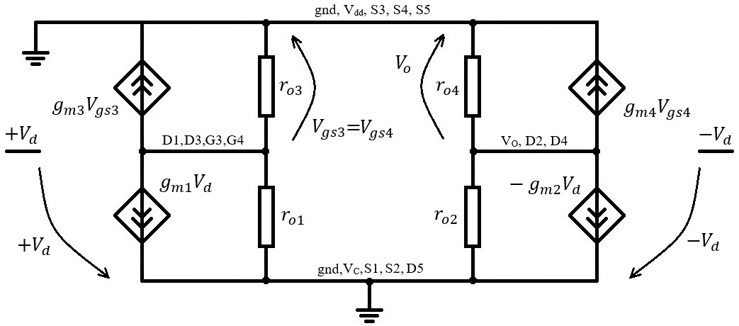
2 Stage Operational Amplifier – Transfer Function
Getting the transfer function is a little more difficult. First, let us build a (simplified) small signal equivalent circuit.
For this, we take the simplified differential pair and common source equivalent circuit (from previous lectures)
For the differential pair, we are only interested in the output node. We have already solved for V_{gs4}
$$V_{gs4}=−\frac{g_{m1}}{g_{m3}}V_{d}$$
$${g_{m4}V}_{gs4}=−g_{m4}\frac{g_{m1}}{g_{m3}}V_{d}={−g_{m1}V}_{d}$$
So the two voltage controlled current sources are actually identical and can be replaced by one g_{m1}2V_{d} source (we also dropped the minus sign as the “+” and “–” inputs are inverted in the OpAmp compared to the differential pair).
Beside the compensation network, we will also take into account the capacitances from the first and second stage outputs (C₁ and C₂ respectively).
Differential Pair Small Signal Equivalent Circuit
Common Source Small Signal Equivalent Circuit

Slide 12
2 Stage Operational Amplifier – Transfer Function
As usual, we write that the current going out from each node is zero.
$$g_{m1}{2V}_{d}+\frac{V_{gs5}}{Z_{1}}+\frac{V_{gs5}−V_{O}}{Z_{C}}=0$$
$$g_{m5}V_{gs5}+\frac{V_{O}}{Z_{2}}−\frac{V_{gs5}−V_{O}}{Z_{C}}=0$$
This may not look to complicated but the compensation network, Z_{C}, creates a feedback path over the second stage. As a result, the equations are coupled. (In all previous circuits we could solve the nodes one by one. Now we need to solve the equations as a system.)

Slide 13
2 Stage Operational Amplifier – Transfer Function
First, let us see why we need compensation in the first place. For this we remove the compensation and calculate the transfer function. As the compensation / feedback is removed, this is much easier to solve.
$$g_{m1}{2V}_{d}+\frac{V_{gs5}}{Z_{1}}=0$$
$$V_{gs5}=−g_{m1}{Z_{1} 2V}_{d}$$
$$g_{m5}V_{gs5}+\frac{V_{O}}{Z_{2}}=0$$
$$V_{O}=−g_{m5}Z_{2} V_{gs5}$$
Z₁ and Z₂ are given by:
$$Z_{1}=R_{o1}||\frac{1}{sC_{1}}=\frac{R_{o1}}{sC_{1}}\frac{1}{R_{o1}+\frac{1}{sC_{1}}}=\frac{R_{o1}}{sC_{1}}\frac{sC_{1}}{s{R_{o1}C}_{1}+1}=\frac{R_{o1}}{s{R_{o1}C}_{1}+1}$$
$$Z_{2}=\frac{R_{o2}}{s{R_{o2}C}_{2}+1}$$

Slide 14
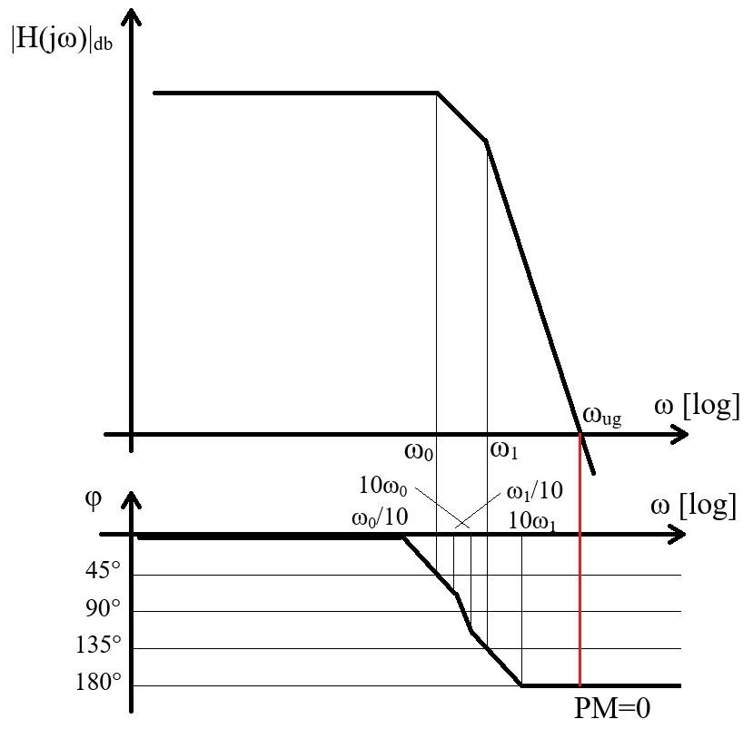
2 Stage Operational Amplifier – Transfer Function
Combining all this, we get.
$$H\left(s\right)=\frac{V_{O}}{{2V}_{d}}=\frac{{g_{m1}R}_{o1}{ g}_{m5}R_{o2}}{\left(1+s{R_{o1}C}_{1}\right)\left(1+s{R_{o2}C}_{2}\right)}$$
We have two poles (an no zero):
$$ω_{O}=\frac{1}{{R_{o1}C}_{1}}$$
$$ω_{1}=\frac{1}{{R_{o2}C}_{2}}$$
The problem with this is that the two poles result quite close together. R_{o1} and R_{o2} are both the output resistances of two MOS transistors (a nmos and a pmos) in parallel. Similarly, C₁ is mostly given by MN5 gate capacitance and C₂ is mostly given by the load capacitance. Here the difference can be larger but C₂ is quite likely to be also a gate capacitance.
This will result in an unstable system (or at least in a very low phase margin system) as soon as we place the OpAmp in a feedback loop.

Slide 15
2 Stage Operational Amplifier – Transfer Function
Miller Effect
We would like to determine the input equivalent capacitance for an inverter gain stage that has a capacitor connected in parallel.
The equivalence condition is that both capacitors (the real and the equivalent one) have the same charge. This makes sense as, from outside, we evaluate the capacitance based on how much charge flows into the node.
Capacitor voltage:
$$V_{C}=(A+1)∆V_{i}$$
$$V_{C}=∆V_{i}$$
Capacitor charge:
$$Q=CV_{C}=(A+1)C∆V_{i}$$
$$Q={C_{eq}V}_{C}=C_{eq}∆V_{i}$$
Equivalent capacitance:
$$C_{eq}=(A+1)C≅AC$$

Slide 16
2 Stage Operational Amplifier – Transfer Function
We note that the compensation capacitor C_{C} is indeed in parallel to the second gain stage, the common source.
This allows us to calculate the pole from first stage output, V_{gs5}, by replacing C_{C} with the equivalent Miller capacitance. (The big advantage is that the Miller equivalent capacitance is connected to ground so the V_{gs5} node equation is decoupled from V_{O} and thus easy to solve.)
The equivalent Miller capacitance is C_{C} multiplied by the second stage gain, g_{m5}R_{o2}. This is in parallel to C₁ and, as it is much larger, C₁ is usually neglected.
$$g_{m1}{2V}_{d}+\frac{V_{gs5}}{Z_{1}}=0$$
$$Z_{1}=R_{o1}||\frac{1}{s{g_{m5}R_{o2}C}_{C}}=\frac{R_{o1}}{1+s{g_{m5}R_{o1}R_{o2}C}_{C}}$$
$$V_{gs5}=−g_{m1}{Z_{1} 2V}_{d}$$
So we get:
$$V_{gs5}={\frac{−g_{m1}R_{o1}}{1+s{g_{m5}R_{o1}R_{o2}C}_{C}}2V}_{d}$$
$$ω_{0}=\frac{1}{{g_{m5}R_{o1}R_{o2}C}_{C}}$$

Slide 17
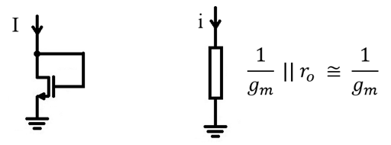
2 Stage Operational Amplifier – Transfer Function
The Miller capacitance also affects the output pole, but in a different way. The compensation capacitor connects MN5 gate and drain together. At frequencies much higher than ω₀ (the first pole), C_{C} can be considered a low impedance connection. Practically, we can consider MN5 having the gate and drain shorted (at high frequency only!)
This means MN5 appears as “diode connected” and we have seen that the equivalent output resistance of a diode connected mos transistor (“mos diode”) is 1/g_{m}. So we have a 1/g_{m5} resistance in parallel to R_{o2}. 1/g_{m5} is much smaller than R_{o2} so R_{o2} can be neglected.
A second effect is that C₁ appears also connected to the output (as V_{gs5} and V_{O} nodes are practically shorted at this frequency). So the total capacitance seen in the output node is C₁+C₂.
The second pole frequency results:
$$ω_{1}=\frac{g_{m5}}{C_{1}+C_{2}}$$
There is also a zero, given by:
$$ω_{z}=\frac{−1}{C_{C}\left(\frac{1}{g_{m5}}−R_{C}\right)}$$

Slide 18
2 Stage Operational Amplifier – Transfer Function
In conclusion, the OpAmp transfer function is given by:
$$H\left(s\right)=\frac{V_{O}}{{2V}_{d}}=\frac{A_{0}\left(1+\frac{s}{ω_{z}}\right)}{\left(1+\frac{s}{ω_{0}}\right)\left(1+\frac{s}{ω_{1}}\right)}$$
where:
$A_{0}=g_{m1}$ $R_{o1} g_{m5}R_{o2}$
$$ω_{0}=\frac{1}{{g_{m5}R_{o1}R_{o2}C}_{C}}$$
$$ω_{1}=\frac{g_{m5}}{C_{1}+C_{2}}$$
$$ω_{z}=\frac{−1}{C_{C}\left(\frac{1}{g_{m5}}−R_{C}\right)}$$

Slide 19
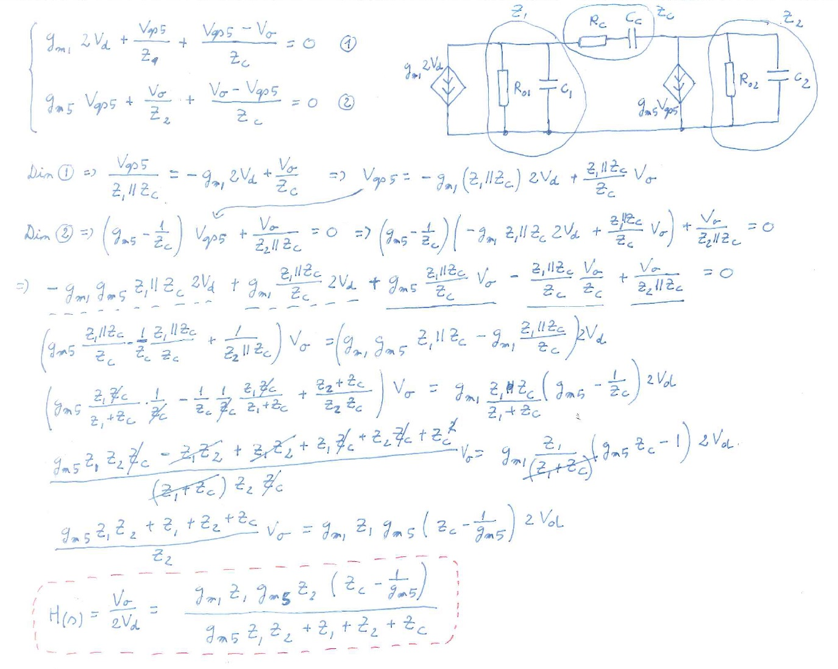
2 Stage Operational Amplifier – Transfer Function

Slide 20
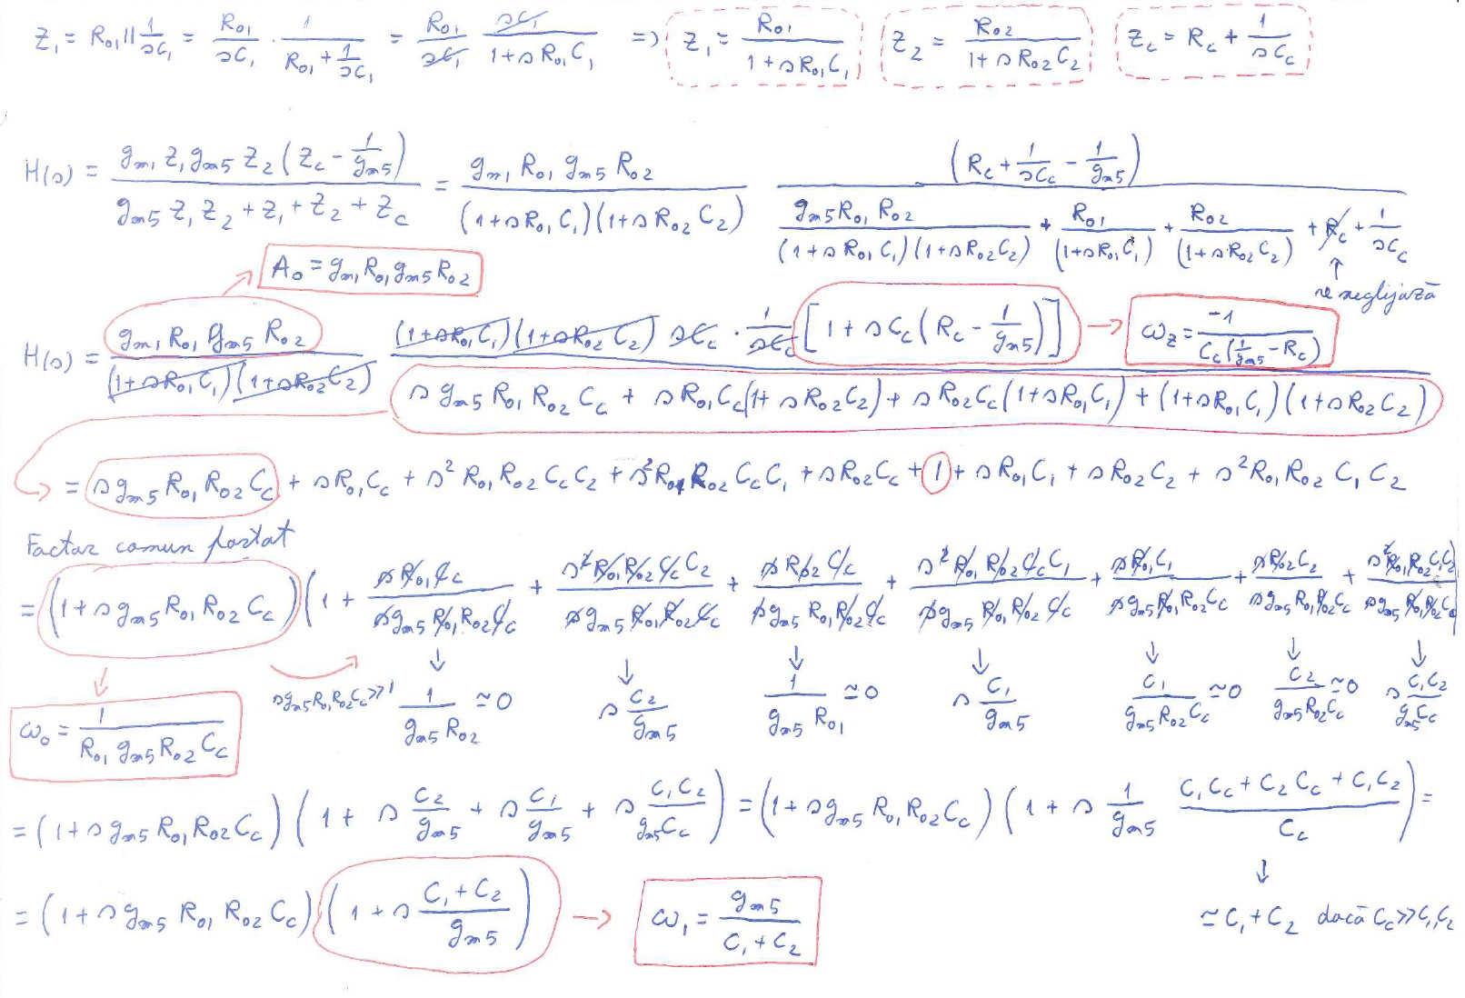
2 Stage Operational Amplifier – Transfer Function

Slide 21
2 Stage Operational Amplifier – Transfer Function
Now to draw the transfer function.
First, we assume ω₁ is much larger than ω₀. This is a reasonable assumption as g_{m5}R_{o1}R_{o2}>>1/g_{m5}.
We can rewrite ω₀ as:
$$ω_{0}=\frac{1}{{g_{m5}R_{o1}R_{o2}C}_{C}}=\frac{g_{m1}}{{g_{m1}R_{o1}{g_{m5}R}_{o2}C}_{C}}=\frac{g_{m1}}{{A_{0}C}_{C}}$$
$$ω_{0}=\frac{g_{m1}}{{A_{0}C}_{C}}$$
Now to calculate the unity gain frequency, ω_{ug}.
$$\left|H\left(ω_{ug}\right)\right|=\frac{A_{0}\left|1+j\frac{ω_{ug}}{ω_{z}}\right|}{\left|1+j\frac{ω_{ug}}{ω_{0}}\right|∙\left|1+j\frac{ω_{ug}}{ω_{1}}\right|}=\frac{A_{0}\sqrt{1+{\left(\frac{ω_{ug}}{ω_{z}}\right)}^{2}}}{\sqrt{1+{\left(\frac{ω_{ug}}{ω_{0}}\right)}^{2}}∙\sqrt{1+{\left(\frac{ω_{ug}}{ω_{1}}\right)}^{2}}}$$
We assume that ω_{ug} is (much) higher than ω₀ and (much) lower than ω₁ and ω_{z}.
$$\left|H\left(ω_{ug}\right)\right|=\frac{A_{0}}{\frac{ω_{ug}}{ω_{0}}}=\frac{A_{0}{ ω}_{0}}{ω_{ug}}$$

Slide 22
2 Stage Operational Amplifier – Transfer Function
But, by definition (of the unity gain frequency)
$$\left|H\left(ω_{ug}\right)\right|=1$$
So we get
$ω_{ug}=$ $A_{0}ω_{0}$
$$ω_{0}=\frac{g_{m1}}{{A_{0}C}_{C}}$$
$$ω_{ug}=\frac{g_{m1}}{C_{C}}$$
Now we come back to our assumption that ω_{ug} is (much) lower than ω₁.
This is now a design requirement!
$$\frac{g_{m1}}{C_{C}}>\frac{g_{m5}}{C_{1}+C_{2}}$$

Slide 23
2 Stage Operational Amplifier – Transfer Function
Now let us discuss the zero.
If we do not use compensation resistor, R_{C}=0, we have:
$$ω_{z}=−\frac{g_{m5}}{C_{C}}$$
This corresponds to a right plane zero, that leads to a phase decrease.
$$\left(1−jω\frac{C_{C}}{g_{m5}}\right) → φ=arctan\left(−\frac{ω C_{C}}{g_{m5}}\right) → φ→−90° when ω→∞$$
We really don’t like this! This brings the phase down so it leads to instability.
This is why we introduce the compensation resistor, in order to adjust the zero frequency.
$$ω_{z}=\frac{−1}{C_{C}\left(\frac{1}{g_{m5}}−R_{C}\right)}$$
A first option is to design R_{C}=1/g_{m5} and cancel de zero completely (move it to extremely high frequencies).
An even better option is to design R_{C}>1/g_{m5} and move the zero to the left plane. This is much better because in this case the zero will bring the phase up (the arctan argument becomes positive so it will go to +90° at high ω).
Usually, R_{C} is sized such that the zero is placed slightly above the second pole.

Slide 24
2 Stage Operational Amplifier – Transfer Function
We note that MN3 gate node also introduces a pole.
Expected pole frequency is (as usual)
$$ω_{3}=\frac{1}{{R_{eq3}C}_{eq3}}$$
Where R_{eq3} and C_{eq3} are the equivalent resistance and capacitance between MN3 gate and ground.
As MN3 is diode connected, the resistance to ground will be given by 1/g_{m3}.
The capacitance is mainly given by Cgs3 and Cgs4.
So we get
$$ω_{3}=\frac{g_{m3}}{C_{gs3}+C_{gs4}}$$
We see that this is relatively high frequency as 1/g_{m3} is a small resistance. (But so is ω₁)
However, this pole appears only on the V_{inm} path. V_{inp} signal is not passing MN3 gate.
Having this two different signal paths results in a zero (at the frequency when the signals travelling on this two paths cancels each other).
The conclusion is that the MN3 gate introduces a high frequency pole – zero pair.

Slide 25
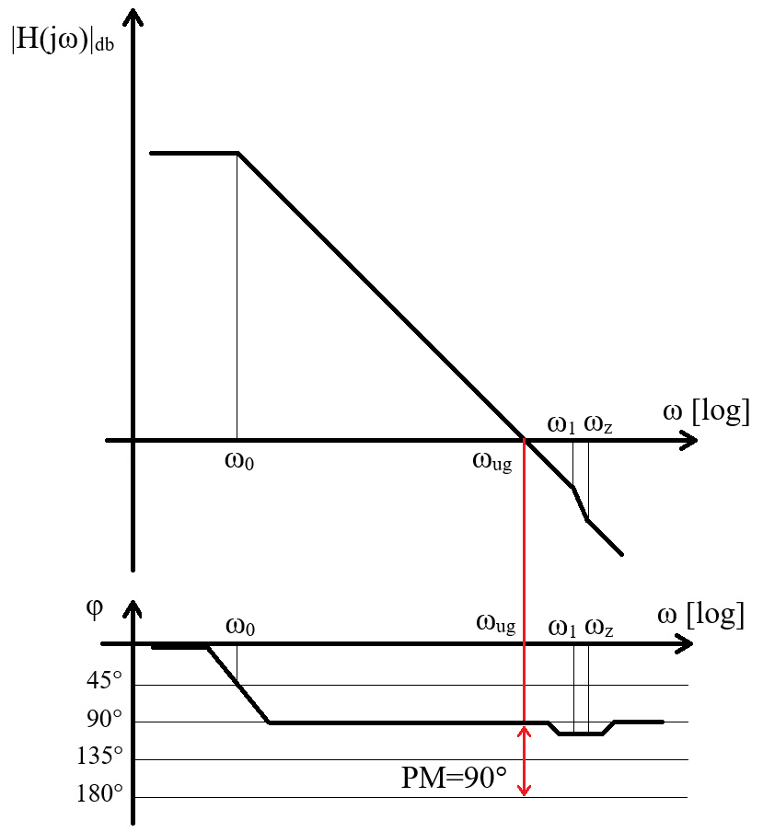
2 Stage Operational Amplifier
Assumptions:
ω₁ is at least 10 times larger than ω_{ug}.
ω_{z} is slightly (less then 10 times) higher than ω₁.
Comments:
At high frequencies this graph is not realistic. We only considered the two poles and one zero discussed in this lecture. But at higher frequencies, other poles will appear and the phase will drop (the gain will also drop faster than predicted by this graph).
The graph is however realistic up to second pole and can be safely used to determine the phase margin.
While a 90° phase margin can be achieved, it is usually not desired. It costs requires a bigger compensation capacitance and makes the opamp slower. The usual target for the phase margin is usually lower (at about 75°).

Slide 26
2 Stage Operational Amplifier – Common Mode Gain
OpAmp Common Mode Gain
The operational amplifier is composed from a differential pair stage and a common source stage.
Ideally, the differential pair has zero common mode gain (the common mode is completely rejected)
$$A_{1, CM}=\frac{V_{gs5}}{V_{CM}}=0$$
We know the common source stage gain
$$A_{2}=\frac{V_{O}}{V_{gs5}}{=g}_{m5}\left({r_{o5}||r}_{o7}\right)$$
Due to the first stage common mode rejection, the total common mode gain also results zero:
$$A_{0}=\frac{V_{O}}{V_{CM}}=A_{1,CM}A_{2}=0$$
However, it is important to remember that the differential pair gain is zero only as a first approximation!
If we take into account the small asymmetries (systematic and random) there will be a small but finite common mode gain. This means that some of the differential signal will reach the second stage.
The second stage is asymmetric – it does not know that the signal at it’s input was produced by a differential or a common mode signal – it will amplify everything with A₂.

