Slide 1
Differential Pair
FILS – Integrated Circuits

Slide 2
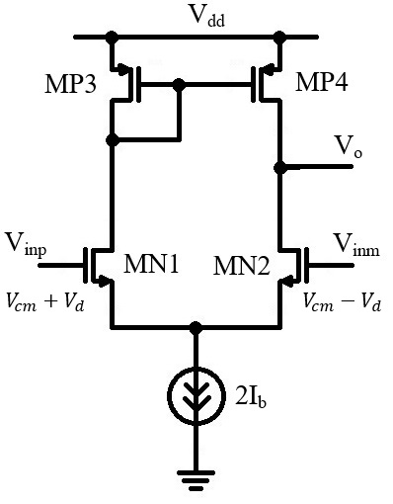
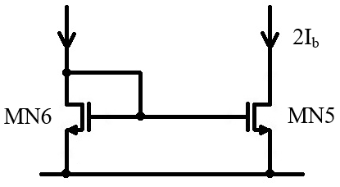
Differential Pair – Small Signal Analysis
We replace all transistors with their small signal equivalent circuit.
The 2I_{b} current source is implemented using a current mirror.
As we have seen in previous lectures, a bias current mirror can be replaced with the output resistance (in this case, r_{o5}).
MOS transistor small signal equivalent circuit:

Slide 3
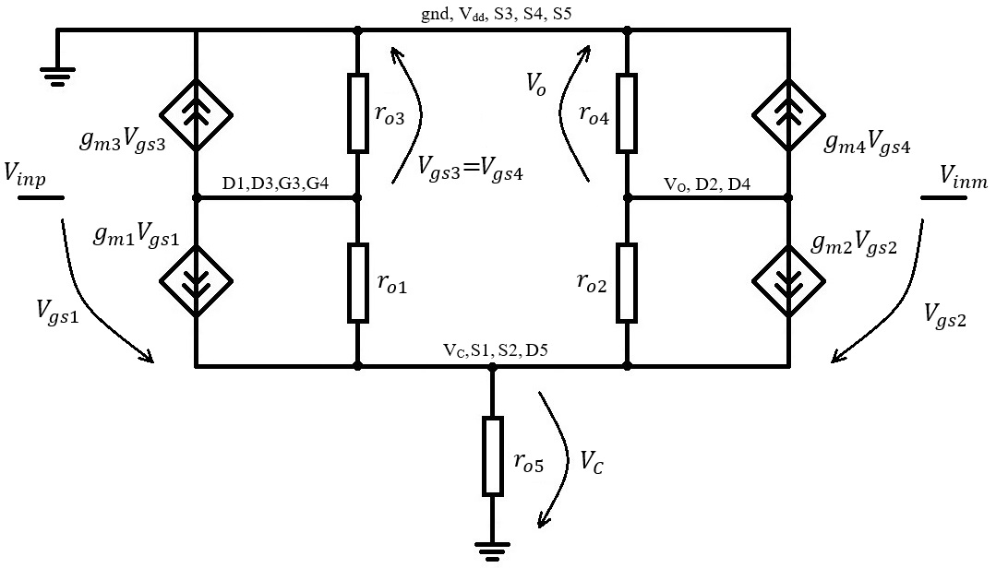
Differential Pair – Small Signal Analysis
The small signal equivalent circuit results:

Slide 4
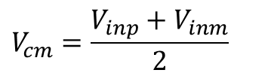
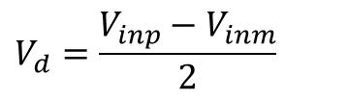


Differential Pair – Small Signal Analysis
Instead of solving this for V_{inp} and V_{inm}, we will solve for the differential and common mode.
They are defined as:
$$V_{d}=\frac{V_{inp}−V_{inm}}{2}$$
$$V_{cm}=\frac{V_{inp}+V_{inm}}{2}$$
Resulting in:
$$V_{inp}=V_{cm}+V_{d}$$
$$V_{inm}=V_{cm}−V_{d}$$
We will split the analysis in:
  Differential Mode – we assume only a differential small signal is applied (common mode signal is kept constant so the small signal component is zero)
  Common Mode – we assume only a common mode signal is applied (inputs are tied together)
The analysis is performed around the equilibrium point.

Slide 5
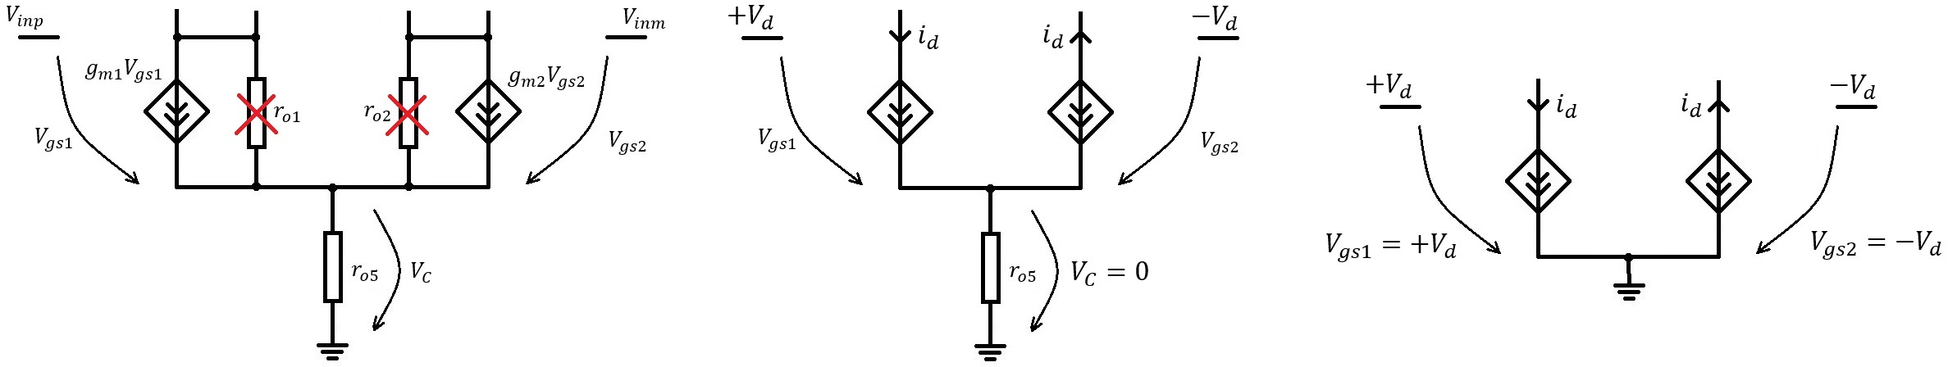

Differential Pair – Small Signal Analysis
Differential Mode Small Signal Equivalent Circuit:
We assume a differential signal to be applied.
By symmetry we can deduce that the two differential transistors will give equal and opposite directions currents.
We apply Kirchhoff I low to the common node, V_{c}, and we deduce that no current if flowing through the r_{o5} resistor.
This means that the common mode voltage is zero in the differential mode
$$V_{C}=0$$
This allows us to simplify the circuit by eliminating r_{o5} and directly connecting the MN1, MN2 sources to ground.
Again, this is valid only in the differential mode.

Slide 6
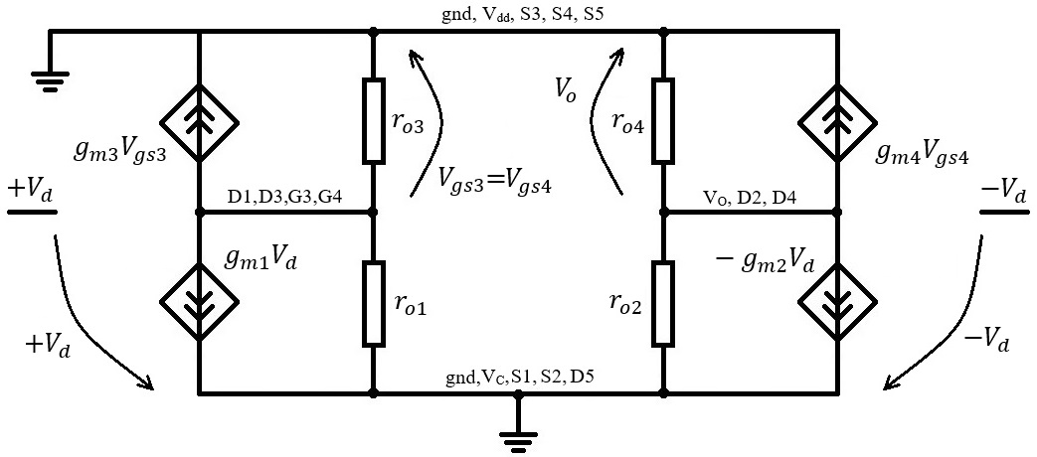
Differential Pair – Small Signal Analysis
The differential mode small signal circuit results:

Slide 7
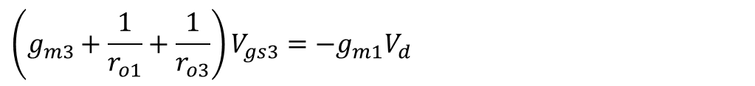
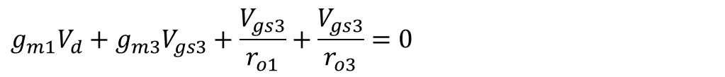
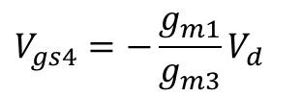
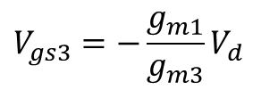
Differential Pair – Small Signal Analysis
We will first solve for G3 node (D1, D3, G3, G4 node).
As always, we write that the sum of the currents going out of the node is zero:
$$g_{m1}V_{d}+g_{m3}V_{gs3}+\frac{V_{gs3}}{r_{o1}}+\frac{V_{gs3}}{r_{o3}}=0$$
$$\left(g_{m3}+\frac{1}{r_{o1}}+\frac{1}{r_{o3}}\right)V_{gs3}=−g_{m1}V_{d}$$
We consider g_{m3} much largen than 1/r_{o1,3} (similar to previous lectures) and we get:
$$V_{gs3}=−\frac{g_{m1}}{g_{m3}}V_{d}$$
But, as G3 is the same as G4 (also both S3 and S4 are connected to ground), we have:
$$V_{gs4}=−\frac{g_{m1}}{g_{m3}}V_{d}$$

Slide 8
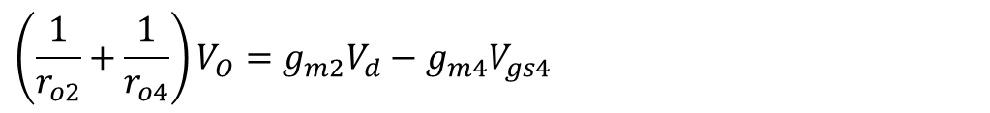
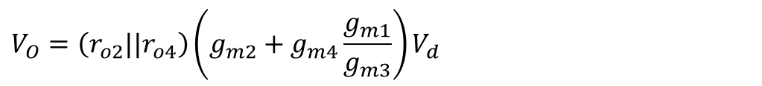
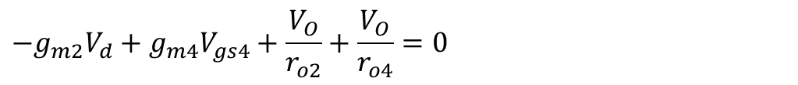
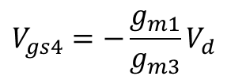
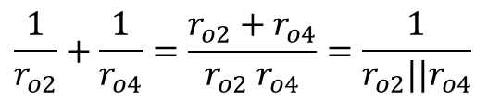
Differential Pair – Small Signal Analysis
Now we use the same method to solve for the output node (V_{O}, D2, D4).
$${−g}_{m2}V_{d}+g_{m4}V_{gs4}+\frac{V_{O}}{r_{o2}}+\frac{V_{O}}{r_{o4}}=0$$
$$\left(\frac{1}{r_{o2}}+\frac{1}{r_{o4}}\right)V_{O}=g_{m2}V_{d}−g_{m4}V_{gs4}$$
But we have
$$\frac{1}{r_{o2}}+\frac{1}{r_{o4}}=\frac{{r_{o2}+r}_{o4}}{{r_{o2} r}_{o4}}=\frac{1}{{r_{o2}||r}_{o4}}$$
$$V_{gs4}=−{\frac{g_{m1}}{g_{m3}}V}_{d}$$
So we get
$$V_{O}=\left({r_{o2}||r}_{o4}\right)\left(g_{m2}V_{d}−g_{m4}V_{gs4}\right)$$
$$V_{O}=\left({r_{o2}||r}_{o4}\right)\left(g_{m2}+g_{m4}\frac{g_{m1}}{g_{m3}}\right)V_{d}$$

Slide 9

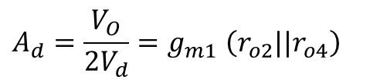
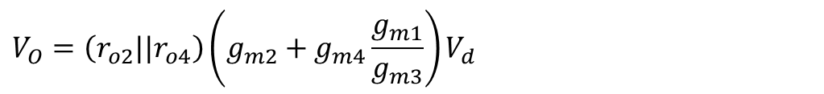



Differential Pair – Small Signal Analysis
Now we have to take into account that:
The differential pair transistors, MN1 and MN2 are identical and, at equilibrium, they are biased at the same current, I_{b}. As a result, they have equal transconductances:
$$g_{m1}=g_{m2}$$
The MP3, MP4 current mirror transistors are identical and, at equilibrium, they are biased at the same current, I_{b}. As a result, they have equal transconductances:
$$g_{m3}=g_{m4}$$
This are very important conditions! As previously discussed, the differential pair relies heavily on symmetry.
With this, we get:
$$g_{m1}$$
$$V_{O}=\left({r_{o2}||r}_{o4}\right)\left(g_{m2}+g_{m4}\frac{g_{m1}}{g_{m3}}\right)V_{d}$$
$$V_{O}{=g}_{m1}\left({r_{o2}||r}_{o4}\right) 2V_{d}$$
The differential gain results: (remember, the actual difference between inputs is V_{inp} – V_{inm}=2V_{d})
$$A_{d}=\frac{V_{O}}{2V_{d}}{=g}_{m1}\left({r_{o2}||r}_{o4}\right)$$

Slide 10
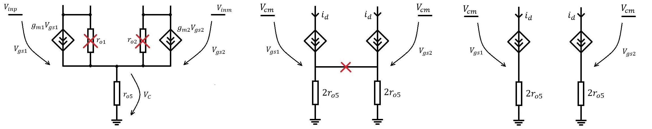
Differential Pair – Small Signal Analysis
Common Mode Small Signal Equivalent Circuit:
We assume that the two inputs are equal (V_{inp}=V_{inm}) and a small signal variation is applied to their common value.
By symmetry we can deduce that the two differential transistors will give equal currents.
We can imagine that the r_{o5} resistor is formed by two parallel 2r_{o5} resistors . The two resistor will have equal currents as well (same value and same voltage drop).
This means that the current from one differential transistor will flow through one 2r_{o5} of the resistors and the current from the other differential transistor, through the other.
This means that there is no current flowing between the two branches. We can eliminate this connection without changing the circuit operation.
With this trick, we have separated the two differential transistors for the common mode analysis.

Slide 11
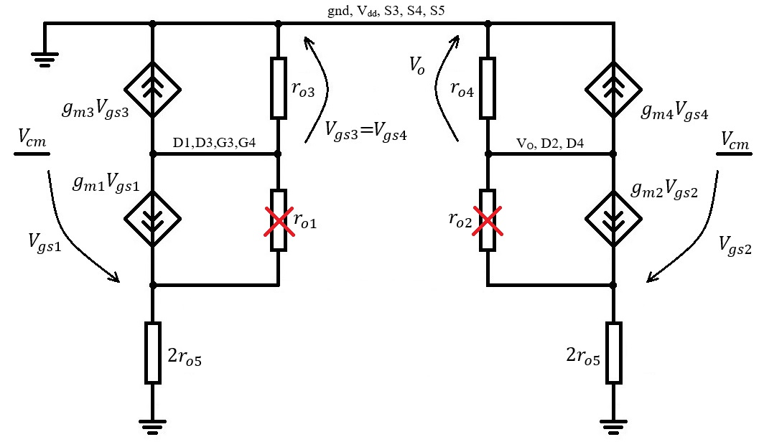
Differential Pair – Small Signal Analysis
The common mode small signal circuit results:

Slide 12
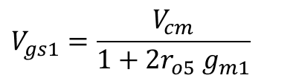

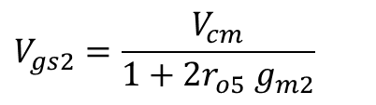
Differential Pair – Small Signal Analysis
To simplify the analysis (and to get the desired answer) we will continue to ignore r_{o1} and r_{o2} resistors.
We first need to determine V_{gs1}:
$V_{cm}=V_{gs1}+2r_{o5} g_{m1}V_{gs1}=\left(1+2r_{o5} g_{m1}\right)$ $V_{gs1}$
$$V_{gs1}=\frac{V_{cm}}{1+2r_{o5} g_{m1}}$$
We note that we can write exactly the same equation for the MN2 branch and get the same result.
$V_{cm}=V_{gs2}+2r_{o5} g_{m2}V_{gs2}=\left(1+2r_{o5} g_{m2}\right)$ $V_{gs2}$
$$V_{gs2}=\frac{V_{cm}}{1+2r_{o5} g_{m2}}$$
For the differential mode, the two V_{gs} voltages were equal to the plus/minus differential voltage applied.
For the common mode, the two V_{gs} voltages are not directly equal to the common mode voltage but they are equal one to the other and proportional to V_{cm}.
We will not care to much on the V_{gs1} and V_{gs2} value, the important results is that they are equal.
$V_{gs1}=$ $V_{gs2}$

Slide 13
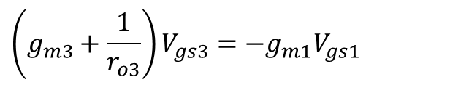
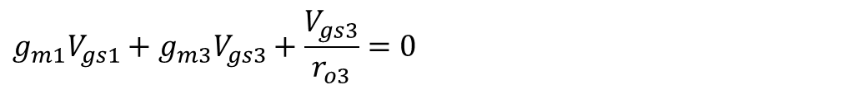
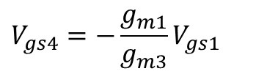
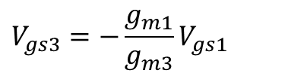
Differential Pair – Small Signal Analysis
Now we can solve for G3 node (D1, D3, G3, G4 node).
$$g_{m1}V_{gs1}+g_{m3}V_{gs3}+\frac{V_{gs3}}{r_{o3}}=0$$
$$\left(g_{m3}+\frac{1}{r_{o3}}\right)V_{gs3}=−g_{m1}V_{gs1}$$
As before, we consider g_{m3} much largen than 1/r_{o3} and we get:
$$V_{gs3}=−\frac{g_{m1}}{g_{m3}}V_{gs1}$$
But, as G3 is the same as G4 (also both S3 and S4 are connected to ground), we have:
$$V_{gs4}=−\frac{g_{m1}}{g_{m3}}V_{gs1}$$

Slide 14



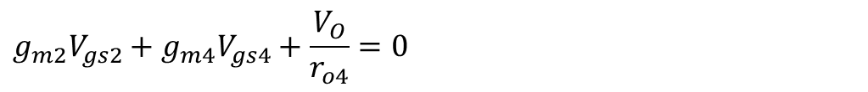

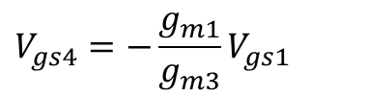


Differential Pair – Small Signal Analysis
Now we solve for the output node (V_{O}, D2, D4).
$$g_{m2}V_{gs2}+g_{m4}V_{gs4}+\frac{V_{O}}{r_{o4}}=0$$
$$V_{O}=−r_{o4}\left(g_{m2}V_{gs2}+g_{m4}V_{gs4}\right)$$
Now we replace V_{gs4} and we use the fact V_{gs1}=V_{gs2}.
$$V_{O}=−r_{o4}\left(g_{m2}V_{gs2}+g_{m4}V_{gs4}\right)$$
$V_{gs1}=$ $V_{gs2}$
$$V_{gs4}=−\frac{g_{m1}}{g_{m3}}V_{gs1}$$
$V_{O}=r_{o4}\left(g_{m4}\frac{g_{m1}}{g_{m3}}−g_{m2}\right)$ $V_{gs1}$
But, due to symmetry, at equilibrium, we have
$$g_{m1}=g_{m2}$$
$$g_{m3}=g_{m4}$$
So all terms cancel out and we get

Slide 15
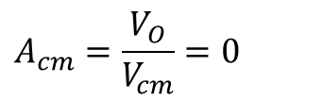

Differential Pair – Small Signal Analysis
So all terms cancel out and we get
$$V_{O}=0$$
This also means that the common mode gain is zero.
$$A_{cm}=\frac{V_{O}}{V_{cm}}=0$$
This is an ideal result, not an accurate result!
If we take into account any of the factors neglected in this analysis, the two terms will no longer perfectly cancel and we will get a small but non-zero common mode gain.
But it is important to get to this result so that we can highlight that idea that the differential pair amplifies the differential signal while rejecting the common mode signal.
It is also important to see that the reason we get zero common mode gain is because the two signal paths cancel each other. In order to have a very low common mode gain we need to have good matching between the two paths.
Non idealities that lead to a finite common mode gain:
  The voltage drop on r_{o1} and r_{o2} is not the same, so they will introduce a current mismatch between the MN1 and MN2 branches.
  The impedance in G3 node is not exactly 1/g_{m3} (we have neglected r_{o3}). This means that we do not get the perfect g_{m4}, g_{m3} cancelation.
  Any mismatch between g_{m1} and g_{m2} or g_{m3} and g_{m4} would lead to common mode gain.

Slide 16



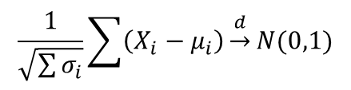
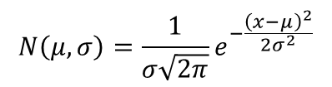
Legea numerelor mari / Teorema limitei centrale
Legea numerelor mari
Legea numerelor mari afirma ca orice sir infinet de esantioane ale unei variabile aleatoare (integrabile in sens Lebesque) converge (in probabilitate – Pr) catre valoarea medie a variabiei aleatoare.
Week Low
Strong Low
Media esantioanelor
Teorema limitei centrale
Teorema limitei centrale afirma ca, in “anumite conditii”, variabila aleatoare obtinuta prin mediarea a unui numar suficient de mare de variabile aleatoare independente (cu mediile si dispersiile bine definite) tinde catre o distirbutie normala, indiferent de distributia variabilelor aleatoare componente.
Exista mai multe formulari (Lyapunov, Lindeberg, Levy) care definesc ce se intelege prin “anumite conditii” si modul de convergenta
Formularea Lyapunov
Normal distribution

Slide 17
Process Variation
Process Variations occur during (each step of) the technological process.
Examples of process variations: mask misalignment, oxide thickens variation, crystallin defects, impurities caught in the oxide, variation in the corrosion processes, …
We have to consider:
  Variations on the same transistor that occur between different wafers / lots (let us consider a generic M1 transistor from our design. We produce more wafers in different lots with this design. On each chip there is a M1 transistor but, due to process variation between wafers/lots, the M1 transistor will have slightly different parameters from chip to chip)
  Variations across the wafer (process parameters will vary across the wafer so transistors that are designed to be identical will not have the same parameters)
We will use as an example the threshold voltage, V_{T}, but process variations affect all parameters.

Slide 18
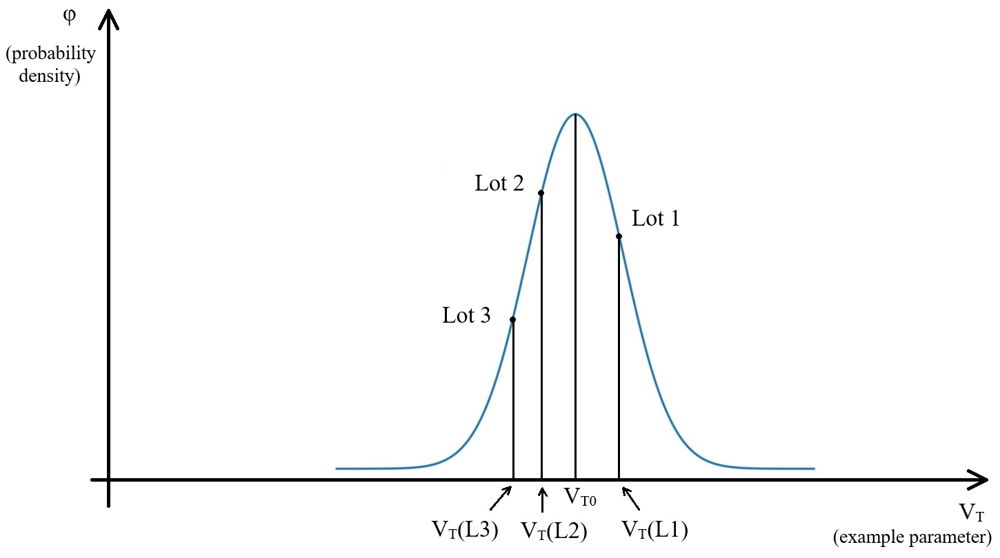
Process Variation

Slide 19
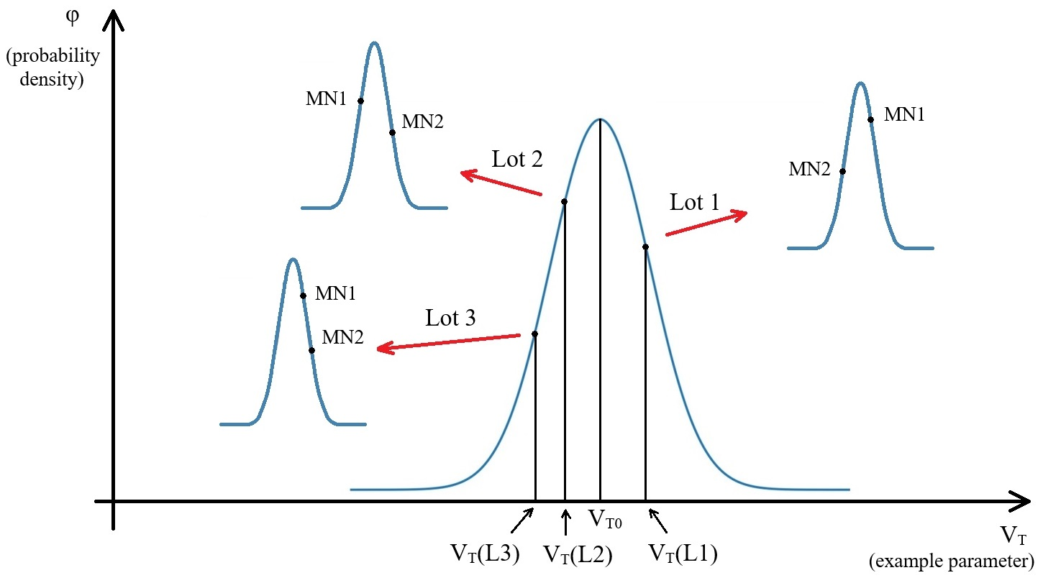
Process Variation

Slide 20
Process Variation
We shall now discuss how can process variations be taken into account during simulations.
There are two main methods: Corners and Monte Carlo
Technological Corners
  Besides the nominal model (based on the centered process) we define corner models that should reflect the extremities of the process.
  Typically corners are defined with digital simulations in mind and are “fast” (all transistor parameters are adjusted for fastest commutation) and “slow” (adjusted for slowest commutation)
  This is considered independent for NMOS and PMOS transistors, leading to ss, sf, fs, ff combinations.
Typical Corners Definition
 |  | PMOS
NMOS |  | Slow | Nom | Fast
 | Slow | SS | SN | SF
 | Nom | NS | NN | NF
 | Fast | FS | FN | FF

Slide 21
Process Variation
Monte Carlo Analysis
  Besides the nominal model (based on the centered process) parameters, the mode also contains the standard distribution (typically this is not done for each parameter but for the most important).
  We need the process standard distribution (modeling the lot to lot variation) and the mismatch standard distribution (for variations between “matched” transistors on the same die)
  Monte Carlo analysis is a statistical simulation that, for each run, will generate a new model for each transistor.
  First, based on the process standard deviation, it generates a correction to the nominal parameter value that is applied for all transistors during this run.
  Then, based on the mismatch standard deviation, it generates a correction for each transistor individually.
  To get relevant results, a statistically relevant number of Monte Carlo runs need to be performed.

Slide 22
Process Variation
Example
We consider two transistors, MN1 and MN2
We consider only one parameter – the threshold voltage V_{T}. For the threshold voltage we have the nominal value, V_{T0}, the process standard deviation, σ_{P}, and the mismatch standard deviation, σ_{M}.
Run 1:
  We generate a threshold voltage correction for the process variation, ΔV_{TP}(R1), based on σ_{P}.
  We generate for each transistor MN1 and MN2 a threshold voltage correction for the mismatch variation, ΔV_{TM}(R1, MN1) and ΔV_{TM}(R1, MN1), based on σ_{M}.
  The threshold voltages used during Monte Carlo Run 1 are:
For MN1:
$$V_{T}\left(R1, MN1\right)=V_{T0}+∆V_{TP}\left(R1\right)+∆V_{TM}\left(R1, MN1\right)$$
For MN2:
$$V_{T}\left(R1, MN2\right)=V_{T0}+∆V_{TP}\left(R1\right)+∆V_{TM}\left(R1, MN2\right)$$
Run 2:
  The process is repeated, but other random numbers are generated for this run, based on the same standard deviations, σ_{P} and σ_{M}.
For MN1:
$$V_{T}\left(R2, MN1\right)=V_{T0}+∆V_{TP}\left(R2\right)+∆V_{TM}\left(R2, MN1\right)$$
For MN2:
$$V_{T}\left(R2, MN2\right)=V_{T0}+∆V_{TP}\left(R2\right)+∆V_{TM}\left(R2, MN2\right)$$

Slide 23


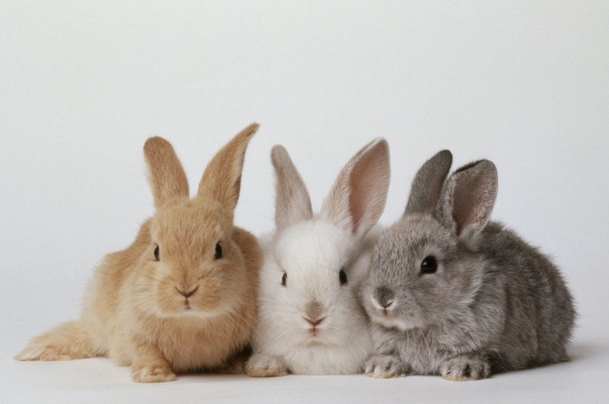



Matching
Due to process variations, devices that are identical in design (have the same W, L and m) are not identical in the actual circuit (“in silicon”).
By matching we refer to a set of measures and design techniques that can be applied to reduce the differences between devices.

Slide 24
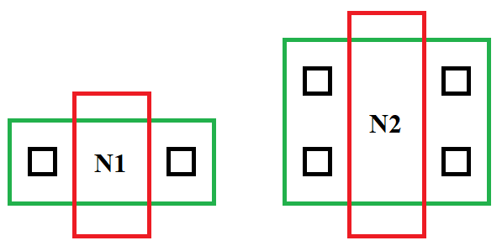
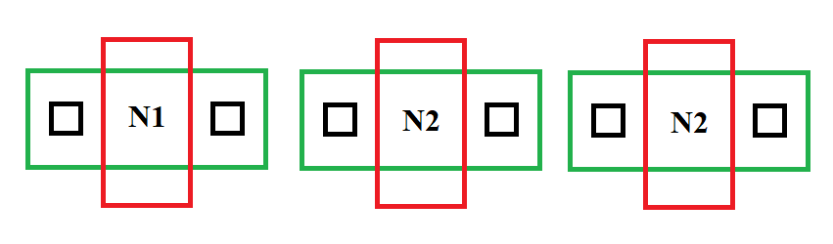
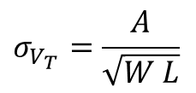
Matching
Some basic matching guidelines
Only devices of the same type can be matched.
Larger devices have better matching
$$σ_{V_{T}}=\frac{A}{\sqrt{W L}}$$
Always use same finger for matched devices
Keep matched devices close together
Mingled devices match better
Keep same geometric center for matched devices
Keep same orientation for matched devices
Keep same current direction for matched devices

Slide 25
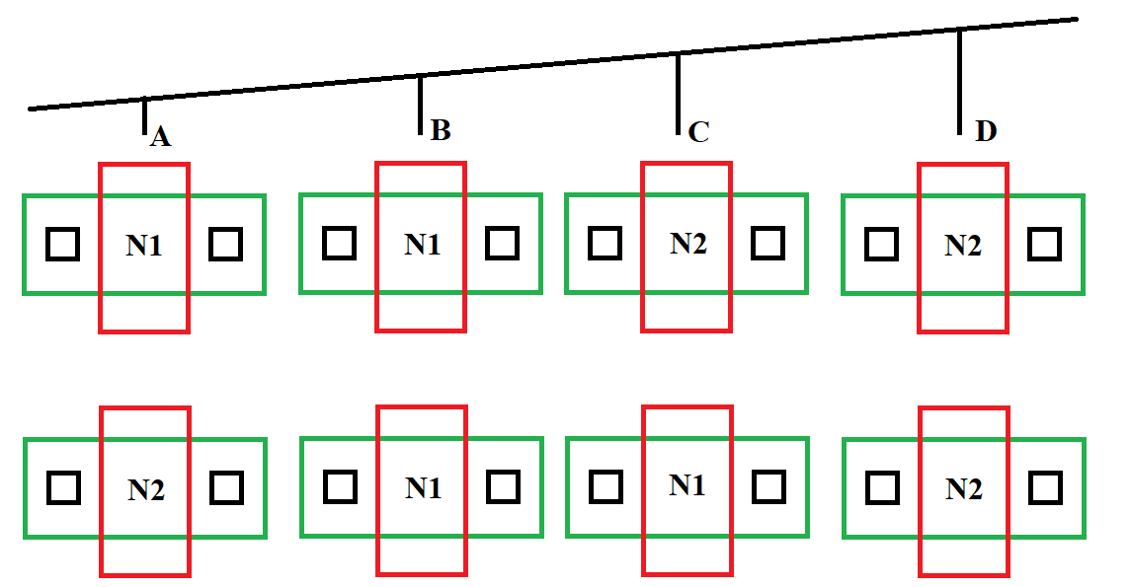

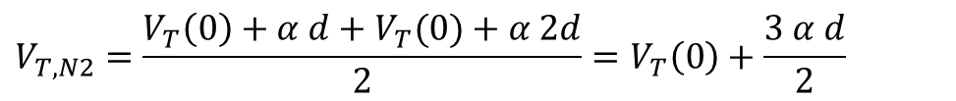
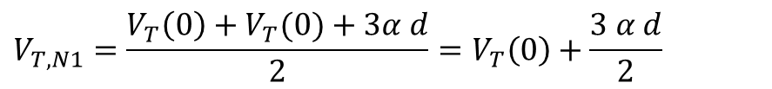
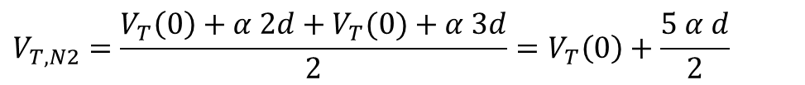
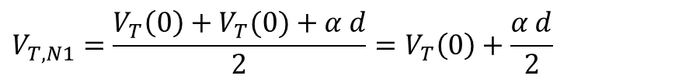
Matching
Let us consider two matched transistors, N1 and N2 having 2 finger each.
Let us consider a linear variation of a process parameter (as usual, we will use V_{T} as example)
$$V_{T}\left(x\right)=V_{T}(0)+α x$$
We consider the transistors equally placed at x=0, x=d, x=2d, x=3d
In Case 1, the average threshold voltage for N1 and N2 are:
$$V_{T,N1}=\frac{V_{T}\left(0\right)+V_{T}(0)+α d}{2}=V_{T}\left(0\right)+\frac{α d}{2}$$
$$V_{T,N2}=\frac{V_{T}\left(0\right)+α 2d+V_{T}(0)+α 3d}{2}=V_{T}\left(0\right)+\frac{5 α d}{2}$$
So we get a mismatch (different average V_{T})
In Case 2, the average threshold voltage for N1 and N2 are:
$$V_{T,N1}=\frac{V_{T}\left(0\right)+V_{T}(0)+3α d}{2}=V_{T}\left(0\right)+\frac{3 α d}{2}$$
$$V_{T,N2}=\frac{V_{T}\left(0\right)+α d+V_{T}(0)+α 2d}{2}=V_{T}\left(0\right)+\frac{3 α d}{2}$$
We get the same average threshold voltage (no mismatch).

Slide 26
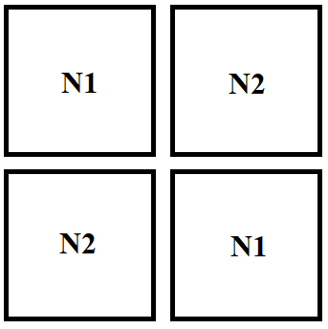
Matching
Common Centroid layout.

