Slide 1
Differential Pair
FILS – Integrated Circuits

Slide 2
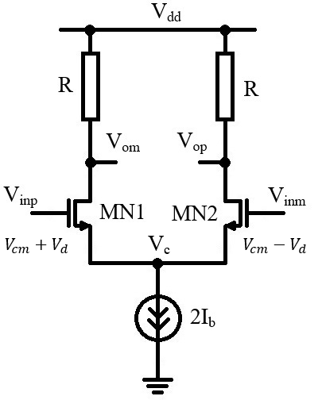
Differential Pair – Resistive Load
The differential pair is the basic comparison stage.
The main idea behind the differential pair is “symmetry” so we shall first study the resistive load differential pair that is fully symmetric.
The schematic is fully differential (differential input, differential output)
Common Mode and Differential Mode
We introduce the notations:
$$V_{d}=\frac{V_{inp}−V_{inm}}{2}$$
$$V_{cm}=\frac{V_{inp}+V_{inm}}{2}$$
Note. In many materials, V_{d} notation is used for V_{inp}–V_{inm}.
We can express V_{inp} and V_{inm} as a function of V_{cm} and V_{d}.
$$V_{inp}=V_{cm}+V_{d}$$
$$V_{inm}=V_{cm}−V_{d}$$

Slide 3
Differential Pair – Resistive Load
Equilibrium (Region I)
If the inputs are equal, the schematic is completely symmetric.
$$V_{inp}=V_{inm}$$
In the common and differential voltage notation, this means:
$$V_{d}=0$$
$$V_{cm}=V_{inp}=V_{inm}$$
In this case, the tail current is split equally between MN1 and MN2.
$$I_{D1}=I_{D2}=I_{b}$$
The output voltages are given by.
$$V_{op}=V_{dd}−RI_{D2}$$
$$V_{om}=V_{dd}−RI_{D1}$$
So we get:
$$V_{op}= V_{om}=V_{dd}−RI_{b}$$

Slide 4
Differential Pair – Resistive Load
Equilibrium (Region I) (continues)
In this analysis we assumed MN1 and MN2 in saturation and the 2I_{b} current mirror functional (output transistor also in saturation).
Transistors MN1 and MN2 are identical: (W/L)₁=(W/L)₂=(W/L)
Transistors MN1 and MN2 have the same gate source voltage and the same overdrive voltage (as the gate voltages are equal and the sources are tied together). We shall use the V_{gsx} and respectively V_{ovx} notation for the MN1 and MN2 gate – source voltage and overdrive voltage respectively, at equilibrium.
This allows us to calculate the overdrive voltage for MN1 and MN2.
$$I_{b}=\frac{1}{2} μ_{n}C_{ox}\left(\frac{W}{L}\right){\left(V_{gsx}−V_{T}\right)}^{2}$$
$$V_{gsx}=V_{T}+\sqrt{\frac{2 I_{b}}{μ_{n}C_{ox}\left(W/L\right)}}$$
$$V_{ovx}=\sqrt{\frac{2 I_{b}}{μ_{n}C_{ox}\left(W/L\right)}}$$

Slide 5
Differential Pair – Resistive Load
Input Common Mode Range
The common node voltage, V_{c} is then:
$$V_{c}=V_{cm}−V_{gs}$$
V_{c} should be high enough so the mirror implementing the 2I_{b} current source is functional (output transistor in saturation): V_{c}>V_{ov,mir}.
$$V_{cm,min}=V_{gs}+V_{ov,mir}$$
V_{c} should be low enough so that MN1 and MN2 transistors are in saturation.

Slide 6
Differential Pair – Resistive Load
Small Unbalance (Region II)
Now we assume some differential voltage is applied.
$$V_{gs1}=V_{T}+V_{ov1}=V_{inp}−V_{c}=V_{cm}+V_{d}−V_{c}$$
$$V_{gs2}=V_{T}+V_{ov2}=V_{inm}−V_{c}=V_{cm}−V_{d}−V_{c}$$
So we get:
$$V_{ov1}−V_{ov2}=2V_{d}$$
$$V_{ov1}=2V_{d}+V_{ov2}$$
The difference applied between the input voltages (2V_{d}) is directly transferred into the overdrive difference between MN1 and MN2.
The second condition is that the sum of MN1 and MN2 drain currents should be equal to the tail current, 2I_{b}.
$$I_{D1}+I_{D2}=2I_{b}$$
This completely determines V_{ov2}, V_{ov2} and V_{c}.
$$I_{D1}$$
$$I_{D2}$$
$$2I_{b}=\frac{1}{2} μ_{n}C_{ox}\left(W/L\right){\left(2V_{d}+V_{ov2}\right)}^{2}+\frac{1}{2} μ_{n}C_{ox}\left(W/L\right)V_{ov2}^{2}$$
$$V_{ov1}$$

Slide 7
Differential Pair – Resistive Load
Small Unbalance (Region II) (continues)
We have:
$${\left(2V_{d}+V_{ov2}\right)}^{2}+V_{ov2}^{2}=\frac{4I_{b}}{μ_{n}C_{ox}\left(W/L\right)}$$
$$V_{ovx}=\sqrt{\frac{2 I_{b}}{μ_{n}C_{ox}\left(W/L\right)}}$$
$$4V_{d}^{2}+4V_{d}V_{ov2}+2V_{ov2}^{2}=2V_{ovx}^{2}$$
$$2V_{d}^{2}+2V_{d}V_{ov2}+V_{ov2}^{2}=V_{ovx}^{2}$$
This is an equation for V_{ov2} with V_{d} as a control parameter.
To this we must add the relationship between V_{ov1} and V_{ov2}.
$$V_{ov1}=2V_{d}+V_{ov2}$$
If V_{d}=0 we get (as expected) he overdrive voltage from equilibrium.
$$V_{ov1}=V_{ov2}=V_{ovx}$$

Slide 8
Differential Pair – Resistive Load
Small Unbalance (Region II) (continues)
We have:
$$V_{ov2}^{2}+2V_{d}V_{ov2}+2V_{d}^{2}−V_{ovx}^{2}=0$$
$$2V_{d}^{2}+2V_{d}V_{ov2}+V_{ov2}^{2}=V_{ovx}^{2}$$
$$V_{ov2}=\frac{−b±\sqrt{b−4ac}}{2a}$$
$$V_{ov1}=2V_{d}+V_{ov2}$$
Now we are interested in the V_{d} voltages for which V_{ov2} and respectively V_{ov1} are zero.
$$a=1, b=2V_{d}, c=2V_{d}^{2}−V_{ovx}^{2}$$
$$V_{ov2}=−V_{d}+\sqrt{V_{ovx}^{2}−V_{d}^{2}}$$
“+” solution
If V_{ov2}=0 we have:
$$V_{d}=\frac{{ V}_{ovx}}{\sqrt{2}}$$
$$2V_{d}^{2}=V_{ovx}^{2}$$
$$V_{ov1}=2V_{d}$$
$$V_{ov1}=\sqrt{2}{ V}_{ovx}$$
In this case, MN2 is off and all the 2I_{b} tail current flows through MN1.
If V_{ov1}=0 we have:
$$V_{d}=−\frac{{ V}_{ovx}}{\sqrt{2}}$$
The overdrive voltage is always positive, so we chose the “–” solution for V_{d}.
$$V_{ov2}=−2V_{d}$$
$$2V_{d}^{2}−4V_{d}^{2}+{4V}_{d}^{2}=V_{ovx}^{2}$$
$$V_{ov2}=\sqrt{2}{ V}_{ovx}$$
In this case, MN1 is off and all the 2I_{b} tail current flows through MN2.

Slide 9
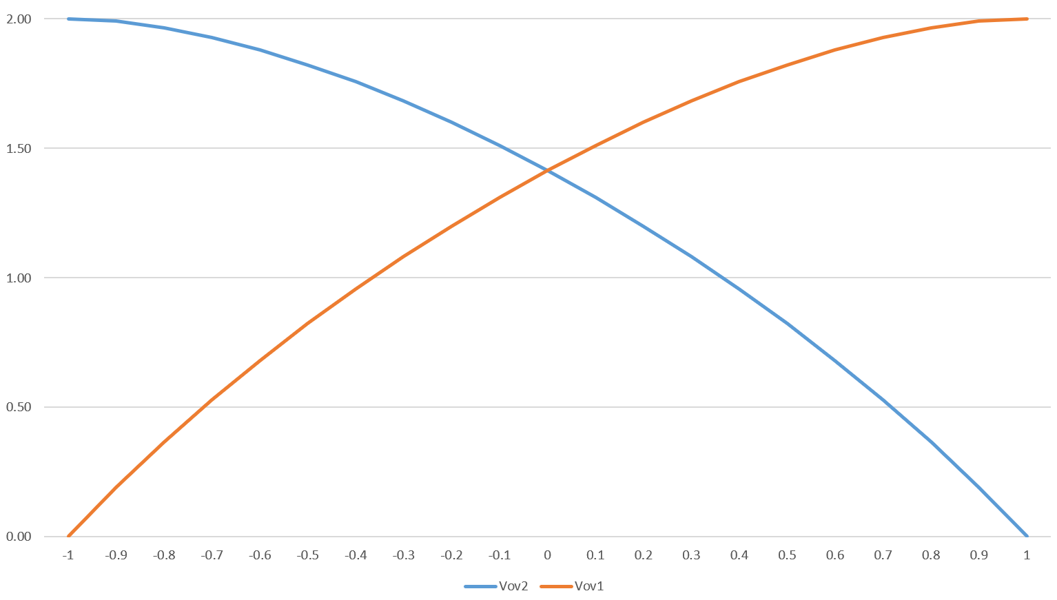
Differential Pair – Resistive Load
Small Unbalance (Region II) (continues)
We can plot V_{ov1} and V_{ov2} as a function of V_{d}.
This graph uses normalized values – V_{ovx} was chosen $1/\sqrt{2}$ so Vd varies from -1 to 1.

Slide 10
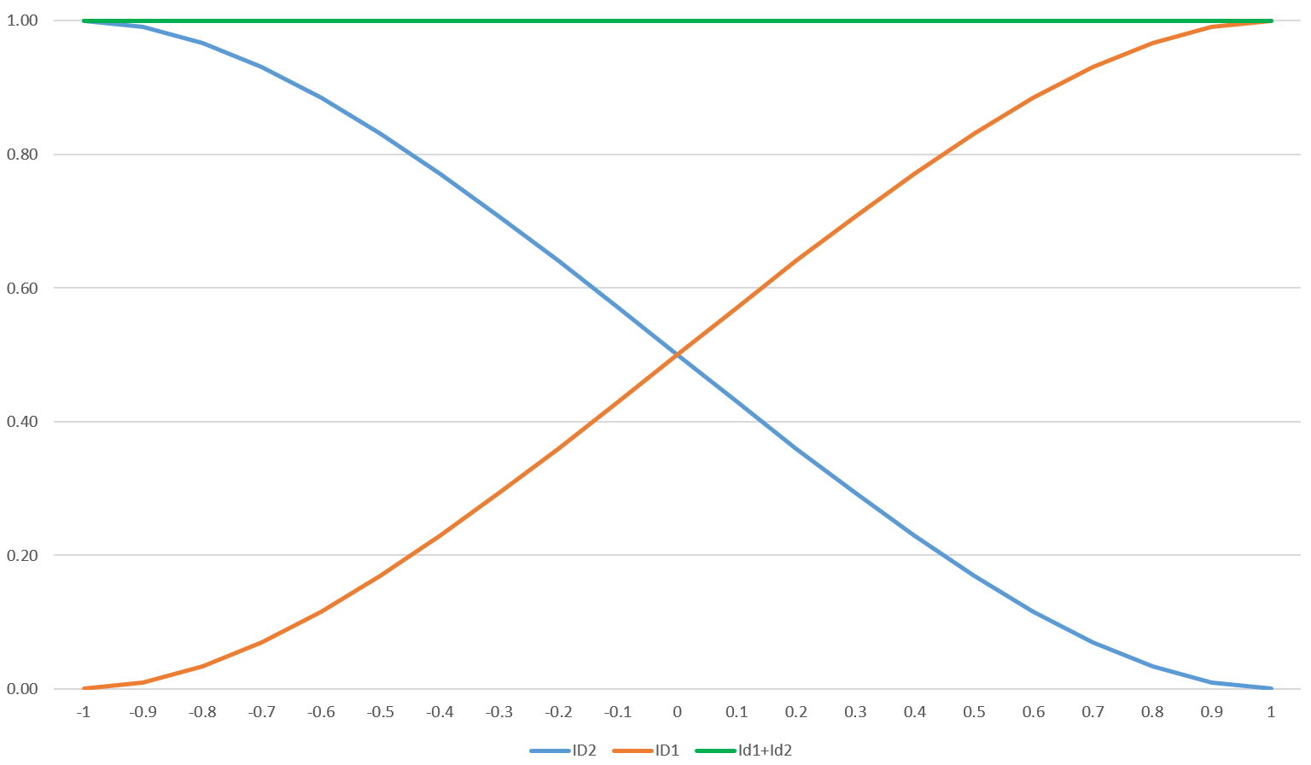
Differential Pair – Resistive Load
Small Unbalance (Region II) (continues)
We can plot I_{D1} and I_{D2} as a function of V_{d}. It can be seen that I_{D1}+I_{D2} is constant.
This graph uses normalized values – $\frac{1}{2}μ_{n}C_{ox}(W/L)$ was chosen $1/4$ so the max current value is 1.

Slide 11
Differential Pair – Resistive Load
Large Unbalance (Region III)
When the differential voltage reaches
$$V_{d}=±\frac{{ V}_{ovx}}{\sqrt{2}}$$
One of the differential transistors closes and all the tail current flows through the other transistor.
In this case, we say that the differential pair is completely unbalanced in one direction.
If we increase the differential voltage above this level, nothing much will happen – the current will continue to flow through only one of the transistors and the other one will remain blocked.

Slide 12
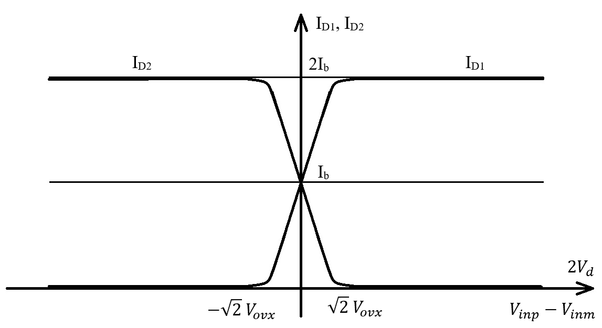
Differential Pair – Resistive Load
I_{D1} and I_{D2} as a function of V_{d}.

Slide 13
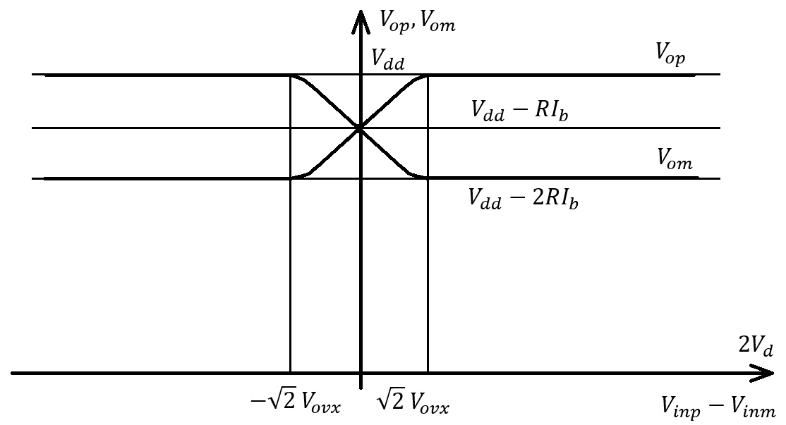
Differential Pair – Resistive Load
V_{op} and V_{om} as a function of V_{d}.

Slide 14
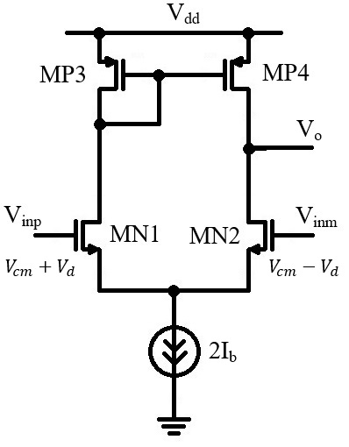
Differential Pair – Active Load
Effects of introducing an active load:
The schematic is no longer perfectly symmetric.
Now the output is single-ended (no longer differential).
Gain and output impedance increase.

Slide 15
Differential Pair – Active Load
Equilibrium
The equilibrium condition is still V_{inp}=V_{inm}.
We consider MN1 and MN2 identical, MP3 and MP4 identical.
In this case, we can see by symmetry that
$$V_{O}=V_{dd}−V_{gs3}$$
Indeed, if this condition is fulfilled, then:
MN3 and MP4 will have the same V_{ds} voltage. They are identical and have the same V_{gs} voltage (by circuit design), so they will have identical current.
MN1 and MN2 will also have the same V_{ds}. They are identical and have the same V_{gs} voltage (as V_{inp}=V_{inm}), so they will also have identical current.
This means that the tail current splits equally between the two branches.

Slide 16
Differential Pair – Active Load
Positive Differential Voltage
For the active load differential pair, the behavior is different if we apply positive versus negative differential voltage
If we apply positive differential voltage (V_{inp}>V_{inm}), MN1 will be turned on more strongly and MN2 will be turned on less than in the equilibrium case.
This means that more current will flow through MN1 and less current through MN2.
MN1 current will flow through MN3, resulting in a higher gate voltage for the MN3, MN4 current mirror.
This means that MN4 will have higher V_{gs} voltage than in the equilibrium position, but is forced to drive less current as it is limited by MN2.
This means that the output voltage will rise to keep MP4 in linear region so that it’s current matches MN2 current.

Slide 17
Differential Pair – Active Load
Negative Differential Voltage
If we apply negative differential voltage (V_{inp}<V_{inm}), MN1 will be turned on more strongly and MN2 will be turned on less than in the equilibrium case.
This means that MN1 is biased to have less current than MN2.
But this is impossible, as the MP3, MP4 current mirror does not allow more current to flow through MN2 than through MN1.
So the 2I_{b} tail current will continue to be divided approximately equally between MN1 and MN2
MN2 will have a high Vgs voltage, but will be limited to the current provided by MP3, MP4 mirror (roughly I_{b}).
So the output voltage will go down to keep MN2 in the linear region so it can adapt to MP4 current.

Slide 18
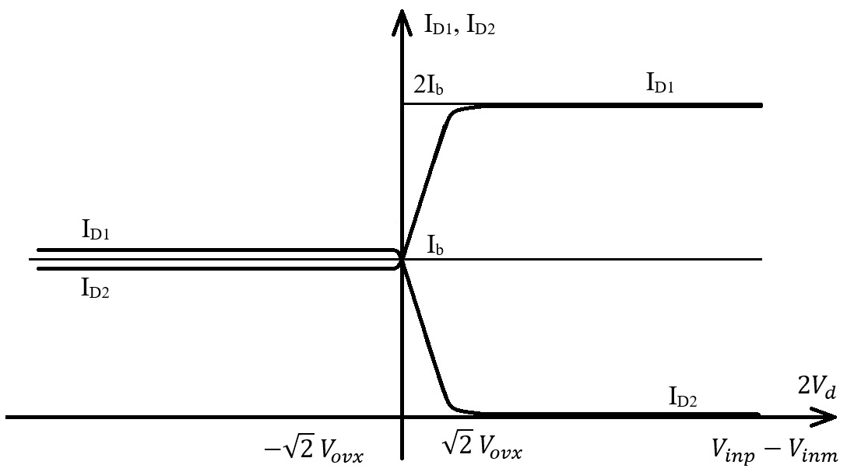
Differential Pair – Resistive Load
I_{D1} and I_{D2} as a function of V_{d}.

Slide 19
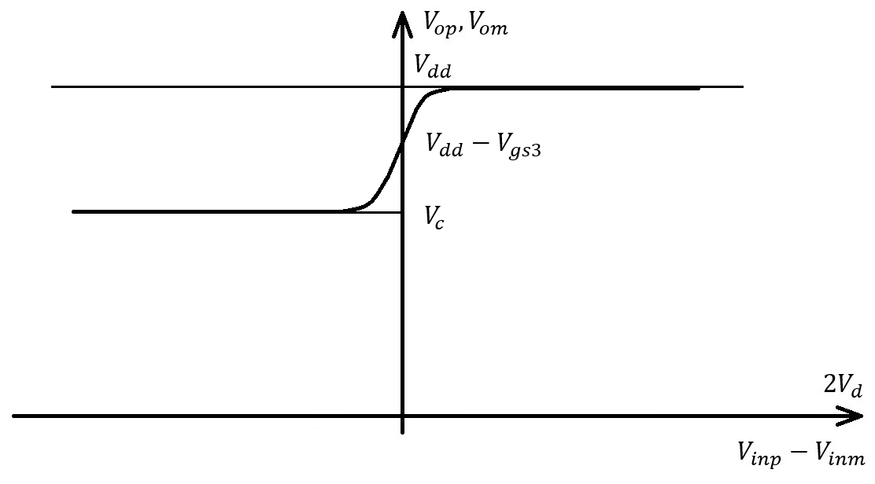
Differential Pair – Resistive Load
V_{o} as a function of V_{d}.

