Slide 1
Cascode Current Mirror
FILS – Integrated Circuits

Slide 2
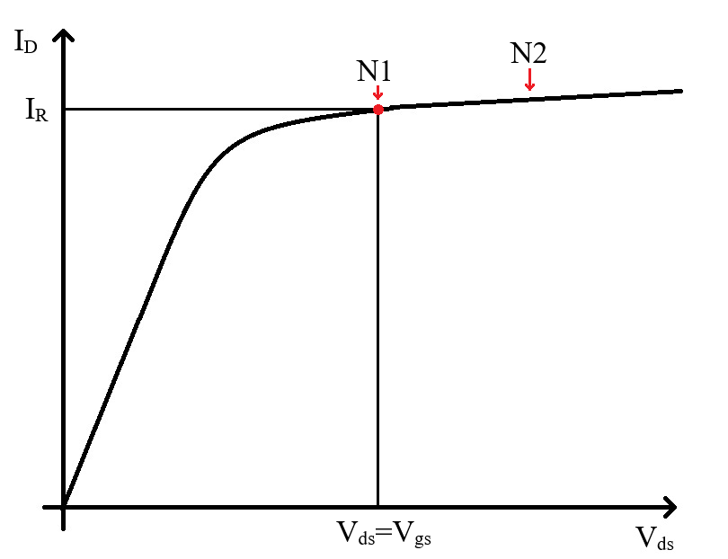
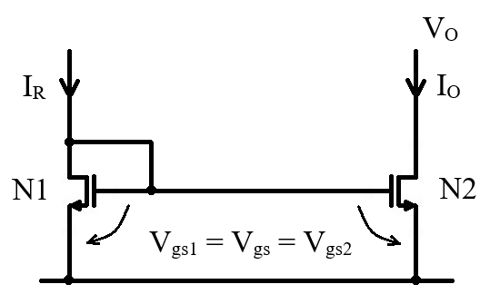
Simple Current Mirror - Reminder
When a simple current mirror is used, there is an error introduced by the channel length modulation effect. The output current is not exactly equal to the input current as the two transistors do not work at the same V_{ds} voltage.
The simple current mirror (small signal equivalent) output resistance is limited by the output transistor output resistance, r_{o}.

Slide 3
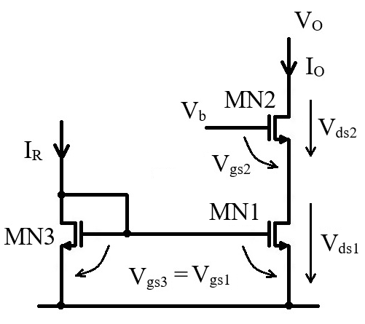


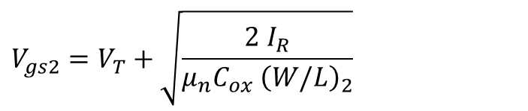
Cascode Current Mirror
A solution to this problem is to decouple the MN1 drain from the output voltage variation.
This is achieved by the MN2 transistor.
$$V_{b}=V_{gs2}+V_{ds1}$$
So we have
$$V_{ds1}=V_{b}−V_{gs2}$$
We assume MN2 to be in saturation. This assumption will give us the output voltage allowed range. With this assumption:
$$V_{gs2}=V_{T}+\sqrt{\frac{2 I_{R}}{μ_{n}C_{ox} {\left(W/L\right)}_{2}}}$$
This is a constant voltage. (We assumed the mirror to be 1:1 ratio. Otherwise there will be a (W/L)₁/(W/L)₃ scaling factor in front of I_{b}, but the voltage will still be constant.)
As V_{b} is also constant, this means V_{ds1} is constant.
This means that MN1 drain – source voltage was decoupled from V_{O}.
MN1 is still influenced by channel length modulation, but has a constant V_{ds} voltage and it’s current will also be constant.

Slide 4
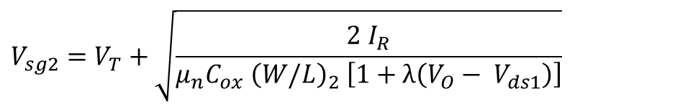
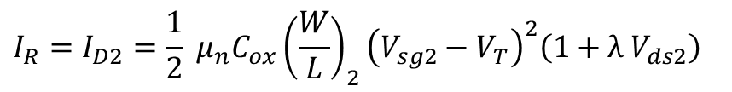
Cascode Current Mirror
Limitations
Of course, the compensation is not perfect. MN2 is also affected by channel length modulation. Taking this into account, MN2 saturation equation is:
$$I_{R}=I_{D2}=\frac{1}{2} μ_{n}C_{ox}{\left(\frac{W}{L}\right)}_{2}{\left(V_{sg2}−V_{T}\right)}^{2}\left(1+λ{ V}_{ds2}\right)$$
Taking this into account, and the fact that V_{ds2}=V_{O}–V_{ds1}, we have
$$V_{sg2}=V_{T}+\sqrt{\frac{2 I_{R}}{μ_{n}C_{ox} {\left(W/L\right)}_{2} \left[1+λ\left({V_{O}− V}_{ds1}\right)\right]}}$$
So V_{gs2} actually depends on the output voltage even if MN2 is in saturation. This means that V_{ds1}=V_{b}-V_{gs2} will also depend on V_{O}.
Any variation of V_{ds1} will lead to a variation of the output current (through the channel length modulation effect).
So the effect is not completely removed, but it is greatly reduced.

Slide 5



Cascode Current Mirror
Output voltage range (Ro: excursia tensiunii de iesire)
This analysis was done under the assumption that MN2 is in saturation. The condition for this is:
$$V_{ds2}≥V_{gs2}−V_{T}=V_{ov2}$$
We would like to express this as a function of the output voltage.
We can express V_{ds2} as:
$$V_{ds2}=V_{O}−V_{ds1}=V_{O}−V_{b}+V_{gs2}$$
Replacing this, we get:
$$V_{O}≥V_{ds1}+V_{ov2}$$
$$V_{O}≥V_{b}−V_{T}$$
If MN2 is no longer in saturation (crosses to the linear region), MN2 will start acting as an open switch and the output voltage variation will be seen in MN1 drain. The MN1, MN3 mirror will still be functional until MN1 enters linear region, but it will work as a simple current mirror. All benefits from the cascode stage will (gradually) disappear.

Slide 6

Cascode Current Mirror
Choosing V_{b} voltage.
From the previous slide, we have seen that, the smaller we choose V_{b}, the higher the output voltage range is.
However, there is a lower limit to V_{b}. For the MN1, MN3 mirror to function properly, MN1 transistor needs to be in saturation.
$$V_{ds1}≥V_{ov1}$$
This means that the minimum V_{b} voltage is given by
$$V_{b, min}=V_{gs2}+V_{ov1}=V_{T}+V_{ov1}+V_{ov2}$$
On the other hand, MN1 and MN3 transistors should have the same drain – source voltage if we want them to have the same current.
For this schematic, V_{ds3}=V_{gs3}=V_{gs1}. We can choose V_{b} such that V_{ds1} also equals V_{gs1}. Namely:
$$V_{b}=V_{gs1}+V_{gs2}$$
This is a good choice and it is widely used, but it does not provide the maximum output voltage range.
Another option is to change the schematic so that MN3 has a lower V_{ds} voltage.

Slide 7
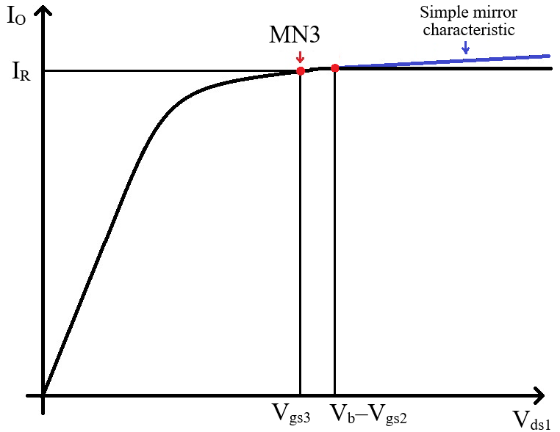
Cascode Current Mirror

Slide 8
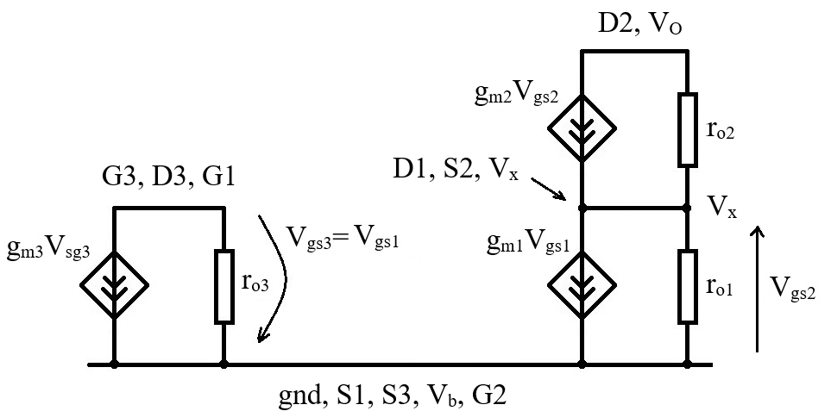
Cascode Current Mirror – Small Signal Circuit
Cascode current mirror small signal equivalent circuit:
MOS transistor small signal equivalent circuit:

Slide 9
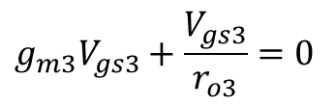



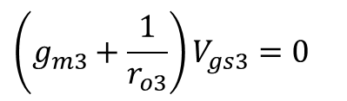
Cascode Current Mirror – Small Signal Circuit
As for the simple current mirror, we are interested in the equivalent output resistance.
We are not applying any signal so there is no gain to calculate.
To do this, we will apply an external small signal V_{O} voltage and we will determine R_{O}=V_{O}/I_{O}.
First we solve for G3 node.
$$g_{m3}V_{gs3}+\frac{V_{gs3}}{r_{o3}}=0$$
$$\left(g_{m3}+\frac{1}{r_{o3}}\right)V_{gs3}=0$$
$$V_{gs3}=0$$
$$V_{gs1}=0$$
$$g_{m1}V_{gs1}=0$$
So (as before) we can simplify the schematic

Slide 10
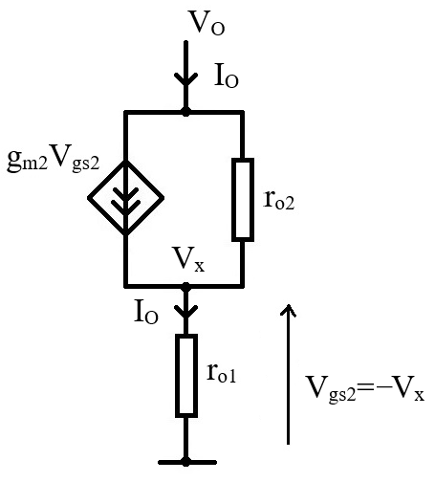

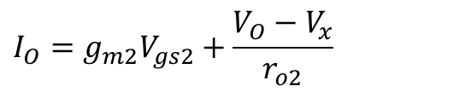
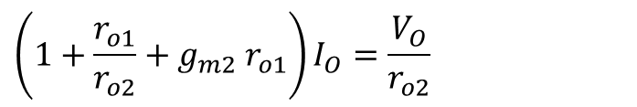

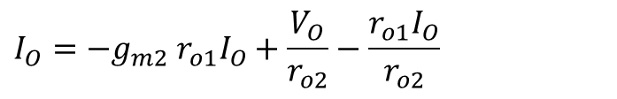



Cascode Current Mirror – Small Signal Circuit
Now we cab solve for I_{O}.
$$I_{O}=g_{m2}V_{gs2}+\frac{V_{O}−V_{x}}{r_{o2}}$$
$$V_{gs2}=−V_{x}$$
$$V_{x}=r_{o1}I_{O}$$
$$I_{O}=−g_{m2}{ r}_{o1}I_{O}+\frac{V_{O}}{r_{o2}}−\frac{r_{o1}I_{O}}{r_{o2}}$$
$$\left(1+\frac{r_{o1}}{r_{o2}}+g_{m2}{ r}_{o1}\right)I_{O}=\frac{V_{O}}{r_{o2}}$$
$$V_{O}=\left(g_{m2}{ r}_{o1}r_{o2}+r_{o1}+r_{o2}\right)I_{O}$$
$$R_{O}=g_{m2}{ r}_{o1}r_{o2}+r_{o1}+r_{o2}$$
But usually g_{m2}r_{o1}r_{o2}>>r_{o1} or r_{o2}, so we have:
$$R_{O}=g_{m2}{ r}_{o1}r_{o2}$$

Slide 11


Cascode Current Mirror – Generating V_{b} potential
We shall now discuss several (3 to be precise) topologies to generate the V_{b} voltage.
First, let us review the conditions we have identified so far for the V_{b} voltage:
  V_{b} should be high enough so that MN1 is in saturation
$$V_{b, min}=V_{gs2}+V_{ov1}=V_{T}+V_{ov1}+V_{ov2}$$
  V_{b} should be chosen such that MN1 and MN3 have the same drain source voltage
$$V_{ds1}=V_{ds3}$$
To this, we will add the observation that the lower we choose V_{b}, the larger the output volage range will be.
$$V_{O}≥V_{b}−V_{T}$$

Slide 12
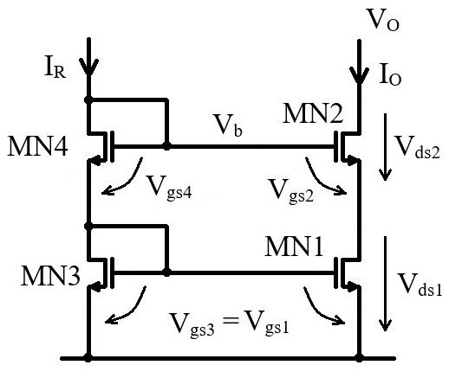


Cascode Current Mirror – Generating V_{b} potential
The first, simplest and most widely used topology just uses a diode connected transistor, MN4, to generate V_{b}.
We have:
$$V_{b}=V_{gs3}+V_{gs4}=V_{ds1}+V_{gs2}$$
So V_{ds1} is given by:
$$V_{ds1}=V_{gs3}+V_{gs4}−V_{gs2}$$
MN2 and MN4 should be designed to have the same V_{gs} voltage
$$V_{gs2}=V_{gs4}$$
This is easily achieved if MN2 and MN4 are identical transistors biased at the same current.
MN3 is diode connected, so V_{ds3}=V_{gs3}. So we get:
$$V_{ds1}=V_{ds3}$$
We note that, as V_{gs1}=V_{gs3} and V_{gs2}=V_{gs4}, V_{b} is also given by:

Slide 13
Cascode Current Mirror – Generating V_{b} potential
The minimum output voltage is given by
$$V_{O,min}=V_{b}−V_{T}=V_{gs3}+V_{gs4}−V_{T}=V_{T}+V_{ov3}+V_{ov4}$$
In conclusion, this schematic keeps MN1 in saturation (V_{ds1}=V_{ds3}>V_{ov1}) and keeps V_{ds1}=V_{ds3}.
However, V_{b} is significantly higher than V_{b,min}
$$V_{b}=V_{gs1}+V_{gs2}={2 V}_{T}+V_{ov1}+V_{ov2}$$
$$V_{b, min}=V_{gs2}+V_{ov1}=V_{T}+V_{ov1}+V_{ov2}$$
This also means that the output voltage range is not optimized

Slide 14
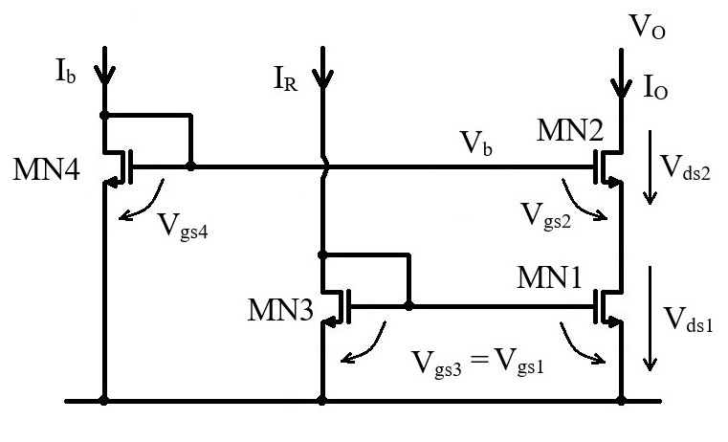
Cascode Current Mirror – Generating V_{b} potential
Intermediate schematic – Not to be used!
Having V_{b} defined by two V_{gs} voltages always leads reduced output voltage range.
One option is to use one V_{gs} voltage instead, as shown in the schematic below.
However, in this schematic V_{ds1} is no longer equal to V_{ds3}.
This would introduce a systematic offset in the output current.

Slide 15
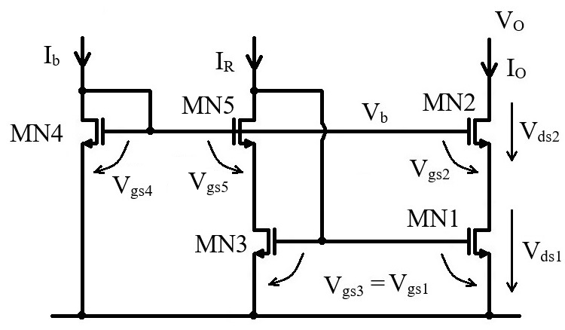




Cascode Current Mirror – Generating V_{b} potential
In this schematic we have introduced MN5 transistor to control MN3 drain voltage.
First, let us concentrate on defining V_{b} voltage.
In this case, we have
$$V_{b}=V_{gs4}=V_{gs2}+V_{ds1}$$
$$V_{b}=V_{T}+V_{ov4}=V_{T}+V_{ov2}+V_{ds1}$$
So we get:
$$V_{ov4}=V_{ov2}+V_{ds1}$$
But, for MN1 to be in saturation, V_{ds1} needs to be larger or equal to V_{ov1}. This gives the condition for V_{ov4}.
$$V_{ov4}≥V_{ov2}+V_{ov1}$$
Regarding V_{ds1}=V_{ds3} condition, we have:
$$V_{b}=V_{gs5}+V_{ds3}=V_{gs2}+V_{ds1}$$
MN5 an MN2 can be sized to have equal V_{gs} voltage (identical transistors biased at same current), so we get:
$$V_{ds1}=V_{ds3}$$

Slide 16
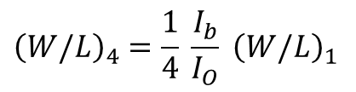
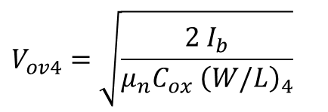
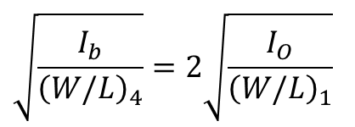

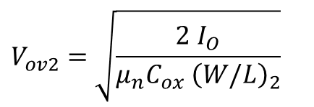
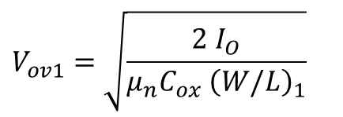
Cascode Current Mirror – Generating V_{b} potential
Sizing MN4
We will size MN4 (determine (W/L)₄) in order to full have
All transistors are in saturation, we have
$$V_{ov4}=V_{ov2}+V_{ov1}$$
$$V_{ov4}=\sqrt{\frac{2 I_{b}}{μ_{n}C_{ox} {\left(W/L\right)}_{4}}}$$
$$V_{ov1}=\sqrt{\frac{2 I_{O}}{μ_{n}C_{ox} {\left(W/L\right)}_{1}}}$$
$$V_{ov2}=\sqrt{\frac{2 I_{O}}{μ_{n}C_{ox} {\left(W/L\right)}_{2}}}$$
This gives us:
$$\sqrt{\frac{2 I_{b}}{μ_{n}C_{ox} {\left(W/L\right)}_{4}}}=\sqrt{\frac{2 I_{O}}{μ_{n}C_{ox} {\left(W/L\right)}_{1}}}+\sqrt{\frac{2 I_{O}}{μ_{n}C_{ox} {\left(W/L\right)}_{2}}}=\sqrt{\frac{2 I_{O}}{μ_{n}C_{ox} }}\left(\frac{1}{\sqrt{{\left(W/L\right)}_{1}}}+\frac{1}{\sqrt{{\left(W/L\right)}_{2}}}\right)$$
For simplicity, we assume (W/L)₁=(W/L)₂. We then have:
$$\sqrt{\frac{I_{b}}{{\left(W/L\right)}_{4}}}=2\sqrt{\frac{I_{O}}{{\left(W/L\right)}_{1}}}$$
$${\left(W/L\right)}_{4}=\frac{1}{4} \frac{I_{b}}{I_{O}} {\left(W/L\right)}_{1}$$

Slide 17
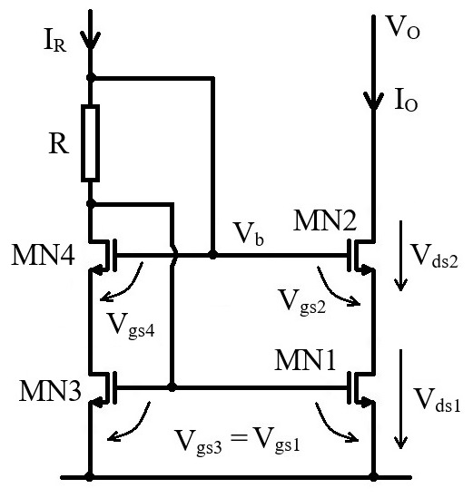
Cascode Current Mirror – Generating V_{b} potential
An alternative way of generating the V_{b} voltage is presented in this schematic. We have
$$V_{b}=V_{gs3}+R I_{R}=V_{gs2}+V_{ds1}$$
Assuming V_{gs2}=V_{gs3}, we get
$$V_{ds1}=R I_{R}$$
This means we need to size the resistor R so that we get the desired V_{ds1} value (so that MN1 is in saturation).
We also have:
$$V_{b}=V_{gs4}+V_{ds3}=V_{gs2}+V_{ds1}$$
If we assume V_{gs4}=V_{gs2}, we also have:
$$V_{ds1}=V_{ds3}$$

