Slide 1
Common Drain Stage
FILS – Integrated Circuits

Slide 2
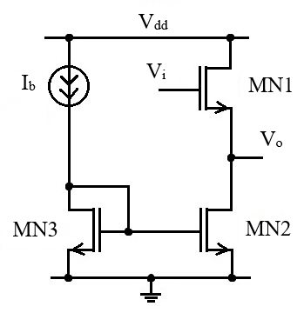
Common Drain Stage
The active load common drain stage is presented here.
MN1 transistor is the actual common drain stage.
MN2 and MN3 form the active load current mirror.

Slide 3
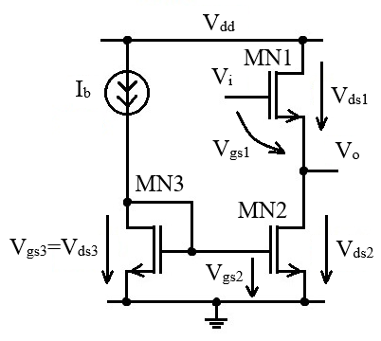






Common Drain Stage
Before we start, let us evaluate the used voltages.
In our MOS transistor model we work with V_{gs} and V_{ds} voltages (V_{sg} and V_{sd} for PMOS transistors) so we need to express this voltages for each transistor.
$$V_{gs1}=V_{i}−V_{O}$$
$$V_{o}=V_{i}−V_{gs1}$$
$$V_{ds1}=V_{dd}−V_{O}$$
$$V_{gs2}=V_{gs3}=V_{ds3}=ct.$$
$$V_{ds2}=V_{O}$$
We analyze the circuit considering the output is “open” (no current if flowing out of the circuit). We “reuse” the output current notation for the current through the output stage
$$I_{O}=I_{D1}=I_{D2}$$

Slide 4
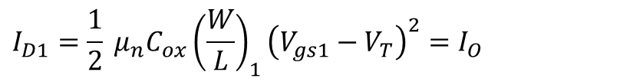
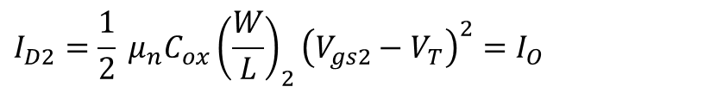
Common Drain Stage – Large Signal Analysis
Region I
We start out analysis with V_{i}=V_{dd} and then decrease V_{i}.
Transistor MN1 has the drain connected to V_{dd}, so it cannot be in the linear region (as long as the gate does not exceed V_{dd}). If V_{i} is high enough, MN1 will be open so it will be in saturation.
V_{ds2}=V_{O}=V_{i}–V_{gs1} so, if V_{i} is high enough, V_{ds2} will be higher than V_{gs2}–V_{T} and MN2 will also in saturation.
In conclusion, in Region I, both MN1 and MN2 are in saturation. They will be described by the saturation equations (we neglect channel length modulation)
$$I_{D1}=\frac{1}{2} μ_{n}C_{ox}{\left(\frac{W}{L}\right)}_{1}{\left(V_{gs1}−V_{T}\right)}^{2}=I_{O}$$
$$I_{D2}=\frac{1}{2} μ_{n}C_{ox}{\left(\frac{W}{L}\right)}_{2}{\left(V_{gs2}−V_{T}\right)}^{2}=I_{O}$$

Slide 5

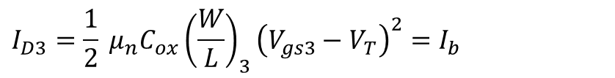

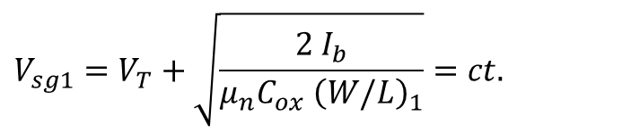

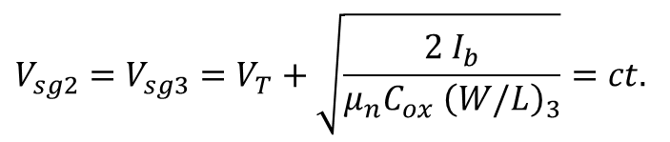
Common Drain Stage – Large Signal Analysis
But transistor MN2 is part of the MN2, MN3 current mirror so we have
$$I_{D3}=\frac{1}{2} μ_{n}C_{ox}{\left(\frac{W}{L}\right)}_{3}{\left(V_{gs3}−V_{T}\right)}^{2}=I_{b}$$
$$V_{sg2}=V_{sg3}=V_{T}+\sqrt{\frac{2 I_{b}}{μ_{n}C_{ox} {\left(W/L\right)}_{3}}}=ct.$$
$$V_{ov2}=\sqrt{\frac{2 I_{b}}{μ_{n}C_{ox} {\left(W/L\right)}_{3}}}$$
Assuming MN2 and MN3 are identical (and neglecting channel length modulation effect), we have
$$I_{D2}=I_{D3}=I_{b}$$
But I_{D1}=I_{D2}=I_{O}, so I_{b} also flows through MN1.
This allows us to calculate V_{gs1}.
$$V_{sg1}=V_{T}+\sqrt{\frac{2 I_{b}}{μ_{n}C_{ox} {\left(W/L\right)}_{1}}}=ct.$$
$$V_{ov1}$$

Slide 6



Common Drain Stage – Large Signal Analysis
We recall that
$$V_{o}=V_{i}−V_{gs1}$$
We have just proven that, during Region I, V_{gs1} is constant, given by:
$$V_{sg1}=V_{T}+V_{ov1}=ct.$$
We can conclude that, in Region I, the output voltage follows the input voltage with a constant shift down of V_{gs1}.
This is why the common drain stage is also known as “source follower”.
Region I lower limit
We are in Region I as long as MN2 is in saturation:
$$V_{ds2}=V_{O}≥V_{ov2}$$
Knowing that V_{i}=V_{O}+V_{gs1}, the condition becomes:
$$V_{i}≥V_{gs1}+V_{ov2}$$

Slide 7
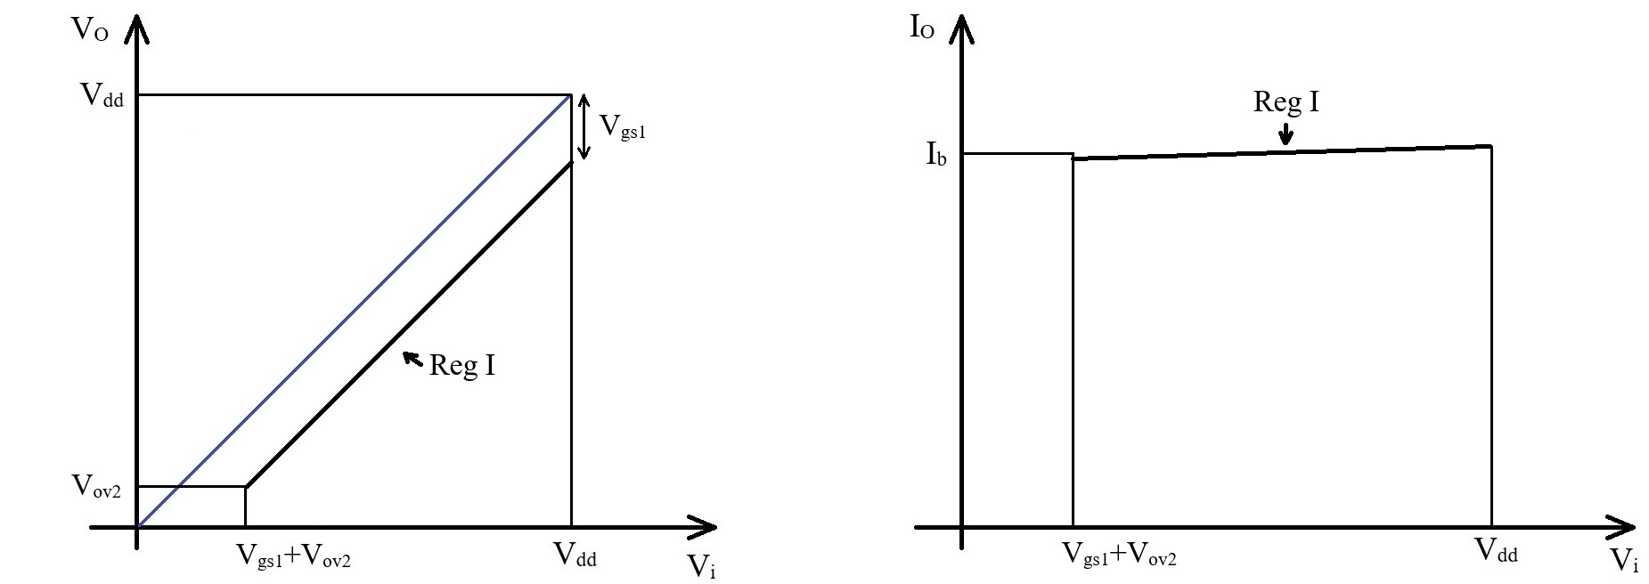
Common Drain Stage – Large Signal Analysis
Region I

Slide 8

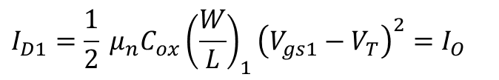
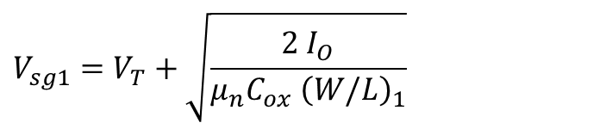
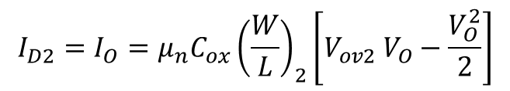
Common Drain Stage – Large Signal Analysis
Region II
In Region II, MN1 is still in saturation but MN2 is in linear region.
This means that the MN2, MN3 current mirror is no longer functioning properly and the output current is no longer constant and equal to I_{b} but starts to decrease.
$$I_{D2}=I_{O}=μ_{n}C_{ox}{\left(\frac{W}{L}\right)}_{2}\left[V_{ov2} V_{O}−\frac{V_{O}^{2}}{2}\right]$$
MN1 is still described by the saturation equation, the only difference is that now it’s drain current is smaller than I_{b} and dependent on V_{O}.
$$I_{D1}=\frac{1}{2} μ_{n}C_{ox}{\left(\frac{W}{L}\right)}_{1}{\left(V_{gs1}−V_{T}\right)}^{2}=I_{O}$$
$$V_{sg1}=V_{T}+\sqrt{\frac{2 I_{O}}{μ_{n}C_{ox} {\left(W/L\right)}_{1}}}$$
$$V_{ov1}$$

Slide 9


Common Drain Stage – Large Signal Analysis
Region II
The output voltage is still equal to
$$V_{o}=V_{i}−V_{gs1}$$
Where
$$V_{sg1}=V_{T}+V_{ov1}$$
The only difference to Region I is that now V_{ov1} is no longer constant (as I_{O} varies). This means that the V_{O} and V_{i} lines are no longer parallel but V_{O} gets slightly closer to V_{i} as V_{i} decreases.

Slide 10





Common Drain Stage – Large Signal Analysis
Region II lower limit
We are in Region II until the output voltage reaches zero.
When V_{O}=0
  MN2 is still in linear region, but with V_{ds2}=0, so:
$$I_{O}=I_{D1}=I_{D2}=0$$
  This implies MN1 current to be 0, but MN1 is not in the linear region as it has high V_{ds} voltage (MN1 drain is at V_{dd}).
  This means that MN1 needs to turn off – MN1 gate – source voltage becomes equal to V_{T} exactly when V_{O} reaches zero voltage. This way MN2 and MN1 reach zero drain current at the same time.
$$V_{i}=V_{T}$$
when
$$V_{O}=0$$
In conclusion, Region II is defined by
$${V_{T}≤V}_{i}<V_{gs1}+V_{ov2}$$
$$0≤V_{O}<V_{ov2}$$
In Region II the current drops from I_{b} to 0.

Slide 11
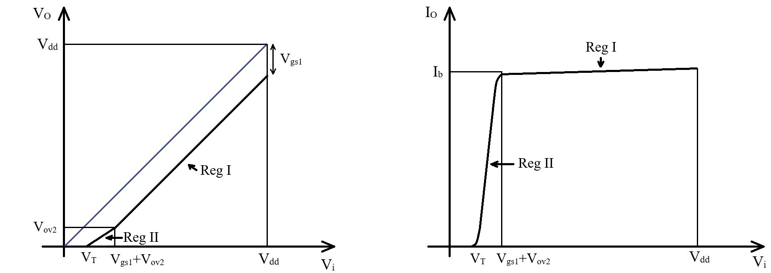
Common Drain Stage – Large Signal Analysis
Region II

Slide 12


Common Drain Stage – Large Signal Analysis
Region III
In Region III, MN1 is blocked and MN2 is in deep linear region with V_{ds}=0.
The output voltage and output current are both zero.
Nothing much happens…
$$V_{O}=0$$
$$I_{O}=0$$
Region III lower limit
Region III starts when V_{i}=V_{T} and lasts until V_{i}=0.

Slide 13
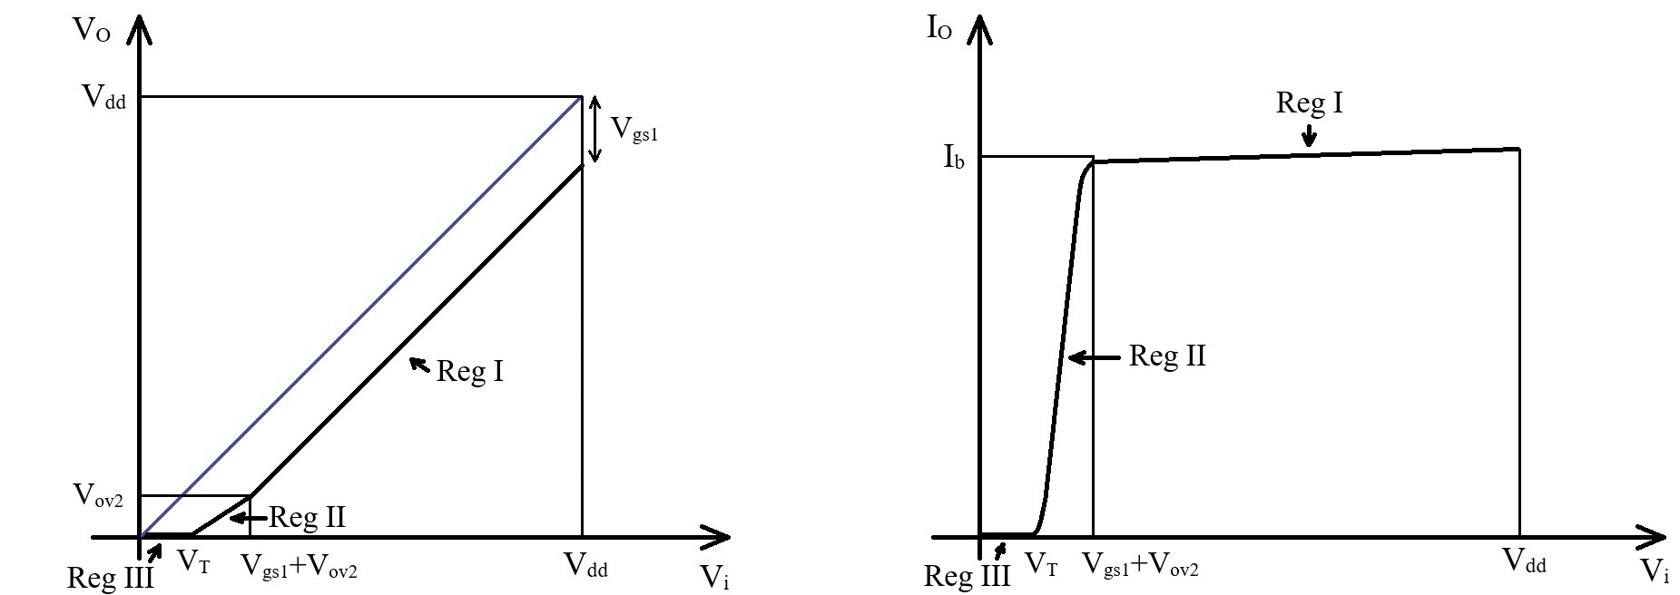
Common Drain Stage – Large Signal Analysis
Region III

Slide 14
Common Drain Stage – Large Signal Analysis
Circuit Gain – Large Signal Perspective
In Region I, the output voltage follows the input voltage with a constant shift. When calculating the small signal gain, all constant shifts are ignored (we only look at variations) so the small signal output variation is equal to the small signal input variation. This results in a gain of 1. (“+1” the circuit is not inverting.)
In Region II, the shift is no longer constant between the input and output so the gain will be below one.
In Region III, the output is constant (at 0) so there is no gain at all.

Slide 15
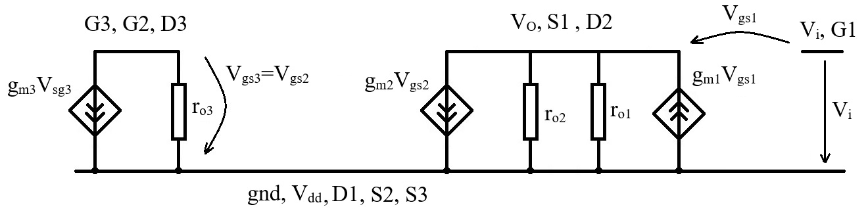
Common Drain Stage – Small Signal Analysis
MOS transistor small signal equivalent circuit:
Common drain (with active load) small signal equivalent circuit:

Slide 16
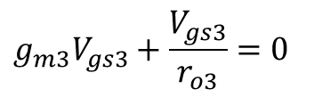



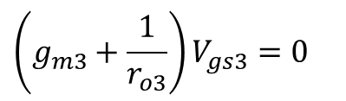
Common Drain Stage – Small Signal Analysis
We have solved the current mirror multiple times
$$g_{m3}V_{gs3}+\frac{V_{gs3}}{r_{o3}}=0$$
$$\left(g_{m3}+\frac{1}{r_{o3}}\right)V_{gs3}=0$$
$$V_{gs3}=0$$
$$V_{gs2}=0$$
$$g_{m2}V_{gs2}=0$$
This allows us to simplify the circuit – we remove the MN3 transistor (as we have already solved for it) and we can also remove the MN2 voltage controlled current source as it gives zero current.
We also flip the circuit to have the input to the left and the output

Slide 17
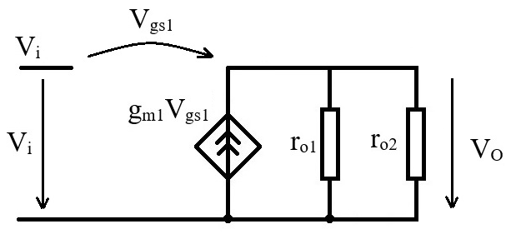

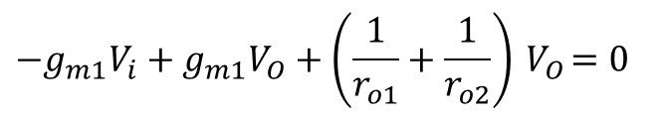
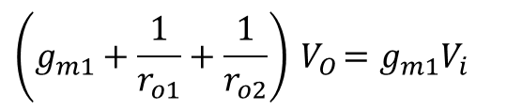
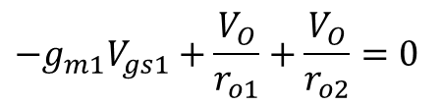


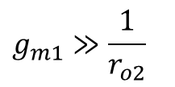

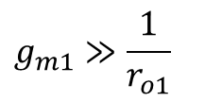
Common Drain Stage – Small Signal Analysis
Now, we solve for the output node. As before, we write the sum of all currents going out of the node equals zero.
$${−g}_{m1}V_{gs1}+\frac{V_{O}}{r_{o1}}+\frac{V_{O}}{r_{o2}}=0$$
$$−g_{m1}V_{i}+g_{m1}V_{O}+\left(\frac{1}{r_{o1}}+\frac{1}{r_{o2}}\right){ V}_{O}=0$$
$$\left(g_{m1}+\frac{1}{r_{o1}}+\frac{1}{r_{o2}}\right){ V}_{O}=g_{m1}V_{i}$$
$$V_{gs1}=V_{i}−V_{O}$$
But usually (g_{m1} is large, r_{o} is large so 1/r_{o} is small)
$$g_{m1}≫\frac{1}{r_{o1}}$$
$$g_{m1}≫\frac{1}{r_{o2}}$$
So we can neglect r_{o1} and r_{o2} and we get
$$g_{m1}V_{O}=g_{m1}V_{i}$$
Or equivalent
$$V_{O}=V_{i}$$
This corresponds to a gain of “1”:
$$A=\frac{V_{O}}{V_{i}}≅1$$

Slide 18
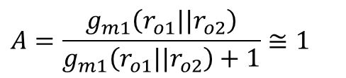
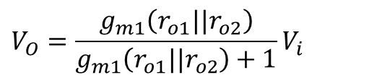
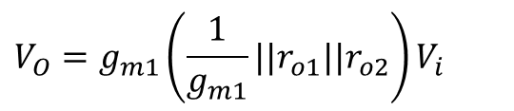
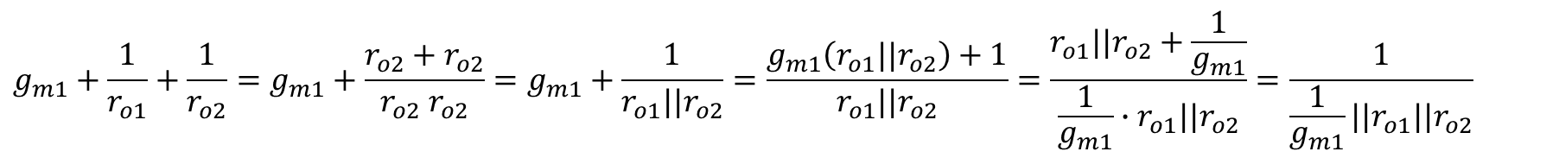
Common Drain Stage – Small Signal Analysis
If we want to calculate the gain more precisely, taking r_{o1} and r_{o2} into account, we first have:
$$g_{m1}+\frac{1}{r_{o1}}+\frac{1}{r_{o2}}=g_{m1}+\frac{r_{o2}+r_{o2}}{r_{o2}{ r}_{o2}}=g_{m1}+\frac{1}{r_{o1}||r_{o2}}=\frac{g_{m1}\left(r_{o1}||r_{o2}\right)+1}{r_{o1}||r_{o2}}=\frac{r_{o1}||r_{o2}+\frac{1}{g_{m1}}}{\frac{1}{g_{m1}}∙r_{o1}||r_{o2}}=\frac{1}{\frac{1}{g_{m1}}||r_{o1}||r_{o2}}$$
So we get:
$$V_{O}=g_{m1}\left(\frac{1}{g_{m1}}||r_{o1}||r_{o2}\right)V_{i}$$
$$V_{O}=\frac{g_{m1}\left(r_{o1}||r_{o2}\right)}{g_{m1}\left(r_{o1}||r_{o2}\right)+1}V_{i}$$
The gain is given by:
$$A=\frac{g_{m1}\left(r_{o1}||r_{o2}\right)}{g_{m1}\left(r_{o1}||r_{o2}\right)+1}≅1$$

Slide 19
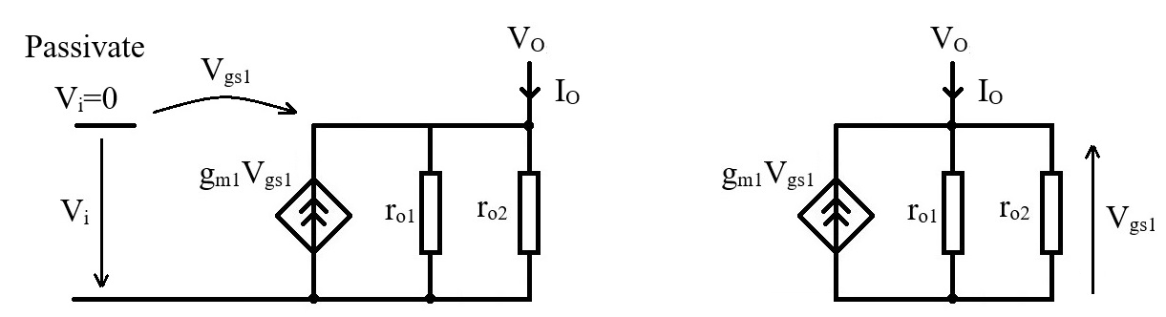
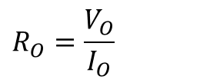
Common Drain Stage – Output Resistance
Note – To determine the output resistance for any small signal equivalent circuit, we will use the following method:
  We passivate all voltage sources.
  We apply a test voltage source at the output and we read the output current (through this test source)
  The equivalent output resistance is given by:
$$R_{O}=\frac{V_{O}}{I_{O}}$$

Slide 20
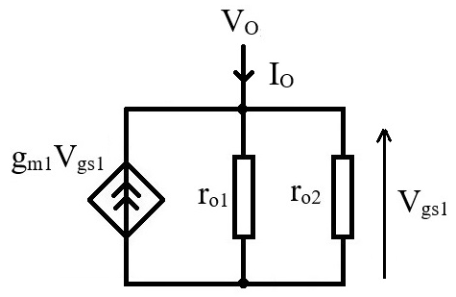

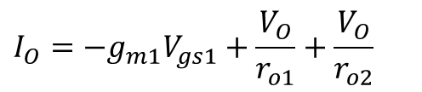
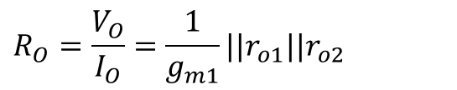
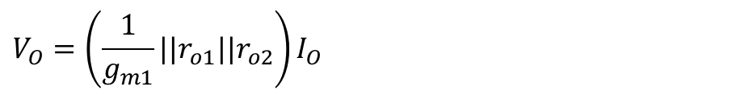
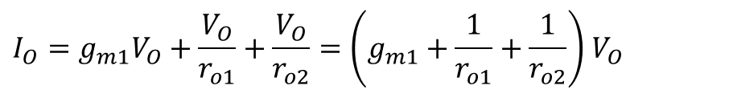

Common Drain Stage – Output Resistance
We have:
$$I_{O}={−g}_{m1}V_{gs1}+\frac{V_{O}}{r_{o1}}+\frac{V_{O}}{r_{o2}}$$
But, after passivation, we have
$$V_{gs1}=−V_{O}$$
So we get:
$$I_{O}=g_{m1}V_{O}+\frac{V_{O}}{r_{o1}}+\frac{V_{O}}{r_{o2}}=\left(g_{m1}+\frac{1}{r_{o1}}+\frac{1}{r_{o2}}\right){ V}_{O}$$
$$V_{O}=\left(\frac{1}{g_{m1}}||r_{o1}||r_{o2}\right)I_{O}$$
$$R_{O}=\frac{V_{O}}{I_{O}}=\frac{1}{g_{m1}}||r_{o1}||r_{o2}$$
As discussed before, r_{o}>>1/g_{m} so this can be approximated by:
$$R_{O}≅\frac{1}{g_{m1}}$$

Slide 21

Common Drain Stage – Substrate Effect
Problem description
The output voltage is given by.
$$V_{o}=V_{i}−V_{gs1}$$
For Region I, we argued that V_{gs1} is constant as V_{T} is a constant and the overdrive voltage is also constant as the drain current is constant.
$$V_{sg1}=V_{T}+V_{ov1}=ct.$$
On the other hand, we know that, due to the substrate effect, the threshold voltage varies with the source – bulk voltage. So we have to assess the source – bulk variation and take it into account in our analysis.

Slide 22
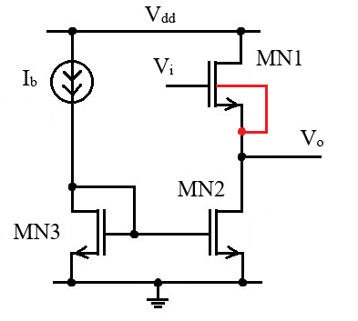
Common Drain Stage – Substrate Effect
Bulk connected to source
In this case, the bulk – source voltage is zero (and, more importantly, is constant) so there is no body effect – the threshold voltage remains constant.
The source follower has a gain close to 1.
For this implementation to be possible, we need a technology that allows floating substrate NMOS transistors. (The common source nmos transistor, MN1, needs to be placed in a isolated p well.)

Slide 23
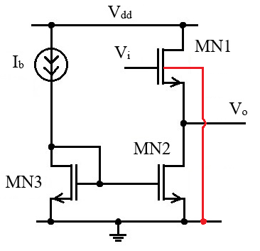

Common Drain Stage – Substrate Effect
Bulk connected to ground
In this case, the source – bulk voltage is equal to the output voltage.
$$V_{sb}=V_{O}$$
In this case we have significant source – bulk voltage that variates during circuit operation. This means that the threshold voltage will also vary.
$$V_{gs1}=V_{T}\left(V_{O}\right)+V_{ov1}$$
The expected effect is that the gain will be reduced (below 1). We will check this in the small signal analysis.

Slide 24
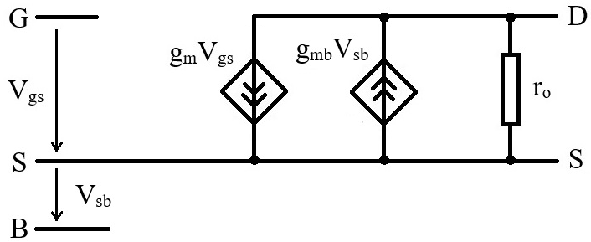

Common Drain Stage – Substrate Effect
We can use the reduced small signal equivalent circuit, as MN2 and MN3 are not affected by the substrate effect.
Form MN1 we need to add the g_{mb} current source.
MN1 source is connected to the output and the substrate is connected to ground, so V_{sb}=V_{O}. We have:
$${g_{mb}V}_{sb}=g_{mb}V_{O}$$
Mos transistor small signal model with substrate effect.

Slide 25
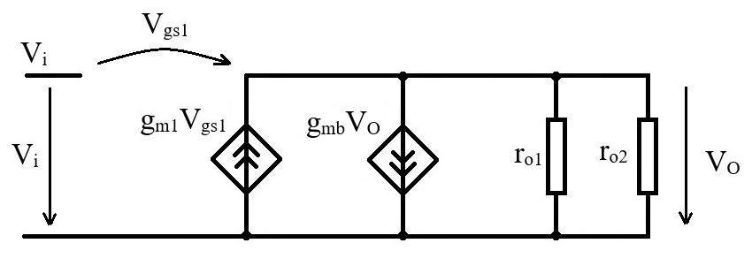
Common Drain Stage – Substrate Effect

Slide 26
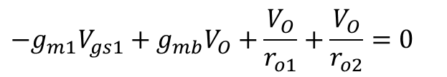
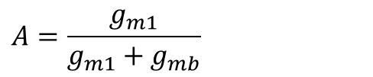
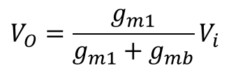
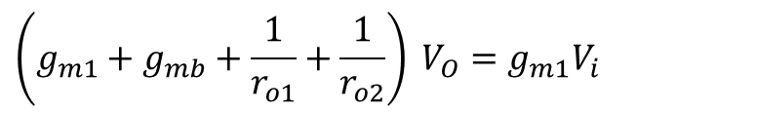

Common Drain Stage – Substrate Effect
Now to solve this. As before, we write the sum of all currents going out of the node equals zero.
$${−g}_{m1}V_{gs1}+g_{mb}V_{O}+\frac{V_{O}}{r_{o1}}+\frac{V_{O}}{r_{o2}}=0$$
$$\left(g_{m1}+g_{mb}+\frac{1}{r_{o1}}+\frac{1}{r_{o2}}\right) V_{O}=g_{m1}V_{i}$$
$$V_{gs1}=V_{i}−V_{O}$$
As before, g_{m1} is usually much larger than 1/r_{o}, so r_{o1} and r_{o2} can be ignored. So we get:
$$V_{O}=\frac{g_{m1}}{g_{m1}+g_{mb}}V_{i}$$
And the gain:
$$A=\frac{g_{m1}}{g_{m1}+g_{mb}}$$

Slide 27

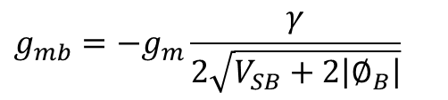
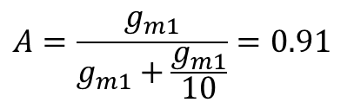
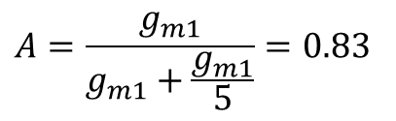
Common Drain Stage – Substrate Effect
We have seen that (see “Substrate Effect” lecture)
$$g_{mb}=−g_{m}\frac{γ}{2\sqrt{V_{SB}+2\left|∅_{B}\right|}}$$
Typically, this means that:
$$g_{mb}≅\frac{g_{m}}{5} …\frac{g_{m}}{10}$$
This gives us the range for the expected gain:
$$A=\frac{g_{m1}}{g_{m1}+\frac{g_{m1}}{5}}=0.83$$
$$A=\frac{g_{m1}}{g_{m1}+\frac{g_{m1}}{10}}=0.91$$

Slide 28
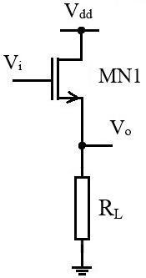

Common Drain Stage – Resistive Load
Let us analyze the resistive load common drain configuration.
In the small signal equivalent circuit, this just means replacing r_{o2} by the load resistance, R_{L}.
As long as
$$R_{L}≪g_{m1}$$
All approximations previously done (neglecting r_{o1} and r_{o2} in parallel to 1/g_{m}) are still valid and the gain and output resistance will be practically the same.
This is a reasonable assumption, as 1/g_{m} is usually a small impedance.
The problems with using a resistive load are:
  The output current is no longer given by a current mirror and will depend on the output voltage. This means that MN1 overdrive voltage will also vary and the shift between V_{O} and V_{i} will not be constant.
  The stage current capability will be less well controlled.

