Slide 1
Common Source Stage
FILS – Integrated Circuits

Slide 2
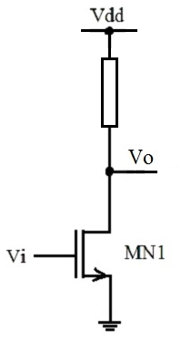

Common Source Stage – Resistive Load
Let us analyze the resistive load common source configuration.
The purpose of this analysis is to understand the limitations of the resistive load / the benefits of the active load.
In this case we have:
$$V_{O}=V_{dd}−R I_{O}$$
In the resistive load case, the small signal load resistance is no longer independent on the large signal operation point.
We could:
  Scenario 1 – Have the same operating point (d.c. output current and output voltage) and the same load resistance, but for this we usually would need a much larger supply voltage.
  Scenario 2 – Have the same output resistance and supply voltage, but this would force us to work at much lower currents.
  Scenario 3 – Have the same operating point (d.c. output current and output voltage) and same supply voltage, but that would force us to work at lower load resistance.

Slide 3
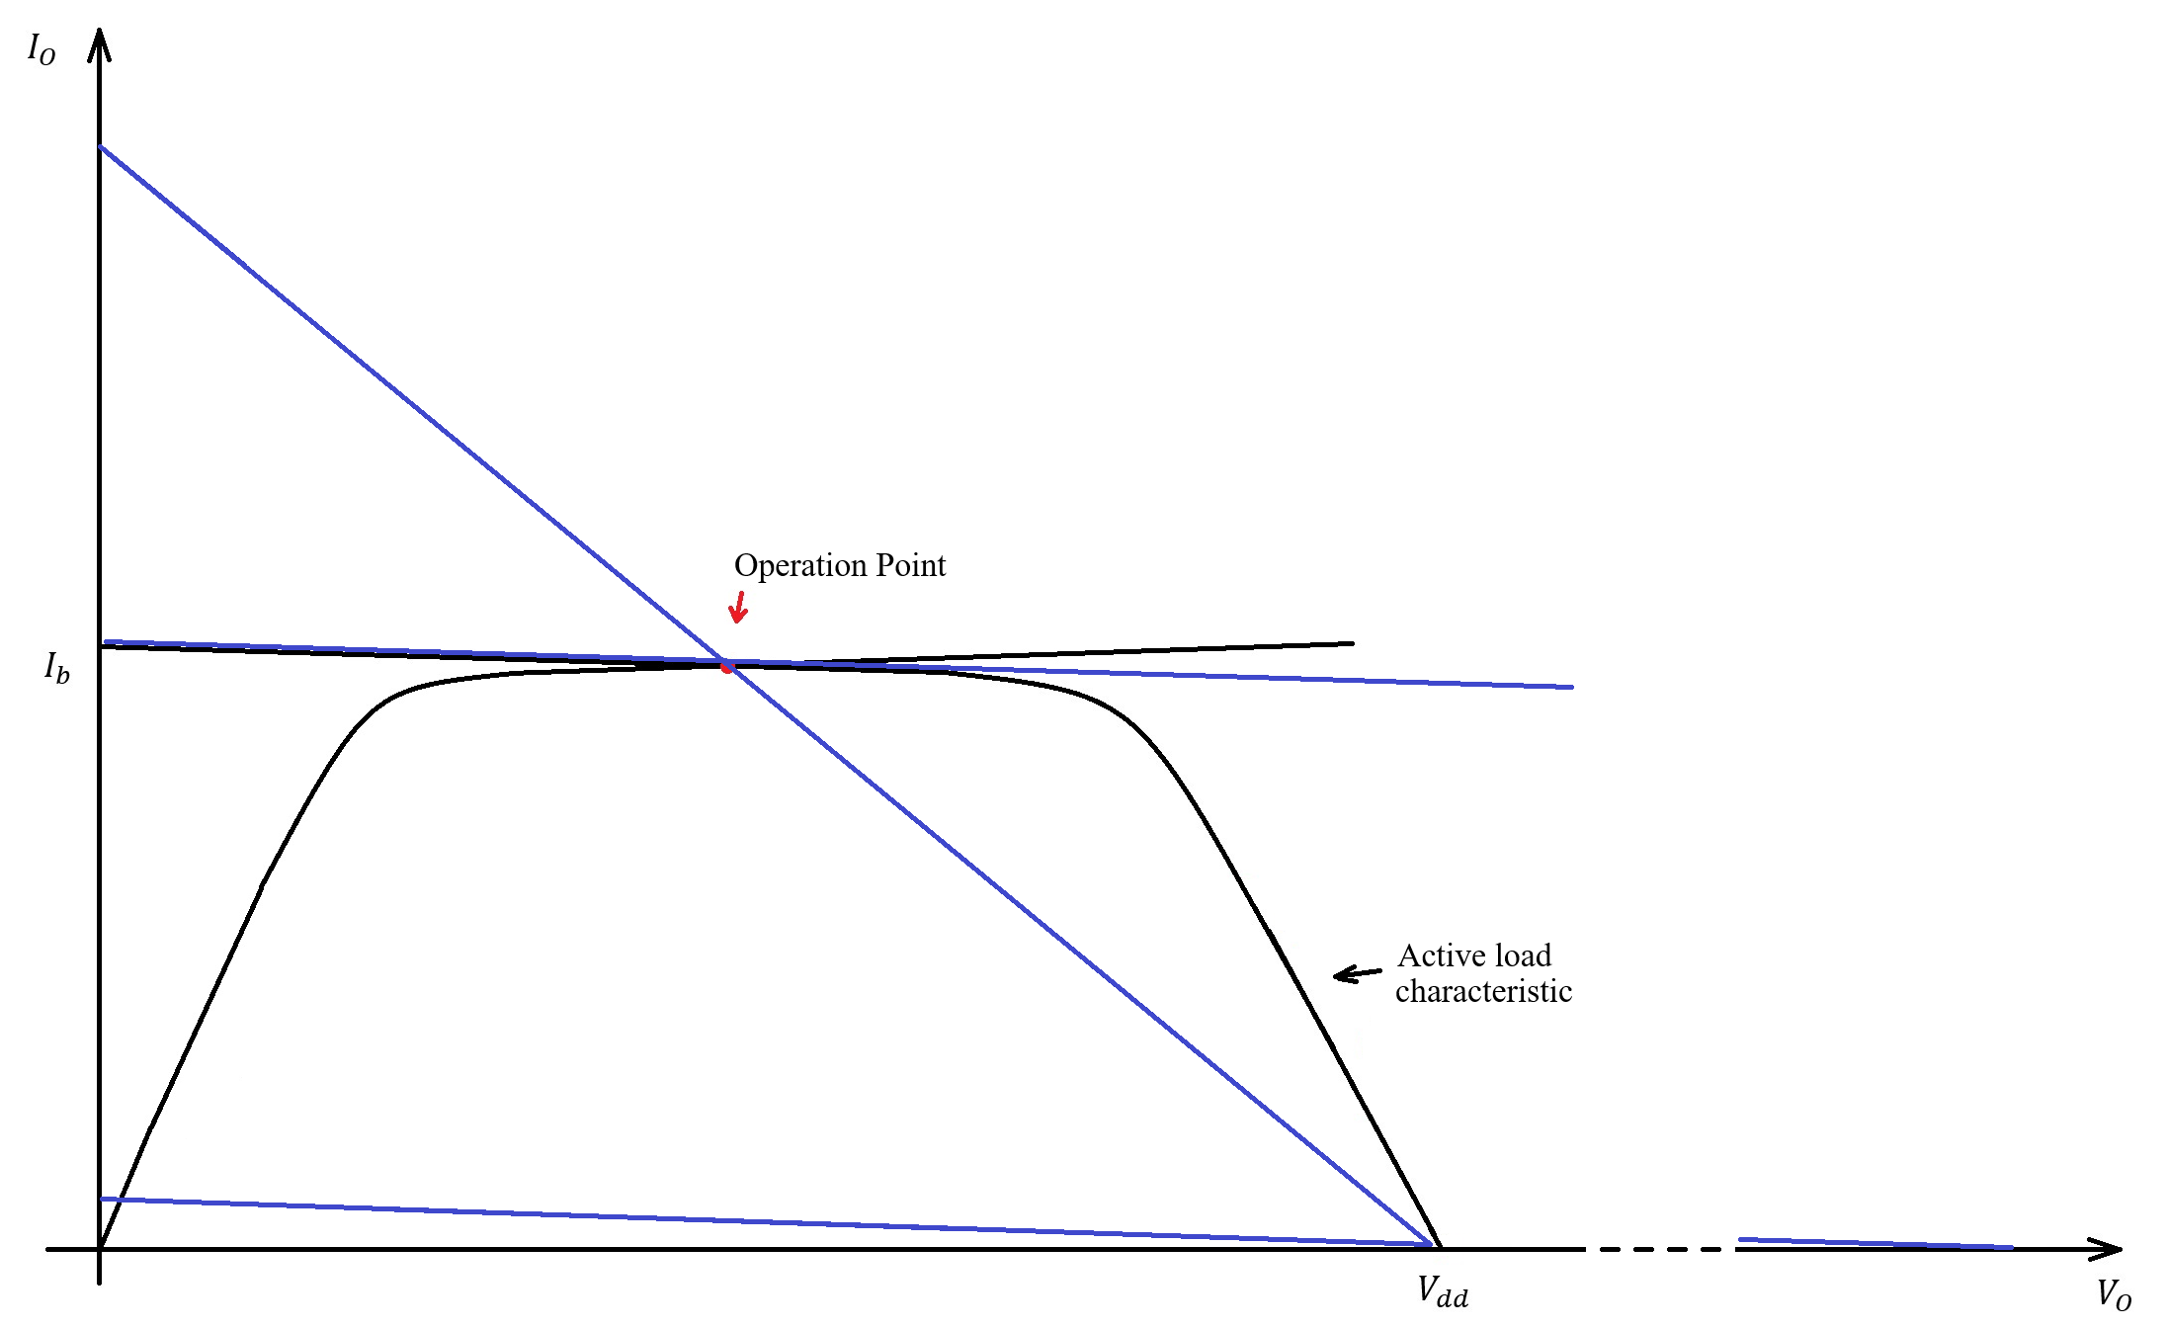
Common Source Stage – Resistive Load

Slide 4
Common Source Stage – Resistive Load
Numerical Example
Let us assume that, for the active load, we have an operation point of V_{O}=2.5V (middle off supply range), I_{O}=10uA and we also have a small signal output resistance of r_{o2}=2MΩ.
The three scenarios we discussed above are:
  Scenario 1 – We target the same operation point (V_{O}=2.5V , I_{O}=10uA) with a load resistance of R=2MΩ. To get the 10uA current, we need a voltage drop of RI_{O}=2MΩ x 10uA=20V on the resistive load. So the needed supply voltage would be V_{dd}=22.5V (2.5V output voltage + 20V on load resistor). In this case we would have the same gain as in the active load case.
  Scenario 2 – We use a resistor equal to the active load equivalent resistance, R=2MΩ, but keep the 5V supply voltage and the V_{O}=2.5V d.c. output voltage. In this case, the bias current is I_{O}=(V_{dd}-V_{O})/R=2.5V/2MΩ, we get I_{O}=1.25uA. This significantly lower current results in a lower MN1 transconductance and thus in a lower gain.
  Scenario 3 – we target the same operation point (V_{O}=2.5V , I_{O}=10uA) and same supply voltage, V_{dd}=5V, and adjust the load resistance accordingly. We have V_{dd}-V_{O}=RI_{O}, wo R=(V_{dd}-V_{O})/I_{O}=2.5V/10uA=250kΩ. This means that we can use a significantly lower load resistance, so the gain will also be lower.
Of course, no one designs a resistive load common source stage starting from an active load common source specifications – but the limitations remain. The most common situation is that the output resistance and gain will be significantly lower for the resistive load common source compared to the active load one.

Slide 5
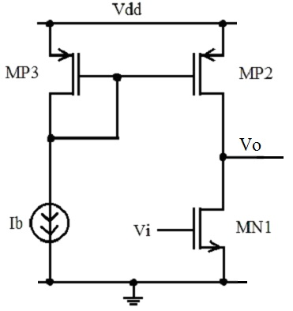
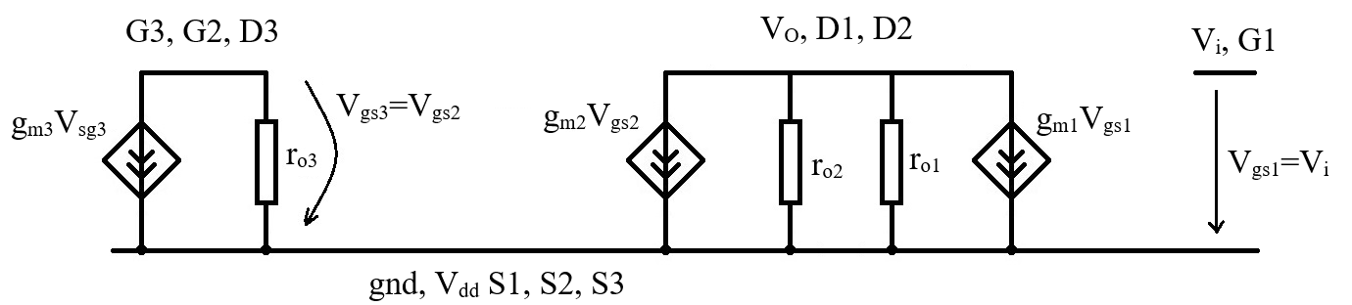
Common Source Stage – Small Signal Analysis
MOS transistor small signal equivalent circuit:
Common source (with active load) small signal equivalent circuit:

Slide 6

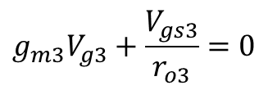



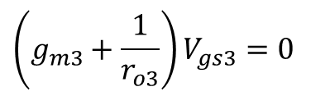
Common Source Stage – Small Signal Analysis
To solve this, we apply the node voltage method.
We start by solving node G3:
$$g_{m3}V_{g3}+\frac{V_{gs3}}{r_{o3}}=0$$
$$\left(g_{m3}+\frac{1}{r_{o3}}\right)V_{gs3}=0$$
$$V_{gs3}=0$$
But G3 and G2 are connected to the same node, so we have
$$V_{gs3}=V_{gs2}$$
$$V_{gs2}=0$$
Note – MP2, MP3 form a bias mirror, so this is exactly the same situation we solved in the previous lecture.
This result tells us that:
$$g_{m2}V_{gs2}=0$$

Slide 7
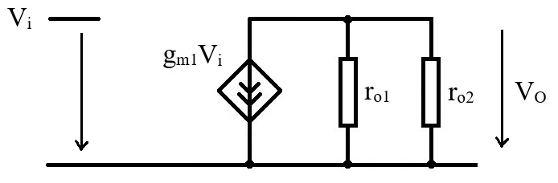

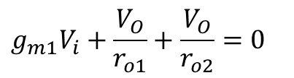


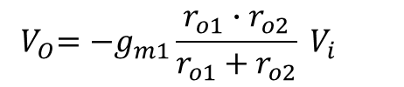
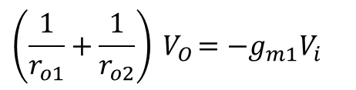
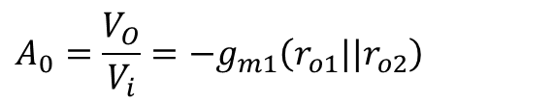
Common Source Stage – Small Signal Analysis
With this result, we can simplify the equivalent circuit.
Now, we solve for the output node:
$$r_{o1}||r_{o2}$$
$$g_{m1}V_{i}+\frac{V_{O}}{r_{o1}}+\frac{V_{O}}{r_{o2}}=0$$
$$\left(\frac{1}{r_{o1}}+\frac{1}{r_{o2}}\right){ V}_{O}=−g_{m1}V_{i}$$
$${ V}_{O}=−g_{m1}{\frac{r_{o1}∙r_{o2}}{r_{o1}+r_{o2}} V}_{i}$$
$${ V}_{O}=−g_{m1}\left(r_{o1}||r_{o2}\right){ V}_{i}$$
By definition, the gain is given by:
$$A_{0}=\frac{V_{O}}{V_{i}}$$
So, for the common source, we get:
$$A_{0}=\frac{V_{O}}{V_{i}}=−g_{m1}\left(r_{o1}||r_{o2}\right)$$

Slide 8
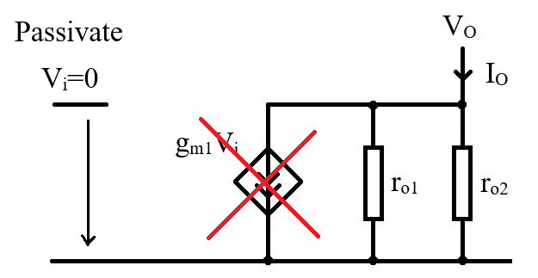
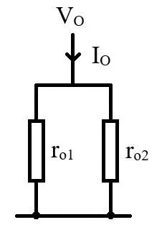

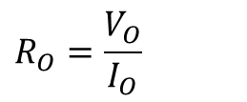
Common Source Stage – Output Resistance
Note – To determine the output resistance for any small signal equivalent circuit, we will use the following method:
  We passivate all voltage sources.
  We apply a test voltage source at the output and we read the output current (through this test source)
  The equivalent output resistance is given by:
$$R_{O}=\frac{V_{O}}{I_{O}}$$
For our circuit, after passivating Vi, we end up with r_{o1} and r_{o2} connected in parallel:
$$R_{O}=r_{o1}||r_{o2}$$

Slide 9
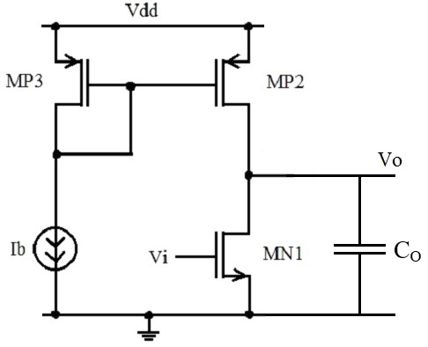
Common Source Stage – Transfer Function
Now, we shall consider the case in which we have a capacitive load.
First of all, why is this case relevant? Our analysis assumed MN1 and MP2 in saturation (Region III) and in this case the dominant capacitances are C_{gs} – this does not reflect this situation at all.
C_{gs1} is connected to the input voltage source. In our analysis, an ideal voltage source gives 0 impedance to the node regardless of the capacitance connected to it. Is this realistic? Obviously not.. But to analyze the input node we need to know the circuit driving it – so we need to perform the analysis on the output stage of the driving circuit.
C_{gs2} is shorted to ground as G2 is ground in small signal.
C_{gd1} is an interesting capacitance (a Miller capacitance), but we ill neglect it in this analysis as it is generally small in saturation.
So.. Where does C_{O} come from? C_{O} is the input capacitance to the next stage. We assumed so far that the output is “open” and we justified this assumption by saying that the output is usually connected to a MOS transistor gate (input to a next stage). Well, this assumption works fine in d.c. but in the small signal analysis we need to take the load capacitance into account.

Slide 10
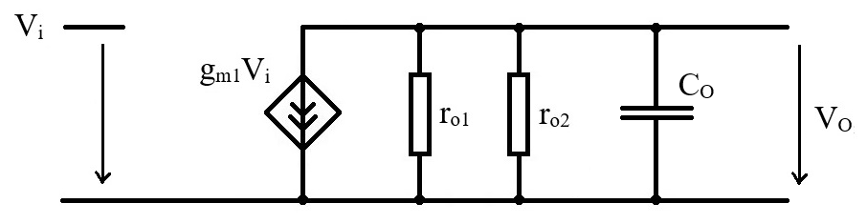
Common Source Stage – Transfer Function
Small signal equivalent circuit – we added a capacitor on the output node, so the small signal equivalent circuit will be exactly the same plus the new capacitor on the output node.
We can use the simplified small signal equivalent circuit (with the bias current mirror solved out) as all the steps done during the simplification are not affected by the output capacitor and are still valid.

Slide 11
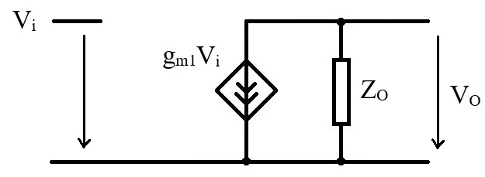


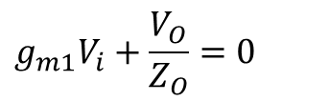

Common Source Stage – Transfer Function
To make solving this easier, we note that r_{o1}, r_{o2} and C_{O} are connected in parallel. We already have the R_{O} notation for r_{o1}||r_{o2} (see output resistance slide). We introduce the Z_{O} notation for R_{O} parallel to C_{O}.
With this notation, the equation for the output node becomes:
$$g_{m1}V_{i}+\frac{V_{O}}{Z_{O}}=0$$
$$V_{O}=−g_{m1}Z_{O}V_{i}$$
This result is very similar to the small signal low frequency case (were there was no C_{O}). The only difference is that the output resistance was replaced by the output impedance.
$$Z_{O}$$
$$R_{O}=r_{o1}||r_{o2}$$

Slide 12
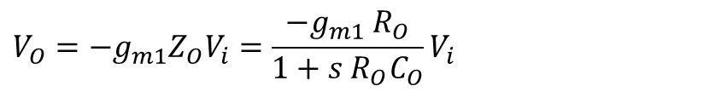
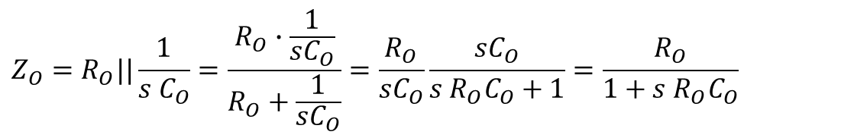
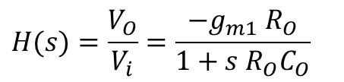
Common Source Stage – Transfer Function
Now to evaluate Z_{O}.
$$Z_{O}=R_{O}||\frac{1}{s C_{O}}=\frac{R_{O}∙\frac{1}{sC_{O}}}{R_{O}+\frac{1}{sC_{O}}}=\frac{R_{O}}{sC_{O}}\frac{sC_{O}}{s{ R}_{O}C_{O}+1}=\frac{R_{O}}{1+s{ R}_{O}C_{O}}$$
With this, we have.
$$V_{O}=−g_{m1}Z_{O}V_{i}=\frac{−g_{m1} R_{O}}{1+s{ R}_{O}C_{O}}V_{i}$$
The transfer function is, by definition, V_{O}/V_{i}. With this, we get:
$$H(s)=\frac{V_{O}}{V_{i}}=\frac{−g_{m1} R_{O}}{1+s{ R}_{O}C_{O}}$$

Slide 13


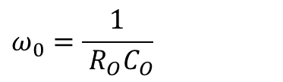
Common Source Stage – Transfer Function
But we have already seen that the small signal low frequency gain is
$$A_{0}=−g_{m1}R_{O}$$
We introduce the following notation for the system pole:
$$ω_{0}=\frac{1}{{ R}_{O}C_{O}}$$
And switch to the Fourier notation (s → jω)
With this, the function becomes:
$$H(s)=\frac{ A_{O}}{1+j\frac{ω}{ω_{0}}}$$

