Slide 1
Common Source Stage
FILS – Integrated Circuits

Slide 2
Pulling a node up/down
Let us understand the expression “a node is pulled up (or down)”. (in romana: nodul este tras in sus (sau in jos))
We shall consider the following scenario:
We have a node that is connected both towards supply and ground through one ore more components (or subcircuits). This is an extremely general case – this can be any node in our circuit.
The node is in equilibrium. This means (according to Kirchhoff I) the sum of all currents sourced into the node is equal to the sum of all currents sink out of the node.
Now let’s assume that one of the components connecting the node to ground starts sinking more current.
In this case, the circuit needs to find a new equilibrium position, corresponding to a new node voltage.
Usually, all components have the current directly proportional to the voltage applied on them.
The unbalance we introduced is in favor of the sink current. So the new node voltage needs to favor the sourced current to bring back the equilibrium.
This means that the new node voltage will be lower, as this increases the voltage drop on the components connecting the node to supply (thus increasing the sourced current) and reduces the voltage drop on the components connecting the node to ground (thus reducing the sink current).
We say that the “node is pulled down”.
A similar but opposite argument can pe applied to the case we increased the sourced current, the node will then move up.
Conclusion:
A node is “pulled down” by drawing current out of it (sink current).
A node is “pulled up” by injecting current into it (sourced current).

Slide 3
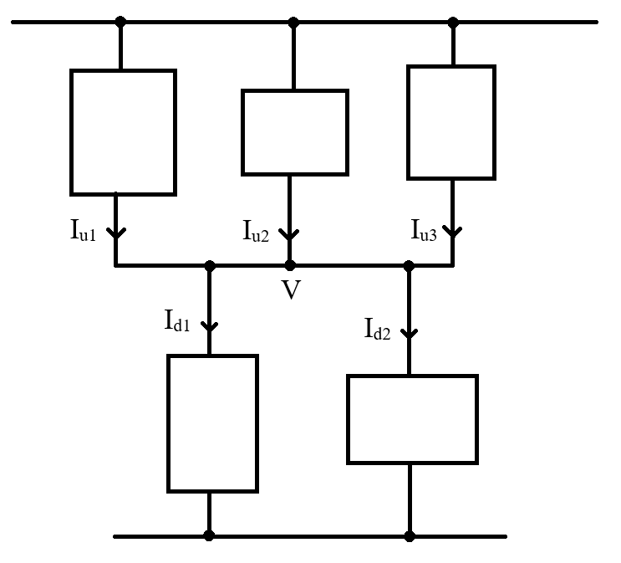
Pulling a node up/down

Slide 4
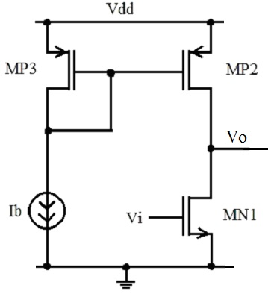
Common Source Stage
The active load common source stage is presented here.
MN1 transistor is the actually common source stage.
MP2 and MP3 form the active load current mirror.

Slide 5
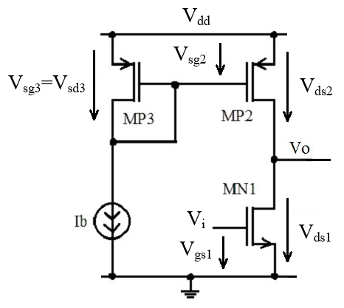
Common Source Stage
Before we start, let us evaluate the used voltages.
In our MOS transistor model we work with V_{gs} and V_{ds} voltages (V_{sg} and V_{sd} for PMOS transistors) so we need to express this voltages for each transistor.
$$V_{gs1}=V_{i}$$
$$V_{ds1}=V_{O}$$
$$V_{sg2}=V_{sg3}=V_{sd3}=ct.$$
$$V_{sd2}=V_{dd}−V_{O}$$

Slide 6
Common Source Stage – Large Signal Analysis
We analyze the circuit considering the output is “open” (no current if flowing out of the circuit). This is a realistic assumption as usually the output is connected to a MOS transistor gate.
Note: As there is no current flowing out of the circuit, we can “reuse” the “output current” label to denote the common drain current of MN1 and MP2 (current through the output stage).
$$I_{O}=I_{D1}=I_{D2}$$
To understand the circuit behavior we apply the following approach:
We draw the output characteristics for both MN1 and MP2 transistors on the same graph, as a function of V_{O}.
MN1 and MP2 currents are equal (as we assumed above no current flows out of the circuit). This means that operation point will be at the intersection of the two output characteristics.
This is a rather strange graph: output current as a function of output voltage. But this is a good graphical way of determining the V_{O} value for which MN1 and MP2 currents are equal.
We use the approach described above to:
Identify the operation modes (and the associated conditions)
Derive the V_{O}(V_{i}) characteristic
Derive the I_{O}(V_{i}) characteristic

Slide 7
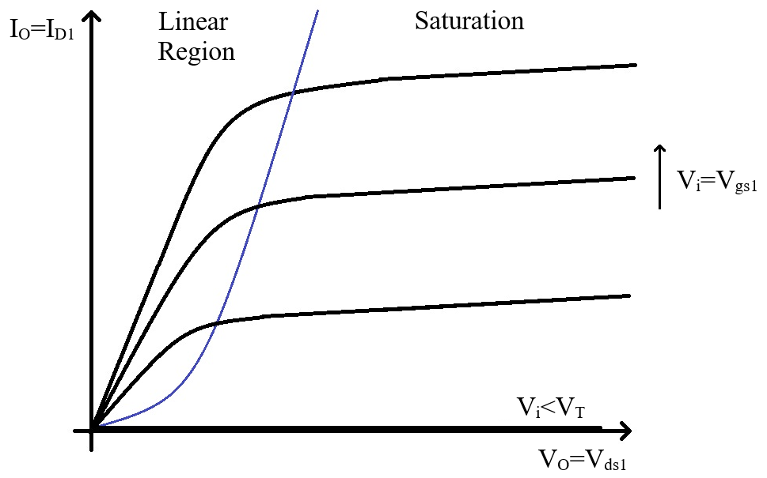
Common Source Stage – Large Signal Analysis
For MN1:
V_{O} represents the drain – source voltage V_{O}=V_{ds1}.
V_{i} represents the gate – source voltage V_{i}=V_{gs1}.
We vary V_{i} from 0 to V_{dd}, so we have a complete family of I_{D}(V_{ds}) at constant V_{gs} characteristics.

Slide 8
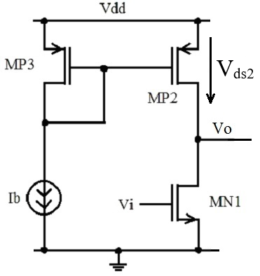
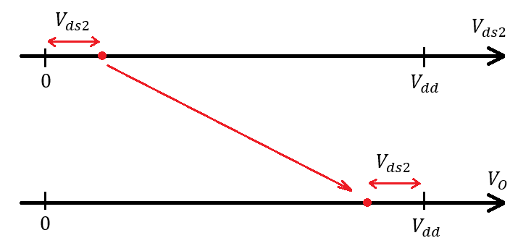
Common Source Stage – Large Signal Analysis
MP2 is part of the MP2, MP3 current mirror, so it’s source – gate voltage is fixed by MP3.
MP3 is biased in saturation and has I_{b} current, so it’s source – gate voltage is given by:
$$V_{sg2}=V_{sg3}=V_{T}+\sqrt{\frac{2 I_{b}}{μ_{p}C_{ox} {\left(W/L\right)}_{3}}}$$
$$I_{b}=I_{D3}=\frac{1}{2} μ_{p}C_{ox}{\left(\frac{W}{L}\right)}_{3}{\left(V_{sg}−V_{T}\right)}^{2}$$
So we have only one characteristic, corresponding to V_{gs2} given above.
On the other hand, for MP2 we have:
$$V_{sd2}=V_{dd}−V_{O}$$
So we need to apply a variable change (V_{ds2} to V_{O}) to get the characteristic we want.
$$V_{sd2}=V_{dd}−V_{O}$$
$$V_{O}=V_{dd}−V_{sd2}$$
So we need to apply a variable change (V_{ds2} to V_{O}) to get the characteristic we want.

Slide 9
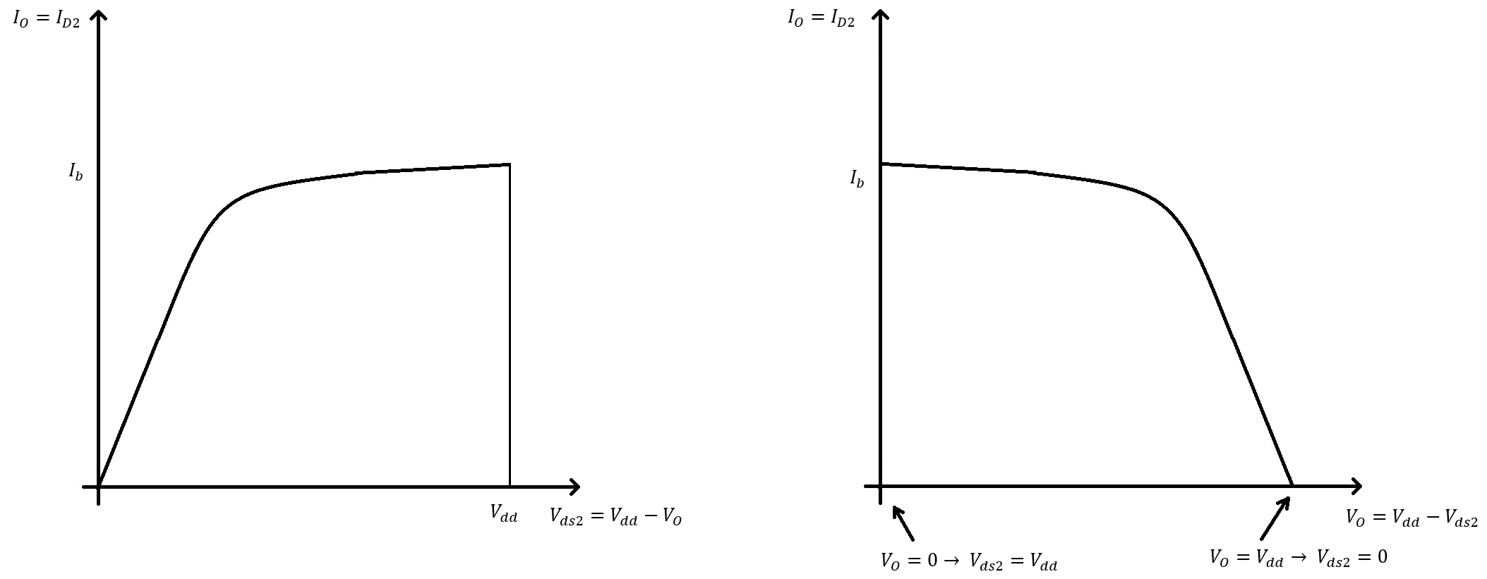
Common Source Stage – Large Signal Analysis
Sow, the I_{D2}(V_{O}) characteristic looks like this:
The minus sign corresponds to a mirroring with respect to the vertical axis
Adding V_{dd} corresponds to a linear shift to the right.

Slide 10
Common Source Stage – Large Signal Analysis
Region I
Condition:
$$V_{i}<V_{T}$$
MN1 is blocked (V_{gs1}=V_{i}<V_{T}).
$$I_{D1}=0=I_{O}$$
MP2 is biased in the (deep) Linear Region.
Indeed, MP2 is opened (V_{gs2} is given by V_{gs3} and is above V_{T}, see previous slides) but I_{D2}=I_{D1}=0. The only way MN2 can have I_{D2}=0 with V_{gs2}>V_{T} is to have V_{ds2}=0 – this corresponds to the deep Linear Region.
$I_{D2}=μ_{p}C_{ox}{\left(\frac{W}{L}\right)}_{2}\left[\left(V_{gs2}−V_{T}\right)V_{ds2}−\frac{V_{ds2}^{2}}{2}\right]=$ $μ_{p}C_{ox}{\left(\frac{W}{L}\right)}_{2}\left[V_{ov2}\left(V_{dd}−V_{O}\right)−\frac{{\left(V_{dd}−V_{O}\right)}^{2}}{2}\right]=I_{D1}=0$
This can only be fulfilled is:
$$V_{dd}−V_{O}=0$$
So, during Region I, the output voltage is equal to V_{dd}:
$$V_{O}=V_{dd}$$

Slide 11
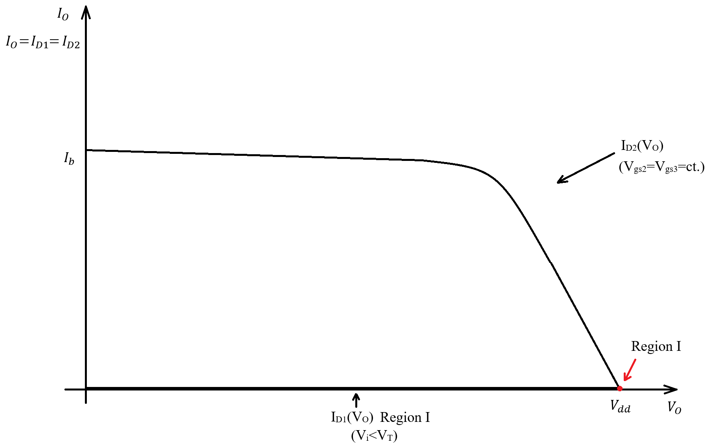
Common Source Stage – Large Signal Analysis
Region I

Slide 12
Common Source Stage – Large Signal Analysis
Region I
Now to draw the V_{O}(V_{i}) and I_{O}(V_{i}) characteristics for Region I.
Region I lasts from V_{i}=0 to V_{i}=V_{T}.
As shown before, the output voltage is constant and equal to Vdd during Region I
$$V_{O}=V_{dd}$$
The output current is zero during Region I (as MN1 is blocked).
$$I_{O}=0$$

Slide 13
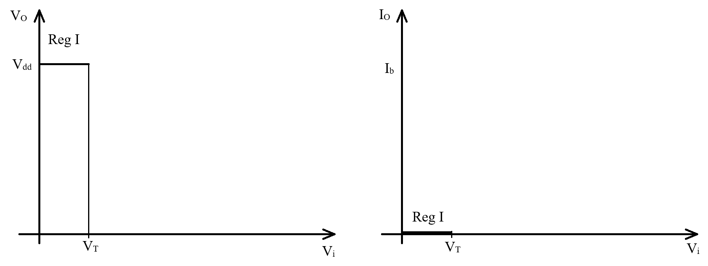
Common Source Stage – Large Signal Analysis
Region I

Slide 14
Common Source Stage – Large Signal Analysis
Region II
Condition:
$$V_{T}<V_{i}<V_{T}+V_{ovx}$$
We switch to Region II when the input voltage gets above the threshold and MN1 turns on.
We will explain the upper limit (and who V_{ovx} is) when we analyze Region III.
MN1 is biased in Saturation
Indeed, MN1 is now opened (V_{gs1}=V_{i}>V_{T}) but with low overdrive, so it is not able to pull the output node too low.
MN1 is described by: (saturation equation, V_{gs1}=V_{i}, we can neglect the channel length modulation term)
$$I_{D1}=\frac{1}{2} μ_{n}C_{ox}{\left(\frac{W}{L}\right)}_{1}{\left(V_{i}−V_{T}\right)}^{2}=I_{O}$$
MP2 is biased in the Linear Region.
MN1 is has lower current, so MN2 needs to work in the linear region so it can adapt to MN1 current. This time the current is no longer 0, we are no longer in the deep linear region.
$I_{D2}=μ_{p}C_{ox}{\left(\frac{W}{L}\right)}_{2}\left[\left(V_{gs2}−V_{T}\right)V_{ds2}−\frac{V_{ds2}^{2}}{2}\right]=$ $μ_{p}C_{ox}{\left(\frac{W}{L}\right)}_{2}\left[V_{ov2}\left(V_{dd}−V_{O}\right)−\frac{{\left(V_{dd}−V_{O}\right)}^{2}}{2}\right]=I_{0}$
If we force I_{D1}=I_{D2}, we get a second order equation in V_{O}, with V_{i} as parameter. This can be solved algebraically and the result will depend on square root of V_{i}.

Slide 15
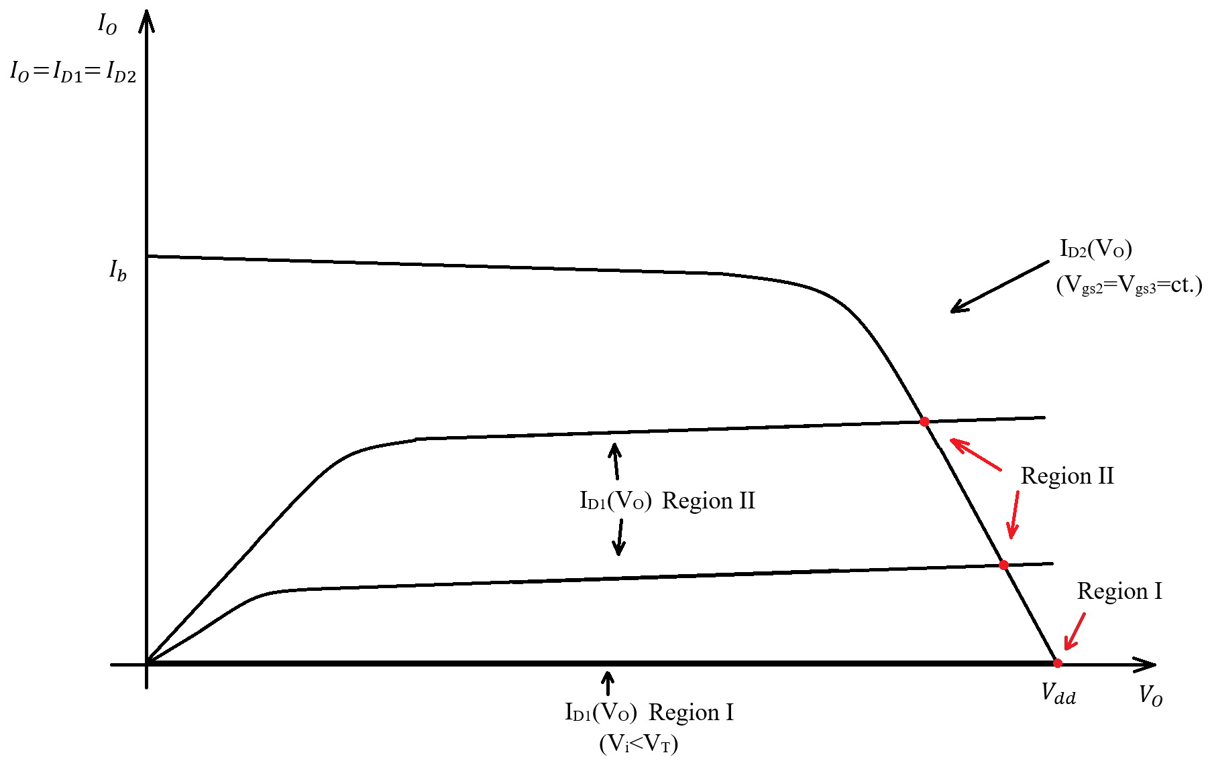
Common Source Stage – Large Signal Analysis
Region II

Slide 16
Common Source Stage – Large Signal Analysis
Region II
Now to draw the V_{O}(V_{i}) and I_{O}(V_{i}) characteristics for Region II.
Region II lasts from V_{i}=VT to V_{i}=V_{T}+V_{ovx}.
The transition from Region II to Region III corresponds to MP2 switching from linear region to saturation. So the output voltage at the end of Region II corresponds to:
$$V_{ds2, sat}=V_{ov2}=\sqrt{\frac{2 I_{b}}{μ_{p}C_{ox} {\left(W/L\right)}_{3}}}=ct.$$
The output voltage at the end of Region II is:
$$V_{O}\left(V_{i}=V_{T}+V_{ovx}\right)=V_{dd}−V_{ov2}$$
At the end of Region II, MP2 switches to saturation, so the output current will be I_{b} (MP2 saturation current, this is under the assumption that MP2 and MP3 are identical):

Slide 17
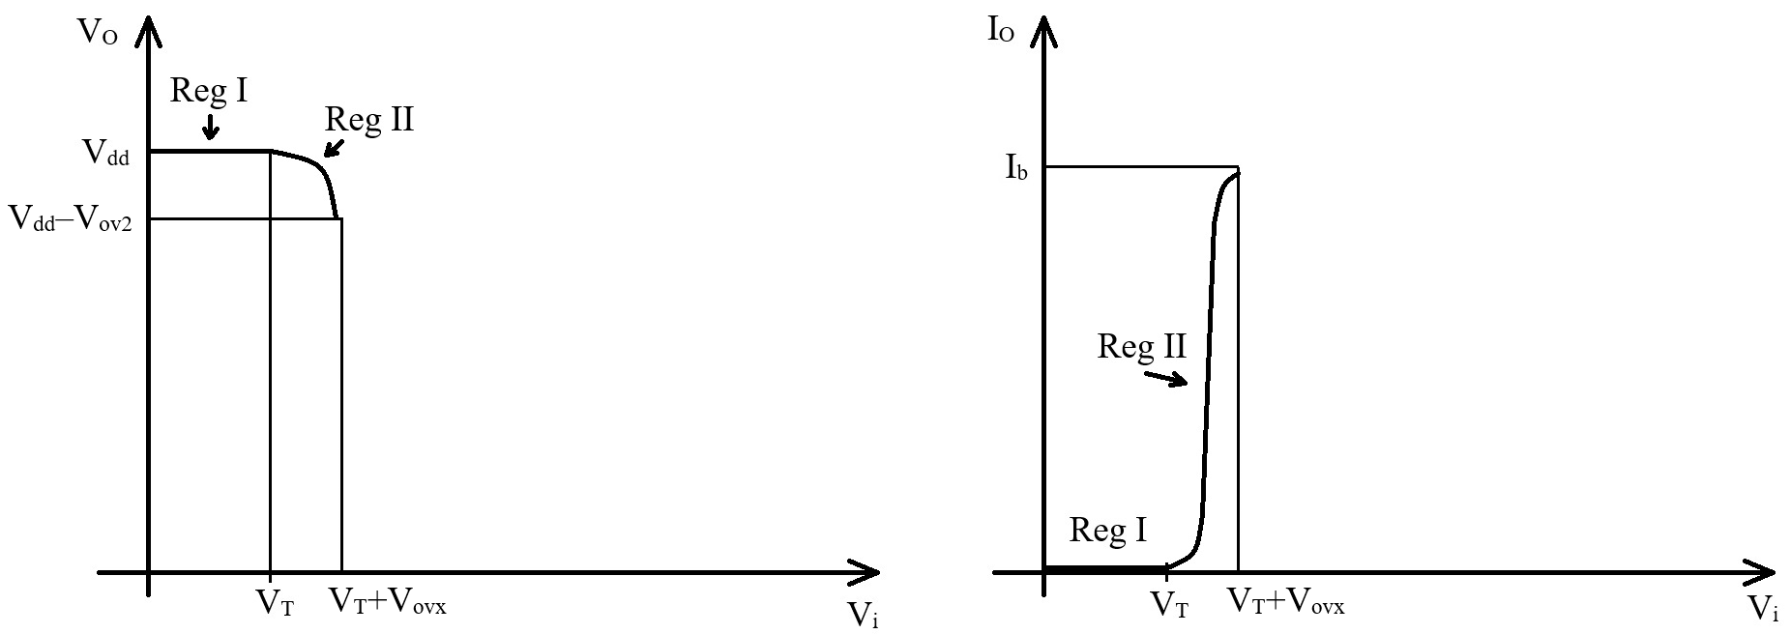
Common Source Stage – Large Signal Analysis
Region II

Slide 18
Common Source Stage – Large Signal Analysis
Region III
Condition:
$$V_{i}≅V_{T}+V_{ovx}$$
Region III is the region where both MN1 and MN2 are in saturation.
Let us first try to neglect the channel length modulation effect and see what happens…
Both transistors are described by the saturation equation
$$I_{D1}=\frac{1}{2} μ_{n}C_{ox}{\left(\frac{W}{L}\right)}_{1}{\left(V_{i}−V_{T}\right)}^{2}=I_{O}$$
$$I_{D2}=\frac{1}{2} μ_{p}C_{ox}{\left(\frac{W}{L}\right)}_{2}V_{ov2}^{2}=I_{O}=I_{b}$$
The resulting equation does not depend on the output voltage! Instead, it is an equation for V_{i}.
If we neglect the channel length modulation effect, there is only one V_{i} voltage for which the saturation currents of MN1 and MP2 perfectly match.
This allows us to introduce V_{ovx} – the MN1 overdrive voltage for which MN1 has the same saturation current as MP2.
$$V_{i}=V_{T}+\sqrt{\frac{2 I_{b}}{μ_{n}C_{ox} {\left(W/L\right)}_{1}}}$$
$$V_{ovx}=\sqrt{\frac{2 I_{b}}{μ_{n}C_{ox} {\left(W/L\right)}_{1}}}$$

Slide 19
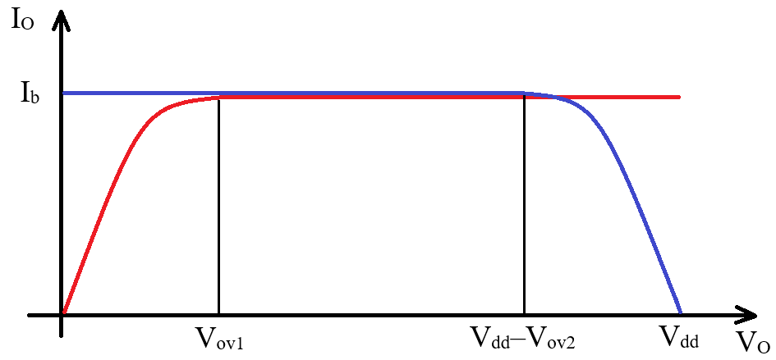
Common Source Stage – Large Signal Analysis
Region III
If this happens (this = MN1 and MN2 saturation currents perfectly match and we neglect channel length modulation), the output voltage in undefined. Any value between V_{ov1} and V_{dd}-V_{ov2} fulfills the current equation.
This leads to an infinite gain:
If V_{i}<V_{T}+V_{ovx} by any (arbitrarily small) margin, MN1 current is lower then MP2 saturation current, so MP2 needs to be in the linear region. As a result V_{O}>V_{dd} – V_{ov2}.
The moment V_{i}>V_{T}+V_{ovx}, again by any (arbitrarily small) margin, MN1 saturation current becomes too large for MP2, so MN1 needs to be in linear region. This means that the output value jump to V_{o}<V_{ov1}.

Slide 20
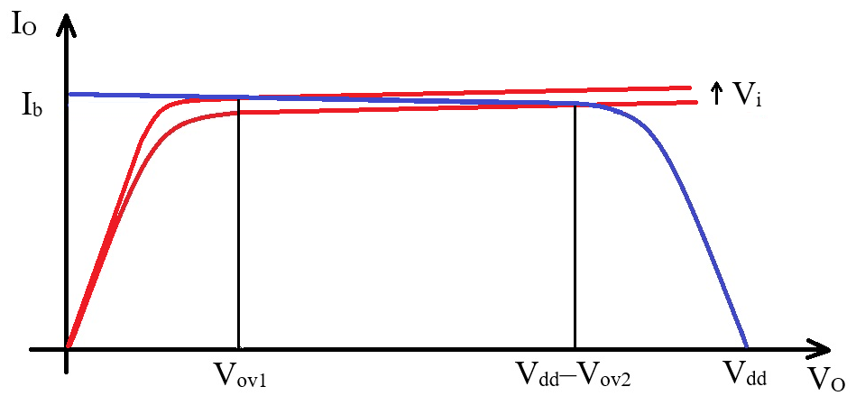
Common Source Stage – Large Signal Analysis
Region III
This is not really physical… This only shows us that, when analyzing Region III we must take into account the channel length modulation effect. With this, the equations for Region III become:
$$I_{D1}=\frac{1}{2} μ_{n}C_{ox}{\left(\frac{W}{L}\right)}_{1}{\left(V_{i}−V_{T}\right)}^{2}\left(1+λ_{1}V_{O}\right)=I_{O}$$
$$I_{D2}=\frac{1}{2} μ_{p}C_{ox}{\left(\frac{W}{L}\right)}_{2}V_{ov2}^{2}\left(1+λ_{2}\left(V_{dd}−V_{O}\right)\right)=I_{O}$$
Note that, taking the channel length modulation into account, MP2 current is no longer precisely equal to I_{b}.
This equations now depend on V_{O} and can be solved for the V_{O}(V_{i}) characteristic.

Slide 21
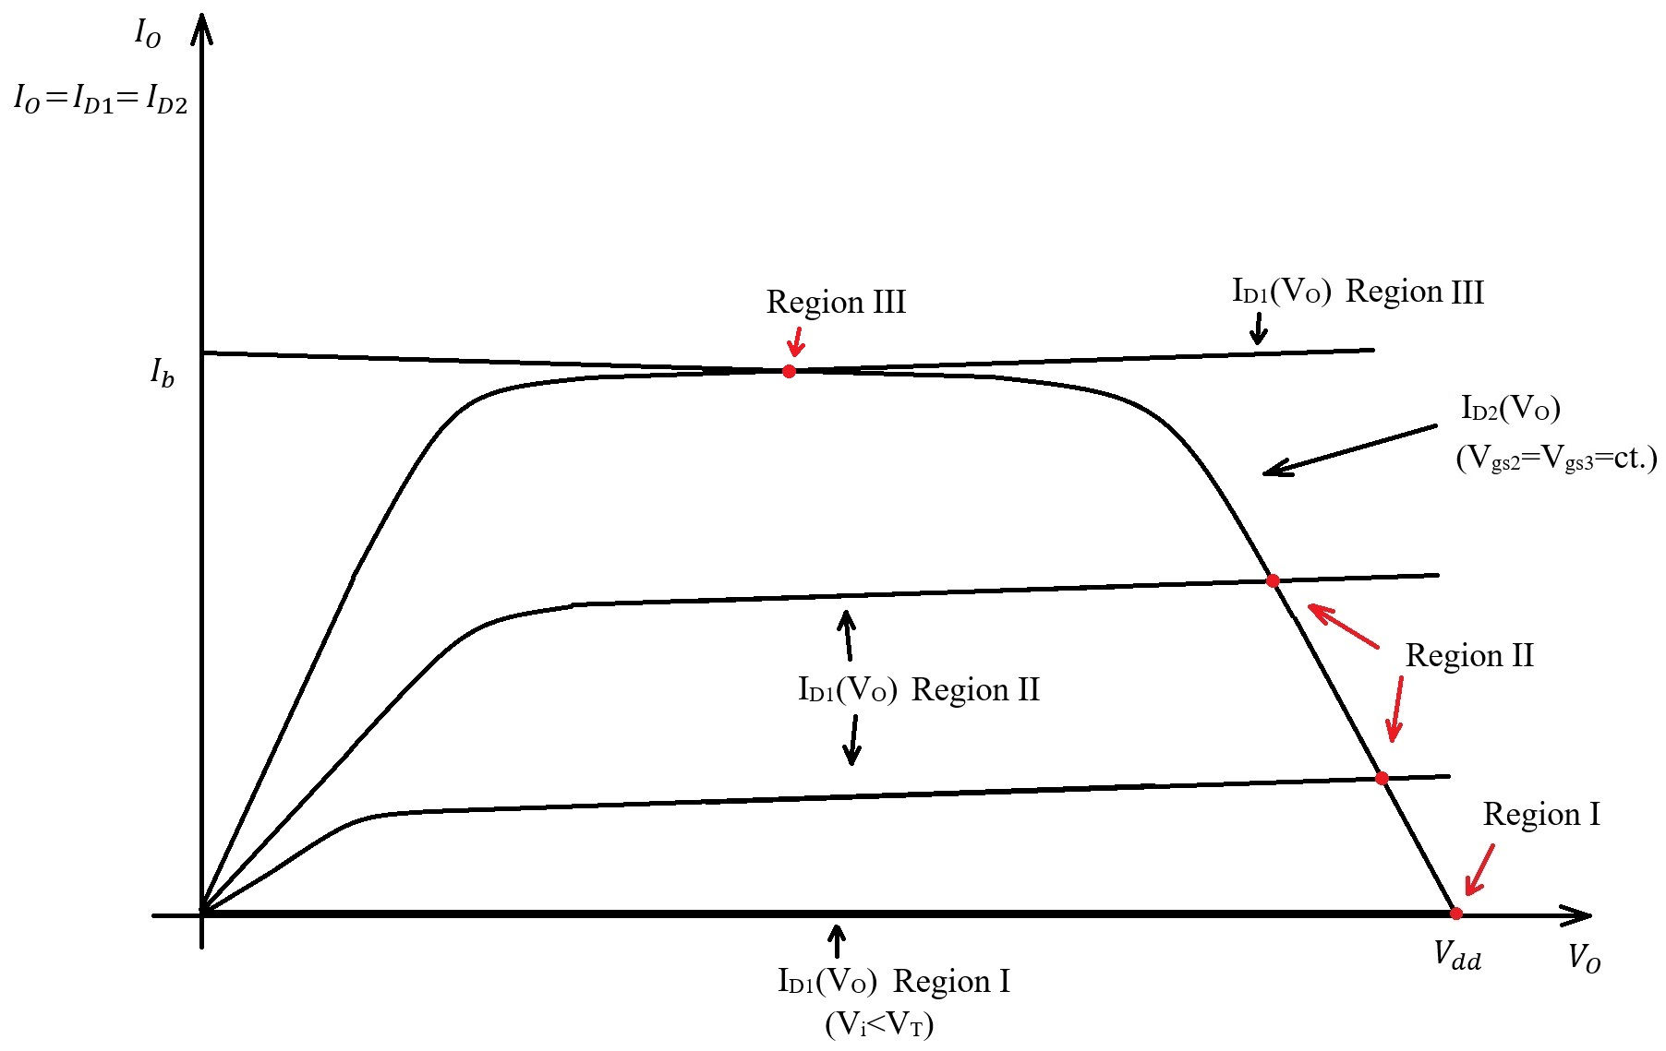
Common Source Stage – Large Signal Analysis
Region III

Slide 22
Common Source Stage – Large Signal Analysis
Region III
Now to draw the V_{O}(V_{i}) and I_{O}(V_{i}) characteristics for Region III.
Region II is located around V_{i}=V_{T}+V_{ovx}.
During Region III, the output voltage varies from:
$$V_{O}=V_{dd}−V_{ov2}$$
to:
$$V_{O}=V_{ovx}$$
Note that V_{ovx} is, by definition, V_{ov1} during Region III.
On the I_{O}(Vi) graph, nothing much happens – the current is still equal to I_{b} during Region III.

Slide 23
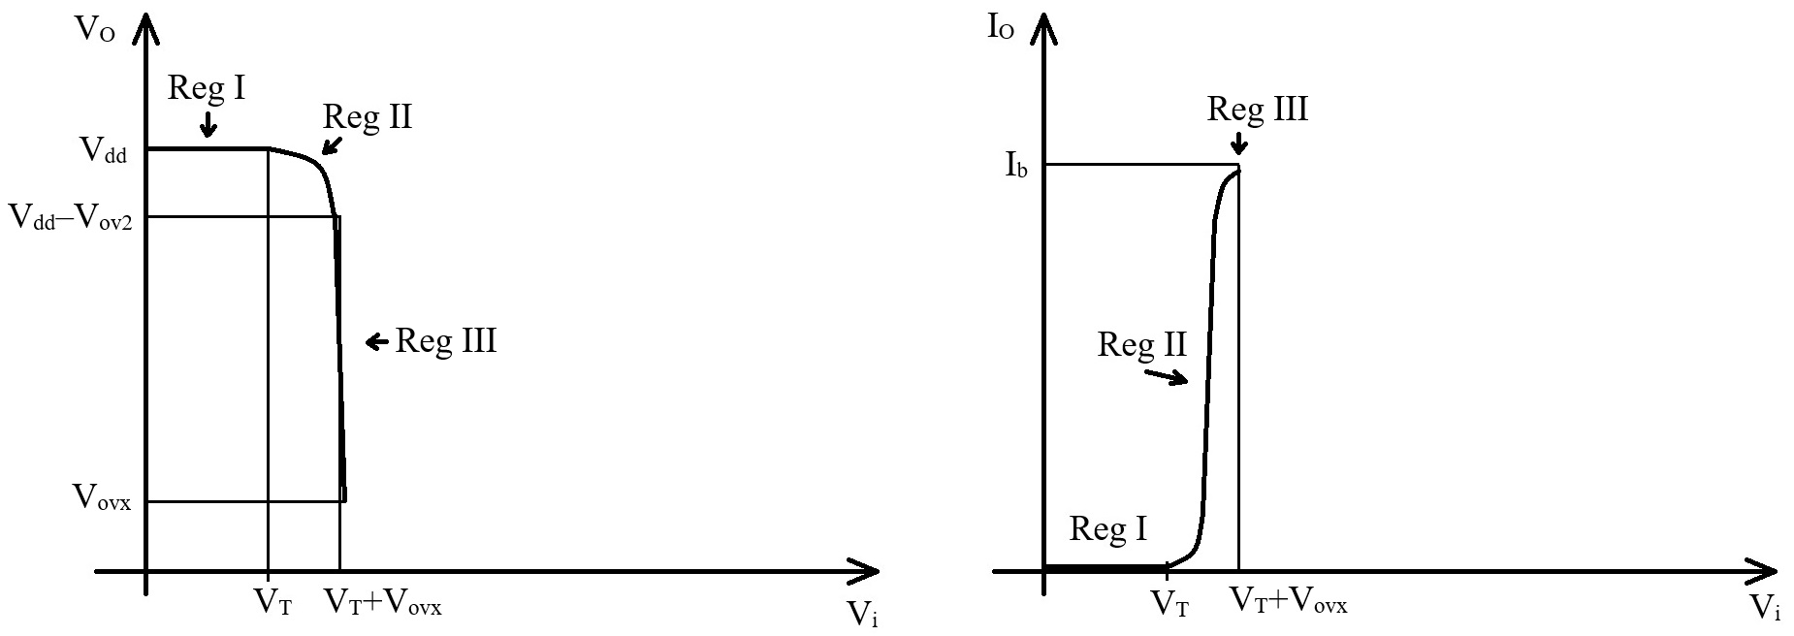
Common Source Stage – Large Signal Analysis
Region III

Slide 24
Common Source Stage – Large Signal Analysis
Region IV
Condition:
$$V_{T}+V_{ovx}<V_{i}<V_{dd}$$
In Region IV, MP1 is in linear region and MP2 is in saturation.
The transistors are described by:
$I_{D1}=μ_{n}C_{ox}{\left(\frac{W}{L}\right)}_{1}\left[\left(V_{i}−V_{T}\right){ V}_{O}−\frac{V_{O}^{2}}{2}\right]=$ $I_{0}$
$$I_{D2}=\frac{1}{2} μ_{p}C_{ox}{\left(\frac{W}{L}\right)}_{2}V_{ov2}^{2}=I_{O}=I_{b}$$
In Region IV, we can neglect the channel length modulation effect, so I_{D2} can be (approximately) considered equal to I_{b}.
If we force I_{D1}=I_{D2}, we get a second order equation in V_{O}, with V_{i} as parameter. This can be solved algebraically.
We can see that, as V_{i} increases, V_{O} needs to get closer and closer to 0 to compensate.

Slide 25
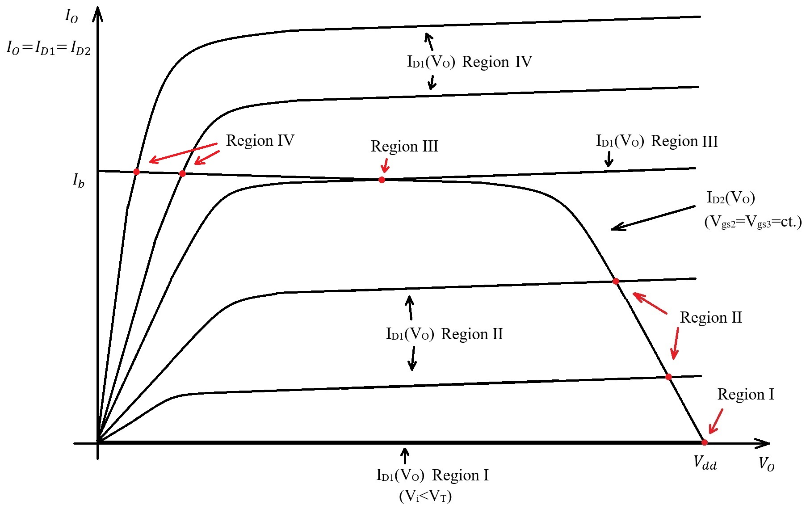
Common Source Stage – Large Signal Analysis
Region IV

Slide 26
Common Source Stage – Large Signal Analysis
Region IV
Now to draw the V_{O}(V_{i}) and I_{O}(V_{i}) characteristics for Region IV.
Region II given by V_{i}>V_{T}+V_{ovx}.
We normally also impose V_{i}<V_{dd}, but this is needed only to protect the transistor against overvoltage.
During Region IV, the output voltage starts from V_{O}=V_{ovx} and asymptotically drops to 0.
As V_{O} gets closer to 0, the square term becomes negligible and the output voltage will asymptotically go as:
$V_{O}=$ $\frac{I_{b}}{μ_{n}C_{ox}{\left(\frac{W}{L}\right)}_{1}\left(V_{i}−V_{T}\right)}$
The output current will not change much during Region IV, as it is fixed by the MP2, MP3 current mirror to I_{b}. Due to channel length modulation effect, the output current will increase slightly as V_{O} approaches 0 (as V_{sd2}=V_{dd}–V_{O}, so V_{sd2} increases as V_{O} approaches 0).

Slide 27
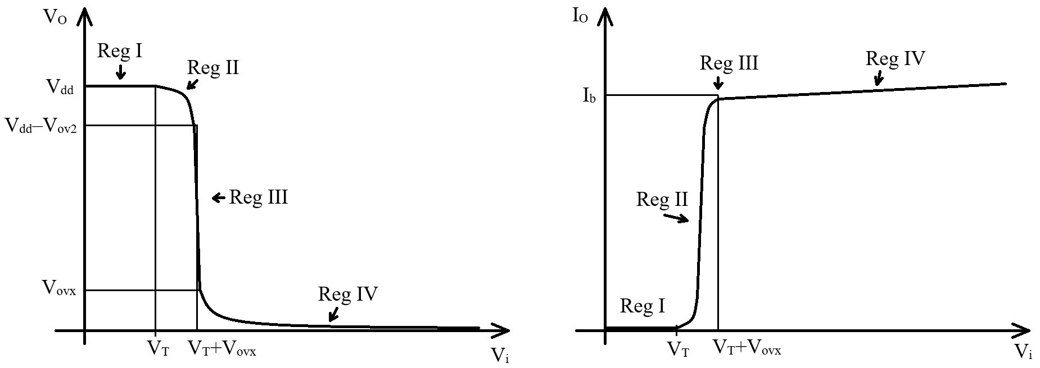
Common Source Stage – Large Signal Analysis
Region IV

Slide 28
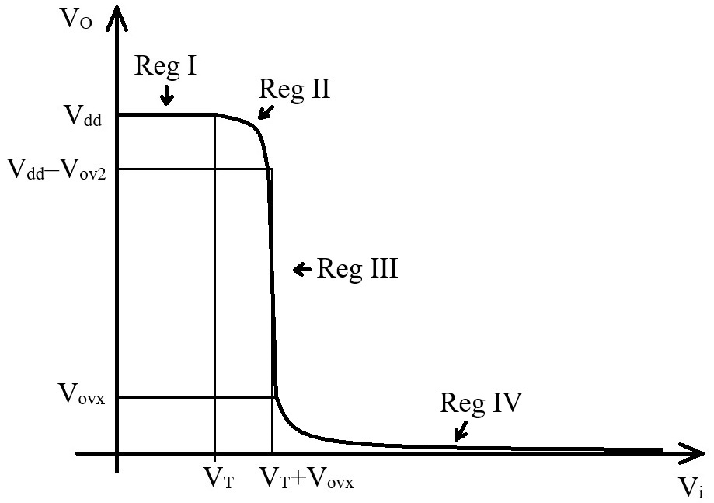
Common Source Stage – Large Signal Analysis
Circuit Gain – Large Signal Perspective
We will determine the circuit gain (in Region III only) by small signal analysis, but it is useful to analyze the gain by looking at the V_{O}(V_{i}) large signal characteristic.
It can first be seen that the gain is negative – the output voltage decreases as V_{i} increases.
The gain in Reg III is high – the output voltage varies by a significant amount for a slight V_{i} change. In all other regions the gain is rather low (V_{O} variation is comparable to V_{i}, in Region I the gain is 0 as V_{O} is constant).

