Slide 1
Small Signal Model / Current Mirror
FILS – Integrated Circuits

Slide 2
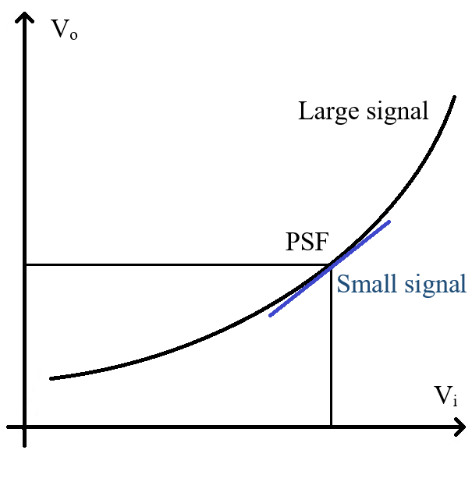
Small Signal Analysis
Any circuit is completely described by Kirchhoff I, Kirchhoff II and device model equations.
In general this leads to a system of non-linear differential equations. This are difficult to solve and, except for very simple examples, require numerical methods. The associated spice analysis is “Tran”.
To simplify the analysis, we will consider that the circuit varies around a static operating point (PSF – punct static de functionare).
To determine the static operationg point, we still need to solve non-linear equations, but we remove all time dependence from them (all time derivatives are 0, this is why it is called “static”) so the equations are algebraic (not differential). The associated spice analysis is “DC”.
Now, we will consider time variation to happen around the operation point. If the variations are small enough, we can use the Taylor first order approximation to linearize the equations. This way we simplify the problem to linear differential equations. We then apply a Fourier (or Laplace) transform and convert the differential equations in algebraic equations (but in frequency domain, not in time domain). The associated spice analysis is “AC”.

Slide 3
Small Signal Analysis
Taylor series representation around x₀, for an infinitely differentiable single variable real function, is:
$$f\left(x\right)=f\left(x_{0}\right)+\frac{1}{1!}{\left(\frac{df}{dx}\right)}_{(x_{0})}\left(x−x_{0}\right)+\frac{1}{2!}{\left(\frac{d^{2}f}{dx^{2}}\right)}_{(x_{0})}{\left(x−x_{0}\right)}^{2}+..+\frac{1}{n!}{\left(\frac{d^{n}f}{dx^{n}}\right)}_{(x_{0})}{\left(x−x_{0}\right)}^{n}+..$$
First order Taylor approximation (linearization):
$$f\left(x\right)≅f\left(x_{0}\right)+{\left(\frac{df}{dx}\right)}_{(x_{0})}\left(x−x_{0}\right)$$
Multiple variables (2 variables) first order Taylor approximation
$$f\left(x,y\right)≅f\left(x_{0},y_{0}\right)+{\left(\frac{∂f}{∂x}\right)}_{(x_{0},y_{0})}\left(x−x_{0}\right)+{\left(\frac{∂f}{∂y}\right)}_{(x_{0},y_{0})}\left(y−y_{0}\right)$$
What Taylor’s theorem actually states: (from Wikipedia)

Slide 4
Small Signal Analysis
We will start by deriving the small signal model for the resistor, the supply voltage and bias current.
The resistor is already a linear component so it should not be surprising that the small signal model is identical to the large signal model – but we will do the derivation step-by-step to be used as an example.
Large signal resistor model (Ohm’s Law):
$$V=R I$$
We linearize this equation using first order Taylor approximation arround a defined static opperating point I_{PSF}, V_{PSF}.
$$V=V_{PSF}+\frac{d V}{d I}\left({I−I}_{PSF}\right)$$
$$V−V_{PSF}=\frac{d V}{d I}\left({I−I}_{PSF}\right)$$
$$∆V=\frac{d V}{d I} ∆I$$
ΔV and ΔI represent the small signal variations around the static operating point.
We shall also use the v and i notations (lower case) for small signal values (v= ΔV and i= ΔI)
For the resistor we have
$$\frac{d V}{d I}=R$$
So we get the resistor small signal model:
$$∆V=R ∆I$$
or equivalent
$$v=R i$$

Slide 5
Small Signal Analysis
We will now consider a fixed supply voltage, V_{DD}.
As the supply voltage is fiexd, it’s derivative (in respect to anythign) is 0.
$$\frac{d V_{dd}}{d V_{i}}=0$$
$$∆V_{dd}=0$$
Conclusion: A fixed voltage supply line is considered shorted to ground in a small signal analysis.
We will now consider a fixed bias current, I_{b}.
Similarly, the derivative of a fixed bias current is also 0 (in respect to anythign).
$$\frac{d I_{b}}{d V_{i}}=0$$
$$∆I_{b}=0$$
Conclusion: A fixed bias current is considered “open” (0 current flow) in a small signal analysis.
Please note that this results are valid only as long as we consider the supply voltage and bias current to be constant. For example, if we would like to determine the power supply rejection ration for our circuit, we then apply a signal on the supply line to see the effect at the output. In this case, the supply voltage is clearly not “ground” anymore .

Slide 6
MOS Transistor Small Signal Model
We will now derive the small signal for MOS transistor in saturation.
The drain current is a function of 2 variables, V_{gs} and V_{ds}:
$$I_{D}(V_{gs}, V_{ds})=\frac{1}{2} μ_{n}C_{ox}\left(\frac{W}{L}\right){\left(V_{gs}−V_{T}\right)}^{2}\left(1+λ V_{ds}\right)$$
We linearize this equation using the first order Taylor approximation, this time for a function of 2 variables. We will do so around a static operation point, V_{gs0}, V_{ds0}.
$$I_{D}\left(V_{gs}, V_{ds}\right)=I_{D}\left(V_{gs0}, V_{ds0}\right)+\frac{∂I_{D}}{∂V_{gs}}\left(V_{gs}−V_{gs0}\right)+\frac{∂I_{D}}{∂V_{ds}}\left(V_{ds}−V_{ds0}\right)$$
Both derivatives are evaluated in the static operation point, V_{gs0}, V_{ds0}.
The small signal variables are: (we will continue using the lower case notation)
$$i_{D}=∆I_{D}=I_{D}\left(V_{gs}, V_{ds}\right)−I_{D}\left(V_{gs0}, V_{ds0}\right)$$
$$v_{gs}=∆V_{gs}=\left(V_{gs}−V_{gs0}\right)$$
$$v_{ds}=∆V_{ds}=\left(V_{gs}−V_{ds0}\right)$$

Slide 7
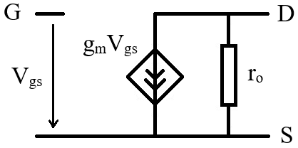
MOS Transistor Small Signal Model
The small signal MOS transistor model results.
$$i_{D}=\frac{∂I_{D}}{∂V_{gs}}v_{gs}+\frac{∂I_{D}}{∂V_{ds}}v_{ds}$$
This equation tells us that the drain – source small signal current has two components – so the equivalent small signal model will have two parallel branches.
The first component is a current controlled by the gate – source voltage. We will model this by a voltage controlled current source. The associated coefficient is called “transconductance”.
$$\frac{∂I_{D}}{∂V_{gs}}=g_{m}$$
The second term is controlled by the drain – source voltage, so it will be modelled as a resistance. It is named “output resistance”.
$$\frac{∂I_{D}}{∂V_{ds}}=\frac{1}{r_{o}}$$
The final small signal model equation results:
$$i_{D}=g_{m} v_{gs}+\frac{v_{ds}}{r_{o}}$$

Slide 8
MOS Transistor Small Signal Model
$$I_{D}(V_{gs}, V_{ds})=\frac{1}{2} μ_{n}C_{ox}\left(\frac{W}{L}\right){\left(V_{gs}−V_{T}\right)}^{2}\left(1+λ V_{ds}\right)$$
$$g_{m}=\frac{2 I_{D}}{V_{ov}}$$
We need not to calculate the transconductance and output resistance.
$$\frac{∂I_{D}}{∂V_{gs}}=2\frac{1}{2} μ_{n}C_{ox}\left(\frac{W}{L}\right)\left(V_{gs}−V_{T}\right)\left(1+λ V_{ds}\right)=2 \frac{1}{2} μ_{n}C_{ox}\left(\frac{W}{L}\right){\left(V_{gs}−V_{T}\right)}^{2}\left(1+λ V_{ds}\right)\frac{1}{\left(V_{gs}−V_{T}\right)}=\frac{2{ I}_{D}}{V_{ov}}$$
Alternatively, we have:
$$I_{D}$$
$$V_{ov}$$
$$\frac{∂I_{D}}{∂V_{gs}}=\sqrt{2{ μ}_{n}C_{ox}\left(\frac{W}{L}\right) \frac{1}{2}{ μ}_{n}C_{ox}\left(\frac{W}{L}\right){\left(V_{gs}−V_{T}\right)}^{2}}=\sqrt{2{ μ}_{n}C_{ox}\left(\frac{W}{L}\right) I_{D}}$$
$$g_{m}=\sqrt{2{ μ}_{n}C_{ox}\left(\frac{W}{L}\right) I_{D}}$$
$$I_{D}$$
For the output resistance, we have:
$$\frac{∂I_{D}}{∂V_{ds}}=λ \frac{1}{2} μ_{n}C_{ox}\left(\frac{W}{L}\right){\left(V_{gs}−V_{T}\right)}^{2}=λ I_{D}$$
$$I_{D}$$
$$\frac{∂I_{D}}{∂V_{ds}}=\frac{1}{r_{o}}$$
$$r_{o}=\frac{1}{λ I_{D}}$$

Slide 9
MOS Transistor Small Signal Model
The final small signal MOS transistor model results:
$$g_{m}=\frac{2 I_{D}}{V_{ov}}$$
$$r_{o}=\frac{1}{λ I_{D}}$$
Where:
$$λ=\frac{1}{L}\frac{dX_{d}}{dV_{ds}}$$

Slide 10
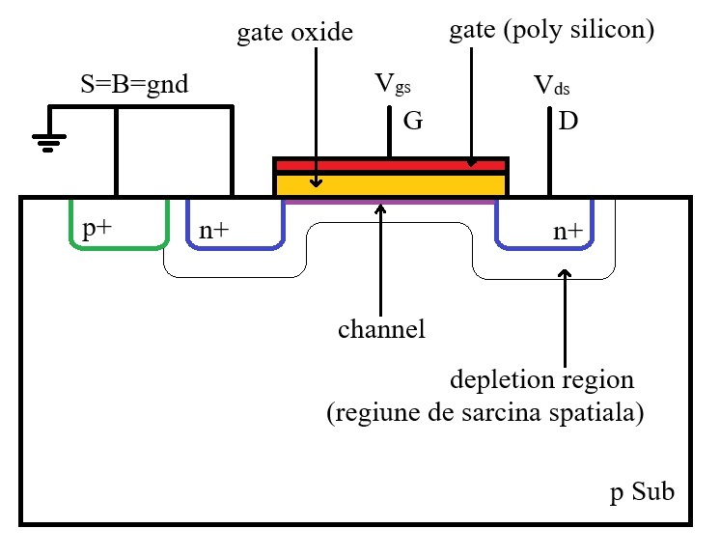
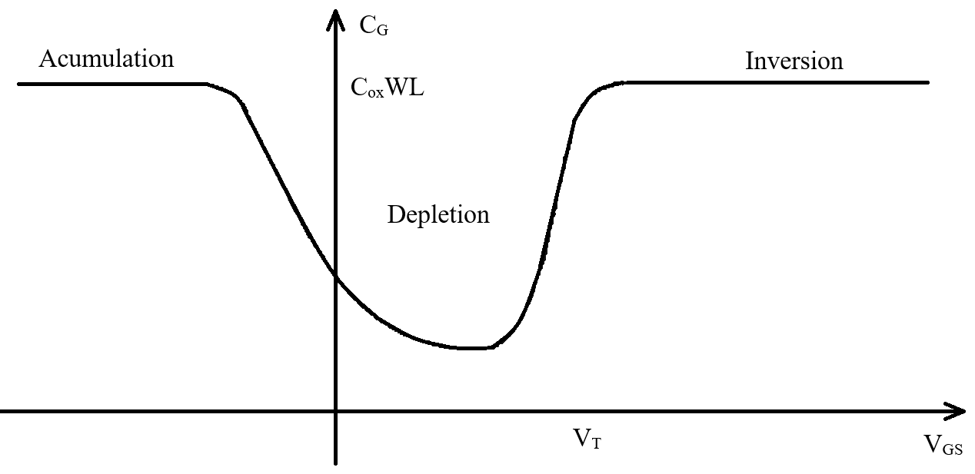
Total Gate Capacitance
For negative V_{GS} voltages, the majority carriers are attracted to the surface forming an accumulation layer.
For positive V_{GS} voltages below the threshold voltage the capacitance is between the gate and the depletion region, so the effective distance between armature plates is effectively increased and depends on V_{GS}. As a result, the C_{G} is lower.
In inversion, all additional charge is added to the channel, so the distance between the capacitor plates is again equal to the oxide thickness.
$$C_{G}=C_{ox}WL$$

Slide 11
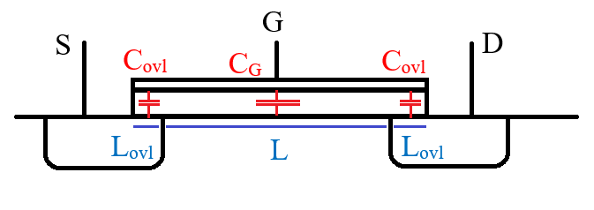
Overlap Capacitance
There is always an overlap region between the gate (oxide and poly) and source/drain diffusions.
This overlap region introduces an overlap capacitance.
For the overlap capacitance, the distance between armatures is always the oxide thickness.
There are two overlap capacitances, one gate-source and one-gate drain. They are equal under the assumption that the drain and source are symmetrical and the overlap length is the same.
The overlap capacitance is given by (where L_{ovl} is the overlap length and is much smaller than L).
$$C_{ovl}=C_{ox}WL_{ovl}$$

Slide 12
C_{GS} and C_{GD} capacitances
The total gate capacitance is between gate and the channel – one armature is actually distributed along the channel.
As in our model we work with the drain and source terminals, we need to split the total gate capacitance between source and drain (C_{gs} and C_{gd}).
Linear Region
Saturation
The channel is continuous from source to drain so we will consider that the gate capacitance is equally distributed between source and drain.
The channel is interrupted at the drain. We will consider that the entire gate-channel capacitance is connected to the source.
Also, the capacitance is smaller (by a factor of 2/3)
$$C_{GS}=\frac{1}{2}C_{ox}WL+C_{ovl}$$
$$C_{GS}=\frac{2}{3}C_{ox}WL+C_{ovl}$$
$$C_{GD}=\frac{1}{2}C_{ox}WL+C_{ovl}$$
$$C_{GD}=C_{ovl}$$

Slide 13
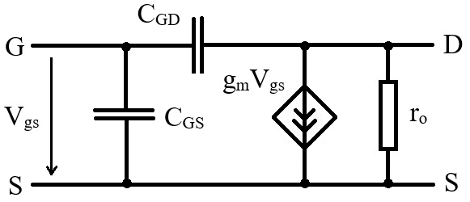
C_{GS} and C_{GD} capacitances in small signal equivalent model
We add the C_{GS} and C_{GD} capacitors to the small signal model
Note that the small signal model presented in this lecture corresponds to the saturation region, so add the saturation C_{GS} and C_{GD} values.
Note that, in saturation, C_{GS} is significantly larger than C_{GD}. However, C_{GD} can be very important in some cases as it is connected as a Miller capacitor.

Slide 14
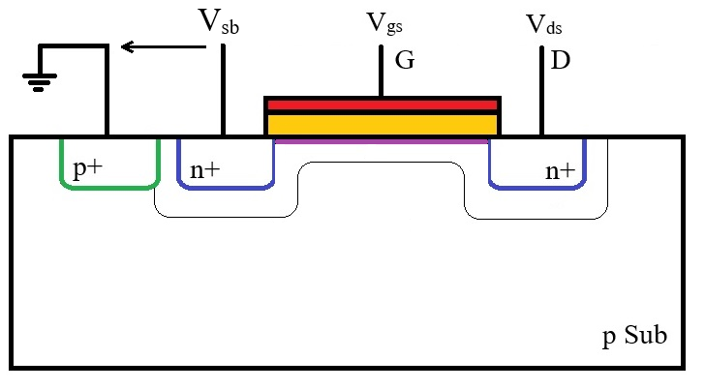
The Body Effect
Let us not consider the case in which V_{S}≠V_{B}. (For simplicity we will consider V_{S}=V_{D} as a first step.)
In this case the source – substrate and drain – substrate junctions are reversed bias.
This results in an increased depletion region and, as a result, a higher V_{GS} voltage is needed to create the channel.
In conclusion, the threshold voltage increases with the source – bulk voltage.
$$V_{T}=V_{T0}+γ\left(\sqrt{V_{SB}+2\left|∅_{B}\right|}−\sqrt{2\left|∅_{B}\right|}\right)$$
Where V_{T0} is the threshold voltage when V_{SB}=0, γ is the body effect constant and 2|Φ_{B}| is the surface potential.
We will consider the effect of the body effect on the threshold voltage to be independent on V_{ds}.
The body effect can be significant, V_{T} can increase with about 1V for V_{sb} increase of 5V.

Slide 15
The Body Effect – Small signal
Taking into account the body effect, the drain currents depends on VSB as well, so the small signal model results:
$$i_{D}=\frac{∂I_{D}}{∂V_{gs}}v_{gs}+\frac{∂I_{D}}{∂V_{ds}}v_{ds}+\frac{∂I_{D}}{∂V_{sb}}v_{sb}$$
Where:
$$I_{D}(V_{gs}, V_{ds},V_{sb})=\frac{1}{2} μ_{n}C_{ox}\left(\frac{W}{L}\right){\left(V_{gs}−V_{T}(V_{sb})\right)}^{2}\left(1+λ V_{ds}\right)$$
$$\frac{∂I_{D}}{∂V_{sb}}=\frac{∂I_{D}}{∂V_{T}}\frac{∂V_{T}}{∂V_{sb}}$$
Composite function differentiation
$$\frac{∂I_{D}}{∂V_{T}}=−\frac{∂I_{D}}{∂V_{gs}}=−g_{m}$$
$$\frac{∂V_{T}}{∂V_{sb}}=\frac{γ}{2\sqrt{V_{SB}+2\left|∅_{B}\right|}}$$
$$V_{T}=V_{T0}+γ\left(\sqrt{V_{SB}+2\left|∅_{B}\right|}−\sqrt{2\left|∅_{B}\right|}\right)$$
We get:
$$g_{mb}=−\frac{∂I_{D}}{∂V_{sb}}=g_{m}\frac{γ}{2\sqrt{V_{SB}+2\left|∅_{B}\right|}}$$

Slide 16
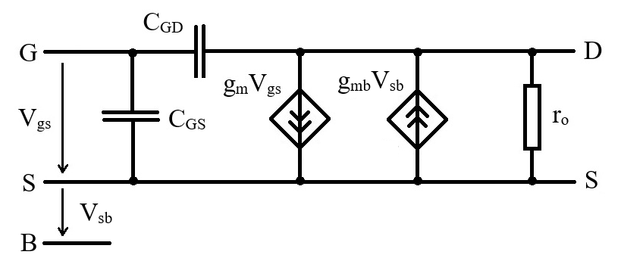
Body effect included in small signal equivalent model
The body effect is modelled as a voltage controlled current source, similar to V_{gs}.

Slide 17
Drain current temperature dependence
The carrier mobility decreases with temperature. This results in a drain current decrease with temperature effect.
The threshold voltage decreases with temperature. The drain current actually depends on the overdrive voltage, V_{ov}=V_{gs} – V_{T}, so a decreasing threshold voltage will actually increase the drain current.
$$I_{D}=\frac{1}{2} μ_{n}C_{ox}\left(\frac{W}{L}\right){\left(V_{gs}−V_{T}\right)}^{2}$$
Which effect is dominant depends on the overdrive voltage:
If the overdrive voltage is low – V_{gs} is close to the V_{T} – any change in the threshold voltage will have a large impact on the current. In this case the VT dependence is dominant and the current increases with temperature.
If the overdrive voltage is large – V_{gs} is much higher to the V_{T} – a change in the threshold voltage will have little impact on the current. In this case the u_{n}C_{ox} dependence is dominant and the current decrease with temperature.
Thermal Stable Point (TSP) – there is a Vgs voltage for which the two effects perfectly compensate each other and the current is independent on temperature.

Slide 18
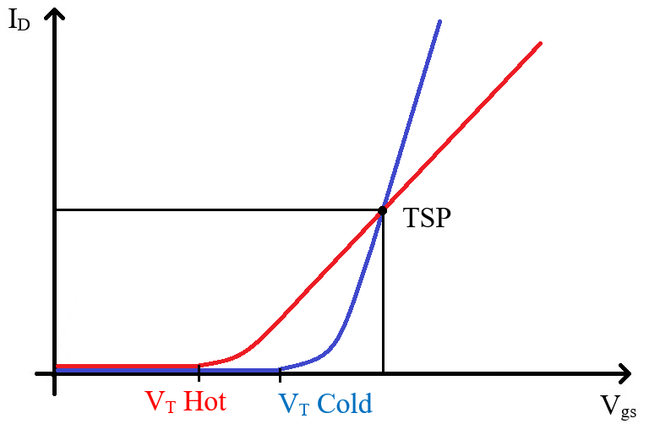
Drain current temperature dependence

Slide 19
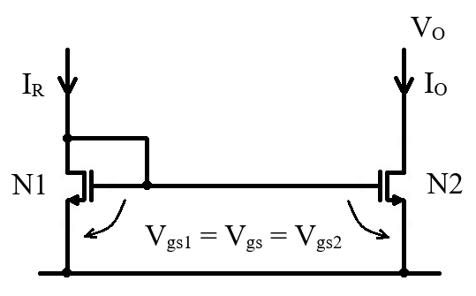
Current Mirror
A current mirror has a reference current input and provides one or more current outputs equal (or in a well defined ratio) to the reference current.
The basic NMOS current mirror circuit is presented below.
Circuit functionality is based on:
Both transistors have the same V_{gs} voltage as they have the gates and sources connected together.
In saturation, the current is given by the V_{gs} voltage (V_{ds} dependence is small) so, as long as both transistors are in saturation they will have equal currents (provided that the transistors are identical)
N1 transistor cannot be in linear region as it has V_{ds}=V_{gs} (so V_{ds}>V_{gs}–V_{T}). It cannot be blocked either as long as I_{R}≠0, so it must be in saturation.
The current mirror works properly only if N2 is also in saturation. This imposes a condition on the minimum output voltage: V_{O}=V_{ds2}>V_{gs}–V_{T}.

Slide 20
Current Mirror
Same idea, less words, more equations ☺
N1 is in saturation (V_{ds}=V_{gs}>V_{gs}–V_{T}) so it is described by:
$$I_{R}=I_{D1}=\frac{1}{2} μ_{n}C_{ox}{{\left(\frac{W}{L}\right)}_{1}\left(V_{gs}−V_{T}\right)}^{2}$$
We assume N2 is in saturation. This is equivalent to assuming:
$$V_{O}=V_{ds2}>V_{gs}−V_{T}$$
In this conditions, N2 is also described by the saturation equation:
$$I_{O}=I_{D2}=\frac{1}{2} μ_{n}C_{ox}{{\left(\frac{W}{L}\right)}_{2}\left(V_{gs}−V_{T}\right)}^{2}$$
So we have:
$$\frac{I_{O}}{I_{R}}=\frac{{\left(W/L\right)}_{2}}{{\left(W/L\right)}_{1}}$$
So the ratio between the reference (input) and output currents is given by the geometric ratio of the two transistors.
If the transistors are identical, the input and output currents will also be equal. (Provided that N2 is in saturation and neglecting the channel length modulation effect.)

Slide 21
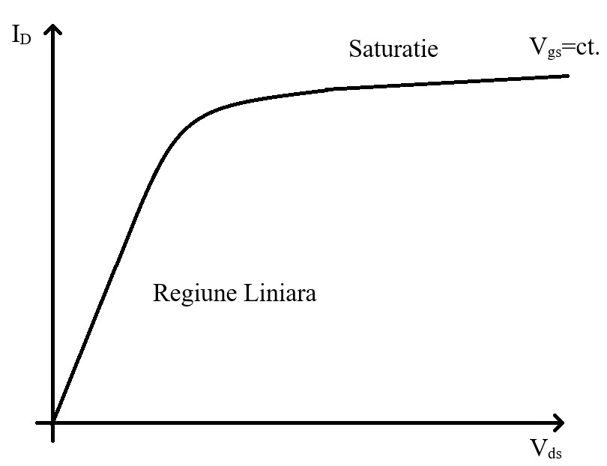
Current Mirror
Same story from a different perspective…
Let us first look at N2.
N2 is just a transistor with a fixed V_{gs} voltage.
So, in saturation, it will just provide a fixed current..
If we want a specific current, we just need to make sure we provide the right V_{gs} voltage for N2.
To get the right V_{gs} voltage to bias N2, we use a “reference transistor”, N1.
We use N1 in diode connection (gate and drain connected together) and inject the desired reference current through it.
This way, N1 V_{gs} voltage will be adjusted to the correct value.
$$I_{R}=I_{D1}=\frac{1}{2} μ_{n}C_{ox}{{\left(\frac{W}{L}\right)}_{1}\left(V_{gs}−V_{T}\right)}^{2}$$
$$V_{gs}=V_{T}+\sqrt{\frac{2 I_{R}}{μ_{n}C_{ox} {\left(W/L\right)}_{1}}}$$

Slide 22
Current Mirror
Current mirror output characteristic:
We assume N1 and N2 to be identical for simplicity (W/L)₁=(W/L)₂.
They also have the same gate – source voltage (V_{gs1}=V_{gs2}), so they will have the same output characteristic.
N1 has V_{ds}=V_{gs} so it is biased in the marked point.
Due to the loop (gate – drain connection) the V_{gs} voltage is adjusted so that I_{R} flows through N1.
N2 can be biased anywhere on the characteristic depending on the output voltage.
From this picture we can clearly see the channel length modulation / finite output resistance effect on current mirroring – N2 current is equal to I_{R} only if V_{O}=V_{gs}, otherwise there will be a small error due to different drain source voltages.
We can also see that if N2 is no longer in saturation (V_{O} drops below V_{gs}–V_{T}) the output current starts to drop and the mirror is no longer working (the error between I_{O} and I_{R} is no longer negligible)
If N1 and N2 have different W/L ratios, the transistors will no longer have the same characteristic but the characteristics will be scaled with the W/L ratios – all above arguments and conclusions are still valid.
The finite output resistance error can be reduced either by using longer transistors (the output resistance is proportional to the channel length) or by using more complex circuits (cascode current mirror).

Slide 23
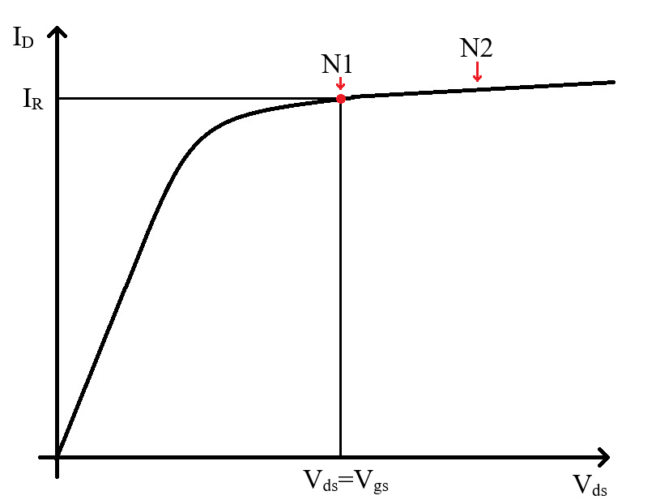
Current Mirror

Slide 24
Current Mirror – Small Signal Analysis
We will consider a bias current mirror. This is to say that the reference current is fixed, so it’s small signal variation is 0. This means that we replace the IB current source with an “open circuit” in the small signal circuit (just omit it).
We replace both transistors with the small signal equivalent circuit and we connect them according to the large signal schematic.
Note that we do not have any input signal in this circuit.

Slide 25
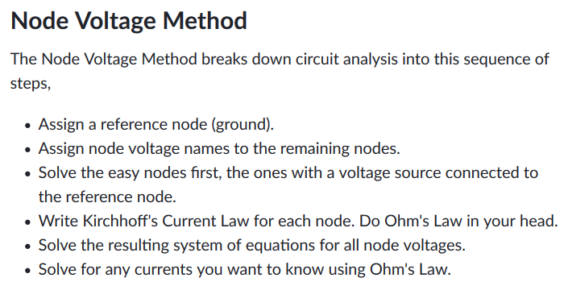
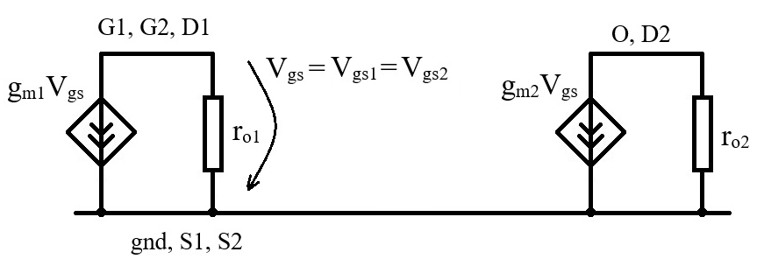
Current Mirror – Small Signal Analysis
A simple and systematic way of solving small signal equivalent circuits is based on the Node Voltage Method and basically resumes to writhing for each node that the sum of currents going out of the node is equal to 0 (K1 law).
Now to apply this for our circuit. We first solve the gate node (G1, G2, D2).
$$g_{m1}V_{gs}+\frac{V_{gs}}{r_{o1}}=0$$
$$\left(g_{m1}+\frac{1}{r_{o1}}\right)V_{gs}=0$$
$$V_{gs}=0$$
This is not really unexpected.. We do not apply any small signal current so the resulting small signal voltage is 0.
This means that also g_{m2}V_{gs}=0, so the voltage controlled current source disappears and we are left only with r_{o2}.
Conclusion: A bias current mirror is equivalent at small signal with the output resistance of the output transistor.
$$V_{gs}=0$$

Slide 26
Mos Diode – Small Signal Analysis
Let us now consider a MOS diode (MOS transistor with gate and drain connected together) .
This time we do not assume the current to be constant, so there will be a small signal current, i.
$$V_{gs}=\frac{r_{o} \frac{1}{g_{m}}}{\left(r_{o}+\frac{1}{g_{m}}\right)}i$$
$$g_{m}V_{gs}+\frac{V_{gs}}{r_{o}}−i=0$$
$$\left(g_{m}+\frac{1}{r_{o}}\right)V_{gs}=i$$
$$V_{gs}=\frac{1}{\left(g_{m}+\frac{1}{r_{o}}\right)}i$$
$$V_{gs}=\left(\frac{1}{g_{m}}||{ r}_{o}\right) i$$
This is exactly the same result we would get if we replace the MOS diode (small signal equivalent circuit) with an equivalent resistor.
Note that 1/g_{m} is usually much smaller then r_{o}, to this can be approximated by 1/g_{m}.

Slide 27
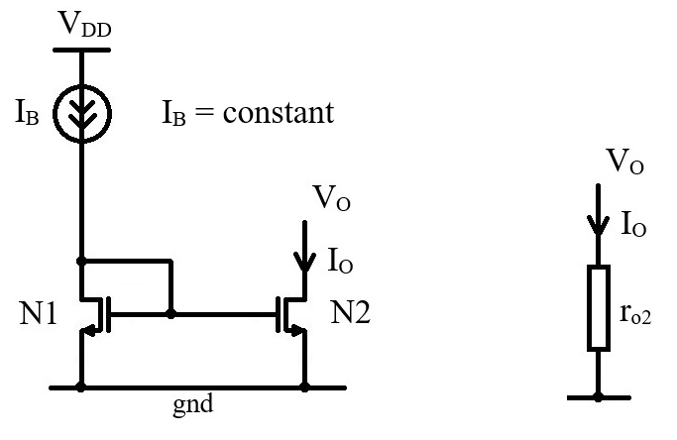
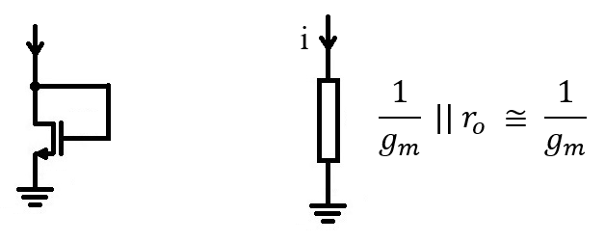
Equivalences to remember
A bias current mirror (small signal current equal to zero) is equivalent at small signal with the output resistance of the output transistor.
A MOS diode is equivalent at small signal with a resistor of approximately 1/g_{m} value.

