Slide 1
CMOS Process
FILS – Integrated Circuits

Slide 2
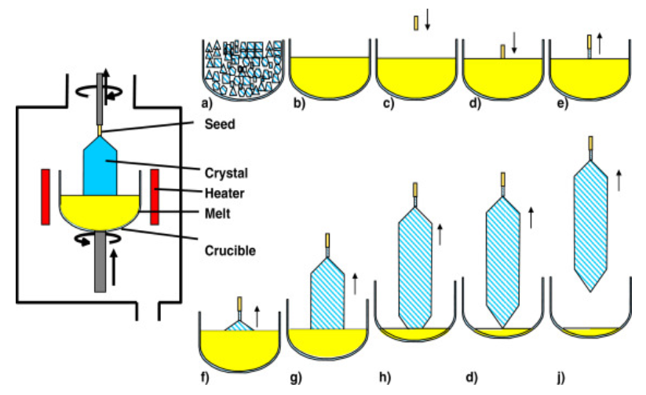
Czochralski method for obtaining monocrystalline silicon
The Czochralski method is the most important technique for obtaining monocrystalline silicon.
It uses a monocrystalline seed that comes in contact with melted silicon and then is slowly pulled up.
The silicon will solidify and follow the seed crystalline structure, resulting in a monocrystalline rod.
There are other methods of growing monocrystalline silicon.
Purification process: chemical purification, physical purification (floating region)
Source: https://www.sciencedirect.com/topics/chemistry/czochralski-process

Slide 3
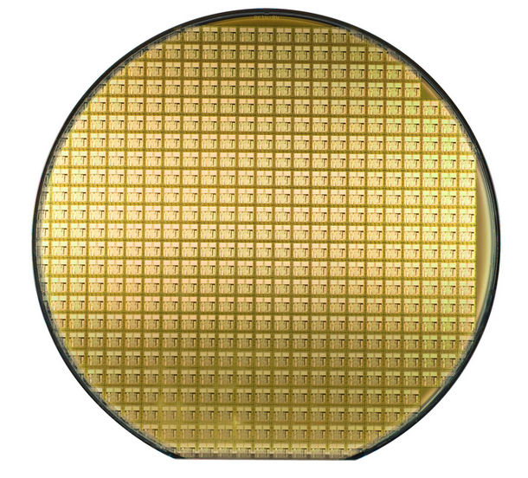
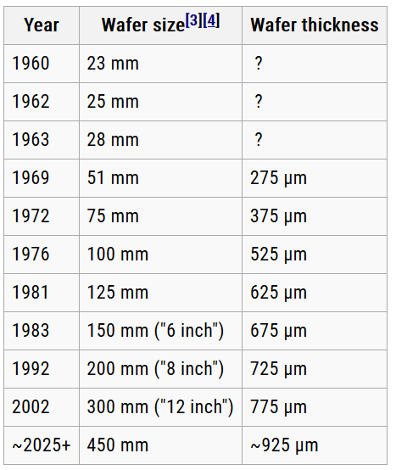
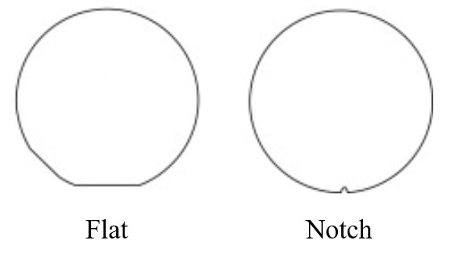
Silicon Wafers
The monocrystalline silicon rod is cut into wafers.
Typical wafer sizes used today are 6, 8 and 12 inch.
For wafer alignment, either a flat or a notch is used.
Wafers can be intrinsic (undoped) but are usually pre-doped to either N or P type.
Depending on the process, wafers can have different crystallographic orientations.

Slide 4
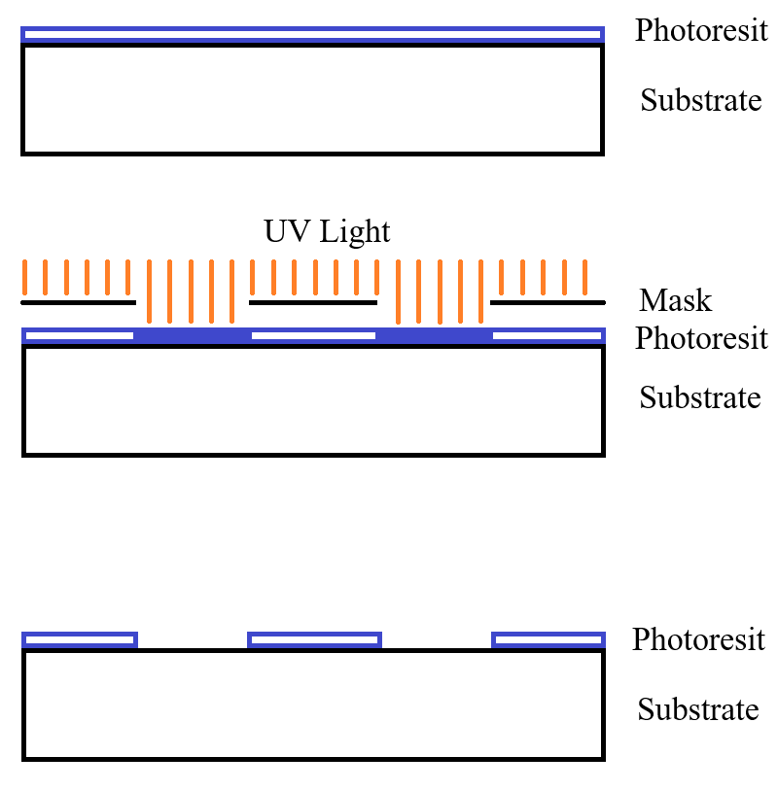
Photolithographic Process
The Photolithographic Process allows us to select the area of effect for some process steps.
The wafer initially passes through some cleaning and heating process to remove impurities and moisture.
The wafer is then covered with a photoresist layer.
Then the wafer (and photoresist) is exposed to UV light through a mask.
The mask has transparent and opaque areas so the UV light only reaches certain areas of the photoresist.
The photoresist polymerases in the areas exposed to light.
Then the photoresist is developed – the polymerized photoresist is selective corroded.
There are “positive” photoresists that are corroded in the areas exposed to light and “negative” photoresists that are corroded in the areas not exposed to light.
Now the real intended process can be applied and it will take effect only in the areas not covered by photoresist.
After the process is completed, the photoresist is cleaned away and the wafer is ready for the next step.

Slide 5
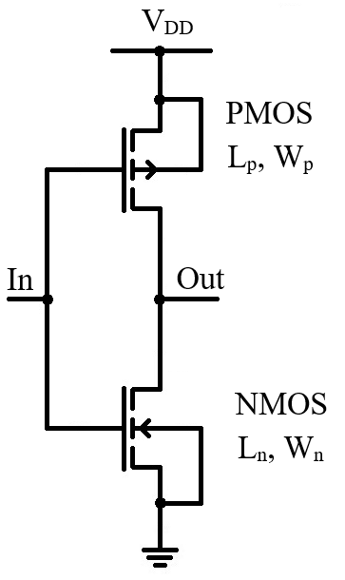
Example Circuit - Inverter
For presenting the CMOS technological process, we will use the inverter as an example.
The inverter is well suited for this task as it has one NMOS transistor, one PMOS transistor and a few connections (useful for presenting the metal system).
In this lecture we use the 4 terminal symbol for the transistor. This is useful as the MOS transistor physical implementation (layout) has 4 terminals so the correspondence between layout and schematic is easier to follow.
Note that for each transistor it is required to specify the channel length and width.
Next slides will present for each stage of the process two views:
The cross section view (vertical slice through the transistor) – this is the view most used while studying the transistor physics (this is the view presented in the previous lecture)
Layout (top view) – this is the “view from above”. This is the view that is actually used for building the circuit.

Slide 6
Technological Process
We shall discuss a very simple CMOS technological process.
We consider we start with a p-type substrate (P Subst). This means that the wafer was pre-dopped to p type.
This means we can implement NMOS transistors directly on the substrate, but for PMOS transistors we will need an n-type region (N Well).

Slide 7
Cross Section - Substrate

Slide 8
N Well
The first process step consists in defining the n-type region for the PMOS transistors.
This corresponds to the first photolithographic prosses – the N Well mask.
During this process step, a deep but not very strongly dopped n-type region is created.
In this example we only have one PMOS transistor so we only need one N Well region. In real circuits there will be multiple N Well regions were the PMOS transistors are placed.

Slide 9
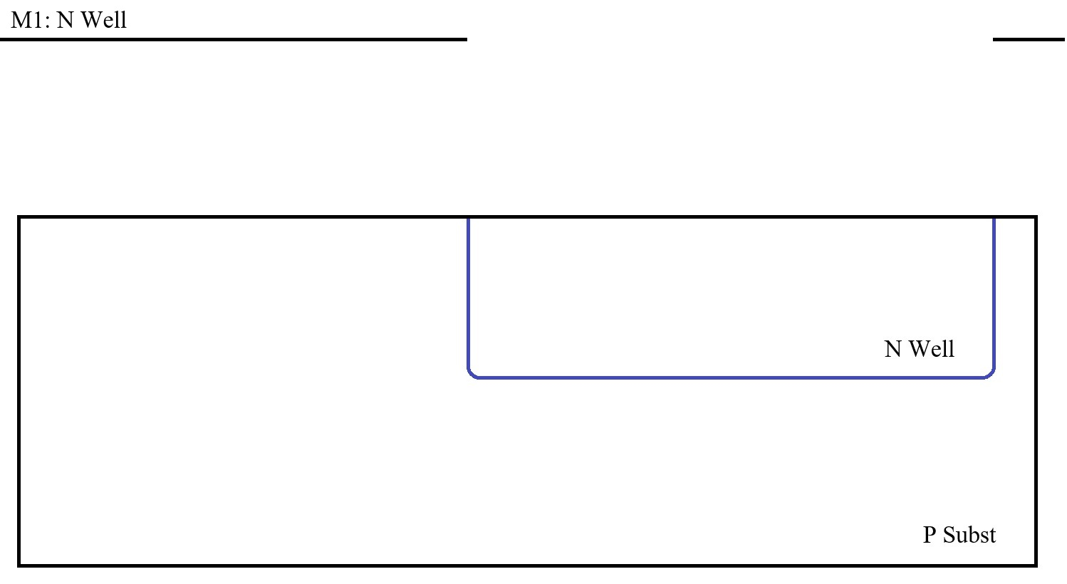
Cross Section – N Well

Slide 10
Layout – N Well

Slide 11
Active
The next step of the process is to define the active regions.
The entire wafer except for the active regions will be covered with Field Oxide (FOX). So we need to mark as “active region” all regions that we need to further dope as either n or p type.
This corresponds to the second photolithographic prosses – the Active mask.
During this process step, the field oxide is grown (covering everything except the regions marked by the Active layer).
LOCOS (locally corroded oxide) – Bird’s Beak
In this example we need two active areas inside the N Well – one for the PMOS transistor and one for the substrate contact and two active areas outside the N Well – one for the NMOS transistor and one for the substrate contact.
The channel width is defined by the Active mask.

Slide 12
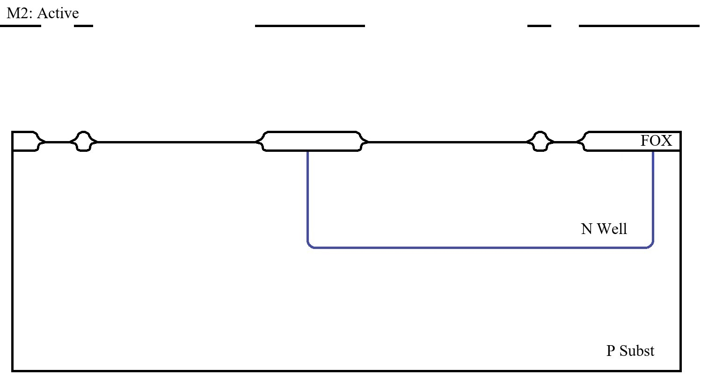
Cross Section – Active

Slide 13
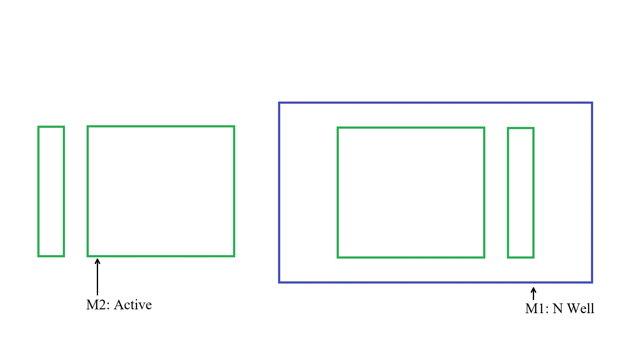
Layout – Active

Slide 14
Poly Si
The next step of the process is to grow the gate oxide.
The gate oxide is much thinner then the field oxide but it is a better quality oxide, as all MOS transistors properties depend on it.
There is no mask involved, the process affects the entire wafer (but actually the main groth happens in the active areas as the rest is already covered by the FOX).
Then a poly silicon layer is deposited on the entire wafer. (Again, no mask involved… yet!)
Then, a photolithographic process is applied and the poly silicon is removed from everywhere it is not protected by the mask.
This corresponds to the third photolithographic prosses – the Poly Si mask.
The channel length is defined by the Poly Si mask.

Slide 15
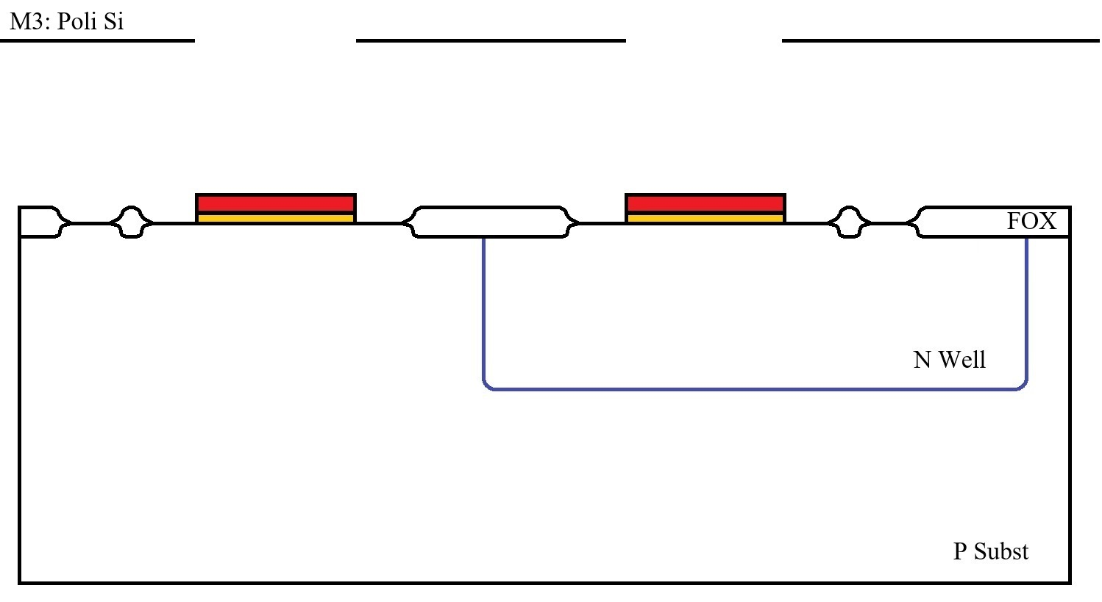
Cross Section – Poly Si

Slide 16
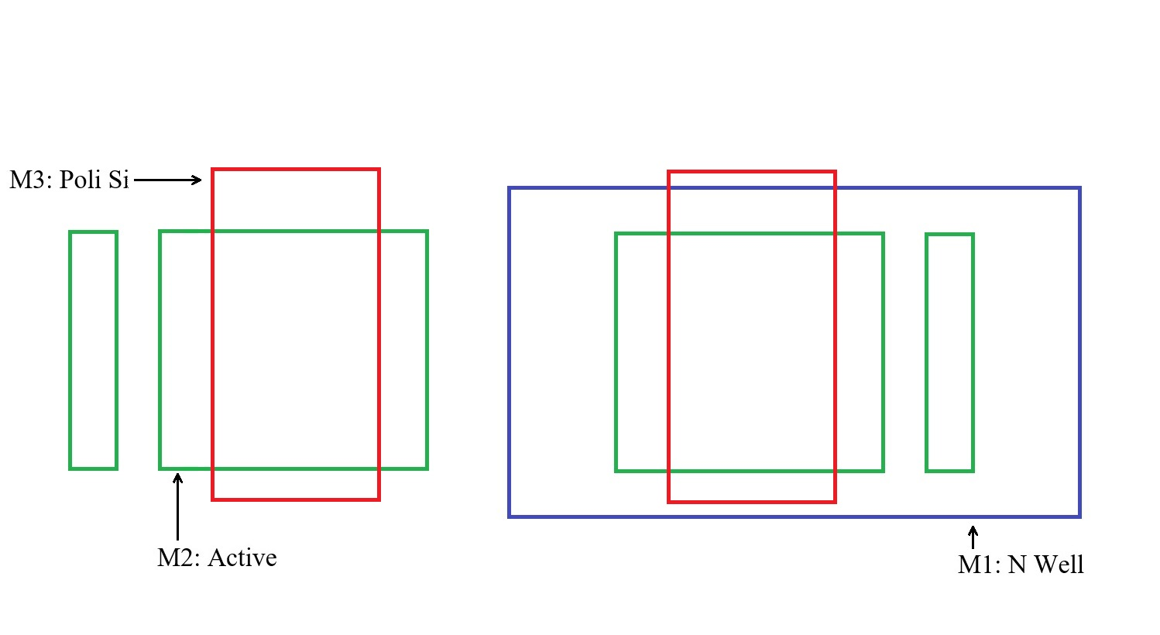
Layout – Poly Si

Slide 17
N Select and P Select
The next two process steps corresponds to the n+ and p+ doping for the drain, source and substrate contacts.
It can be seen that the N Select and P Select masks are always drown around the active mask. Some active areas are “covered” by N Select while others by P Select.
However, the actual doping will only take place inside the active area – even if the N/P Select masks extends outside the Active, that area is covered by field oxide (FOX) that prevents the doping.
Similarly, the active area below the gate oxide and Poly Si layers will not be dopped (as it is covered by Poly Si).
This process of first defining the Poly Si gate area and then doping the source and drain is an example of self-aligned process (in romana: “autoaliniere”) – see dedicated slide for more details.

Slide 18
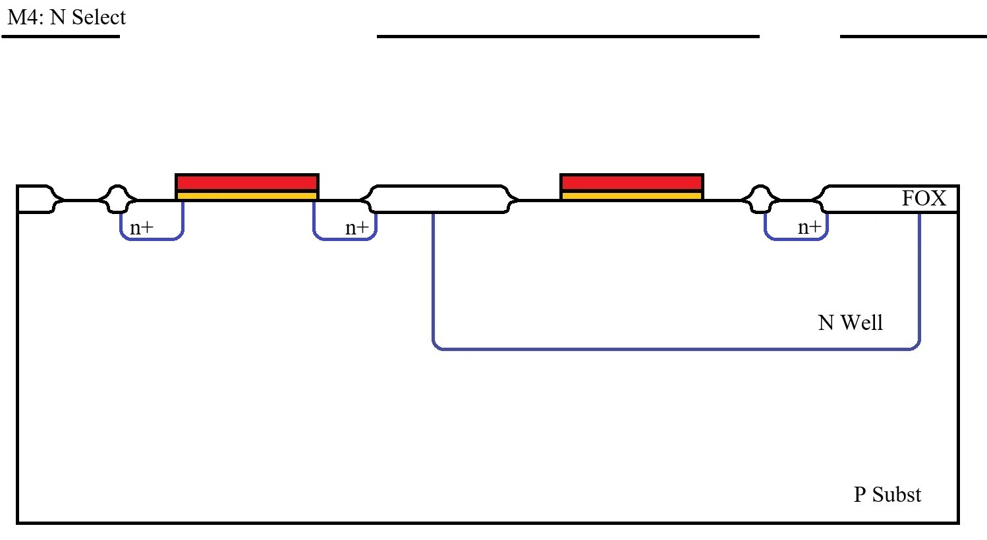
Cross Section – N Select

Slide 19
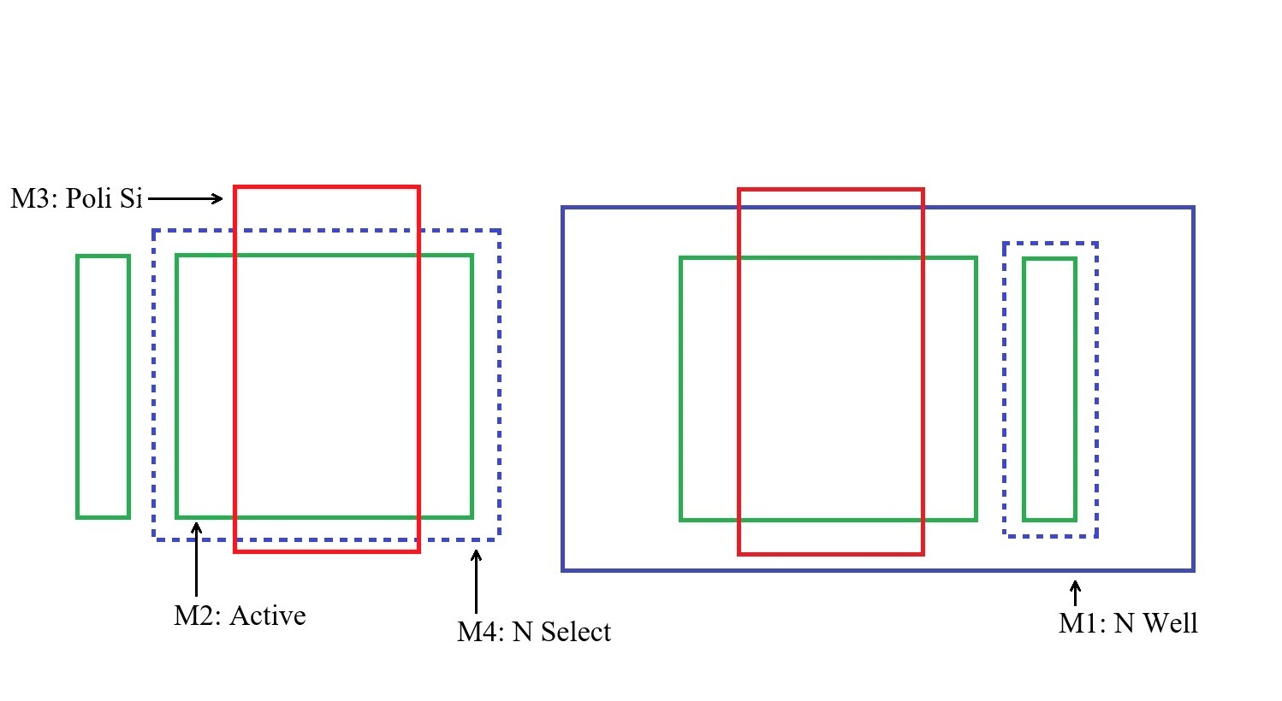
Layout – N Select

Slide 20
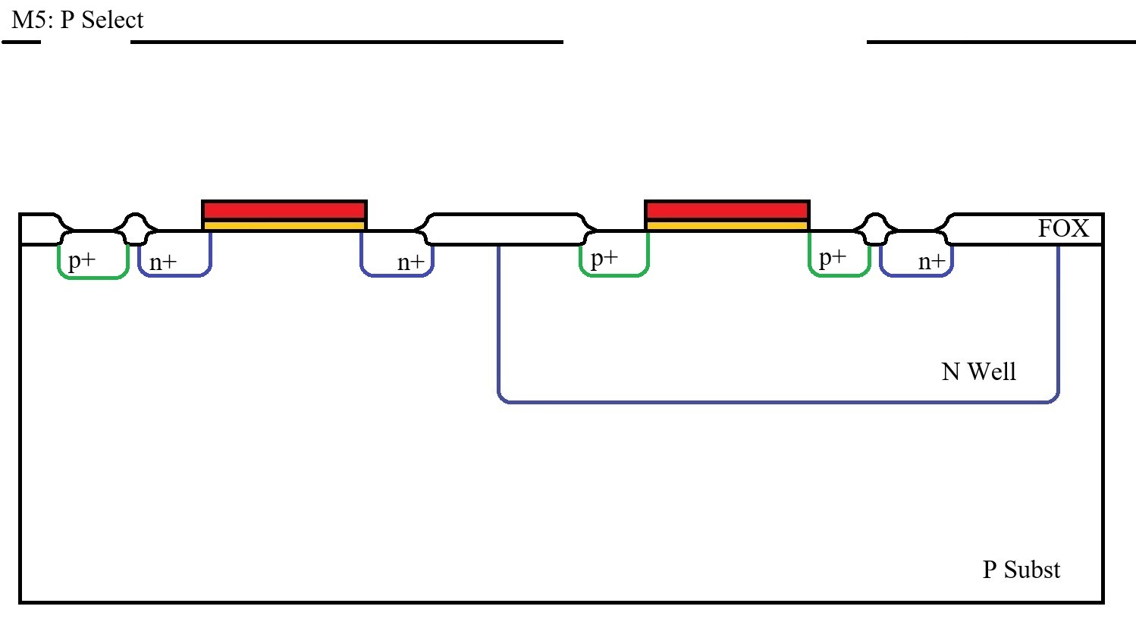
Cross Section – P Select

Slide 21
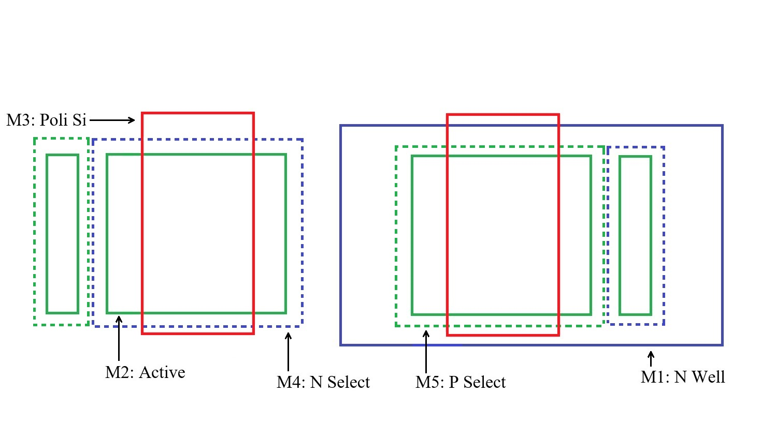
Layout – P Select

Slide 22
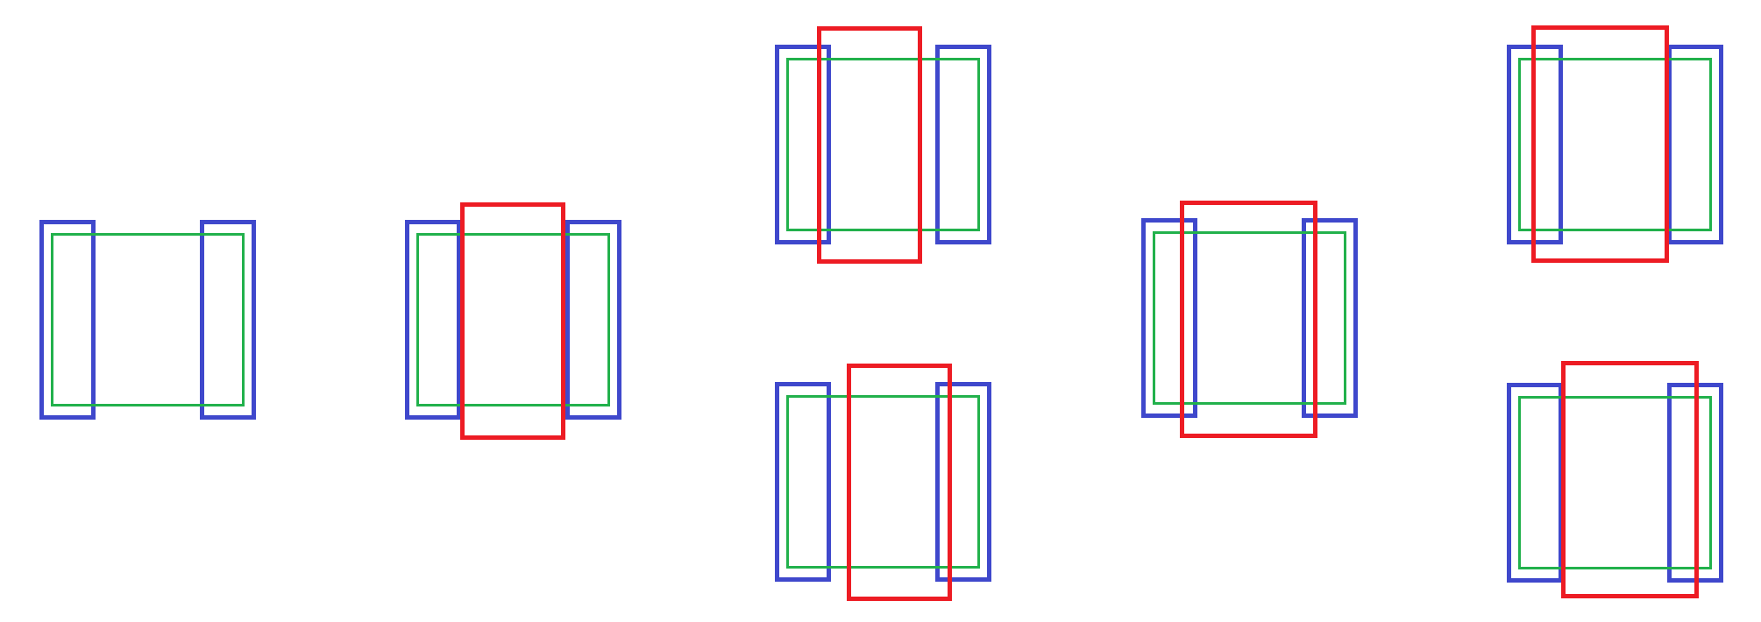
Self-Alignment
This is an example how a NOT Self-Aligned process would look like.
From the flow perspective, it may look more natural to first do the drain and source doping and then to place the gate poly between them.
The problem with this is that, if there is a misalignment between the N/P Select and the Poly masks, there is a high risk that the poly will not cover the entire distance between the drain and source. In this case the channel will not reach from drain to source and the transistor will never open.
This can be solved by making the poly extra wide, so even if the maximum missalignemnt occurs, it will still reach from source to drain. But this increases the overlap capacitance.

Slide 23
Self-Alignment
The above presented problem is solved in a more efficient manner by first defining the gate poly and then doing the drain and source doping on top.
This way, the gate poly acts as a mask, so the drain and source will start exactly at the edge of the gate poly.
Due to lateral diffusion, there will still be some overlap capacitance but much lower than in the case we intentionally extend the poly over the drain and source to account for mask misalignments.
The fact that the gate poly is dopped during the same doping step as the source and drain also helps in controlling the threshold voltage.
This process technique of using one layer to automatically define the next is called “self-alignment” and it is often use (this was just one important example).

Slide 24
Contact
At this point, all transistors are completed but the connections are missing.
The next process steps consists in covering the entire wafer with an isolation layer, PSG (poly silicate glass). This is also a Si oxide layer but this time it is deposited, not grown by oxidation).
This process covers the entire wafer, not mask is involved.
Then, a photolithographic process is applied to create the contact holes.
As the Layout view slide shows, the contact holes are never placed on top of the gate oxide, as the stress will affect the transistor performances. The gate poly Si is extended outside the gate area to accommodate for the contact holes.

Slide 25
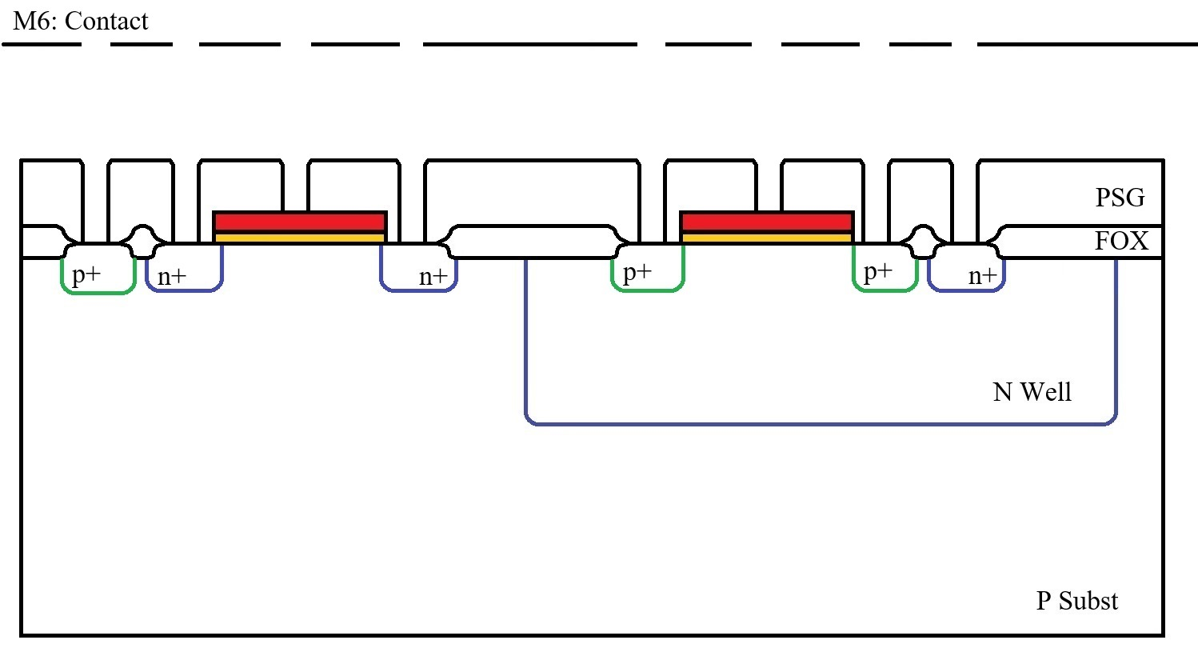
Cross Section – Contact

Slide 26
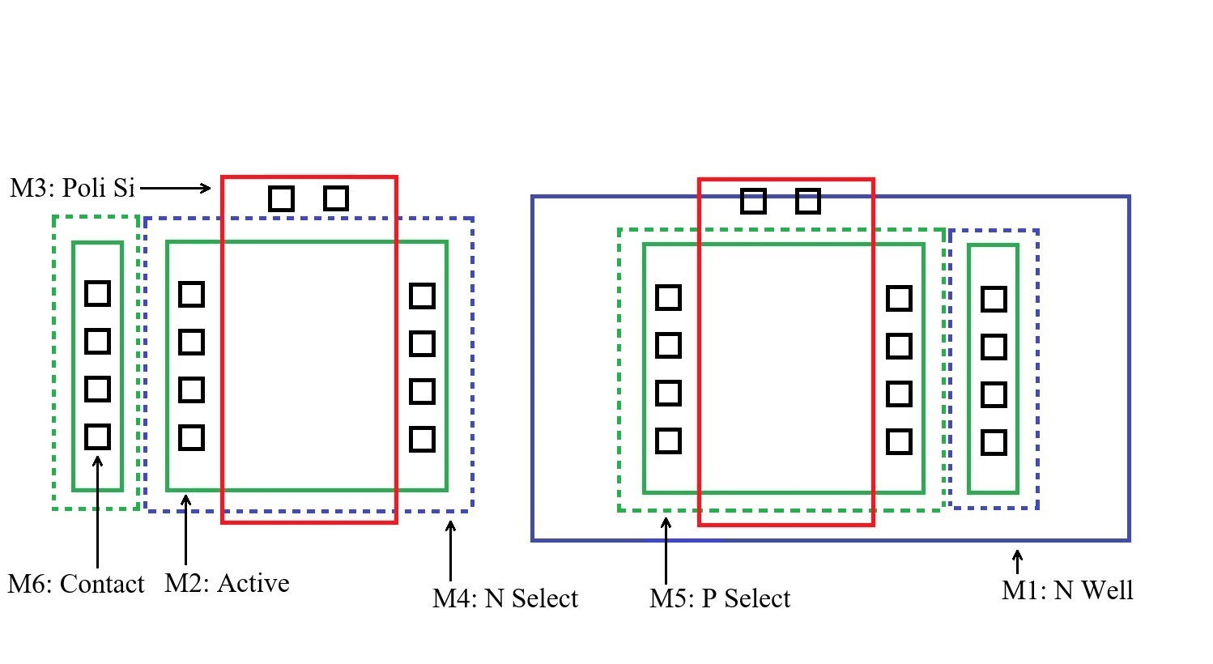
Layout – Contact

Slide 27
Metal 1
The next process steps consists in covering the entire wafer with a metal layer.
This process covers the entire wafer, not mask is involved.
Then, a photolithographic process is applied to create the desire metal structure (define the connections).

Slide 28
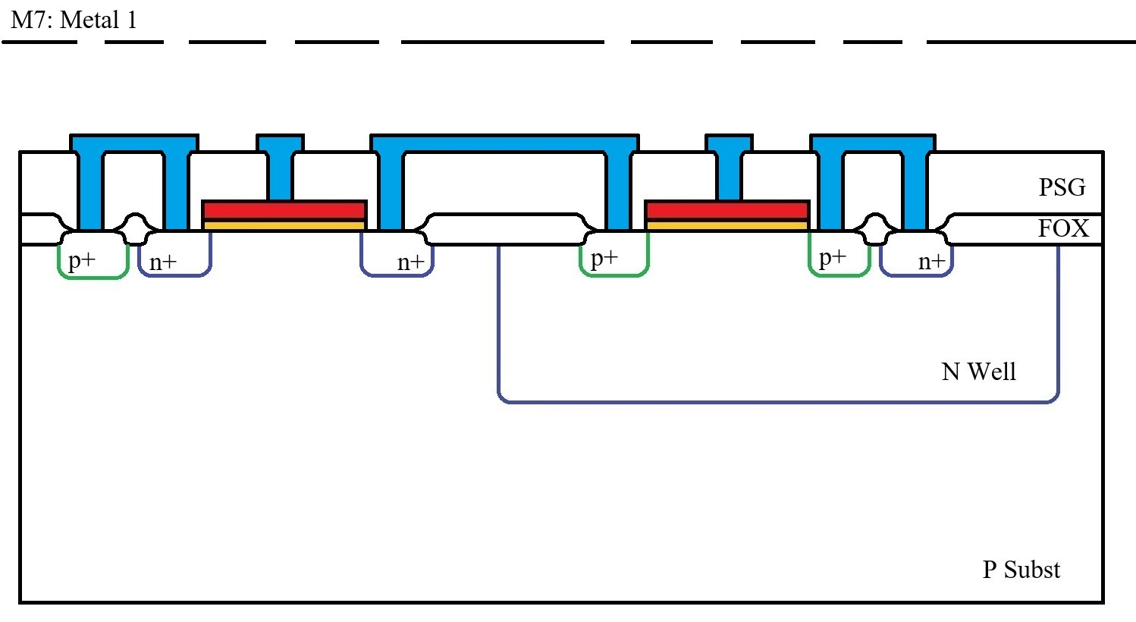
Cross Section – Metal 1

Slide 29
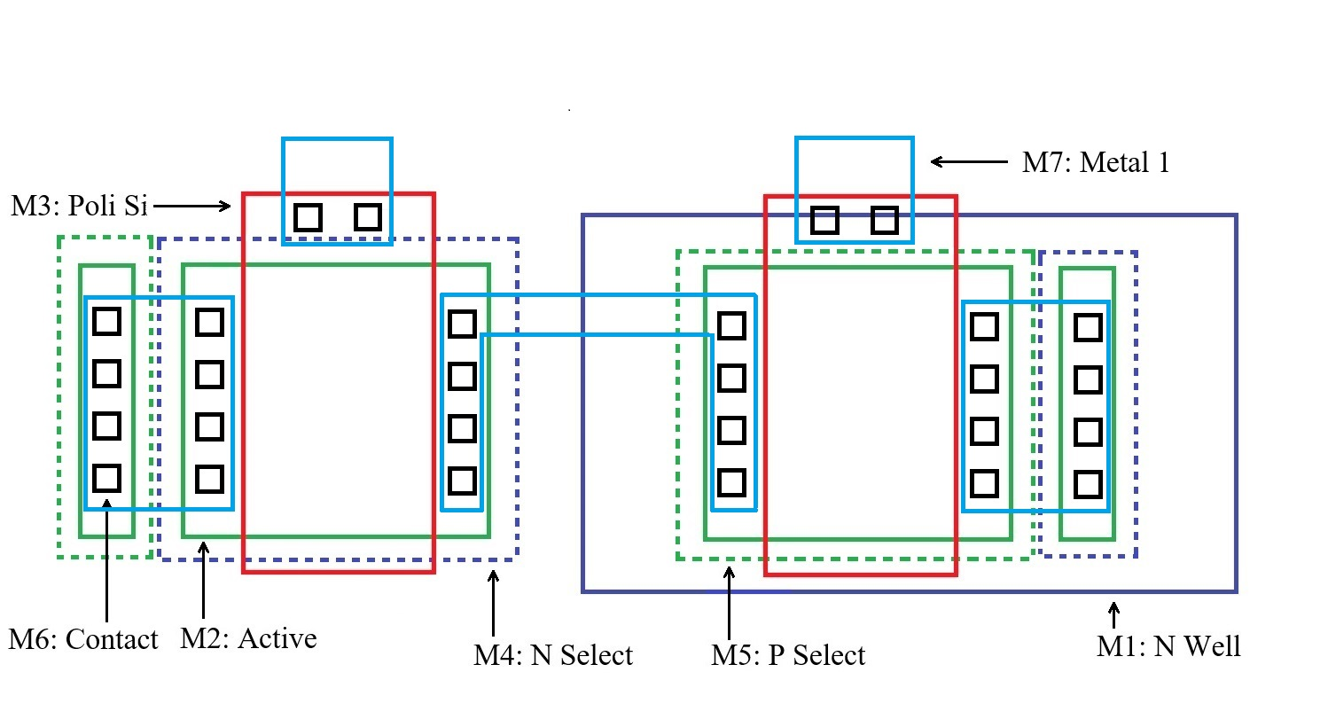
Layout – Metal 1

Slide 30
Via and Metal 2
In this example process, we have two metal layers but modern processes can have many more.
Two more photolithographic processes are needed to open the connections between metal layers (called “via”) and to define the Metal 2 desired shapes (wires).
After the last metal layer, the entire wafer is covered with the final isolation layer. A final photolithographic process is needed to define the pad openings for the bonding wires. (not presented in the pictures)

Slide 31
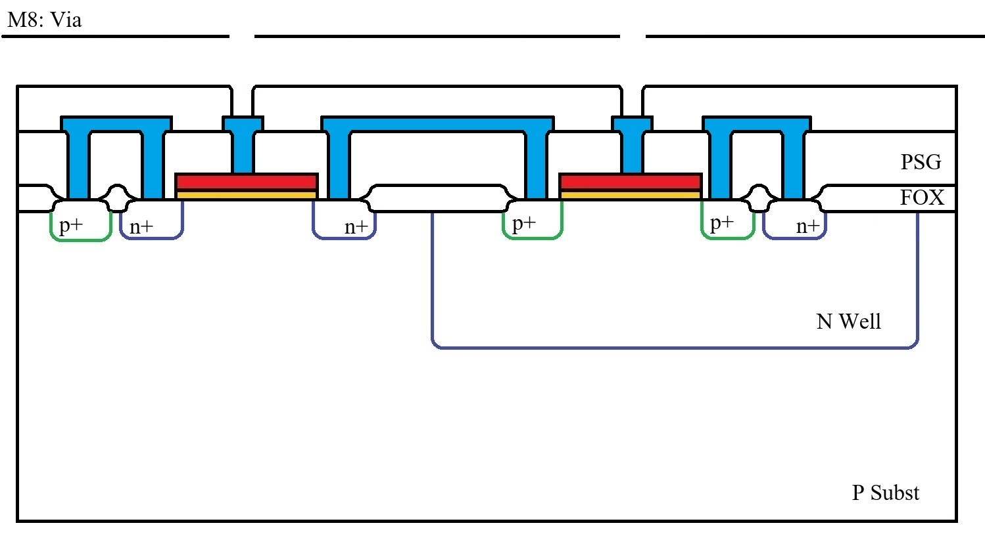
Cross Section – Via

Slide 32
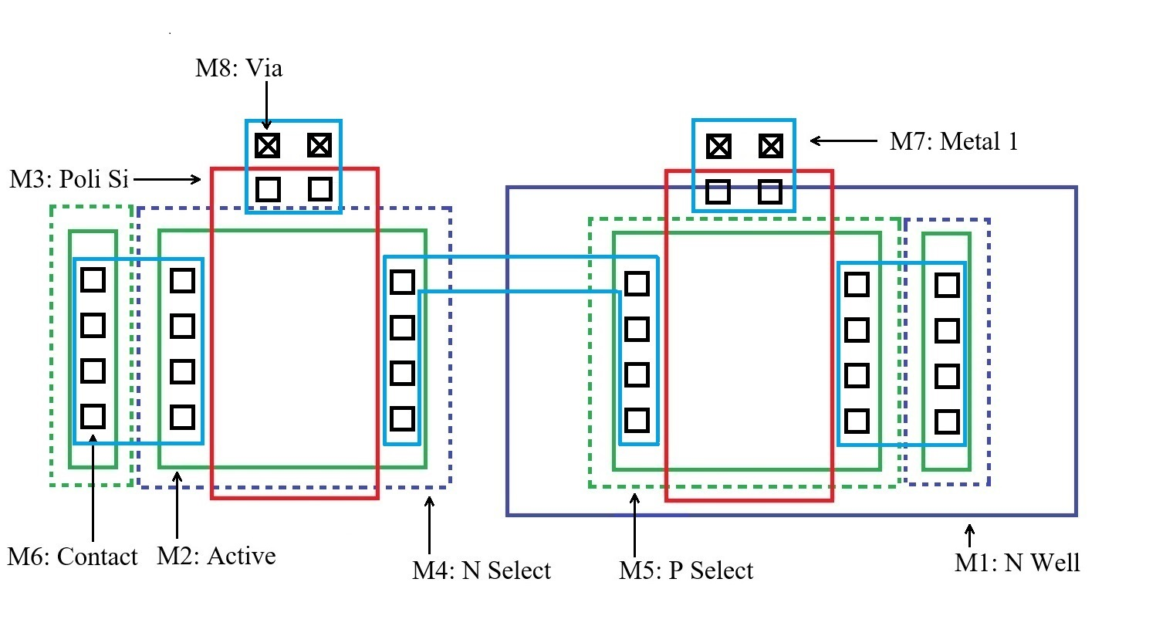
Layout – Via

Slide 33
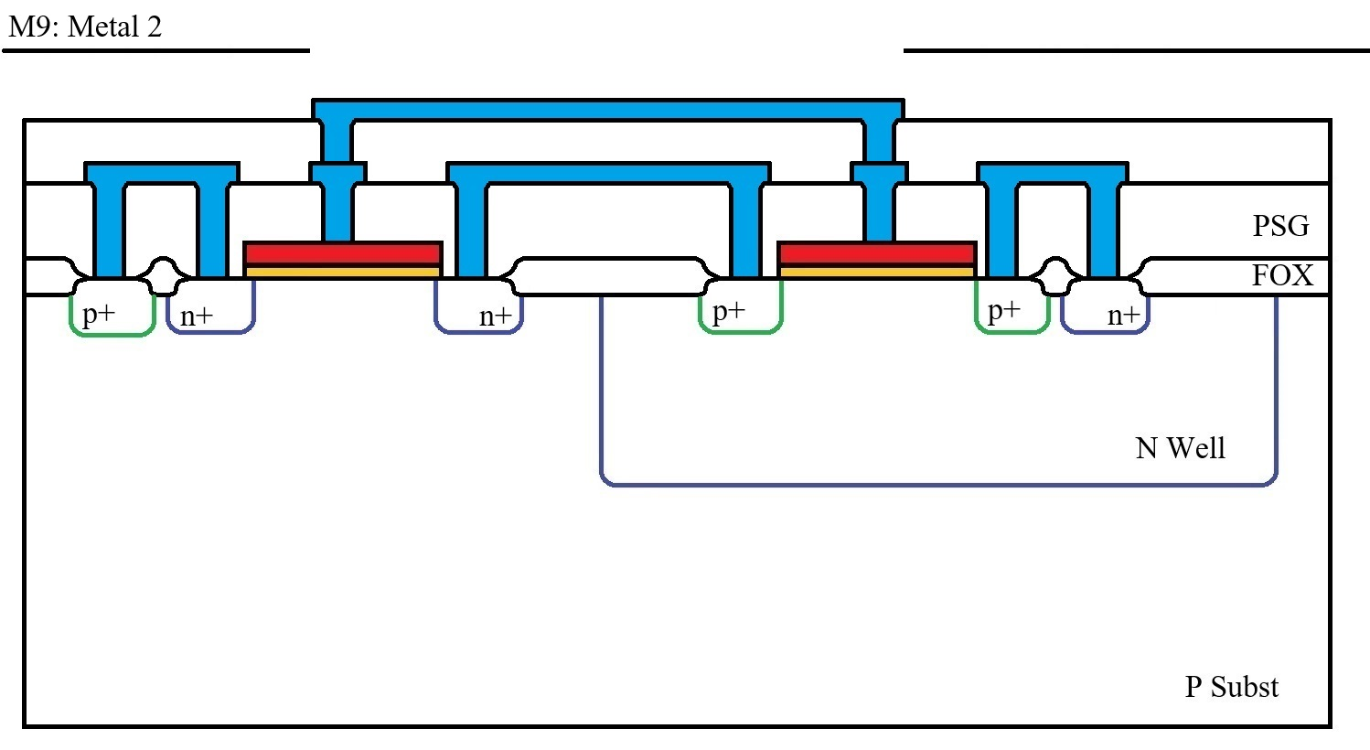
Cross Section – Metal 2

Slide 34
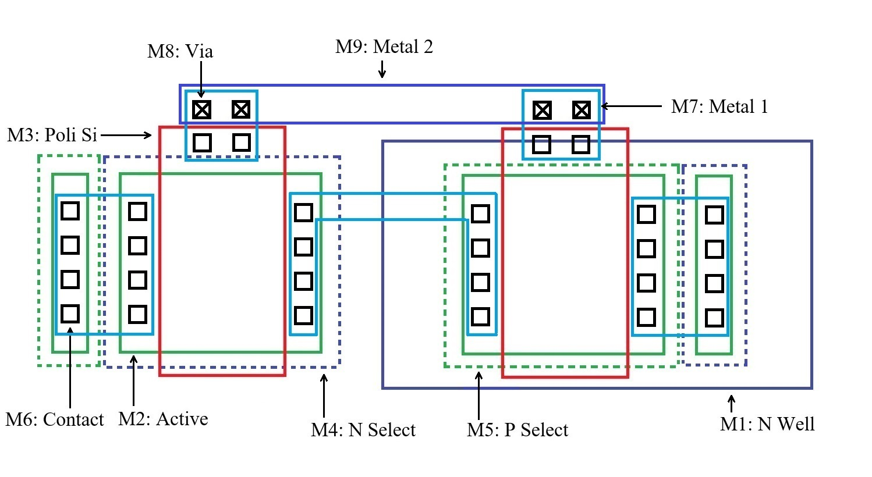
Layout – Metal 2

Slide 35
DRC – Design Rules Check
Design Rules Check (DRC) check consists in checking all technology specific geometric rues.
There is not a standard set of DRC rules but each technology has it’s own rule set. (however there are rules that can be found in practically all technologies)
Examples of DRC rules:
Minimum distance between two metal lines (on same metal layer).
Minimum metal line width.
Minimum transistor width and length.
Contact and via size.
Minimum distance between N Select and P Select active areas.
Rule to specify if via over contact is allowed or not.
Minimum gate poly extension outside channel active area.

Slide 36
LVS – Layout versus Schematic
Layout versus Schematic (LVS) check consists in checking that the layout corresponds to the schematic.
The LVS checks that:
There is a one to one correspondence between schematic and layout transistors, including sizing (L and W)
All connections (between components and to the “outside world”) from the schematic perfectly correspond to the connections from the layout.

Slide 37
LVS – Layout versus Schematic
W_{n}
W_{p}
L_{n}
L_{p}

Slide 38
Things are much more complex then presented here…
Twin tub – most processes use both n and p wells. This is much better for controlling transistor performances (V_{T}).
Additional photolithographic step for doping inside the channel for controlling the threshold voltage. (Usually this mask is not explicitly drown during the layout but is automatically generated from the other masks)
LDD – lightly dopped drain – in modern processes there is a small lightly dopped region between the channel and the actual drain contact. This is needed in submicron processes to reduce the electric field near the drain and thus reduce the number of hot carriers (high energy carriers that can tunnel in the gate oxide)
Silicide (rom: “salicidare”) – gate poly is covered by a Si – Ti alloy that dramatically increases conductivity. This makes poly silicon routing possible.
Tungsten plugs – aluminum (together with copper) is largely used for wiring (metal layer) as it is reasonable low ohmic and has good mechanical properties. But at the Al – Si interface there is a risk of “spiking” (Al forms filaments inside the silicon and can short circuit the drain/source junctions to the substrate). Tungsten is a much better interface metal for Si surfaces.
Metal stack - The metallization system should have good mechanical properties (so it sticks to the isolation layer) should have good conductivity (so the wires are low ohmic) and should provide good contact to the silicon surface). For this reasons, the metallization system is usually quite complex and consists of a metal stack.
Annealing process – after some process steps (ion implantation), the substrate crystallin structure is affected. This can be fixed by a thermal treatment (that gives enough energy to the atoms to move back in the correct crystallin order). This is also needed for activating the impurities.
Thermal budget – at high temperatures, the impurities diffuse into the silicon. For this reason it is important to avoid high temperature steps at the and of the process as they will affect all implants.

Slide 39
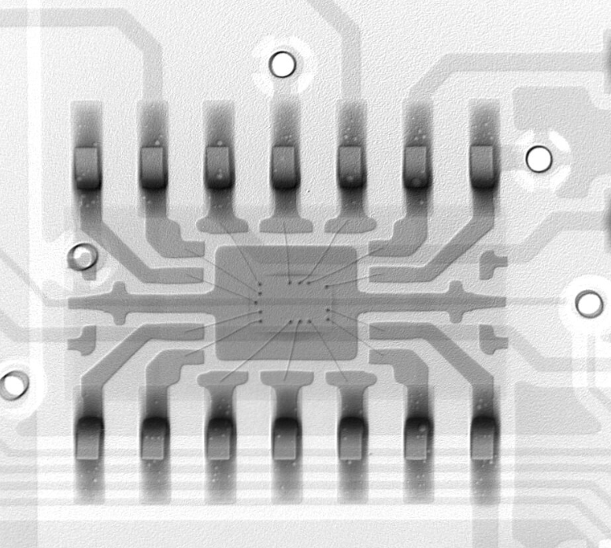
Backend Process – Sawing / Bonding / Packaging
Chip versus die:
the die is the “piece of silicon”
The chip is the packaged die
At the end of the front end process, the individual dies are separated from the wafer (bay sawing or laser cutting).
The dies are then placed inside the package and bonded.
For this, a bonding diagram is needed, detailing the coordinates of each pad and where it should be connected to (package pin).
After this, chips proceed to back end testing.

