Slide 1
Mos Transistor Model
FILS – Integrated Circuits

Slide 2
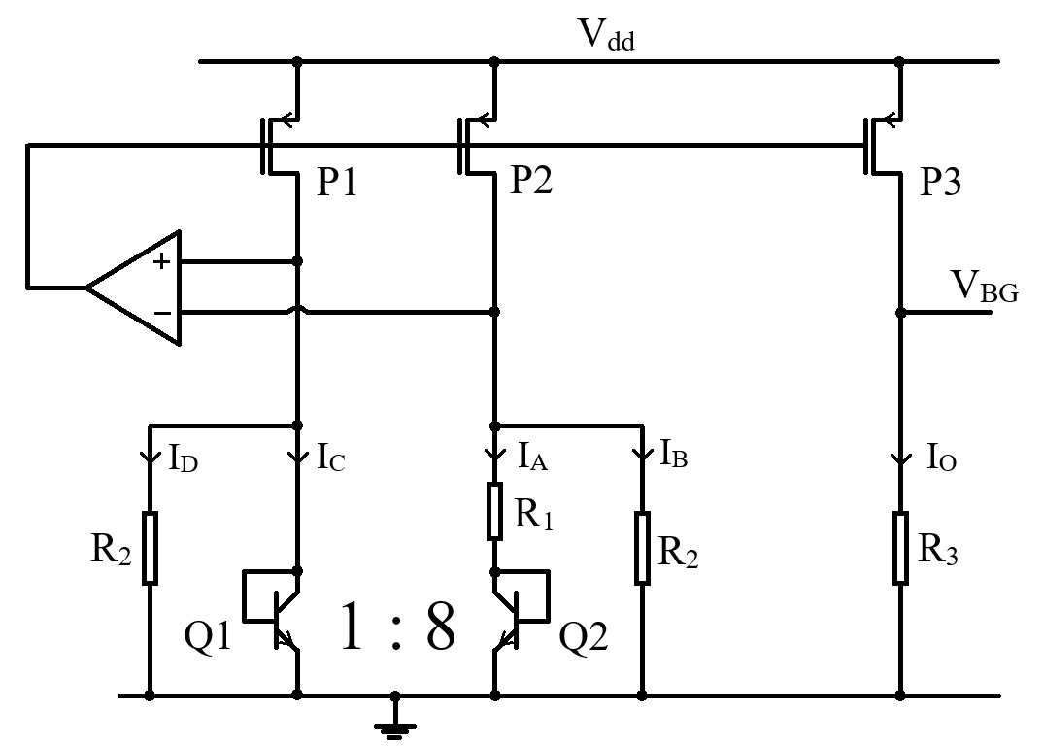
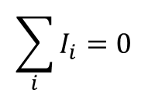
Kirchhoff I law
Any circuit is completely described by:
Device equations.
Kirchhoff I law.
Kirchhoff II law.
Kirchhoff I law:
The sum off all currents entering a node is 0. (Currents going out of the node are considered with a “–” sign.)
Kirchhoff I law directly results from charge conservation.
Node
$$\sum_{i}{I_{i}}=0$$

Slide 3
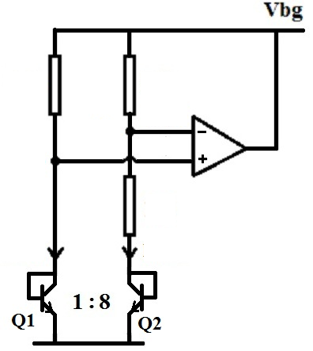


Kirchhoff II law
Kirchhoff II law:
The voltage sum along any closed loop is 0.
“There is an electric potential” – to any node of the circuit, we can attach an electric potential. The voltage drop between any two nodes is given by the potential difference between the two nodes.
Example 1: closed loop
Example 2: any voltage across the circuit
A
$$\sum_{i}{V_{i}}=0$$
V_{DA}
V_{AB}
V_{AB}
B
D
V_{BD}
V_{AG}
V_{BC}
$$V_{AB}+V_{BD}+V_{DA}=V_{A}−V_{B}+V_{B}−V_{D}+V_{D}−V_{A}=0$$
C
$$V_{AG}=V_{AB}+V_{BC}+V_{CG}$$
V_{CG}
G, V=0

Slide 4
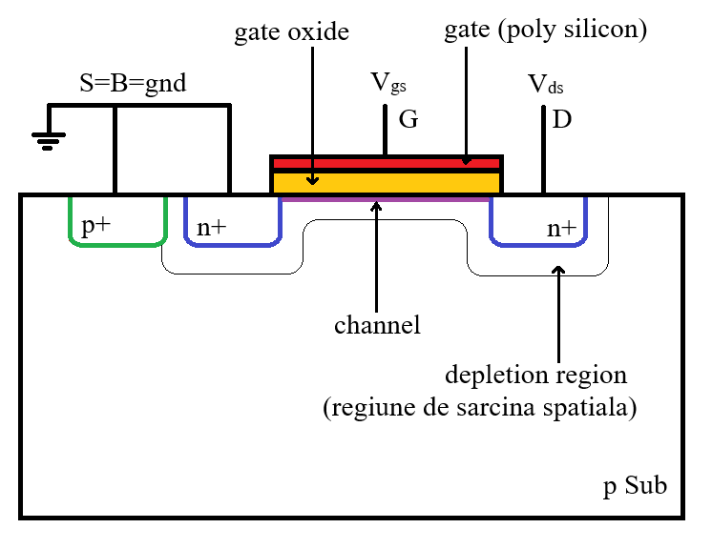
MOS Transistor Model – cross section

Slide 5
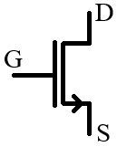
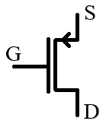
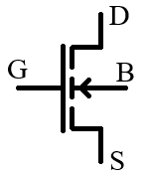
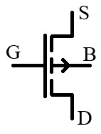
MOS Transistor Symbol
NMOS Transistors
PMOS Transistors
NMOS 3 terminals symbol
B is considered shorted to S
Arrow points in the current flow direction
PMOS 3 terminals symbol
B is considered shorted to S
Arrow points in the current flow direction
NMOS 4 terminals symbol
B is shown explicitly
Arrow points in the B – S pn junction direction
PMOS 4 terminals symbol
B is shown explicitly
Arrow points in the B – S pn junction direction

Slide 6
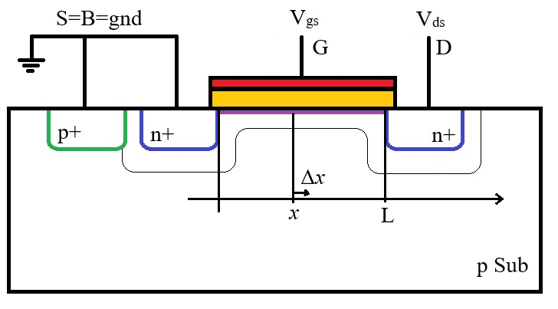
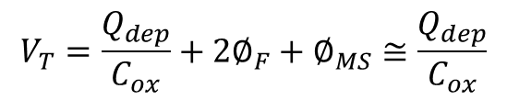
MOS Transistor Model
We assume that there is a threshold voltage such that:
For V_{gs}<V_{T} the channel is not formed and all gate voltage contributes to the spacial charge region.
For V_{gs}>V_{T} the channel is formed and all additional gate voltage over V_{T} only contributes to channel charge.
Threshold voltage is given by:
$$V_{T}=\frac{Q_{dep}}{C_{ox}}+2∅_{F}+∅_{MS}≅\frac{Q_{dep}}{C_{ox}}$$
Defining a channel element
We consider the x axis to be along the channel with x=0 at the source and x=L at the drain (L is the channel length).
We consider a very small Δx channel element at an arbitrary position, x, inside the channel.

Slide 7
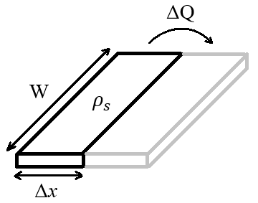
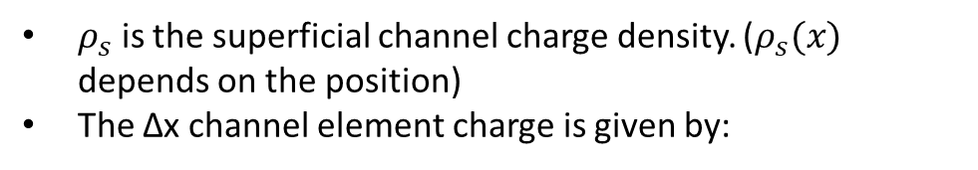

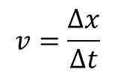

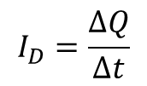
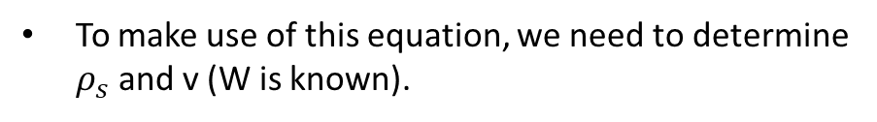
MOS Transistor Model – Linear Region Model
The current (by definition) is given by:
$$I_{D}=\frac{∆Q}{∆t}$$
$ρ_{s}$ is the superficial channel charge density. ($ρ_{s}(x)$ depends on the position)
The Δx channel element charge is given by:
$$∆Q=ρ_{s} ∆x W$$
Let v be the average charge speed.
$$v=\frac{∆x}{∆t}$$
Drain current equation results:
$$I_{D}=W ρ_{s} v$$
To make use of this equation, we need to determine $ρ_{s}$ and v (W is known).

Slide 8
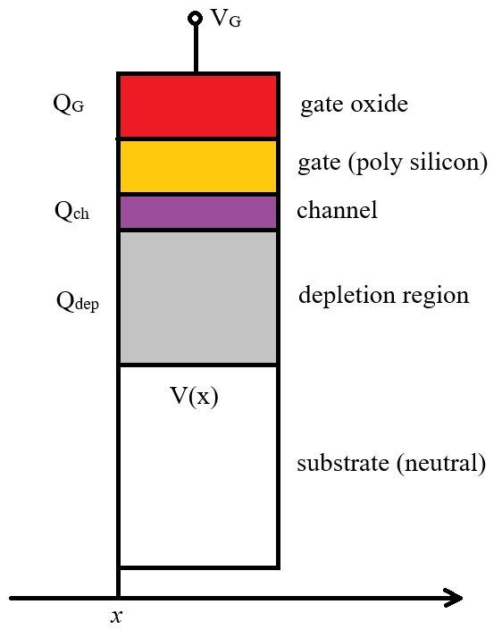




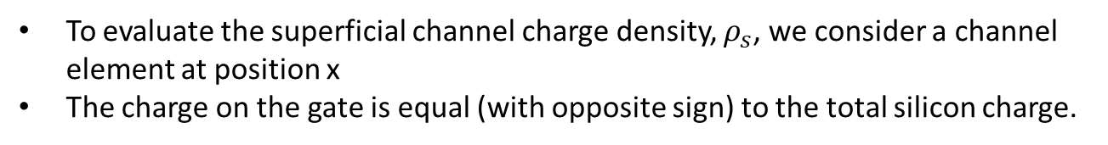
MOS Transistor Model – Linear Region Model
To evaluate the superficial channel charge density, $ρ_{s}$, we consider a channel element at position x
The charge on the gate is equal (with opposite sign) to the total silicon charge.
$$Q_{G}=− (Q_{ch}+Q_{dep})$$
Total gate charge is given by the MOS capacitor
$$Q_{G}=C \left(V_{G}−V(x)\right)$$
The depletion region charge is given equal to the total gate charge at the threshold voltage (with a minus sign for an n-type transistor)
$$Q_{dep}=−C V_{T}$$
The channel charge results
$$Q_{ch}=− Q_{G}−Q_{dep}=−C \left(V_{G}−V\left(x\right)−V_{T}\right)$$
To get the superficial channel charge, we need to divide Q_{ch} to the channel element area. For this, let C_{ox} be gate specific capacitance (capacitance of unit area). In this case, we have
$$ρ_{s}(x)=−C_{ox} \left(V_{G}−V\left(x\right)−V_{T}\right)$$

Slide 9

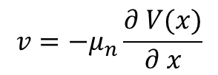
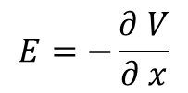
MOS Transistor Model – Linear Region Model
The average charge speed, v, is given by the charge mobility multiplied by the electric field. We consider that the charge only moves along the channel (no charge flow on the vertical direction as it is blocked by the oxide)
$$v=μ_{n}E$$
The electric field is given by the electric potential gradient, $\overline{E}=−∇∅$. In one dimension (x direction) this becomes:
$$E=−\frac{∂ V}{∂ x}$$
So the average charge speed results
$$v=−μ_{n}\frac{∂ V(x)}{∂ x}$$

Slide 10
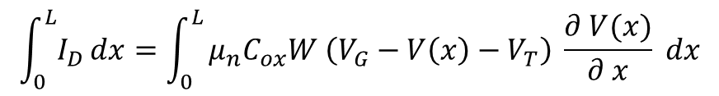
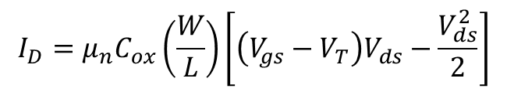
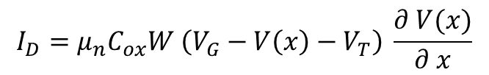
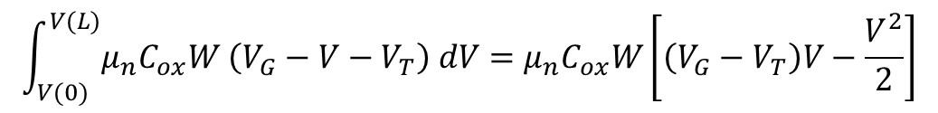
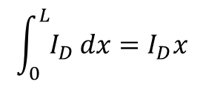
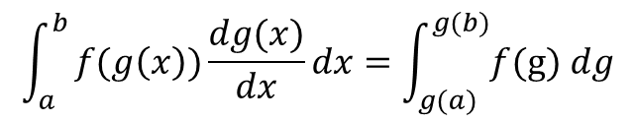
MOS Transistor Model – Linear Region Model
Replacing all this in the original current equation we get
$$I_{D}=μ_{n}C_{ox}W \left(V_{G}−V\left(x\right)−V_{T}\right) \frac{∂ V(x)}{∂ x}$$
The current does not depend on x (due to charge conservation)
We can solve this – eliminate x – by integrating the current for the entire channel length (from x=0 – source to x=L – drain)
Variable change formula
$$\int_{0}^{L}{I_{D}}dx=\int_{0}^{L}{μ_{n}C_{ox}W \left(V_{G}−V\left(x\right)−V_{T}\right) \frac{∂ V(x)}{∂ x} dx}$$
$$\int_{a}^{b}{f(g\left(x\right))\frac{dg(x)}{dx}}dx=\int_{g(a)}^{g(b)}{f(\text{g}\text{)} dg}$$
$$\int_{0}^{L}{I_{D}}dx=I_{D}x$$
Evaluated between 0 and L
$$\int_{V(0)}^{V(L)}{μ_{n}C_{ox}W \left(V_{G}−V−V_{T}\right) dV}=μ_{n}C_{ox}W\left[\left(V_{G}−V_{T}\right)V−\frac{V^{2}}{2}\right]$$
Evaluated between V(0)=0 and V(L)=V_{ds}
The drain current equation results
$$I_{D}=μ_{n}C_{ox}\left(\frac{W}{L}\right)\left[\left(V_{gs}−V_{T}\right)V_{ds}−\frac{V_{ds}^{2}}{2}\right]$$

Slide 11
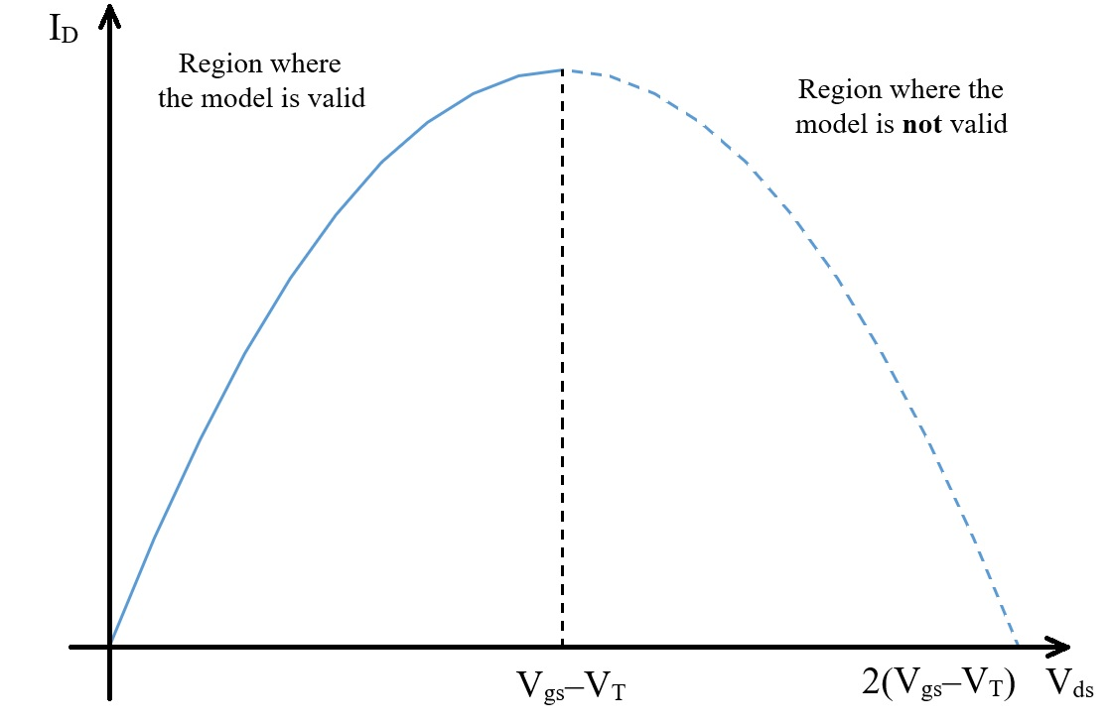





MOS Transistor Model
The operation region described by the equation determined above is called Linear Region (the reason being that I_{D} depends linearly on V_{gs})
This model equation is only valid as long as the channel extends from source to drain.
For the channel to extend all the way to the drain, it needs that the gate – drain voltage to be greater than the threshold voltage, V_{gd}>V_{T} (as this is the threshold voltage definition – the voltage needed to form the channel).
We prefer to express V_{gd} using V_{gs} and V_{ds}, as this are the voltages we use in our model.
$$V_{gs}=V_{gd}+V_{ds}$$
So we have:
The corresponding condition for the linear region results:
$$V_{gd}>V_{T}$$
$$V_{gs}−V_{ds}>V_{T}$$
$$V_{gs}−V_{T}>V_{ds}$$
$$V_{ds}<V_{gs}−V_{T}$$

Slide 12
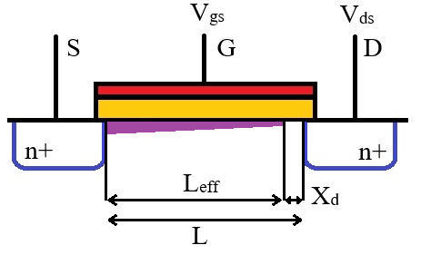
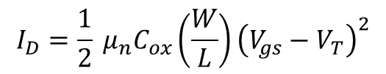
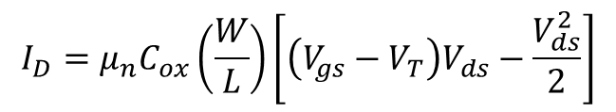
MOS Transistor Model – Saturation Model
If V_{ds} exceeds V_{gs}–V_{T}, the channel becomes interrupted near the drain.
This new operation region is called Saturation.
This does not cut the current flow – the electric field is in the right direction to pull the charges from the channel edge to the drain.
The drain current will be described by the same equation, except that V_{ds} is now replace with the voltage drop across the channel. The channel edge is always one V_{T} below the gate voltage, so the voltage drop along the channel is V_{gs}–V_{T}.
$$I_{D}=μ_{n}C_{ox}\left(\frac{W}{L}\right)\left[\left(V_{gs}−V_{T}\right)V_{ds}−\frac{V_{ds}^{2}}{2}\right]$$
Replace V_{ds} by V_{gs}–V_{T}
We get:
$$I_{D}=\frac{1}{2} μ_{n}C_{ox}\left(\frac{W}{L}\right){\left(V_{gs}−V_{T}\right)}^{2}$$

Slide 13
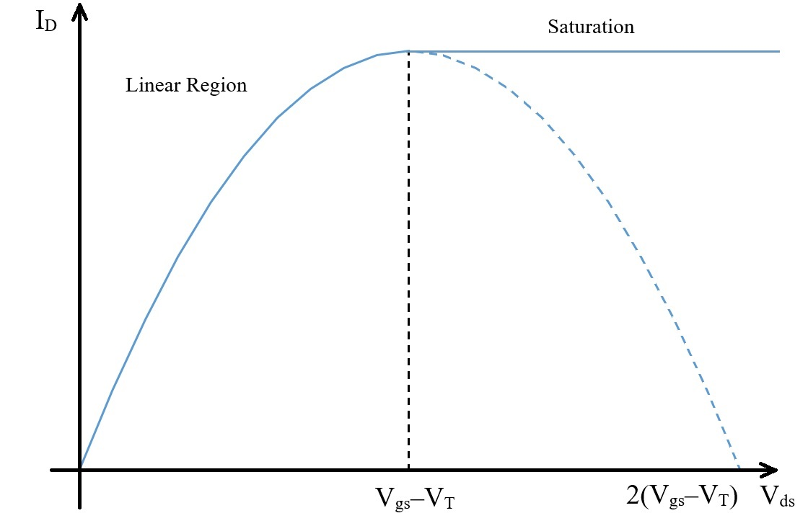
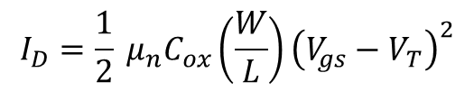
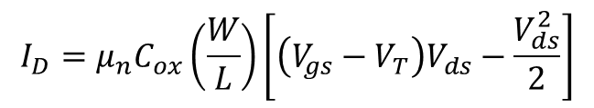
MOS Transistor Model – Saturation Model
Linear Region
$$I_{D}=μ_{n}C_{ox}\left(\frac{W}{L}\right)\left[\left(V_{gs}−V_{T}\right)V_{ds}−\frac{V_{ds}^{2}}{2}\right]$$
Saturation
$$I_{D}=\frac{1}{2} μ_{n}C_{ox}\left(\frac{W}{L}\right){\left(V_{gs}−V_{T}\right)}^{2}$$

Slide 14
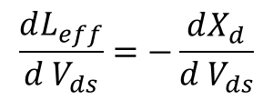
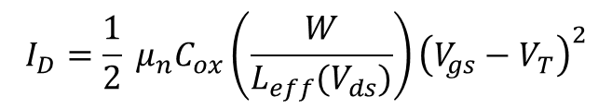

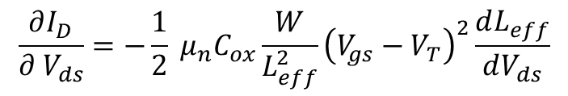
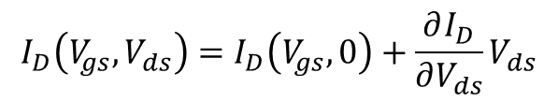
MOS Transistor Model – Channel length modulation
As the drain voltage increases, the channel cutoff point moves further from the drain.
In the model equation from previous slide, we should use the effective channel length, not the distance between drain and source.
$$I_{D}=\frac{1}{2} μ_{n}C_{ox}\left(\frac{W}{L_{eff}(V_{ds})}\right){\left(V_{gs}−V_{T}\right)}^{2}$$
Where L_{eff} depends on V_{ds} so, as a result, I_{D} also depends on V_{ds}.
We will consider this variation to be small, so we will use a first order Taylor approximation.
$$I_{D}\left(V_{gs}, V_{ds}\right)=I_{D}\left(V_{gs}, 0\right)+\frac{∂I_{D}}{∂V_{ds}}V_{ds}$$
Where
$$\frac{∂I_{D}}{∂ V_{ds}}=−\frac{1}{2} μ_{n}C_{ox}\frac{W}{L_{eff}^{2}}{\left(V_{gs}−V_{T}\right)}^{2}\frac{dL_{eff}}{dV_{ds}}$$
We have
$$L_{eff}=L−X_{d}$$
$$\frac{dL_{eff}}{d V_{ds}}=−\frac{dX_{d}}{d V_{ds}}$$

Slide 15

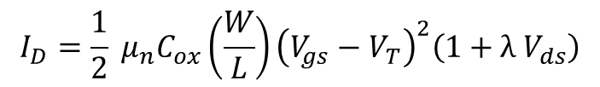
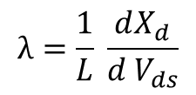
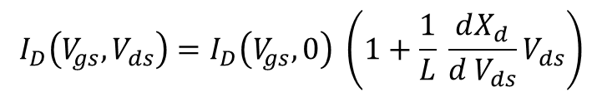
MOS Transistor Model – Channel length modulation
We evaluate the derivative at V_{ds}=0 (the point arround we do the Talyor expansion). There L_{eff}=L, so we get:
$$\frac{∂I_{D}}{∂ V_{ds}}(V_{ds}=0)= \frac{1}{2} μ_{n}C_{ox}\frac{W}{L}{\left(V_{gs}−V_{T}\right)}^{2}\frac{1}{L}\frac{dX_{d}}{d V_{ds}}=I_{D}\left(V_{gs}, 0\right)\frac{1}{L}\frac{dX_{d}}{d V_{ds}}$$
$$I_{D}\left(V_{gs}, 0\right)$$
Replacing this back in our Taylor series, we get
$$I_{D}\left(V_{gs}, V_{ds}\right)=I_{D}\left(V_{gs}, 0\right) \left(1+\frac{1}{L} \frac{dX_{d}}{d V_{ds}}V_{ds}\right)$$
We have the channel length modulation coefficient:
$$λ=\frac{1}{L} \frac{dX_{d}}{d V_{ds}}$$
Also replacing the I_{D}(V_{gs}, 0) expression, we get the drain current saturation model:
$$I_{D}=\frac{1}{2} μ_{n}C_{ox}\left(\frac{W}{L}\right){\left(V_{gs}−V_{T}\right)}^{2}\left(1+λ V_{ds}\right)$$

Slide 16



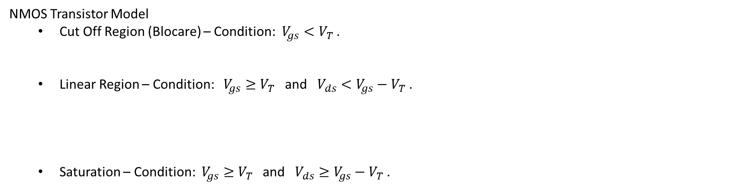
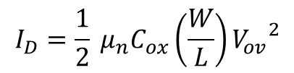
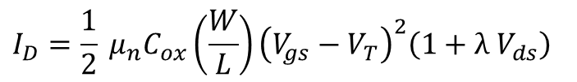
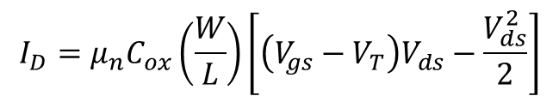
MOS Transistor Model – large signal
NMOS Transistor Model
  Cut Off Region (Blocare) – Condition: $V_{gs}<V_{T}$ .
  Linear Region – Condition: $V_{gs}≥V_{T}$ and $V_{ds}<V_{gs}−V_{T}$ .
  Saturation – Condition: $V_{gs}≥V_{T}$ and $V_{ds}≥V_{gs}−V_{T}$ .
$$I_{D}=0$$
$$I_{D}=μ_{n}C_{ox}\left(\frac{W}{L}\right)\left[\left(V_{gs}−V_{T}\right)V_{ds}−\frac{V_{ds}^{2}}{2}\right]$$
$$I_{D}=\frac{1}{2} μ_{n}C_{ox}\left(\frac{W}{L}\right){\left(V_{gs}−V_{T}\right)}^{2}\left(1+λ V_{ds}\right)$$
$$I_{D}=\frac{1}{2} μ_{n}C_{ox}\left(\frac{W}{L}\right){V_{ov}}^{2}$$
$$\left(1+λ V_{ds}\right)$$
is usually neglected in large signal analysis
$$V_{ov}=\left(V_{gs}−V_{T}\right)$$
overdrive voltage (notation)
  Note: d.c gate current is 0 in all operation modes: $I_{G}=0.$

Slide 17
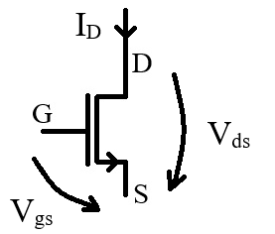
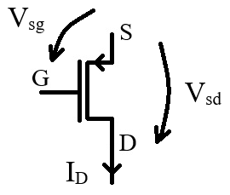
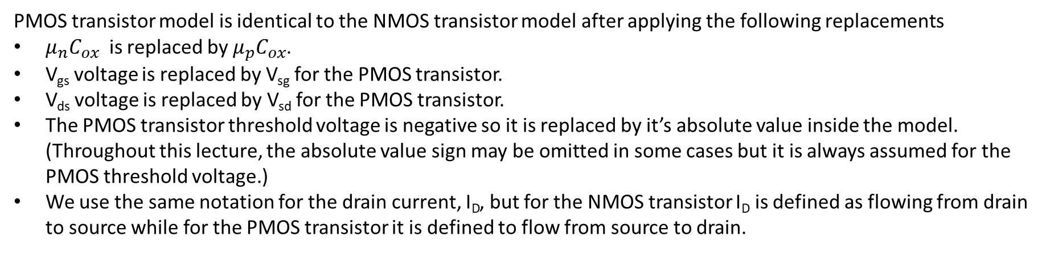
NMOS versus PMOS transistor model
PMOS transistor model is identical to the NMOS transistor model after applying the following replacements
$μ_{n}C_{ox}$ is replaced by $μ_{p}C_{ox}$.
V_{gs} voltage is replaced by V_{sg} for the PMOS transistor.
V_{ds} voltage is replaced by V_{sd} for the PMOS transistor.
The PMOS transistor threshold voltage is negative so it is replaced by it’s absolute value inside the model. (Throughout this lecture, the absolute value sign may be omitted in some cases but it is always assumed for the PMOS threshold voltage.)
We use the same notation for the drain current, I_{D}, but for the NMOS transistor I_{D} is defined as flowing from drain to source while for the PMOS transistor it is defined to flow from source to drain.
NMOS Transistors
PMOS Transistors

Slide 18



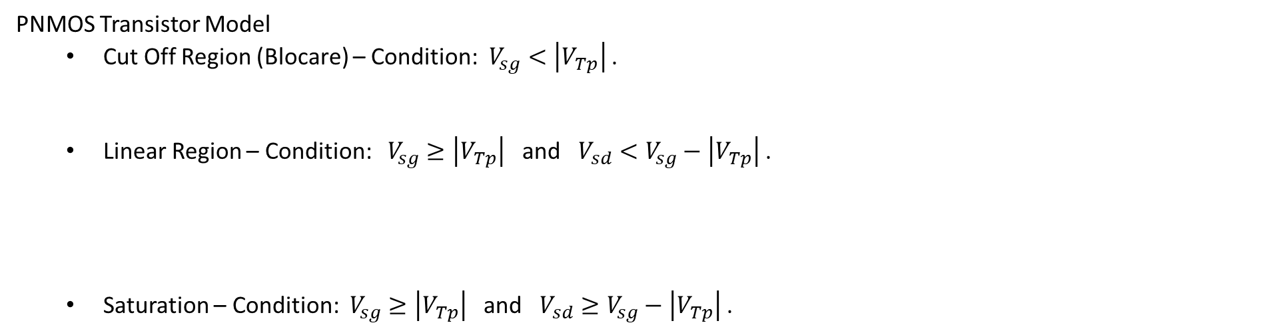
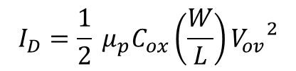
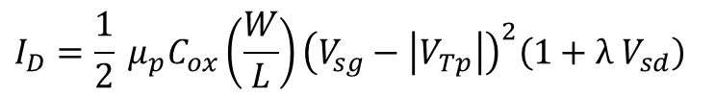

MOS Transistor Model – large signal
PNMOS Transistor Model
  Cut Off Region (Blocare) – Condition: $V_{sg}<\left|V_{Tp}\right|$ .
  Linear Region – Condition: $V_{sg}≥\left|V_{Tp}\right|$ and $V_{sd}<V_{sg}−\left|V_{Tp}\right|$ .
  Saturation – Condition: $V_{sg}≥\left|V_{Tp}\right|$ and $V_{sd}≥V_{sg}−\left|V_{Tp}\right|$ .
$$I_{D}=0$$
$$I_{D}=μ_{p}C_{ox}\left(\frac{W}{L}\right)\left[\left(V_{sg}−\left|V_{Tp}\right|\right)V_{sd}−\frac{V_{sd}^{2}}{2}\right]$$
$$I_{D}=\frac{1}{2} μ_{p}C_{ox}\left(\frac{W}{L}\right){\left(V_{sg}−\left|V_{Tp}\right|\right)}^{2}\left(1+λ V_{sd}\right)$$
$$I_{D}=\frac{1}{2} μ_{p}C_{ox}\left(\frac{W}{L}\right){V_{ov}}^{2}$$
$$\left(1+λ V_{ds}\right)$$
is usually neglected in large signal analysis
$$V_{ov}=\left(V_{sg}−\left|V_{Tp}\right|\right)$$
overdrive voltage (notation for PMOS transistors)
  Note: d.c gate current is 0 in all operation modes: $I_{G}=0.$

Slide 19
MOS Transistor – I_{D}(V_{ds}) characteristic

Slide 20

MOS Transistor – I_{D}(V_{ds}) characteristic

Slide 21


MOS Transistor – I_{D}(V_{gs}) characteristic
$$V_{ds}=V_{gs}−V_{T}$$

Slide 22

MOS Transistor – I_{D}(V_{gs}) characteristic

