Slide 1
AUTosar MCAL crypto
Frankie zeng ae 2019/12/18

Slide 2
AGENDA
S32K Hardware Crypto Engine
S32K1 CSEC
S32K3 HSE
AUTOSAR MCAL CDD
AUTOSAR MCAL Crypto
CDD vs Crypto
Q&A

Slide 3
S32K Hardware Crypto Engine

Slide 4
S32K1 CSEC
S32K3 HSE
SHE specification
AES-128
TRNG
Miyaguchi-Prenell Compression
CMAC
Security Boot
SHE specification
AES-128/AES-256(stream mode)
TRNG
CMAC,HMAC,GMAC
MD5, SHA-1,SHA-224,SHA-256,SHA-512
RSA-4096,ECC-521,DH
Security Boot
Queue Priority
Customer defined feature
symmetry
asymmetric

Slide 5
AUTOSAR MCAL CDD

Slide 6
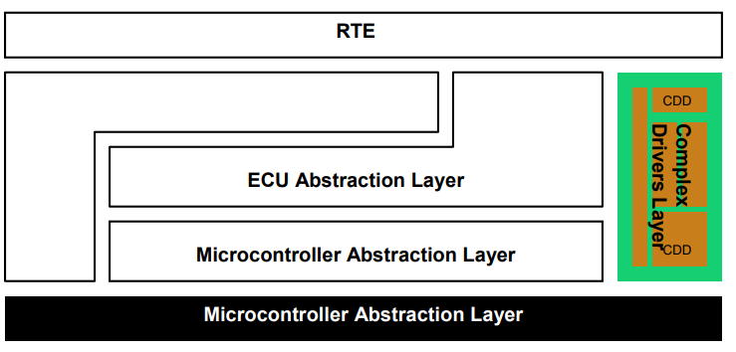
CDD(complex device driver)
AUTOSAR define a speciation for some complex hardware device

Slide 7
NXP Support
AUTOSAR 4.2 MCAL CSEC CDD Driver
Application Note about CSEC: AN5401, Getting Started with CSEc Security Module
A Demo Project
Some basic MCAL module
EB Config Project
A Demo main to use some crypto feature and print execute time
GCC, IAR, GHS

Slide 8
AUTOSAR MCAL Crypto

Slide 9
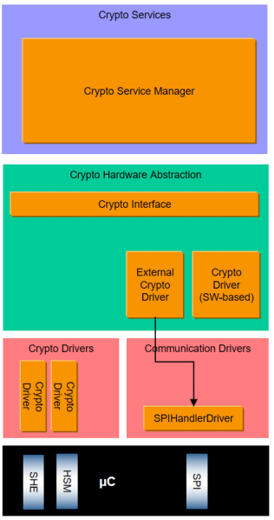
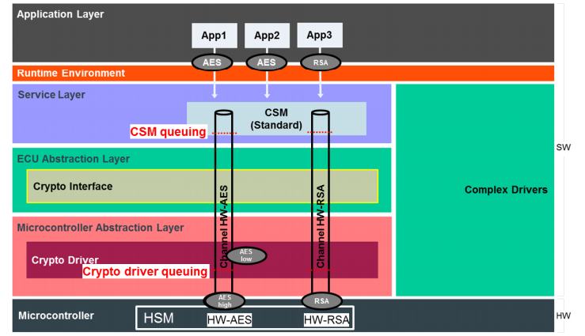
Support a simple fake file to help customer verify Crypto(HW)
CSM
CryIF
MCAL
Support Key Config & Management (without in CSEC)
Crypto(HW)

Slide 10
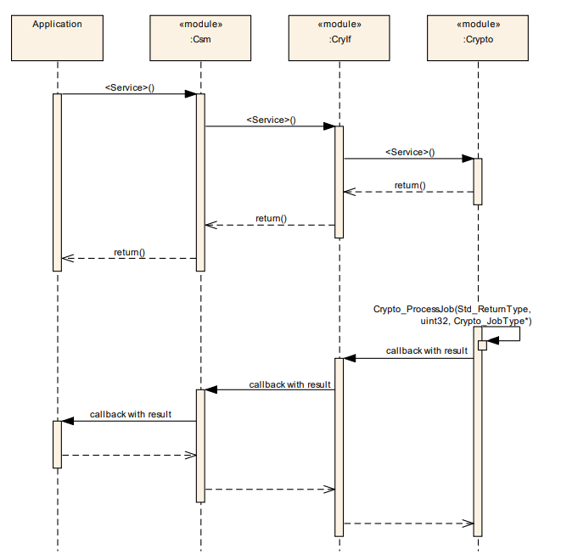
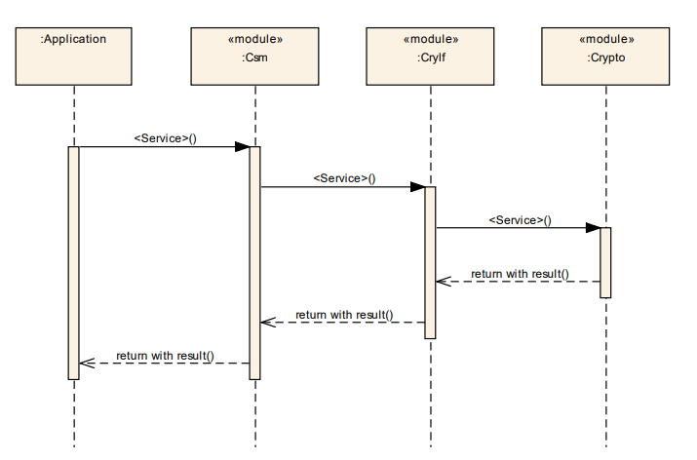

Slide 11
NXP Support
AUTOSAR 4.3 MCAL RTM_P1_HF3_1_0_0
A demo project for crypto is unavailable right now.

Slide 12
CDD vs Crypto

Slide 13
A CDD driver only support S32K1 CSEC (AUTOSAR 4.2)
Crypto driver support both S32K1 and S32K3 (AUTOSAR 4.3), fix bug, keep development
CDD is faster than CSM, low-level
Crypto driver more abstracted, high-level
If S32K1 use crypto driver, it’s easy to migrate to S32K3
Crypto driver is a better choice.

Slide 14
Q&A

