Slide 1
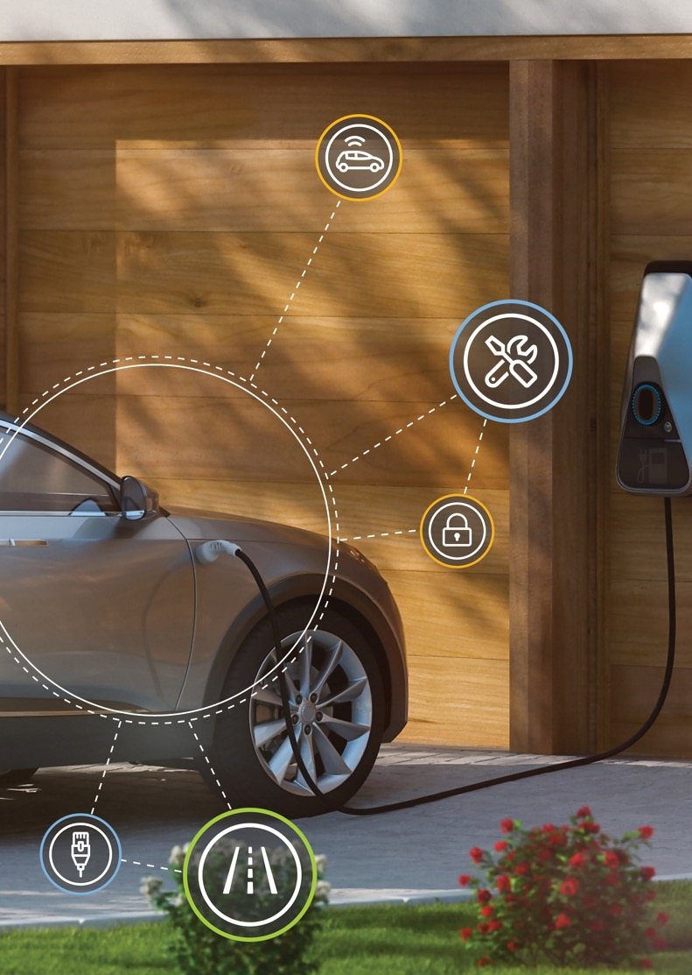
S32k3 microcontroller family for automotive and industrial
Tackling cost and complexity of automotive software development
6-PACK
JUNE 2022
S32K3

Slide 2
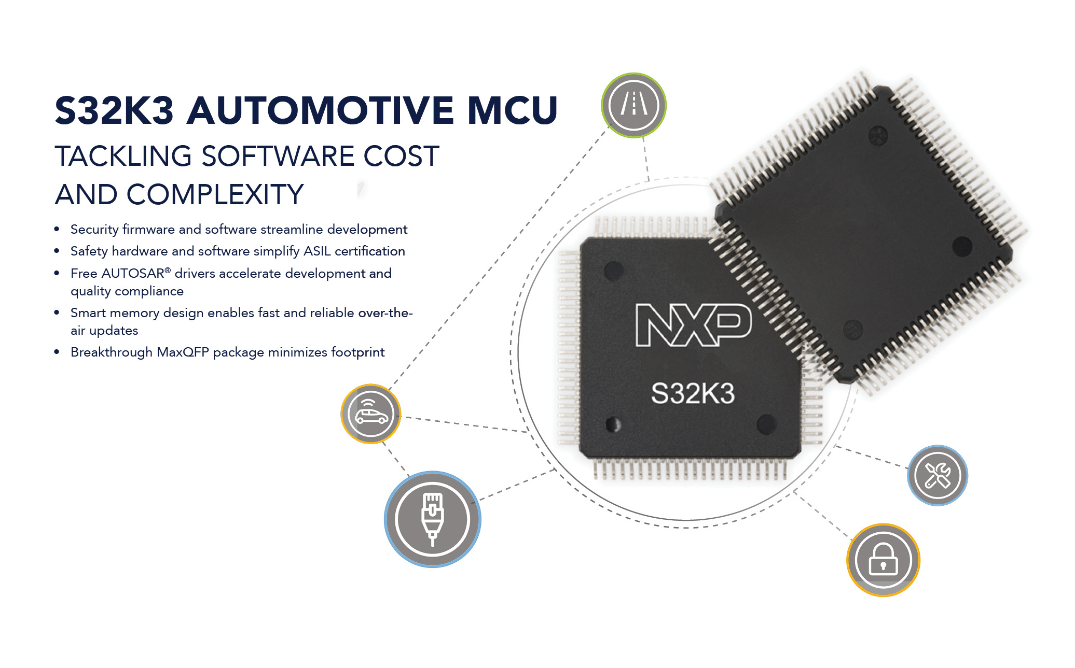
Now Available

Slide 3
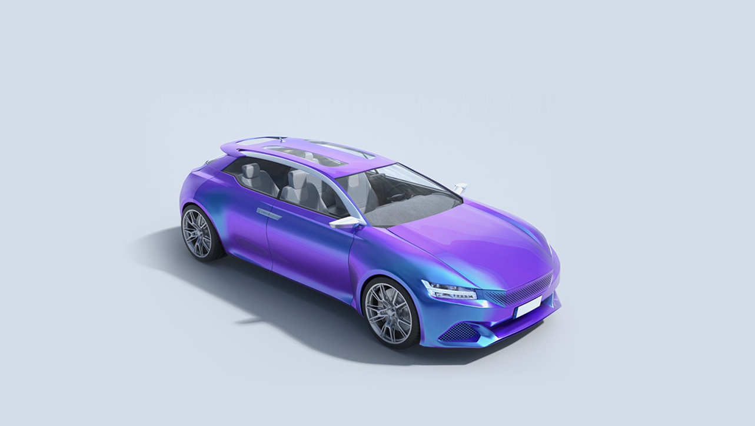

S32k3: expanding the S32 platform
Gateway
Powertrain/
Chassis
Infotainment
ADAS
Body and
Comfort
NXP’s S32 Automotive Platform enables software reuse across multiple applications, reducing development complexity and easing the burden for Tier 1s and carmakers
S32K3 expands S32
into zone control and edge nodes
Extends S32K family into new applications:
  · Advanced Body Electronics
  · Battery Management
  · Zone Control
Engine
Control
Transmission Control
Application Processor
Audio Amplifier
I/O
controller
Telematics box
Car Access
Body Control Module
Battery Management
Park
Assist
Safety
Controller
Window / Sunroof
TPMS
Pump
Control
Lighting
Door
Control
Vision
Cooling Fan Control
Wiper
Seat
Control
Radar
Steering
Column Module
Mirror
Climate
Control
S32K MCU
Target Applications

Slide 4




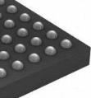
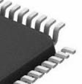

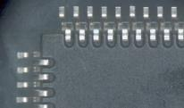

What's new in K3 vs. K1?
S32K1
S32K3
PERFORMANCE
M0+ @ 48 MHz or
M4F @ 80 - 112 MHz
Single-core
1 - 4 M7 @ 120 - 320 MHz
Single-core, Multi-core or Lockstep core
MEMORY
128 KB – 2 MB P-Flash
17 – 256 KB RAM
512 KB - 8 MB P-Flash
128 KB - 1152 KB RAM
SECURITY & OTA
CSEc
Sym Cipher
Up to 20 keys
OTA Support (RWW)
HSE B
Sym & Asym Ciphers; 100+ Keys, Side channel protection
Seamless OTA (RWW, Memory remapping
for A/B Swap, FW rollback option)
SAFETY
ASIL B
ASIL B / D
KEY
PERIPHERALS
100 Mb Ethernet (AVB), up to 3 CAN FD
FlexTimer module, TRGMUX, FlexIO,
PDB for Motor control
Up to 1 Gbps Ethernet (TSN, AVB), up to 8 CAN FD
eMIOS, BCTU, LCU for Motor control
Advanced peripherals I3C, Enhanced FlexIO
PACKAGING
BGA
LQFP
QFN
BGA
MaxQFP
LQFP

Slide 5
S32K3xx 512 KB - 4 MB Device Feature Overview
PRELIMINARY INFO, SUBJECT TO CHANGE
IN PRODUCTION
S32K310 | S32K311 | S32K312 | S32K314 | S32K322 | S32K324 | S32K341 | S32K342 | S32K344 | S32K344
1x Cortex-M7 @ 120MHz |  |  | 1x Cortex-M7 @ 160MHz | 2x Cortex-M7 @ 160MHz |  | 1x LS Cortex-M7 @ 160MHz
ASIL B | ASIL B | ASIL B | ASIL B | ASIL B | ASIL B | ASIL D | ASIL D | ASIL D | ASIL D
HSE B | HSE B | HSE B | HSE B | HSE B | HSE B | HSE B | HSE B | HSE B
512KB Flash | 1MB Flash | 2MB Flash | 4MB Flash | 2MB Flash | 4MB Flash | 1MB Flash | 2MB Flash | 4MB Flash | 4MB Flash
64K SRAM incl. 64K TCM | 128K SRAM incl. 96K TCM | 192K SRAM incl. 96K TCM | 512K SRAM incl. 96K TCM | 256K SRAM incl. 192K TCM | 512K SRAM incl. 192K TCM | 256K SRAM incl. 192K TCM | 256K SRAM incl. 192K TCM | 512K SRAM incl. 192K TCM | 512K SRAM incl. 192K TCM
up to 84 I/Os | up to 84 I/Os | up to 143 I/Os | up to 218 I/Os | up to 143 I/Os | up to 218 I/Os | up to 143 I/Os | up to 143 I/Os | up to 218 I/Os | up to 218 I/Os
16 channel eDMA |  |  | 32ch eDMA | 32 channel eDMA
3x FlexCAN w/ CAN FD |  | 6x FlexCAN w/ CAN FD |  | 4x FlexCAN w/ CAN FD | 6x FlexCAN w/ CAN FD | 4xFlexCAN w/ CAN FD | 4x FlexCAN w/ CAN FD | 6x FlexCAN w/ CAN FD | 6x FlexCAN w/ CAN-FD
 |  |  | No Ethernet / 1x 100Mbps Ethernet (TSN) | No Ethernet / 1x 100Mbps Ethernet (TSN)
1x I3C, 2x I2C |  |  | 2x I2C | 1x I3C, 2x I2C | 2x I2C | 1x I3C, 2x I2C | 1x I3C, 2x I2C | 2x I2C | 2x I2C
4x SPI** |  |  | 6x SPI** | 4x SPI** | 6x SPI** | 4x SPI** | 4x SPI** | 6x SPI** | 6x SPI**
2x 24ch 12-bit ADC |  |  | 3x 24ch 12-bit ADC | 2x 24ch 12-bit ADC | 3x 24ch 12-bit ADC | 2x 24ch 12-bit ADC | 2x 24ch 12-bit ADC | 3x 24ch 12-bit ADC | 3x 24ch 12-bit ADC
 |  |  | 2 x SAI (I2S) | 2x SAI (I2S)
 |  |  | Quad SPI | Quad SPI
LQFP-48 |  | MaxQFP-172 |  | MaxQFP-172
MaxQFP-100 |  |  |  | MaxQFP-100 |  | MaxQFP-100 | MaxQFP-100
 |  |  | MAPBGA-257 |  | MAPBGA-257 |  |  |  | MAPBGA-257
Common HW: LPUART, FlexIO, eMIOS Timers, ACMP, LCU, BCTU, TRGMUX
Common SW: Real-Time Drivers (RTD), Security FW, Safety SW Framework, Core Self-Test Libraries, etc
*K314 100MaxQFP room temp CES only, not for production
**Ethernet 10BaseT1S supported by SPI + external MAC&PHY

Slide 6
S32K3xx 6 mB - 8 MB Device Feature Overview
PRELIMINARY INFO, SUBJECT TO CHANGE
S32K328 | S32K338 | S32K348 | S32K358
2x Cortex-M7 @ 160MHz | 3x Cortex-M7 @ 240MHz | 1x LS Cortex-M7 @ 240MHz | 1x LS Cortex-M7 + 1x Cortex-M7 @ 240MHz
ASIL B | ASIL B | ASIL D | ASIL D
HSE B | HSE B | HSE B | HSE B
8MB Flash
1152K SRAM
up to 218 I/Os
32 channel eDMA
8x FlexCAN w/ CAN-FD
No Ethernet / 1x 1Gbps Ethernet (TSN)
1x I3C, 2x I2C
6x SPI**
3x 24ch 12-bit ADC
2x SAI (I2S)
SDHC(SDIO)
MaxQFP-172
MAPBGA-289
Common HW: LPUART, FlexIO, eMIOS Timers, ACMP, LCU, BCTU, TRGMUX
Common SW: Real-Time Drivers (RTD), Security FW, Safety SW Framework, Core Self-Test Libraries, etc

Slide 7
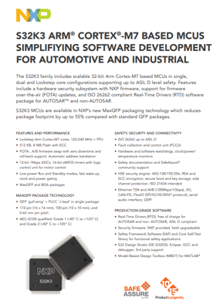
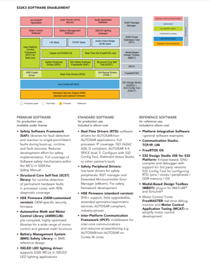
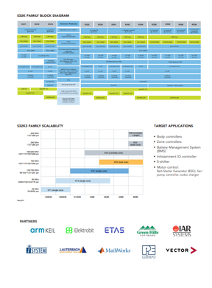
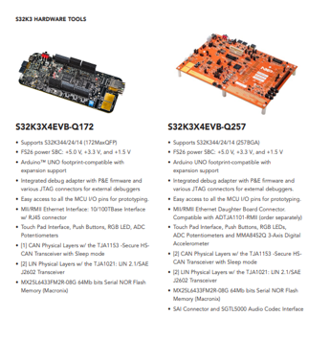
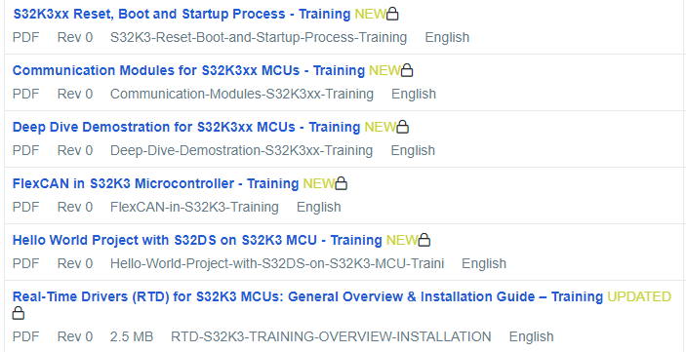
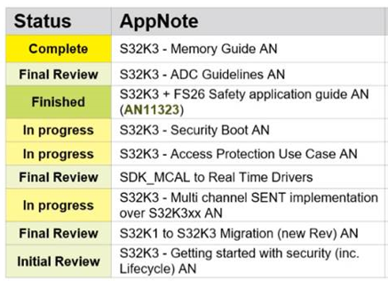
S32k3 Documentation
NOW AVAILABLE on www.nxp.com
  Data Sheet /REV3
  Errata (K3X4, K312)
  Reference Manual /REV3
  Safety Manual @ SafeAssure Community
  HSE firmware Reference Manual @ DocStore
  S32K1/K3 Brochure
  RTD, SAF, SCST, and IPCF Software Product Briefs
  6 Training Modules (more to follow)
COMING SOON:
  Application Notes:
    S32K1 to S32K3 migration
    SDK to RTD migration
    MaxQFP Overview
    …

Slide 8
S32K3 silicon
S32K3 Initial Production PNs
(additional PNs may be set up upon request)
NXP/Distributor/eTailer Stocking PN
P = engineering sample
S = production device
P samples
  P32K344EHT1VMMST 257MBGA
  P32K344EHT1VPBST 172MQFP
  Contact local NXP sales for requests
S production devices
  See table opposite for list of currently orderable PNs
  Note, full list of orderable production part numbers will be added to S32K3 Data Sheet as an excel attachment (same format as as per S32K1 Data Sheet attachment)
Family | PN | Cores | Package | Ethernet | Temp (ambient) | Availability
K344 | S32K344EHT1VMMST | Cortex-M7 (LS) | 257BGA | Y | 105 | Feb’22
 | S32K344EHT1VPBST | Cortex-M7 (LS) | 172MaxQFP | Y | 105 | May’22
 | S32K344NHT1VMMST | Cortex-M7 (LS) | 257BGA | N | 105 | Standard LT
 | S32K344NHT1VPBST | Cortex-M7 (LS) | 172MaxQFP | N | 105 | Standard LT
 | S32K344NHT1MMMST | Cortex-M7 (LS) | 257BGA | N | 125 | Standard LT
 | S32K344NHT1MPBST | Cortex-M7 (LS) | 172MaxQFP | N | 125 | Standard LT
K324 | S32K324EHT1VMMST | 2x Cortex-M7 | 257BGA | Y | 105 | Feb’22
 | S32K324NHT1VPBST | 2x Cortex-M7 | 172MaxQFP | N | 105 | May’22
 | S32K324NHT1VMMST | 2x Cortex-M7 | 257BGA | N | 105 | Standard LT
 | S32K324NHT1MPBST | 2x Cortex-M7 | 172MaxQFP | N | 125 | Standard LT
 | S32K324EHT1VMMSR | 2x Cortex-M7 | 257BGA | Y | 105 | Standard LT
 | S32K324NHT1VPBSR | 2x Cortex-M7 | 172MaxQFP | N | 105 | Standard LT
K314 | S32K314EHT1VMMST | 1x Cortex-M7 | 257BGA | Y | 105 | Feb’22
 | S32K314EHT1VPBST | 1x Cortex-M7 | 172MaxQFP | Y | 105 | May’22
 | S32K314NHT1VMMST | 1x Cortex-M7 | 257BGA | N | 105 | Standard LT
 | S32K314NHT1VPBST | 1x Cortex-M7 | 172MaxQFP | N | 105 | Standard LT
 | S32K314NHT1VPBSR | 1x Cortex-M7 | 172MaxQFP | N | 105 | Standard LT
K312 | S32K312NHT0MPAST | 1x Cortex-M7 | 172MaxQFP | N | 125 | July’22
 | S32K312NHT0MPBST | 1x Cortex-M7 | 172MaxQFP | N | 125 | July’22
 | S32K312NHT0VPAST | 1x Cortex-M7 | 172MaxQFP | N | 105 | Standard LT
 | S32K312NHT0VPBST | 1x Cortex-M7 | 172MaxQFP | N | 105 | Standard LT

Slide 9
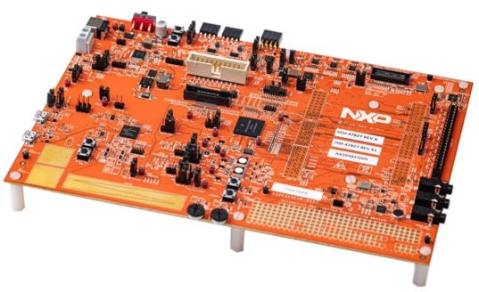
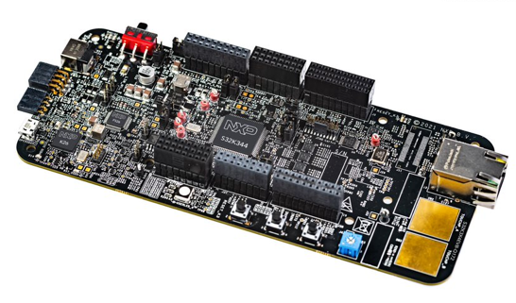
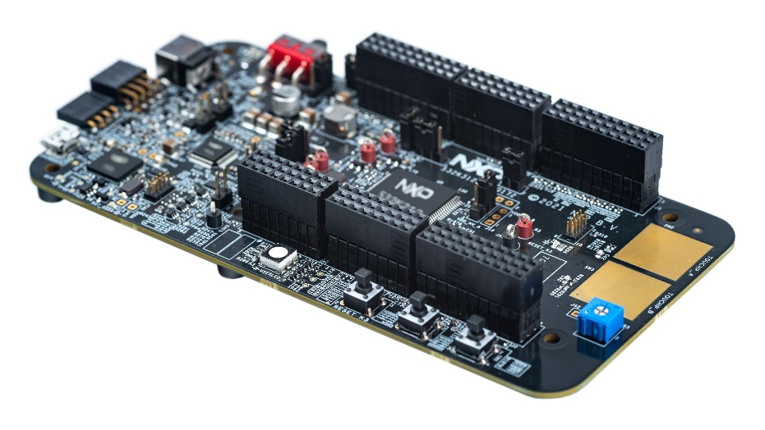
S32k3 Hardware tools
NOW ORDERABLE
S32K3X4EVB-Q257
S32K3X4EVB-Q172
S32K312EVB-Q172
K344 (LS), 257MBGA
S32K3X4EVB-Q257 – K26 included
S32K3X4EVBQ257ND – no K26 MCU, external debugger needed
nxp.com/S32K344EVBQ257
K344 (LS), 172MaxQFP
100Base-Tx non-Auto PHY
For Auto PHY use:
S32K3X4EVB-Q257 + ADTJA1101-RMII
S32K3X4EVB-Q172 – K26 MCU included
S32K3X4EVBQ172ND – no K26 MCU,
external debugger needed
nxp.com/S32K344EVBQ172
K312, 172MaxQFP
S32K312EVB-Q172 – K26 MCU included
nxp.com/S32K312EVBQ172
Notes:
S32K344 Revision on EVBs
Some EVBs initially populated with K344 Rev1.0 (‘T0’)
All production EVBs using Rev1.1 (‘T1’ PN)
-Q257 EVB: no change
-Q172 EVB: some additional resistors will be populated
on EVBs containing Rev1.1 (‘T1’) silicon
Debugger Support
· Kinetis K26 MCU supply issues temporarily affecting
some EVB builds → no On-Board Debugger function
· External debugger support available from NXP partners
– see next slide

Slide 10
S32K3 Evb overview
LAST UPDATE: June 2022
Device | Description | Part Number | K26 MCU populated (OBD function) | CAN PHY | Ethernet PHY | Availability | Where to order | PMIC FS26 OTP Part
K344 K324 K314 | Full-Featured EVB (257MBGA) | S32K3X4EVB-Q257 | Y | TJA1153 (past) TJA1043 (future) | n/a | November 2022 | N/A | MFS2613AMDA2AD
 |  | S32K3X4EVBQ257ND | N | 2 x TJA1153 |  | Now | nxp.com | MFS2613AMDA2AD
 | Low-cost EVB (172MaxQFP) | S32K3X4EVB-Q172 | Y | TJA1043 | Non-Auto | Now | nxp.com | MFS2613AMDA2AD
 |  | S32K3X4EVB-T172 | N | TJA1153 | TJA1103 | July 2022 | N/A | MFS2613AMDA2AD
K312 | Low-cost EVB (172MaxQFP) | S32K312EVB-Q172 | N | TJA1043 | Non-Auto | Now | nxp.com | MFS2613AMDA2AD
Note:
No EVB planned for K342/K341/K322 - use K344 board for evaluation, K312 board for I3C module evaluation
NXP may temporarily disable an EVB part number (ND or non-ND version) that is not in stock. This is simply to prevent orders having to be manually transferred from one part number to another to enable shipment. Distributors should order the current active part number as shown on the NXP website @ www.nxp.com/S32K3
  PN Suffix Missing components
  None None
  ND K26 MCU (provides on-board debug function)
Notes:
S32K3XXEVB-S172 – MII/RMII ENET (‘SABRE’) connector, can connect to different PHY daughter cards e.g. ADTJA1101-RMII for 100Base-T1. If using with PC for debugging, user needs a translator box to translate signals into 100Base-Tx //may be productized later if sufficient market demand

Slide 11







s32K3 EVB – External / 3rd party Debugger support
The following debuggers may be used with S32K3 EVBs that do not include a Kinetis K26 MCU populated (on-board Debug function):
  I-jet: https://www.iar.com/products/architectures/arm/i-jet/
  J-Link: https://www.segger.com/products/debug-probes/j-link/#the-segger-j-link-family-model-overview
  ULINK: https://www2.keil.com/mdk5/ulink
  Green Hills Probe: https://www.ghs.com/products/probe.html
  Power Debug Interface USB 3: https://www.lauterbach.com/frames.html?home.html
  PowerDebug PRO: https://www.lauterbach.com/frames.html?home.html
  iC5700/5000: https://www.isystem.com/products/hardware/on-chip-analyzers.html
  Multilink: http://www.pemicro.com/products/product_viewDetails.cfm?product_id=15320168&productTab=1
  Multilink FX: http://www.pemicro.com/products/product_viewDetails.cfm?product_id=15320143&productTab=1
  Cyclone Flash Programmers (can also be used as debuggers)
    Cyclone LC: http://www.pemicro.com/products/product_viewDetails.cfm?product_id=15320165&productTab=1
    Cyclone FX: http://www.pemicro.com/products/product_viewDetails.cfm?product_id=15320167&productTab=1

Slide 12
S32K3 Software Offerings: premium / standard / reference
Premium software:
NXP supplied
Production grade / Automotive SPICE
*ISO 26262 compliance
Purchase via special MCU part number /one-time license
PREMIUM Security FW (OEM-specific)
S32 Safety Software Framework (SAF)* + Core Self-Test
Application Specific SW: ISELED LED driver, Motor Control Libraries, etc.
Standard software:
NXP supplied
Production grade / Automotive SPICE
*ISO 26262 compliance
Free of charge / included in MCU price
STANDARD Security FW
Real-Time Drivers (RTD)* for AUTOSAR & non-AUTOSAR
Safety Peripheral Drivers*
Inter-Platform Communication Framework (IPCF)
Reference software:
NXP & 3rd party supplied
For reference use
Free of charge / included in MCU price
LIN & TCP/IP stacks
FreeRTOS OS
S32K3 MCU
Notes:
No question? Roll on from previous slide?
Premium SW
All Premium SW priced into the silicon (e.g. Premium Security) comes with 1 year of warranty and liability (incl indemnity) up to a cap of $250k.
All Premium SW with a one-time fee (Premium Safety) comes with 1 year of warranty and liability (incl. indemnity) up to the license fees paid for the software but not exceeding $250k.
Standard SW
Default: no warranty, no liability, no indemnity.
Optional: “Warranty Option” – at price of $250k customer gets 1 year of warranty and liability (incl. indemnity) up to a cap of $250k.
Reference SW
all software provided to customers as example or reference for their own software. It will not qualify to RTM level and for production use. NXP does not provide warranty or liability.

Slide 13
Real-Time DRIVERS (RTD) new, innovative software drivers for AUTOSAR and non-AUTOSAR applications
Specifically focused on Real Time Software
Targeted for MCUs based on Arm® Cortex®-M cores:
S32K3, S32K1 and S32G2 supported now
Compatible solution across S32 processors
ISO 26262 functional safety compliant (up to ASIL D)
Automotive-grade and production ready
Production license included in silicon price
News Brief and more info @ nxp.com/RTD
AUTOSAR MCAL
Complex Device Drivers
Real-Time Drivers (RTD)
NXP
SDK
AUTOSAR & non-AUTOSAR
Notes:
Q: can we talk in a bit more depth about those real-time drivers you mentioned?

Slide 14
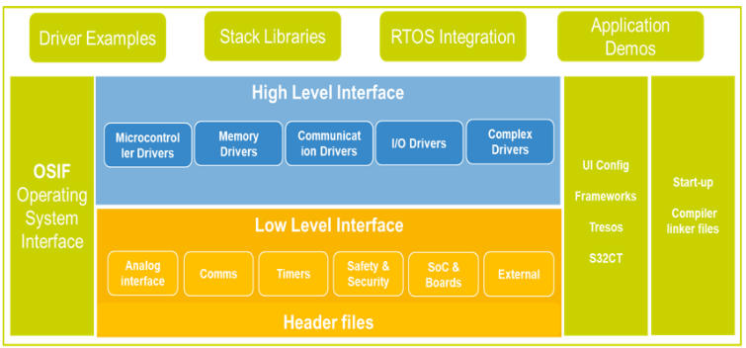
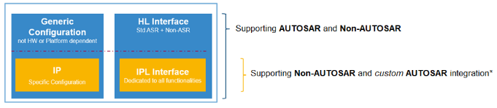
Real-Time DRIVERS (RTD) – OVERVIEW
An RTD driver has two sets of APIs:
High-Level Interface:
AUTOSAR 4.4 implementation
+ non-AUTOSAR implementation
Low-Level Interface:
non-AUTOSAR implementation
Optional stacks: LIN, TCP/IP
Drivers for additional NXP ICs in both AUTOSAR and non-AUTOSAR implementation. For S32K3:
  FS26 – SBC
  TJA1103 – ENET PHY
  TJA115x – Secure CAN PHY
  JA1145A – CAN PHY
Integrated with NXP S32 Design Studio
+ S32 Configuration Tool
Supports multiple toolchains: GCC, GHS, IAR
NXP (S32) HW
Notes:
No question? Roll on from previous slide?

Slide 15


S32K3 Security solution overview
Comprehensive service offer
FAE support
FQE analysis
PSIRT
Standard crypto-driver: MCAL
  One-stop-shop (HW + FW)
  Cost-optimized solution
  Two suppliers (HW / FW)
  Higher solution cost & complexity
S32x
VS
Competition
ECU Functions & Features
ECU Functions & Features
No extra costs
No license fees
No maintenance fees
Solution cost covered by
device price
High-level Security Stack
(AUTOSAR CSM, TLS, etc.)
High-level Security Stack
(AUTOSAR CSM, TLS, etc.)
SW license
SW supplier
Provided by
Crypto Driver
Crypto Driver
HW option
adder per part
HSE
Hardware Security Engine
HSM
HW supplier
FW license
xxxk$ per project
HSE Firmware
HSM Firmware
SW supplier

Slide 16
S32K3 safety software overview
Structural Core
Self-Test (SCST)
S32 Safety Framework Software
(SAF)
Common solution across S32 processors
Developed according to an ISO26262 compliant process
Supporting all safety integrity levels (up to ASIL D)
Fast time to market
Safety Peripheral Driver (SPD)
Safety Peripheral Driver (SPD):
Including two drivers for safety peripherals:
BIST Manager, Extended Microcontroller Error Manager)
Same architecture as Real-Time Drivers
Applicable for both AUTOSAR and non-AUTOSAR environment
S32 Safety Framework Software (SAF):
Provide detection and reaction mechanism for single-point and latent HW faults w/ 6 SW components
Recommended solution for many assumptions in the S32K3xx Safety Manual
Full coverage of Software safety mechanisms within the MCU in S32K3xx Safety Manual
Documentation available for integrating S32 SAF into applications that conform to the ISO26262 standard
Structural Core Self-Test (SCST):
For runtime detection of permanent HW faults in processor cores,
with 90% diagnostic coverage
SCST for Arm Cortex M7

Slide 17
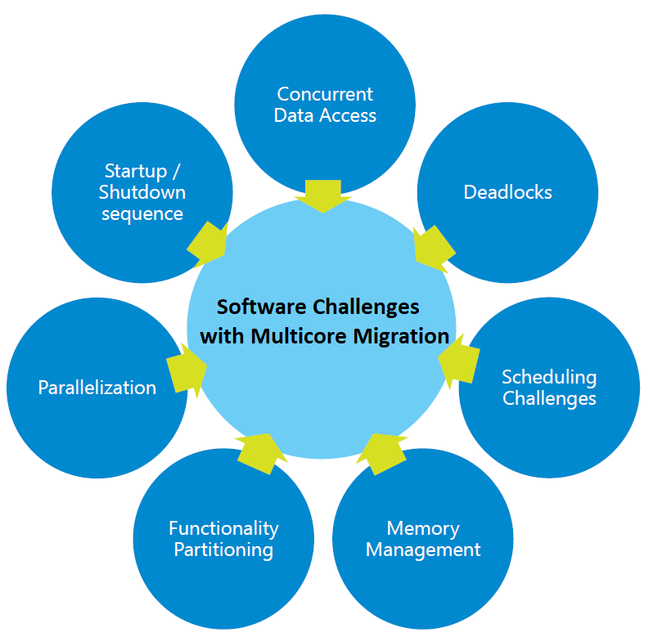
communication for multicore processors & controllers – IPCF SOLUTION
CHALLENGES SEEN AS SYSTEM BENEFITS
Parallel computing: Improving performance of computationally intensive algorithms and functions,
by resolving sub-problems simultaneously on different cores
  Speedup: faster computation by parallelization of the problems
  Improve system responsiveness: distribution of time critical processes to different cores
    interrupt handler or background job worker
    low-priority not interfering with high priority tasks
Safety: multi-core CPUs and meet safety system requirements.
  multiple calculations of the same function simultaneously on different cores
  independent monitoring of cores
  ..
High integration: several software components with varying domains requirements on the same ECU.
SOLUTION: Inter-Platform Communication Framework (IPCF)
IPCF is a subsystem which enables applications, running on multiple homogenous or heterogenous processing cores, located on the same chip or different chips, running on different operating systems (AUTOSAR OS, Linux etc.), to communicate over various transport interfaces (Shared Memory, PCIe, Ethernet, etc.).

Slide 18





IPCF: RTOS to RTOS Shared Memory Use-case (K3 context)
Core2Core communication framework
Shared memory layer
Each S32K3 core runs its own application
IPCF used for exchange of information among central processing unit (CPU) cores in the S32K3 multi-core devices
Based on shared memory layer + core interrupts/messaging units
Pluggable in open standard multicore frameworks (OpenAMP RPMsg)
Demos provided for three environments: bare metal, FreeRTOS and Autosar OS
Customer Apps
Customer Apps
IPCF lib
IPCF lib
Bare metal
(no OS)
RPMsg
RPMsg
IPCF ShM drv
IPCF ShM drv
Zero-copy API
Zero-copy API
MEMORY

Slide 19
S32K3 Software and Tools Overview
NXP SOFTWARE ECOSYSTEM
SERVICES / APPLICATION SOFTWARE
NXP TOOLS & IDE
MIDDLEWARE
OS / DRIVERS / SAFETY
HYPERVISOR (IF AVAILABLE)
ARM® CORTEX® CORES(S)
FIRMWARE / HW ACCELERATORS
AUTOSAR®
Application
Over-The-Air (OTA)
Service
Audio Application
Software
S32K3 Software
Package Manager
Product | Availability
RTD | NOW
Safety Peripheral Drivers | NOW
IPCF | Beta NOW, RTM Jan’22
SAF SCST | NOW NOW
HSE Firmware | NOW
LIN & TCP/IP Stacks | NOW
PET | NOW
MBDT | NOW
AMMCLIB FreeMASTER/MCAT | NOW NOW
ISELED driver | EAR NOW, RTM 2022
S32DS_S32 Platform | NOW
Motor Control
Software*
Battery Management
Software*
ISELED Lighting
Software*
S32K Power Estimation Tool
(PET)
Inter-Platform Comms Framework (IPCF)
for multi-core
LIN
Stack
TCP/IP
Stack
Audio-Video Bridge (AVB) Stack
Classic AUTOSAR OS
Real Time OS
(FreeRTOS, etc)
Model-Based Design Toolbox
(MBDT)
Safety Peripheral Drivers (SPD)
S32 Safety Software Framework (SAF)
Structural Core Self-Test (SCST)
FreeMASTER
Real-Time Drivers (RTD)
MCAT
HSE Crypto
Driver
Ext Device Driver
(FS26…)
S32 Design Studio (S32DS)
+
S32 Config Tool (S32CST)
Arm Cortex-M7 MCU
Hardware Security Engine (HSE)
standard and premium firmware
Firmare
*
Production grade
Third Party
Reference
Notes:
Simplified development
Expanded SW offering
Easier software porting
Within S32K3 family products
Between S32K3 and other S32x products
Automotive quality level
Production grade software

Slide 20
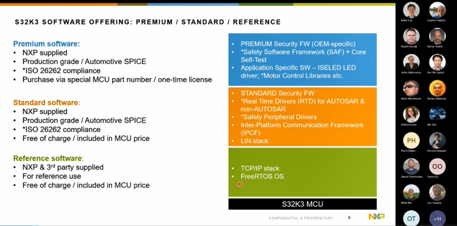
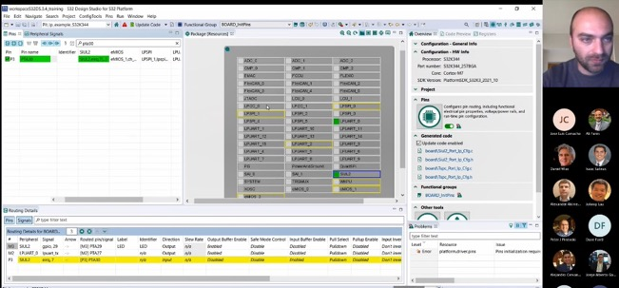
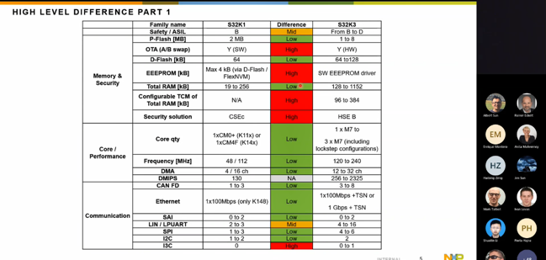
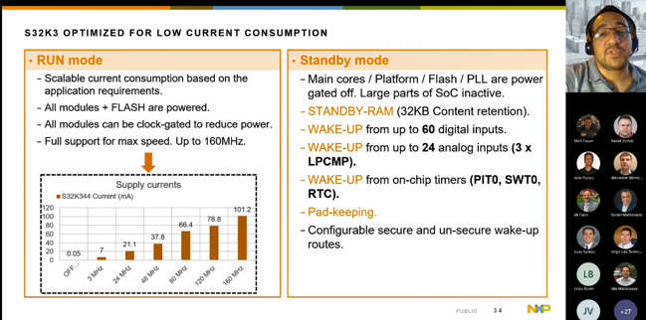
DFAE Training materials
AVAILABLE modules for DFAEs:
.PPTs on DistyNet (sessions recordings will be made available soon)
S32K3 Marketing Overview
S32K3 Technical Overview
S32K3 & S32K1 HW and SW migration
S32K3 SW Overview: RTD, SAF, IPCF, and more
RTD Technical Overview
RTD hands-on demo: SW examples
with S32DS, S32 Config Tool, and EB tresos Studio
S32K3 Enablement & Solutions
Notes:
Original plan was for a hands-on CAS/DFAE training but logistically challenging however EVBs and sw will be provided for self-study

Slide 21
What happens next? / call to action!
NOW: Opportunities: enter into SFDC / ModelN (S32K3 PNs available for registrations)
NOW: Samples: order ‘P’ engineering samples / ‘S’ production devices
NOW: EVBs: enter orders as needed. /NOTE: -Q172 EVB quantities limited initially
  S32K3X4EVBQ257ND /NOTE: standard PN (S32K3X4EVB-Q257) temporarily suspended until more K26 MCUs available
  S32K3X4EVB-Q172 /for customers
NOW: Documentation & SW, all content on nxp.com; NXP Connects (training, demos, promos); Distributor/eTailers stocking & promotions
NOW: Partner Announcements:
  IAR Systems enables next generation automotive applications with NXP’s S32K3 MCU family
  PEmicro Announces Development Tool Support for NXP’s New S32K3 Automotive MCU Family
  Lauterbach's TRACE32 adds support for NXP’s new S32K3 MCU family
  LDRA tool suite provides software assurance for mission-critical systems powered by NXP S32K3 MCUs
  PLS' UDE supports NXP's new S32K3 MCU family with optimized debug, analysis and test functions
COMING: Feb '22 – K3x4 257 BGA production devices available
COMING: May ’22 – K3x4 172 MaxQFP production devices available

